Slide 1
ClassiFicon’21
Koidala Surya Prakash
Durbha Krishna Srikar
Akash Tadwai
Reethu Vinta
Team no. 20
Team name : rust.eze

Slide 2
Task #1
Classifying Positive smile V/s No smile
A straight-away observation from the dataset motivates us to look into visibility of teeth & shape of lips.

Slide 3
How we did it ..?
Transfer learning !!
>> Used a Resnet-18 architecture whose convolutional layer weights were pre-trained on ImageNet dataset.
>> Attached a new classification head for binary classification.
>> Loss function : Cross entropy loss
>> Updated all parameters during backpropagation. (yields faster convergence and better performance)

Slide 4

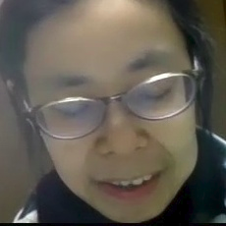
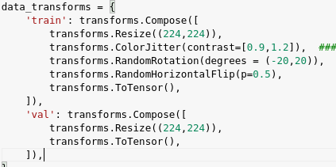
Data Augmentation

Slide 5
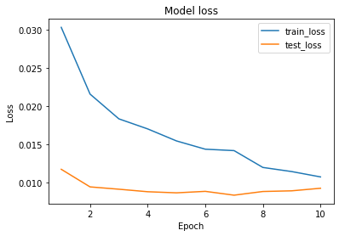
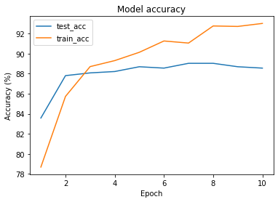
Results (Trained for 10 epochs)
Validation accuracy : 89 %

Slide 6
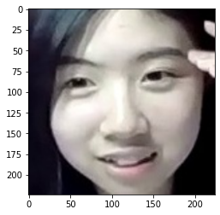
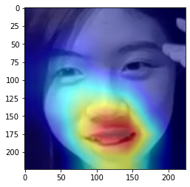
Explainability using Grad-CAM
Label: NOT smile --- Predicted: positive smile
Class probabilities : [Not smile : Pos.smile] :: [0.28,0.72]

Slide 7
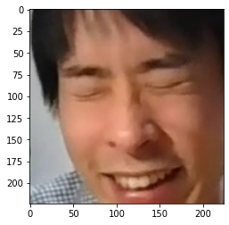
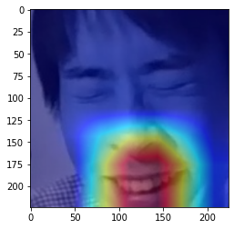
Explainability using Grad-CAM
Label: NOT smile --- Predicted: positive smile
Class probabilities : [Not smile : Pos.smile] :: [0.17,0.83]

Slide 8
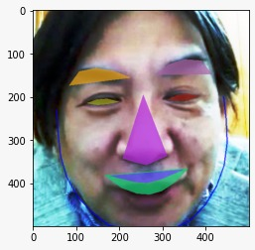
Task#2
Classifying Positive Smile Vs Negative Smile
Dataset is very sensitive i.e, with very minute differences b/w positive vs negative smiles. Hence we thought of Detection of exact features of the face which provides us more opportunity to closely observe Model.
How we did it??
We used HOG-based (Histogram of Oriented Gradients) face detector and loading the facial landmark predictor.
For each face region, we determine the facial landmarks of the ROI (Region of Interest) hence we extracted 8 Key features from the image.
Key Features of the Image highlighted. (Both Lips, Nose, Cheeks, Eyes, Eyebrows etc)

Slide 9









Notes:
All the features of an extracted face for a person

Slide 10
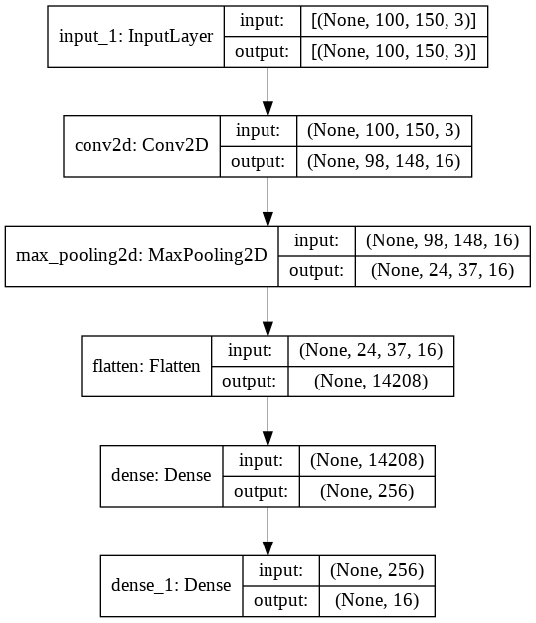
Model Designing and Training
Convolutional Neural Network is designed which takes each Feature Image as Input. The CNN contains sequence of 2D-Convolutional Layers along with Max-Pooling Layers to extract Information and are then saved as a 16-Length Vector.
These 16-Length Vector from each Feature is then concatenated and are provided as Input to a Multi-Layer Perceptron Model. The MLP Model outputs the Probability for the Binary Classification Problem.
The Model is carefully trained so that it doesn’t overfit on the Data. Dropout and Early Stopping Techniques are used to perform Regularisation.

Slide 11
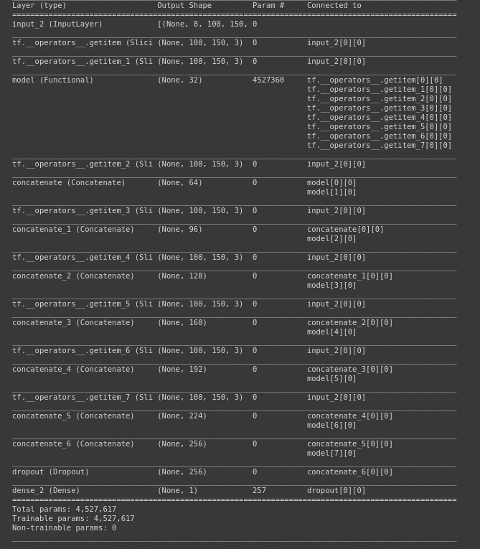

Slide 12
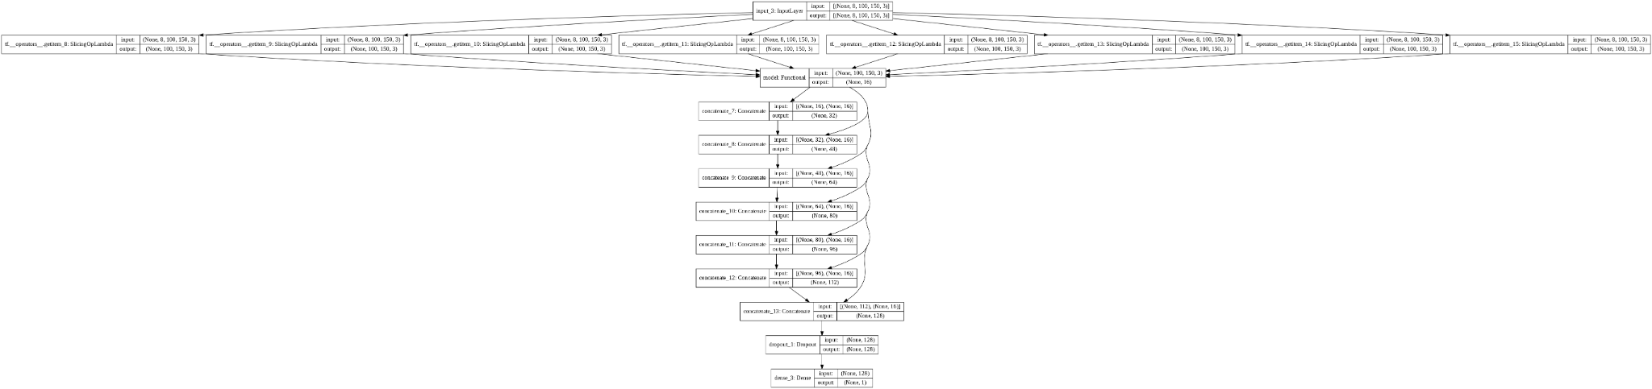
Models

Slide 13

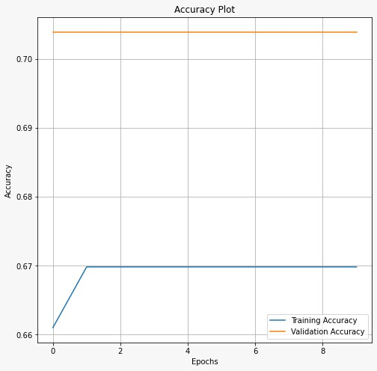
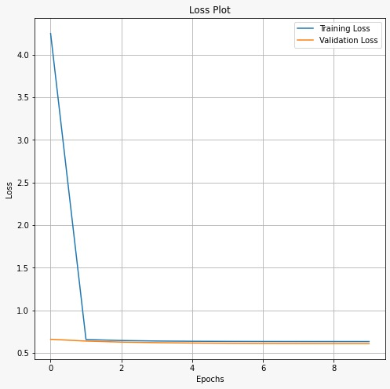
Results
Loss function:
Notes:
Loss fn: Binary Cross Entropy Loss

Slide 14
Code repository
https://github.com/Surya291/ClassiFicon2021_GroupNo_20

