Slide 1
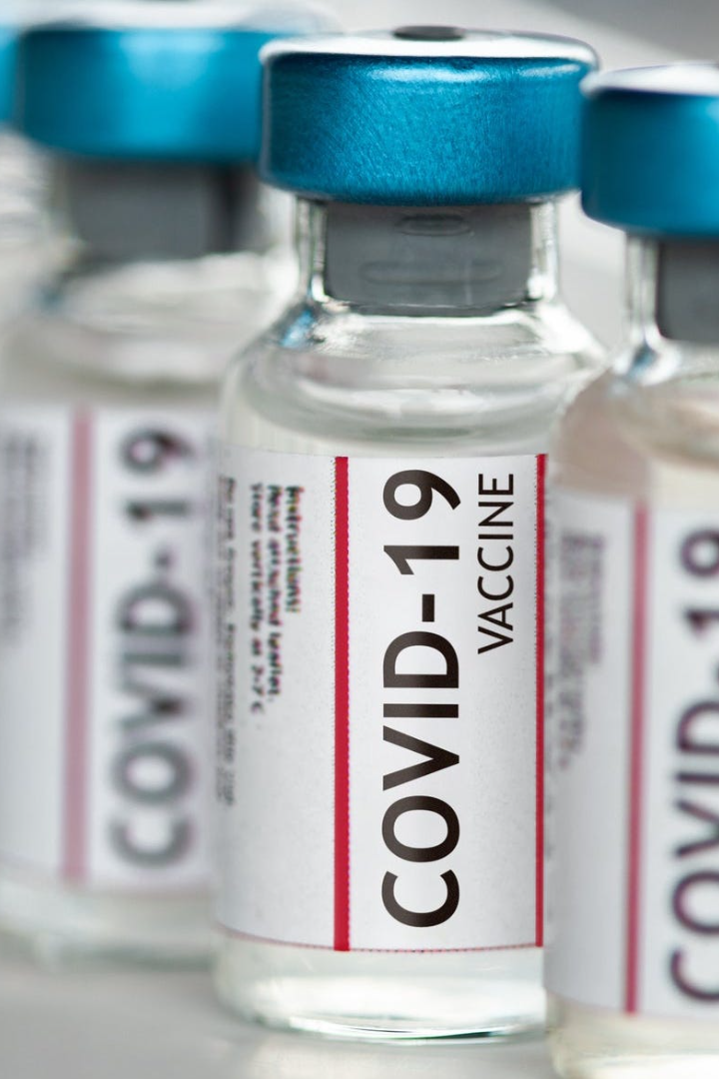
Development of the Covid-19 Vaccine Analysis
Explore the journey of developing a Covid-19 vaccine, from scientific breakthroughs to clinical trials, and the challenges faced along the way.

Slide 2

Introduction to Covid-19
Understand the origins, symptoms, and global impact of the Covid-19 pandemic, leading to the urgent need for a vaccine to combat the virus.

Slide 3

Understanding the Science of Vaccine Development
1
Virus Structure
2
Immune Response
3
Vaccine Components
Learn about the unique structure of the SARS-CoV-2 virus and how it interacts with the human immune system.
Discover how vaccines stimulate the immune system to recognize and fight the virus.
Explore the different types of vaccine components, such as antigens and adjuvants, and their role in vaccine development.

Slide 4
The Different Types of Vaccines Being Developed
Inactivated
RNA/DNA-based
Viral Vector
Traditional approach using inactivated forms of the virus to induce an immune response.
Exploring cutting-edge technologies that use genetic material to trigger an immune response.
Using harmless viruses as carriers to deliver viral components and stimulate immunity.

Slide 5

Challenges in Developing a Covid-19 Vaccine
1
Speed
2
Efficacy
Overcoming the urgency to develop a vaccine rapidly without compromising safety and efficacy.
Finding a vaccine candidate that provides sufficient protection against multiple strains of the virus.
3
Mass Production
Ramping up global manufacturing capabilities to ensure widespread distribution.

Slide 6
Clinical Trials and Their Importance
1
Phase 1
Evaluating safety and dosages in a small group of healthy volunteers.
Phase 2
2
Assessing immune response in a larger group of volunteers to determine optimal dosage.
3
Phase 3
Testing the vaccine's effectiveness and safety on a large scale with diverse populations.

Slide 7
Future Directions and Implications of the Covid-19 Vaccine
Herd Immunity
Long-Term Protection
Lessons Learned
Discuss the potential impact of widespread vaccination on achieving herd immunity and controlling the pandemic.
Reflect on the lessons learned throughout the vaccine development process and their application for future health crises.
Explore research on the duration of vaccine-induced immunity and the need for booster shots.

