Slide 1

MINI PROJECT | 2ND REVIEW
Cryptocurrency Prediction and Market Analysis System
Explainable forecasting with technical analysis, FinBERT sentiment and XGBoost
Shairaaj V S
Surya L
25MX221
25MX229
Guide: Dr. M. Subathra, Assistant Professor (Sl. Grade) | Department of Computer Applications

Slide 2










Project Overview
Problem
Main Objective
News sentiment and ML forecasts are analyzed separately and predictions lack explanations.
Build an explainable crypto forecasting platform that combines market data with news sentiment.
Proposed Solution — one unified pipeline
›
›
›
›
›
Data
Sentiment
Indicators
Forecast
Explain
Dashboard
CoinGecko + NewsAPI
FinBERT
23 technical
XGBoost
TreeSHAP
React 19
1000
23
8
Expected outcome Transparent, interpretable next-day forecasts for decision support.
Cryptocurrencies
Technical indicators
System modules
2

Slide 3

1st Review Comments & Implementation
1st Review Comments | What We Implemented
01 Fixed next-day prediction Provide a fixed forecast for tomorrow rather than one that changes with every live price update. | Fixed tomorrow price range The predicted range stays consolidated and fixed for the selected day, independent of live price updates.
02 Historical price visualisation Add graphs to visualise historical price data. | Historical price charts Graphs for 24 hours, 1 week, 1 month and 1 year to analyse price trends across time periods.
Both review comments have been addressed and implemented in the application.
3

Slide 4
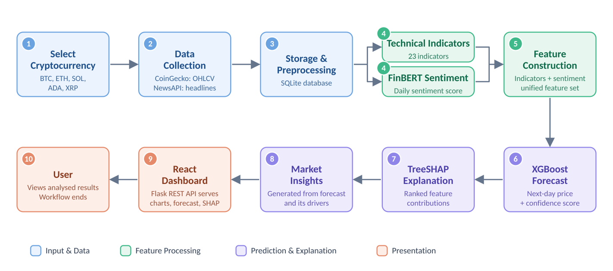
Project Workflow
4

Slide 5
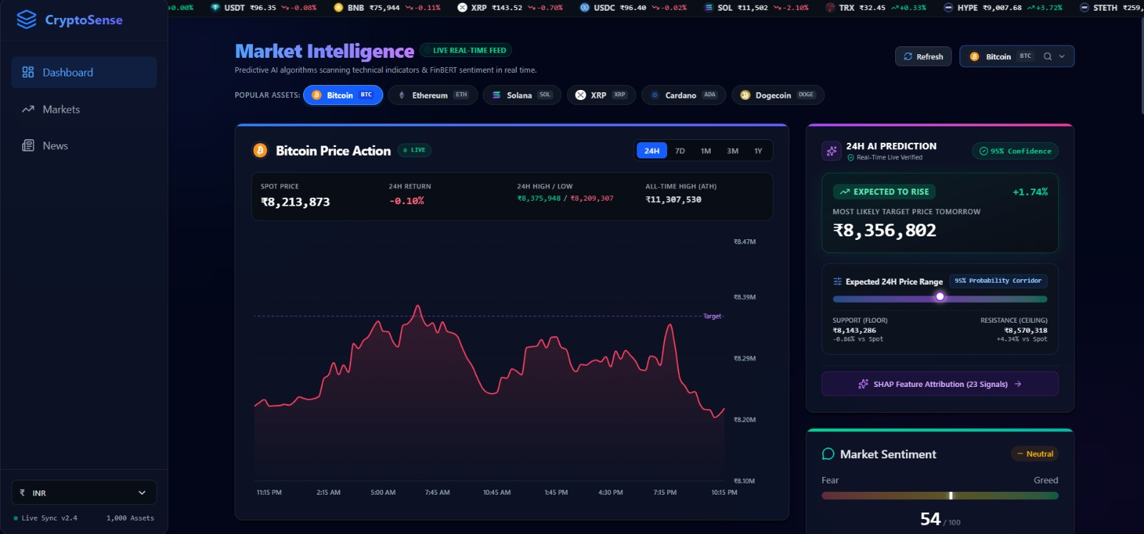
Application Screenshots – Dashboard
Cryptocurrency Prediction and Market Analysis System | Mini Project 2nd Review
5

Slide 6
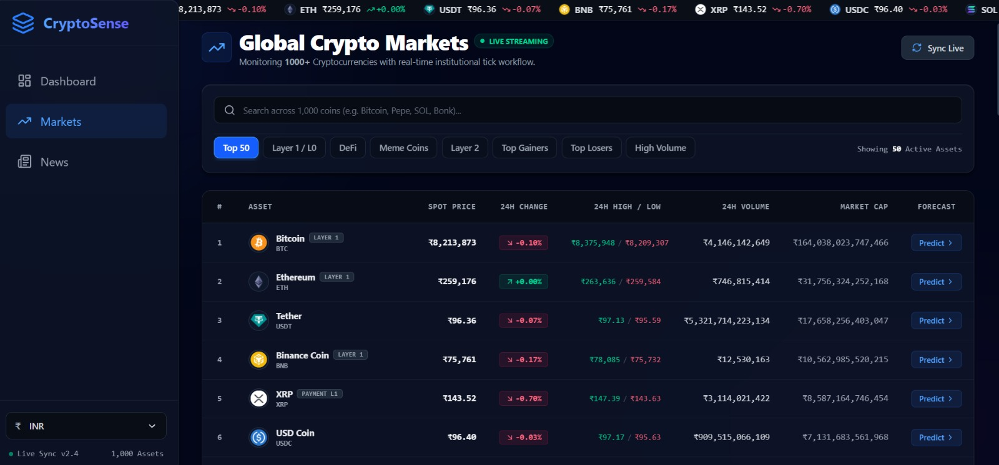
Application Screenshots – Markets
Cryptocurrency Prediction and Market Analysis System | Mini Project 2nd Review
5

Slide 7
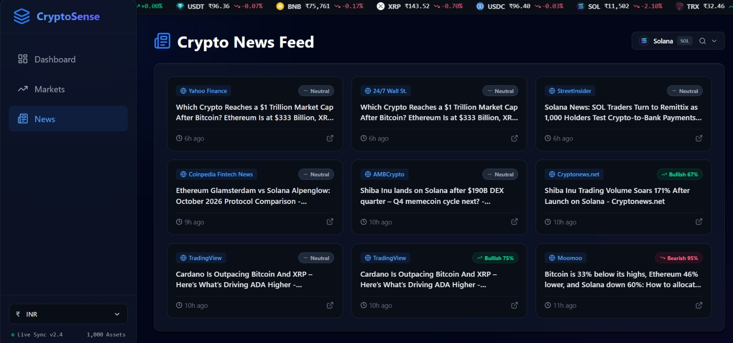
Application Screenshots – News Feed
5

Slide 8
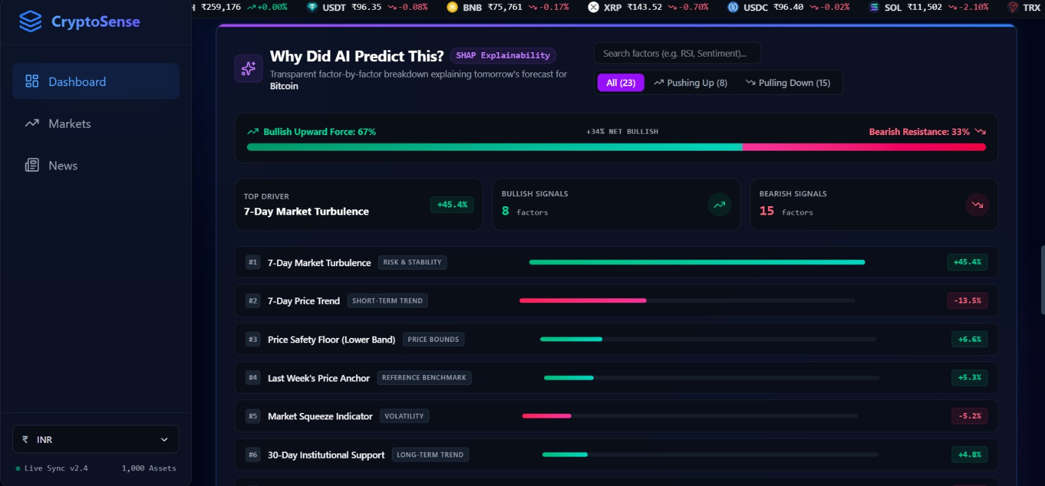
Application Screenshots - SHAP
Cryptocurrency Prediction and Market Analysis System | Mini Project 2nd Review
5

Slide 9

Live Demonstration
[LIVE DEMO]

