Slide 1
SNAKES AND LADDERS USING C++
M.SAMHITHA(1602-17-737-041)
P.SRI VARSHA(1602-17-737-050)
P.SRI SURYA(1602-17-737-049)

Slide 2
INTRODUCTION:
The game is played on a board numbered 1 – 100.
You roll a die, whatever you get you move your seed forward by that number.
On the board snakes and ladders are strategically placed as obstacles and power ups, if you land at the bottom of a ladder you climb up to the top of that ladder, if you land at the head of a snake you drop to the tail of that snake.

Slide 3
MODULES:
DRAW_LINE()
BOARD()
GAMESCORE()
PLAY_DICE()

Slide 4
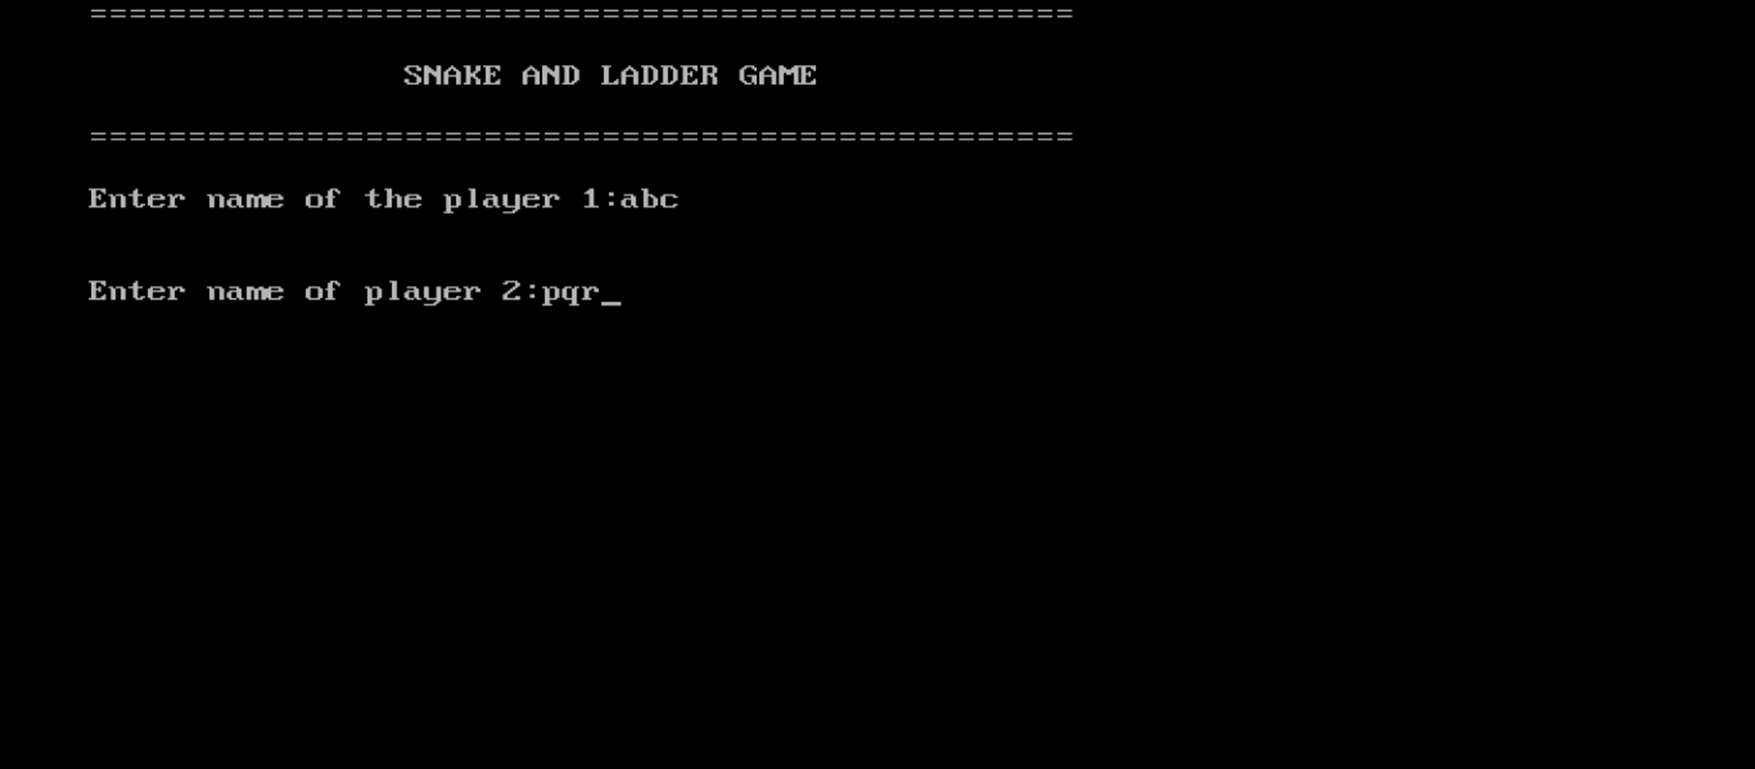

Slide 5
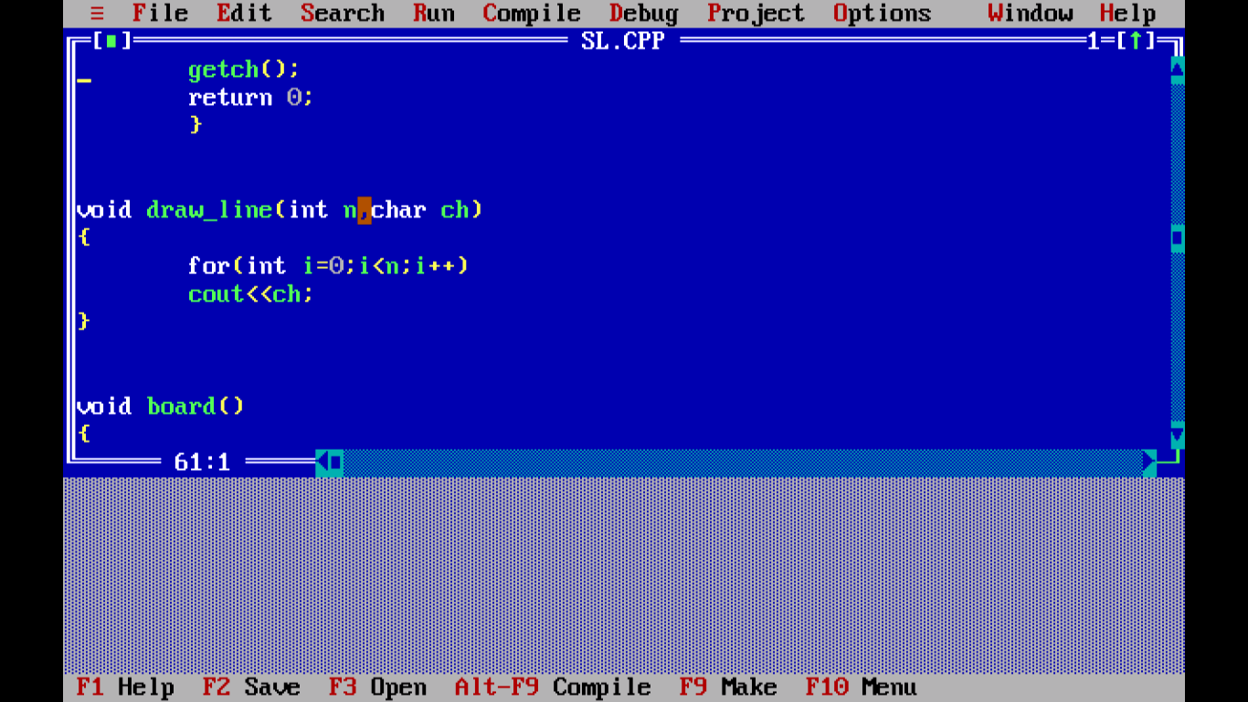
DRAW_LINE()
Accepts number of characters and character type
Displays that particular character the number of times given

Slide 6
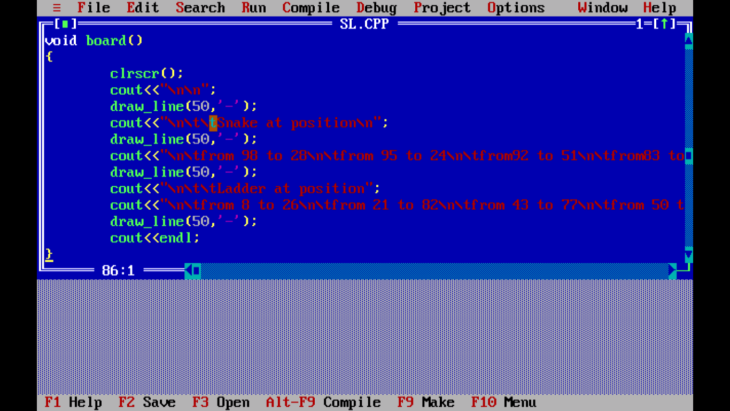
BOARD()
Displays the positions of snakes and ladders on the board

Slide 7
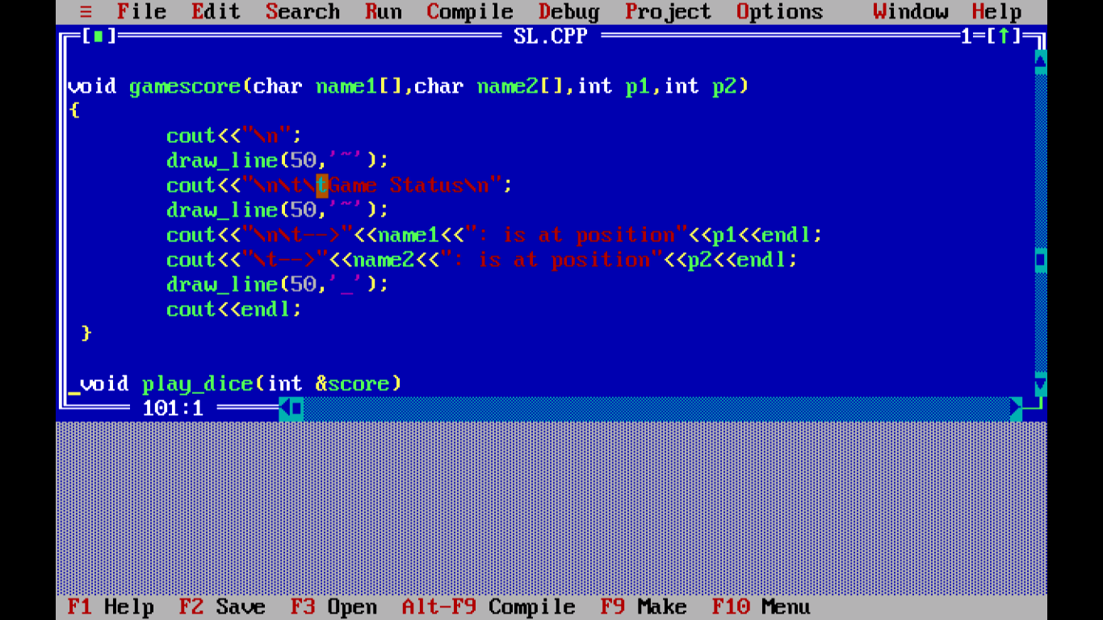
GAMESCORE()
Accepts the player names and position of the players
Returns the game status of both the players with their positions

Slide 8
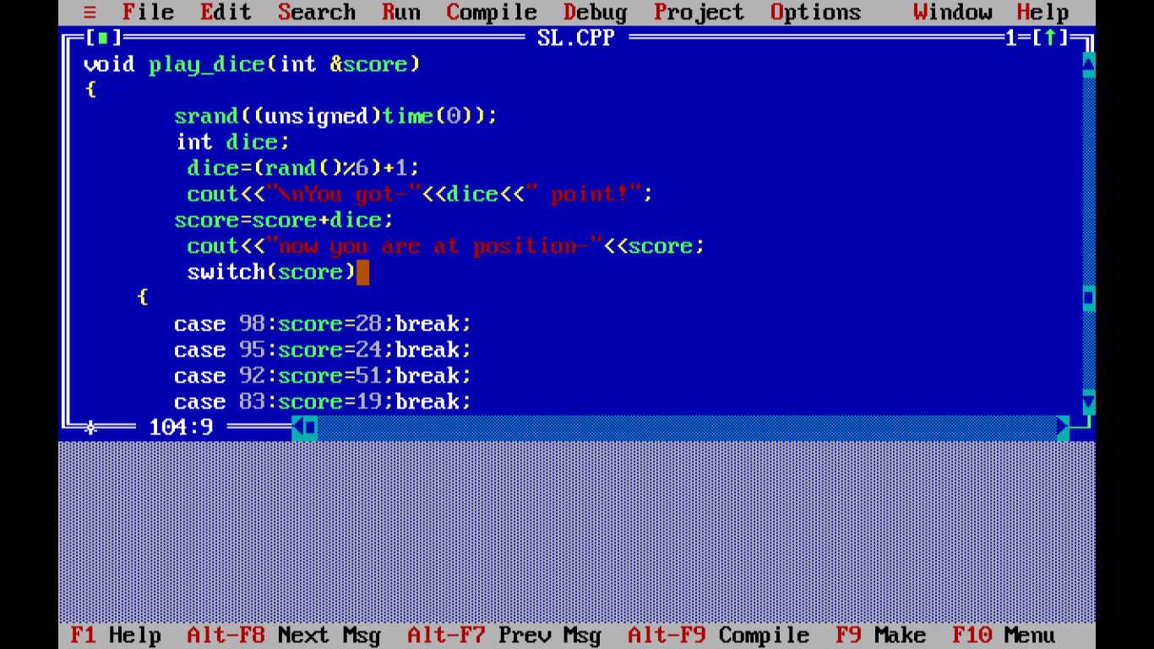
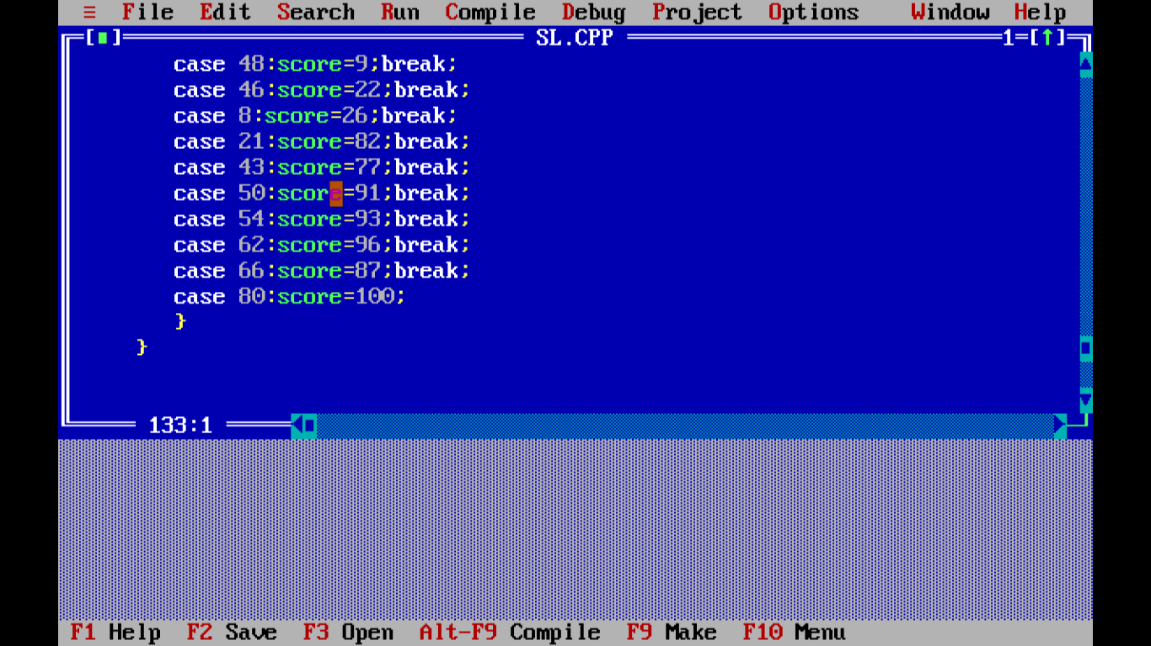
PLAY_DICE()
Gives a random number between 1-6 and adds it up to the score of the players.
If the player lands up at a snake or a ladder, the score is decreased or increased as per the positions.

Slide 9
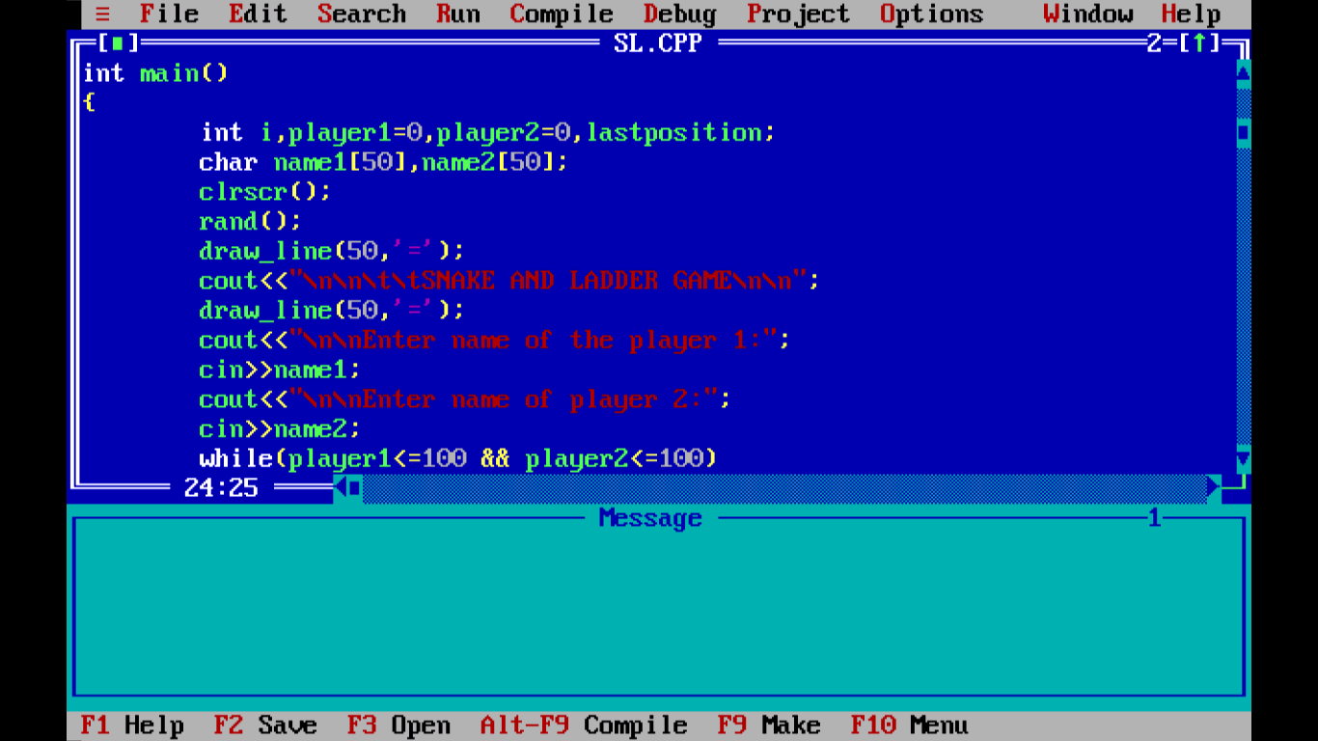
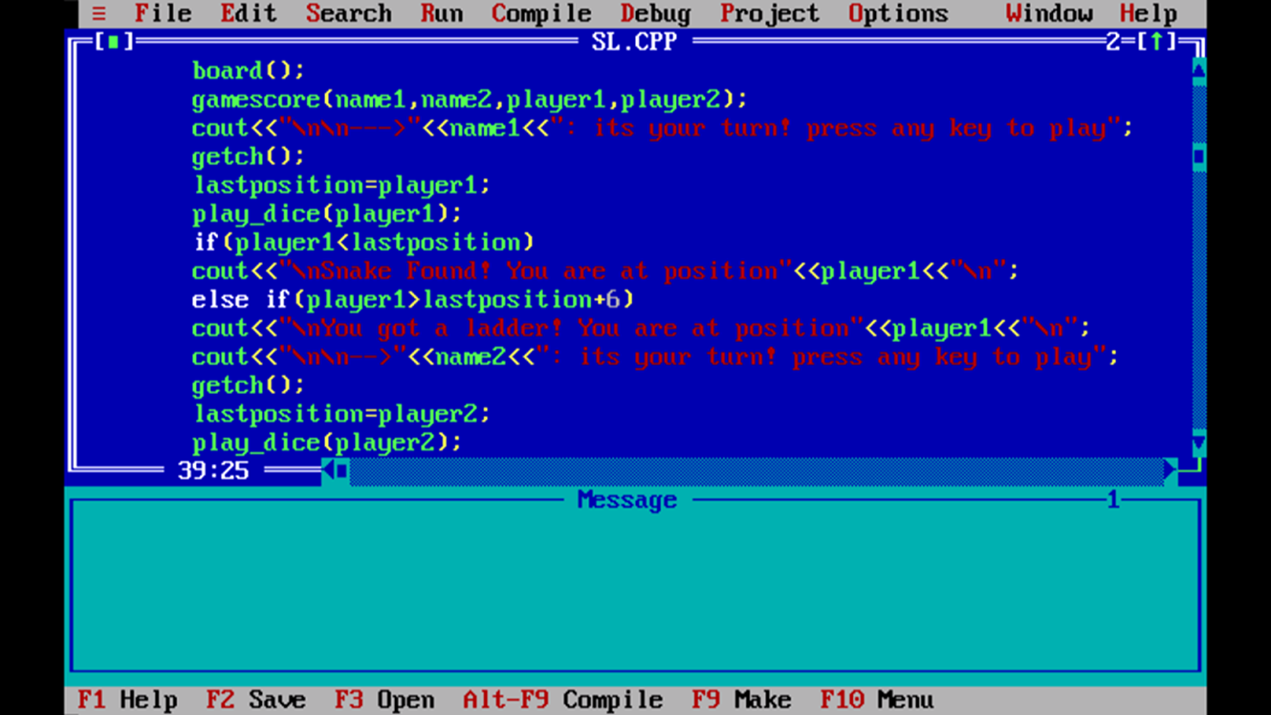
Main()

Slide 10
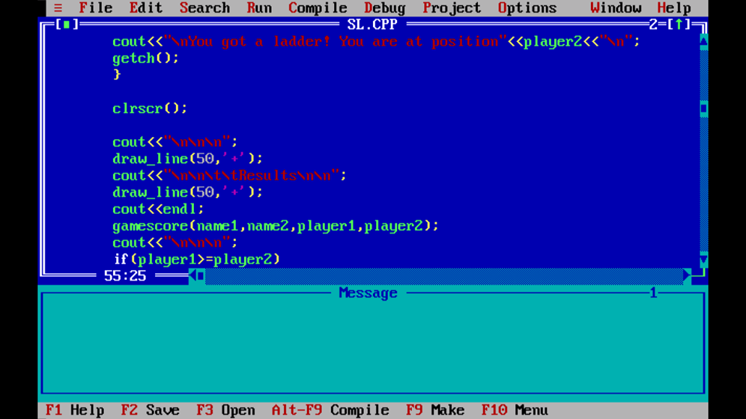
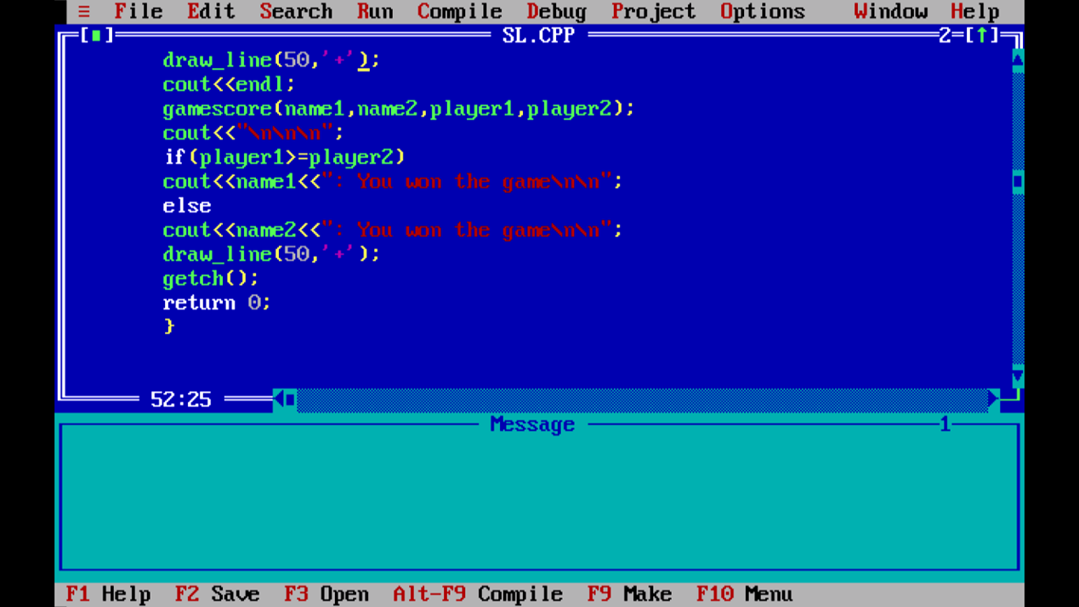

Slide 11
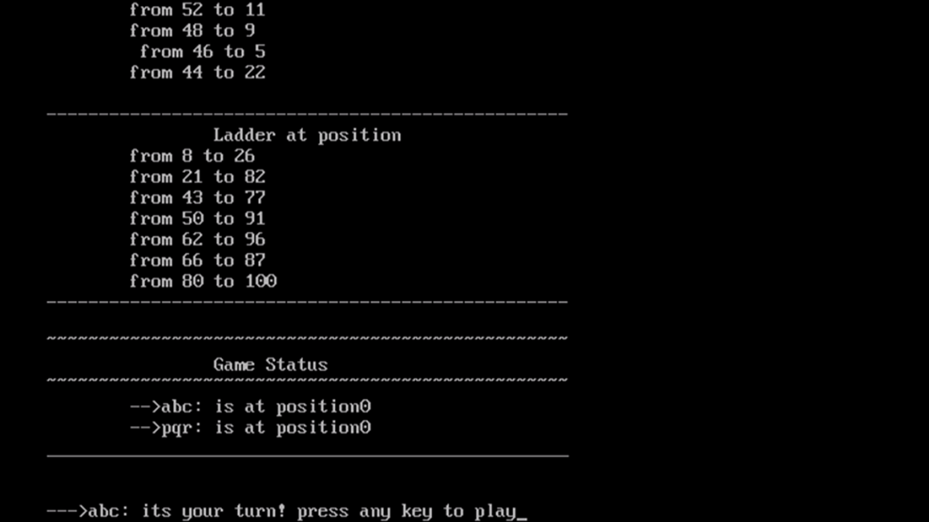
OUTPUT:

Slide 12
THANK YOU

