Slide 1
SMART PARKING
TEAM MEMBERS
BARANIPRIYA R
LALITH KUMAR B
MANIKANDAN S
SAKTHIVEL S
SURYA J

Slide 2
Agenda
PROJECT DEFINITION
DESIGN THINKING

Slide 3
Project Definition
The project involves integrating IoT sensors into public transportation vehicles to monitor ridership, track locations, and predict arrival times. The goal is to provide real-time transit information to the public through a public platform, enhancing the efficiency and quality of public transportation services. This project includes defining objectives, designing the IoT sensor system, developing the real-time transit information platform, and integrating them using IoT technology and Python.

Slide 4
Design Thinking
Project Objective
IOT Sensor Design
Real-Time Transit Information Platform
Integration Approach

Slide 5
Project Objective
Implement a system to continuously monitor the availability of parking spaces in real time.
Develop a mobile application for users to access parking information, reserve spaces, and receive guidance.
Provide efficient guidance to users to find and navigate to available parking spaces.
Use data analytics to continually optimize parking operations.
Encourage user engagement and gather feedback for ongoing improvements.
Ensure that the parking system is accessible and inclusive for all users.
Reduce the environmental impact of parking operations.

Slide 6
IOT Sensor Design
Ultrasonic Sensors:
Deployment: Ultrasonic sensors are often mounted above parking spaces or on light fixtures. They emit ultrasonic waves to detect the presence of a vehicle in a parking space.Function: Ultrasonic sensors measure the distance to the ground and can determine if a parking space is occupied or vacant.
Magnetic Sensors:
Deployment: Magnetic sensors are buried under the surface of each parking space.
Infrared Sensors:
Deployment: Infrared sensors can be mounted on walls or ceilings overlooking parking spaces.
Camera-Based Sensors:
Deployment: Cameras are typically installed at entry/exit points and throughout the parking facility.

Slide 7
IOT Sensor Design
Lidar Sensors:
Deployment: Lidar sensors are often mounted on poles or infrastructure near parking spaces.
Wireless Sensors:
Deployment: These sensors can be installed on the surface of each parking space.
Ground-Loop Sensors:
Deployment: Inductive loop sensors are installed under the pavement near the entry and exit points of parking spaces.
Acoustic Sensors:
Deployment: Acoustic sensors can be mounted on walls or poles in the parking area.
Pressure Sensors:
Deployment: Pressure sensors are embedded in the pavement of each parking space.

Slide 8
Real-Time Transit Information Platform
In designing our mobile app for real-time parking availability, we focus on user-friendliness and efficiency. The home screen offers a map with color-coded markers for available, occupied, and nearly full parking spots. Users can also view this data in a convenient list format and search for parking based on location, price, and availability.
Detailed information about each parking area, including available spots and pricing, is easily accessible. Integration with navigation apps ensures smooth transitions.
Users can personalize their experience and receive real-time notifications about parking availability changes. Feedback options and an FAQ section enhance user engagement.
Accessibility features and continuous real-time updates further streamline the parking experience."

Slide 9
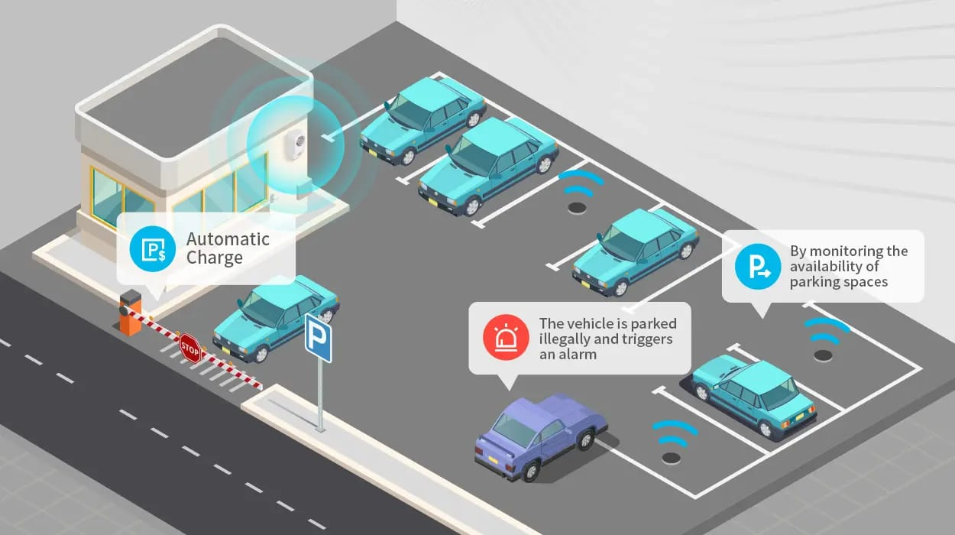
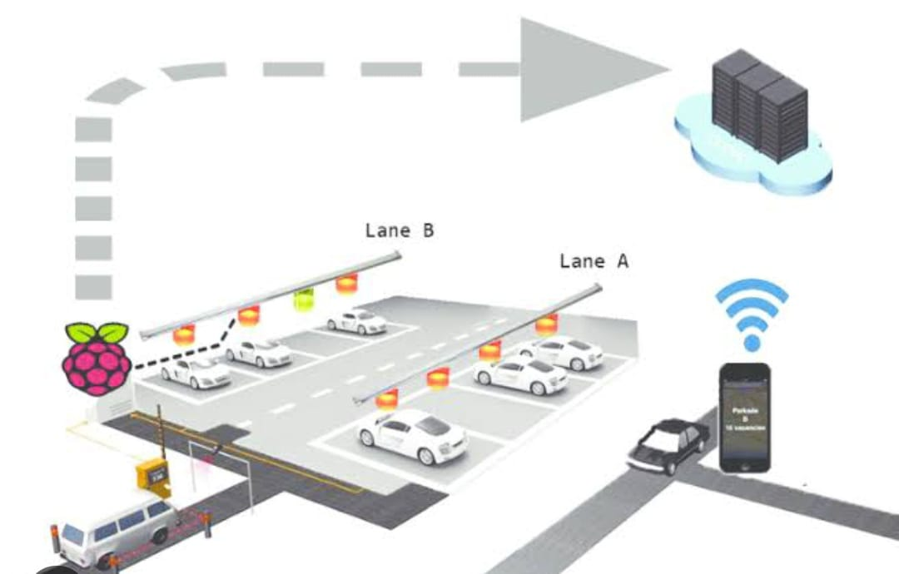
.

Slide 10
Integration Approach
"The data collection process begins with connecting various sensors, such as ultrasonic or infrared, to the Raspberry Pi.
These sensors are strategically placed to detect occupancy and other relevant information in parking spaces.
The Raspberry Pi, functioning as a microcontroller, interprets the sensor data through GPIO pins. Python scripts or dedicated libraries are then utilized to interact with these pins, enabling the Raspberry Pi to read data from the sensors accurately.
The data, representing parking space availability, is processed locally on the Raspberry Pi.
Once processed, the Raspberry Pi communicates this information to a centralized server or cloud platform over the internet through protocols like HTTP or MQTT.
This data is then made accessible to the mobile app via APIs integrated into the app's backend. The mobile app, with features to request and display real-time parking data, can fetch this data from the server.
Through this streamlined process, the mobile app provides users with up-to-date parking availability, offering a seamless and efficient parking experience."

Slide 11
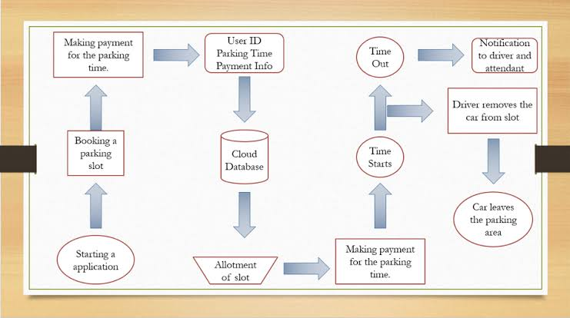

Slide 12
Reference
Title: "Smart Parking Systems for Future Smart Cities: An IoT-Based Approach"Authors: Mohammad S. M. Ali, Ahmed B. Altamimi, Fadi Al-Turjman
Published in: IEEE Access, 2019Link: IEEE Xplore - Smart Parking Systems for Future Smart Cities
Title: "An IoT-based Smart Parking System for Smart Cities"Authors: Varsha Jadhav, Sudhir Warier, Suresh Sankaranarayanan
Published in: IEEE International Conference on Computing, Power and Communication Technologies (GUCON), 2016 Link: IEEE Xplore - IoT-based Smart Parking System for Smart Cities
Title: "Smart Parking System using IoT: A Survey"Authors: Shrinivas R. Zanwar, Nitin A. Kadam
Published in: Procedia Computer Science, 2017 Link: ScienceDirect - Smart Parking System using IoT

Slide 13
Thank you

