Slide 1


PC Performance Monitor Bot Automation
ROBOTIC PROCESS AUTOMATION
ATHITYAA A
3rd year B.Tech Artificial Intelligence and Data Science
K.S.RANGASAMY COLLEGE OF TECHNOLOGY
(Autonomous)
Tiruchengode - 637 215, Namakkal Dt. Tamil Nadu
Notes:
1.7.2013
‹#›

Slide 2
INTRODUCTION
Monitoring PC performance is important for understanding system health and application resource usage.
Manual checking through Task Manager is useful, but it does not provide a customized RPA dashboard or exportable report.
The PC Performance Monitor Bot automates system monitoring using UiPath and PowerShell.
It collects CPU, RAM, GPU, top CPU applications, top RAM applications, and GPU-using applications.
The collected values are written into performance.json and shown in a live HTML dashboard.
The dashboard refreshes automatically every few seconds and provides CSV and Excel export options.
Notes:
1.7.2013
‹#›

Slide 3
ABSTRACT
The PC Performance Monitor Bot is an RPA-based automation project that tracks live computer performance and displays the data in a browser dashboard.
UiPath runs the backend workflow and invokes PowerShell commands to read Windows performance counters.
The bot generates a JSON file containing CPU usage, RAM usage, GPU usage, and top application-level usage details.
The frontend dashboard, developed using HTML, CSS, and JavaScript, fetches the JSON file every three seconds.
The system provides a modern dark UI with progress bars, tables, debug logs, and export options for CSV and Excel.
This project demonstrates a simple and practical method of connecting UiPath automation with a real-time web dashboard.
Notes:
1.7.2013
‹#›

Slide 4
KEY FEATURES AND BENEFITS
Key Features
Monitors total CPU, RAM, and GPU usage in real time.
Displays top CPU-consuming and RAM-consuming applications.
Shows applications currently using GPU resources.
Uses JSON file communication between UiPath and the dashboard.
Refreshes automatically every three seconds.
Exports data to CSV and Excel-compatible files.
Benefits
Reduces manual checking of Task Manager.
Provides a clear visual dashboard for system performance.
Helps identify resource-heavy applications quickly.
Uses a beginner-friendly architecture without a database.
Notes:
1.7.2013
‹#›

Slide 5
REAL WORLD APPLICATION AND USE CASES OF RPA
Student Lab Monitoring - Helps students observe how applications consume CPU, RAM, and GPU.
IT Support - Allows support teams to identify high-resource applications quickly.
Gaming and Graphics Systems - Shows GPU usage while games or rendering tools are running.
Automation Testing - Helps monitor system load while UiPath bots are executing.
Training and Demonstration - Explains how RPA collects operating system data for dashboards.
Small Office Monitoring - Provides a lightweight local dashboard without a full monitoring platform.
Notes:
1.7.2013
‹#›

Slide 6
TOOLS USED
UiPath Studio - Used to create and run the backend monitoring workflow.
Invoke PowerShell Activity - Collects CPU, RAM, GPU, and process usage data.
PowerShell - Reads Windows performance counters and generates JSON output.
HTML - Builds the dashboard structure.
CSS - Provides the dark UI, progress bars, and table styling.
JavaScript - Fetches performance.json, updates the dashboard, and exports data.
JSON File - Acts as the communication bridge between UiPath and the dashboard.
VS Code Live Server - Serves the dashboard files through localhost.
Notes:
1.7.2013
‹#›

Slide 7
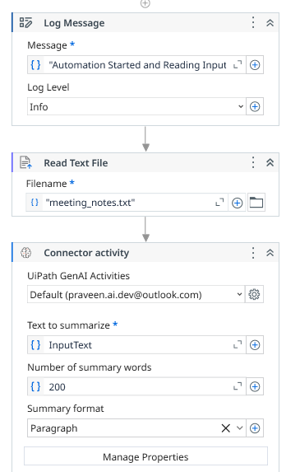
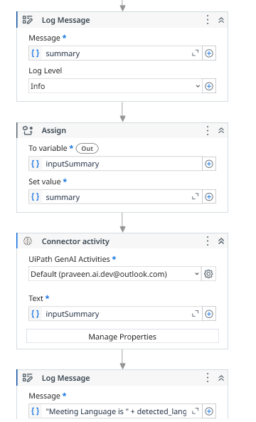
WORK FLOW
Notes:
1.7.2013
‹#›

Slide 8
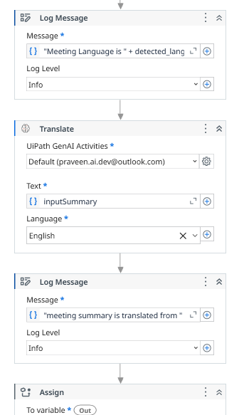
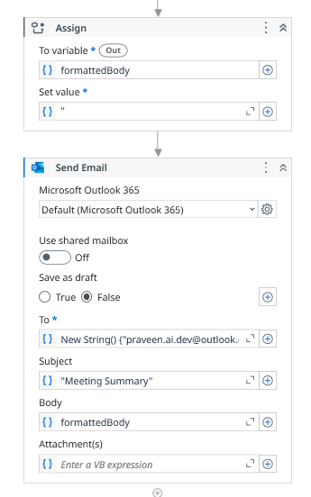
WORK FLOW
Notes:
1.7.2013
‹#›

Slide 9
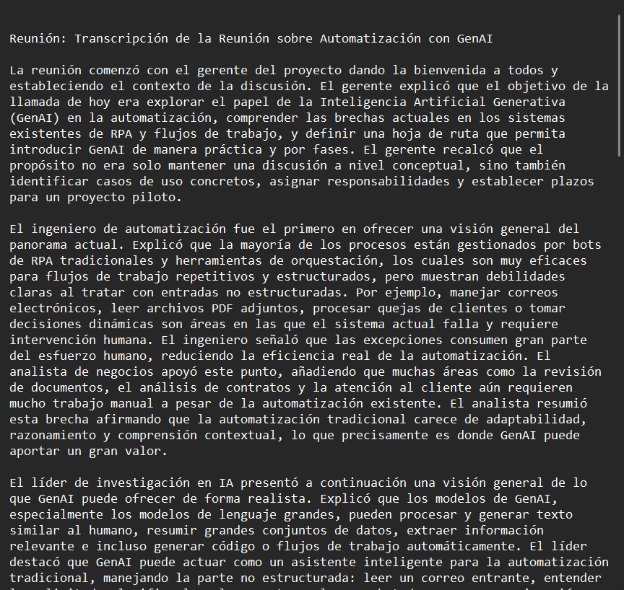
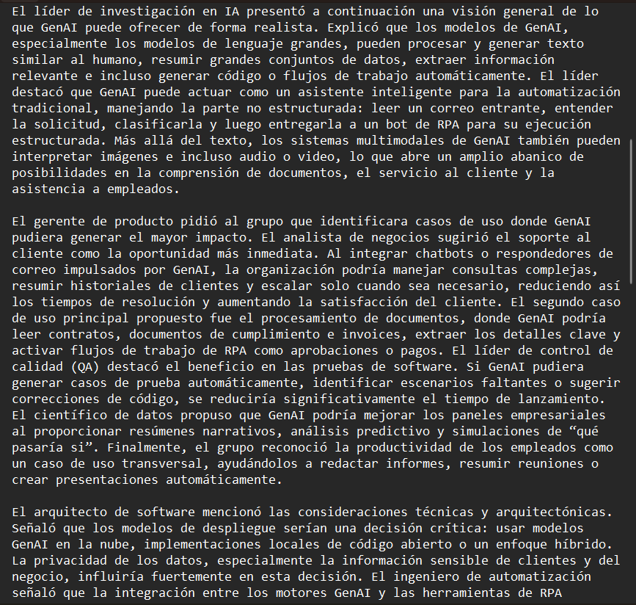
INPUT
Windows counters and JSON data:
Notes:
1.7.2013
‹#›

Slide 10
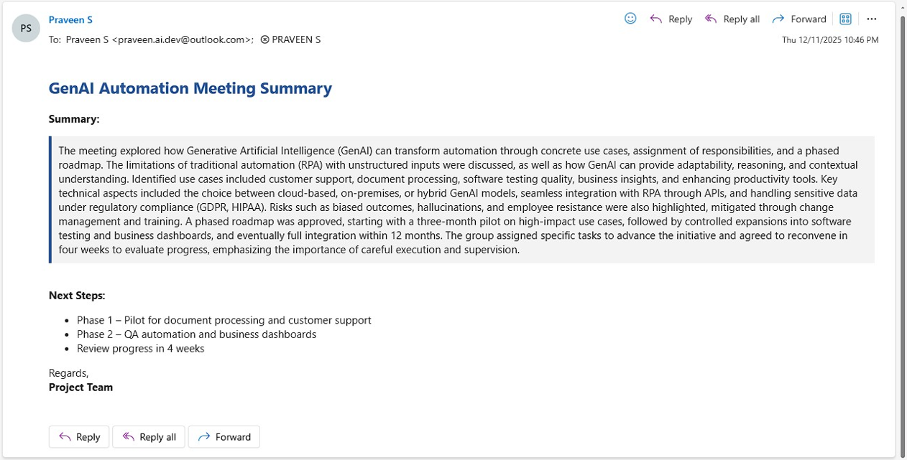
OUTPUT
Notes:
1.7.2013
‹#›

Slide 11
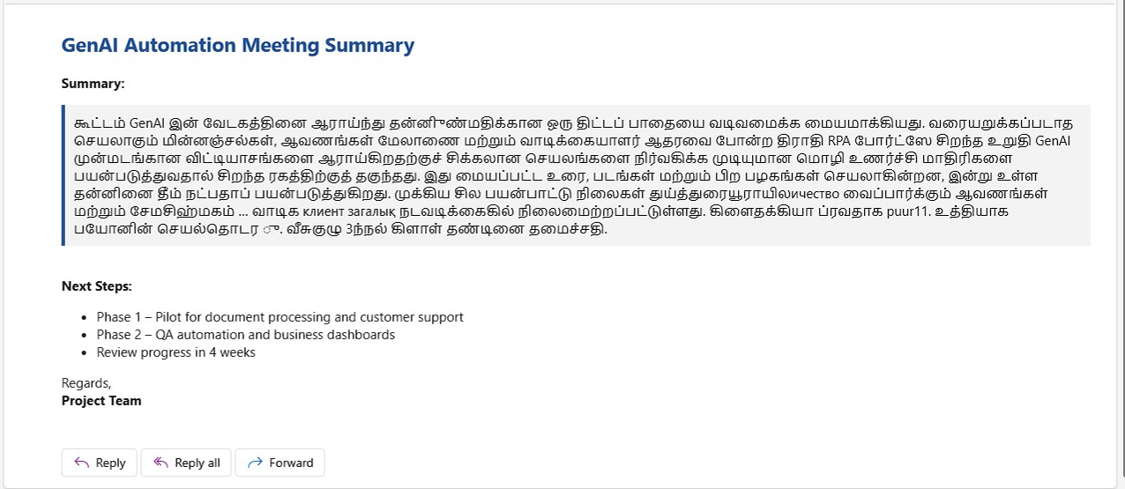
OUTPUT
Notes:
1.7.2013
‹#›

Slide 12
PROCESS
Open UiPath Studio and run Main.xaml.
Invoke PowerShell to collect CPU, RAM, GPU, and process data.
Convert the collected values into structured JSON.
Write JSON safely to dashboard/performance.json.
Open the dashboard using VS Code Live Server.
Fetch performance.json every three seconds.
Update progress bars and application tables dynamically.
Show fallback messages when no GPU apps are active.
Export dashboard data as CSV or Excel.
Notes:
1.7.2013
‹#›

Slide 13
CONCLUSION
The PC Performance Monitor Bot automates the process of collecting and displaying live system performance data. By combining UiPath, PowerShell, JSON, and a browser dashboard, the project provides a simple monitoring solution similar to a lightweight Task Manager. It displays CPU, RAM, GPU, top application usage, and active GPU process details in real time. Debug logs and export options make it useful for learning and local monitoring.
Notes:
1.7.2013
‹#›

Slide 14


Thank You !
PC Performance Monitor Bot connects RPA with a live dashboard.
Thank you for your attention.
/ksrct1994
www.ksrct.ac.in
Notes:
1.7.2013
‹#›

