Slide 1


Priyadarshini Engineering College
Department of Master of Computer Applications
Name : SRINIVASAN.S
Reg. No: 511924622035
MC4411 PROJECT WORK
Symptoms-Based Doctor Recommendation and Appointment System
SUPERVISOR
Ms.Jeevalakshmi.G Assistant Professor,
Department of Master of Computer Applications,
Priyadarshini Engineering College.
Vaniyambadi.
HEAD OF THE DEPARTMENT
Dr.Manikandan G, M.Sc.,B.Ed.,M.Phil.,Ph.D.,
Head of the Department,
Department of Master of Computer Applications,
Priyadarshini Engineering College.
Vaniyambadi.
Anna University, Chennai

Slide 2
Contents
Abstract Project Outline Project Objectives Problem Definition Methodology Hardware and Software Specification Existing System and Proposed System SRS Submission Module Description Database Description System Diagram Data Flow Diagram ER Diagram UML Diagram Execution of 50% Modules (Screenshots)
Anna University, Chennai

Slide 3
Abstract
Symptoms-Based Doctor Recommendation and Appointment System
Symptoms based Doctor Recommendation and Appointment System is a Centralized platform for Symptoms-Driven Doctor Recommendation with Appointment Scheduling. The system analyzes user-provided symptoms using machine learning techniques to recommend suitable specialist categories and relevant highly rated doctors and enable smooth appointments.
Anna University, Chennai

Slide 4
Project Outline
Symptoms-Based Doctor Recommendation and Appointment System
Choosing the right medical specialist based on symptoms is often difficult for patients, leading to inefficient healthcare consultations. Most existing systems focus only on appointment booking and lack intelligent guidance and recommendations for users.This project presents a centralized platform for Symptoms-Driven Doctor Recommendation with Appointment Scheduling. The system analyzes user-provided symptoms using machine learning techniques to recommend suitable specialist categories and relevant highly rated doctors and enable smooth appointments.
Anna University, Chennai

Slide 5
Project Objectives
Symptoms-Based Doctor Recommendation and Appointment System
To predict the medical specialist based on patient symptoms using a machine learning model.To recommend high-rated and relevant doctors based on the predicted specialist.To provide a centralized platform for symptom input, specialist prediction, doctor recommendation, and appointment booking.To implement role-based access control to ensure secure and authorized access for patients, doctors, and administrators.To enable different system functionalities based on user roles, such as appointment management for doctors and system monitoring for administrators
Anna University, Chennai

Slide 6
Problem Definition
Symptoms-Based Doctor Recommendation and Appointment System
In the healthcare domain, patients often face difficulty in identifying the correct medical specialist based on their symptoms. Many people consult the wrong doctor initially, which leads to delayed treatment, increased cost, and inconvenience. Additionally, even after identifying the correct specialist, finding a trusted, highly rated doctor and booking an appointment efficiently remains a challenge. There is a lack of an integrated intelligent system that can: Analyze symptoms,Predict medical specialist,Recommend suitable doctors, And allow seamless appointment booking in one platform.
Anna University, Chennai

Slide 7
Methodology
Symptoms-Based Doctor Recommendation and Appointment
System.
Agile Methodology
Why Agile?
Your project requires frequent dataset updates (symptoms added/removed), iterative ML model improvements, and step‑by‑step module development. Agile allows flexibility and continuous refinement, which matches your workflow.
Agile Steps Applied to Your Project:
Requirement Gathering
Identify patient symptom inputs, doctor modules, appointment flow, admin dashboard needs.
Define ML requirement: disease prediction from symptoms.
Sprint Planning
Break project into small deliverables:
Sprint 1 → Doctor database & login.
Sprint 2 → ML model integration (symptom → disease prediction).
Sprint 3 → Appointment booking flow.
Sprint 4 → Billing & prescription modules.
Sprint 5 → Admin dashboard + feedback analytics.
Anna University, Chennai

Slide 8
Symptoms-Based Doctor Recommendation and Appointment System.
Development : Implement features incrementally in each sprint.
Backend: Node.js + Express + MySQL.
Frontend: React.js..
ML: Python (Scikit‑learn).
Testing : Validate ML predictions with test dataset.
Test doctor recommendation accuracy.
Test appointment booking and HMS integration.
Review : Each college review acts like a sprint review.
Demonstrate completed modules, gather feedback, refine
Iteration : Update symptoms dataset
Retrain ML model.
Add new features (protected routes, visualization dashboard, notifications)
Anna University, Chennai

Slide 9
General methodology
1. Data Collection & Preprocessing
Patient symptoms dataset gathered from medical sources.
Cleaned and standardized symptom entries, ML model training.
2. Machine Learning Model
Trained classification model to predict disease based on symptoms, Evaluated accuracy using test dataset.
Selected best performing algorithm (Random Forest).
3. Disease–Specialist Mapping
Each predicted disease mapped to the correct specialists.
Automated routing logic ensures patients are directed to the right doctor.
4. Doctor Recommendation : Query doctor database by specialization. Filter by availability, ratings.
Return recommended doctor list to patient.
5. Appointment : Patients book appointments with recommended doctors and write reviews after completion.
Doctors manages appointments
Admin dashboard manages doctors, patients.
Anna University, Chennai

Slide 10
Problem Identification → Patients struggle to find the right specialist.
Requirement Analysis → Functional (ML prediction, doctor recommendation, appointment booking) & Non‑functional (usability, scalability).
System Design → Database schema, ML model design, frontend/backend architecture.
Implementation → Node.js, Express, React, MySQL, Python ML.
Testing → Unit, integration, and end‑to‑end testing.
Deployment → Local deployment on 4GB laptop for demo.
Maintenance & Future Scope → Dataset updates, ML retraining, password hashing, cloud deployment, dashboards.
Anna University, Chennai

Slide 11
HARDWARE REQUIREMENTS
Symptoms-Based Doctor Recommendation and Appointment System
Processor :AMD PRO A4-3350B APU Radeon R4 Graphics
Memory(RAM) : 4 GB RAM
Storage : 20GB free space
System Type : x64-based processor
Anna University, Chennai

Slide 12
SOFTWARE REQUIREMENTS
Symptoms-Based Doctor Recommendation and Appointment System
Operating System Edition : Windows 10 Pro
Front End : HTML, CSS, React.js
Back End : Node.js, Python
Database : MySQL
Tools : Vs code, Browser.
Anna University, Chennai

Slide 13
EXISTING SYSTEM
Symptoms-Based Doctor Recommendation and Appointment System
The existing healthcare system largely depends on manual consultation processes
and basic hospital management software. Patients usually visit hospitals physically,
explain symptoms, and wait for doctors’ availability. Doctor selection is mostly
based on referrals or availability rather than data-driven recommendations.
Drawbacks of Existing System No intelligent doctor recommendation based on symptoms Higher waiting time for patients Manual appointment booking leads to time consumption Review system per Specialists.
Anna University, Chennai

Slide 14
PROPOSED SYSTEM
Symptoms-Based Doctor Recommendation and Appointment System
The proposed system gives doctor recommendation and enable time efficient
appointment booking. Machine learning is used to analyze symptoms and
recommends suitable doctors and allows patients to book appointments
Advantages of Proposed System
Intelligent doctor recommendation
Reduced waiting time
Online appointment booking
Better patient experience
Anna University, Chennai

Slide 15
Module Description
Patient Module:
Enter symptoms ,
view Recommendations ,
Book appointment,
After Appintment completion review Doctor.
Doctor Module:
View appointments ,
Handles appointments ,
Update profile.
ML Module:
Predict disease and maps specialization(specialists).
Admin Module:
Manage Patients and doctors.
Anna University, Chennai

Slide 16
DATABASE DESCRIPTION
Symptoms-Based Doctor Recommendation and Appointment System
Table : patient
FILED NAME | DATA TYPE | SIZE | CONSTRAINTS
Patient_id | Int | 10 | Primary key
first_name | Varchar | 256 | UNIQUE
last_name | Varchar | 256 | Not null
date_of_birth | date | - | Unique
gender | Enum(male,female,other) | 30 | Not null
address | Varchar | 512 | Not null
Anna University, Chennai

Slide 17
DATABASE DESCRIPTION
Symptoms-Based Doctor Recommendation and Appointment System
Table : patient
FILED NAME | DATA TYPE | SIZE | CONSTRAINTS
phone_number | bigint | 10 | Not null
email | Varchar | 128 | Not null
blood_type | Enum(a+,b+,etc) | - | Not null
emergency_contact | bigint | 10 | Not null
allergies | Text | 30 | Not null
existing_conditions | Text | 30 | Not null
Profile_photo | Varchar | 255 | Not null
Anna University, Chennai

Slide 18
DATABASE DESCRIPTION
Symptoms-Based Doctor Recommendation and Appointment System
Table : login
FILED NAME | DATA TYPE | SIZE | CONSTRAINTS
Patient_id | Int | 10 | Primary key
password | Varchar | 128 | Not null
Anna University, Chennai

Slide 19
DATABASE DESCRIPTION
Symptoms-Based Doctor Recommendation and Appointment System
Table : doctor
FILED NAME | DATA TYPE | SIZE | CONSTRAINTS
doctor_id | Int | 10 | Primary key
first_name | Varchar | 20 | Not null
last_name | Varchar | 20 | Not null
Specialization | - | 30 | Not null
Phone_number | bigint | 10 | Not null
email | Varchar | 128 | Not null
Anna University, Chennai

Slide 20
DATABASE DESCRIPTION
Symptoms-Based Doctor Recommendation and Appointment System
Table : doctor
FILED NAME | DATA TYPE | SIZE | CONSTRAINTS
Available_days | Varchar | 10 | Not null
Available_from | time | 128 | Not null
Available_to | time | - | Not null
Years_of_experience | Int | 10 | Not null
salary | Int | 30 | Not null
Avg_rating | Decimal(3,2) | 30 | Not null
Total_reviews | Int
Profile_photo | Varchar | 255 | Not null
Anna University, Chennai

Slide 21
DATABASE DESCRIPTION
Symptoms-Based Doctor Recommendation and Appointment System
Table : doctorlogin
FILED NAME | DATA TYPE | SIZE | CONSTRAINTS
doctor_id | Int | 10 | Primary key
password | Varchar | 128 | Not null
Anna University, Chennai

Slide 22
DATABASE DESCRIPTION
Symptoms-Based Doctor Recommendation and Appointment System
Table : Appointment
FILED NAME | DATA TYPE | SIZE | CONSTRAINTS
Appointment_id | Int | 10 | Primary key
patient_id | Int | 10 | Not null
doctor_id | Int | 10 | Not null
Appointment_date | Date | - | Not null
Appointment_time | Time | - | Not null
Appointment_reason | Text | 128 | Not null
Status | Enum | -
Anna University, Chennai

Slide 23
DATABASE DESCRIPTION
Symptoms-Based Doctor Recommendation and Appointment System
Table : reviews
FILED NAME | DATA TYPE | SIZE | CONSTRAINTS
Review_id | Int | 10 | Primary key
Appointment_id | Int | 10 | Not null
patient_id | Int | 10 | Not null
doctor_id | Int | 10 | Not null
Rating | Int | 5 | Not null
Review_text | Text | 128 | Not null
Created_at | Timestamp | - | Not null
Anna University, Chennai

Slide 24
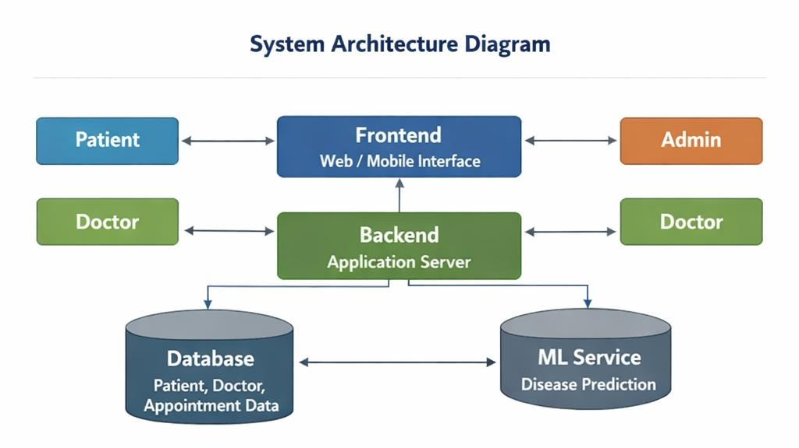
SYSTEM DIAGRAM
Patient
Frontend Web Interface
Admin
Doctor
Doctor
Backend Application server
Database
ML Service

Slide 25
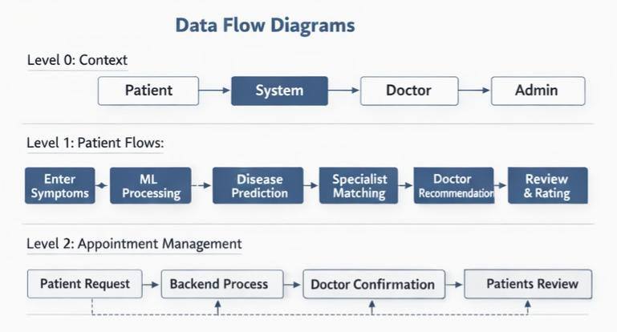
DATA FLOW DIAGRAM

Slide 26
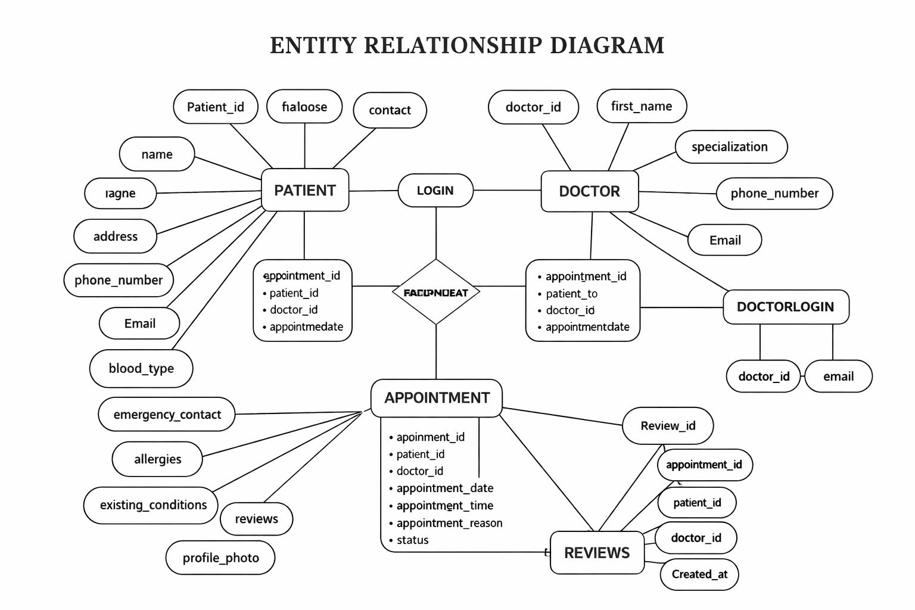
ENTITY RELATIONSHIP DIAGRAM
Photo
name
Admin
dob
Doctor recommend-ation
Symptoms analysis
Booking request
Appointment id
Patient ,doctor id
Appointment date
Status

Slide 27
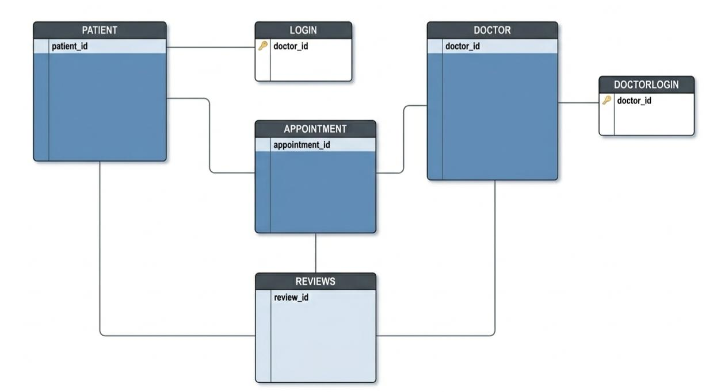
CLASS DIAGRAM
Patient_id
first_name
last_name
date_of_birth
gender
address
phone_number
Email
blood_type
emergency_contact
allergies
existing_conditions
profile_photo
Patient_id
Password
email
doctor_id
first_name
last_name
specialization
phone_number
Email
Available_days
Available_from
Available_to
Years_of_experience
salary
Avg_rating
Total_reviews
profile_photo
doctor_id
Password
email
appointment_id
patient_id
doctor_id
appointment_date
appointment_time
appointment_reason
status
Review_id
appointment_id
patient_id
doctor_id
rating
Review_text
Created_at

Slide 28
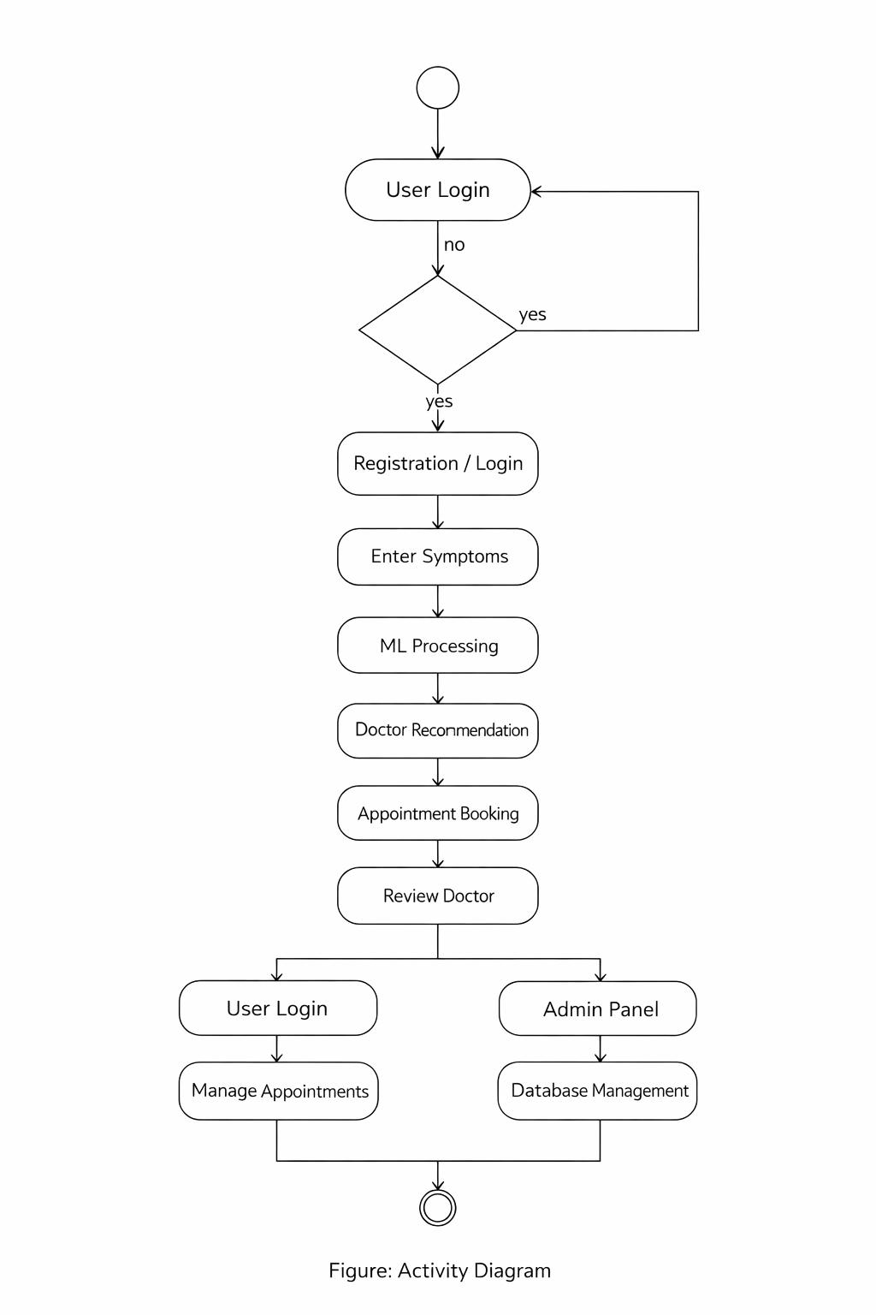
ACTIVITY DIAGRAM
Valid?
no
Doctor login

Slide 29
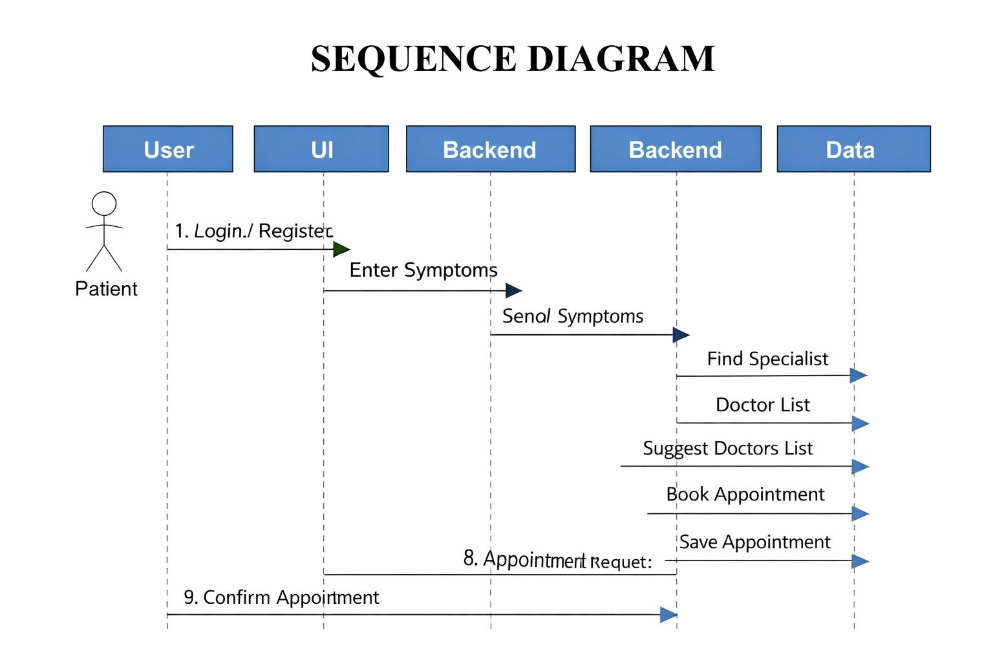
SEQUENCE DIAGRAM
ML process
Login/Register
Analyze Symptoms
Appointment request
Review

Slide 30
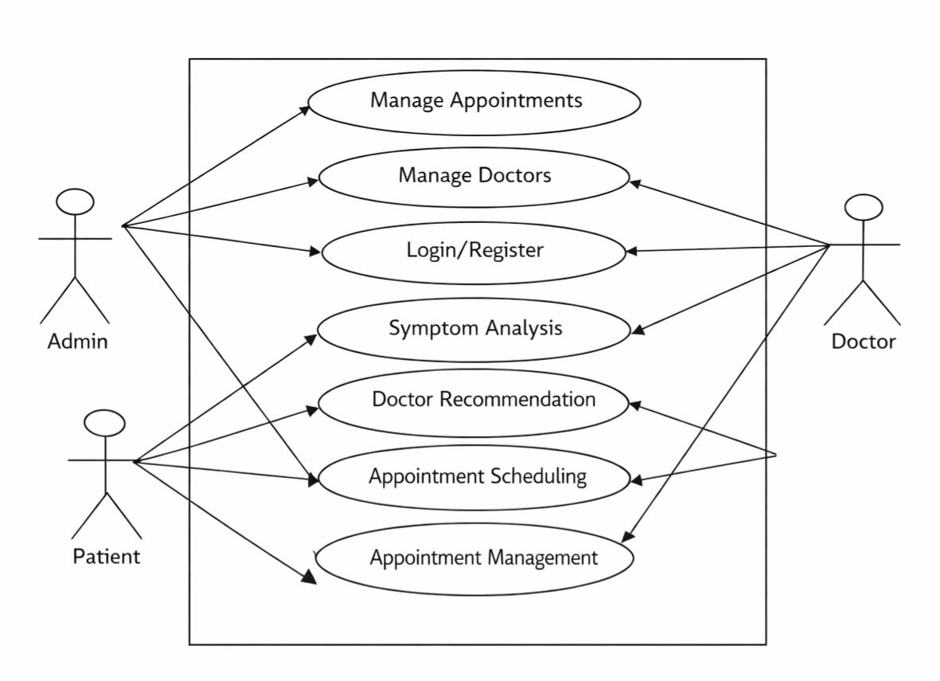
USE CASE DIAGRAM
Manage patient
Review Doctors

Slide 31
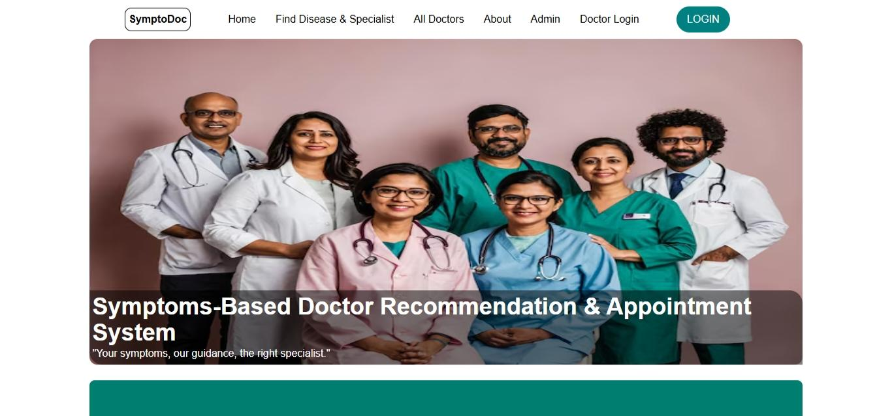
Screenshots
Home page

Slide 32
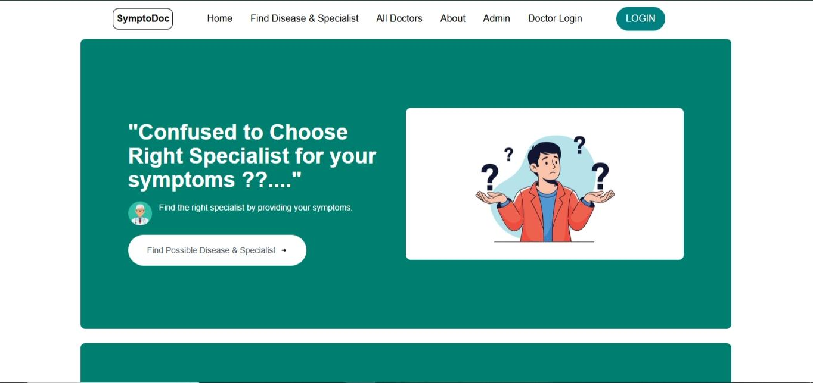
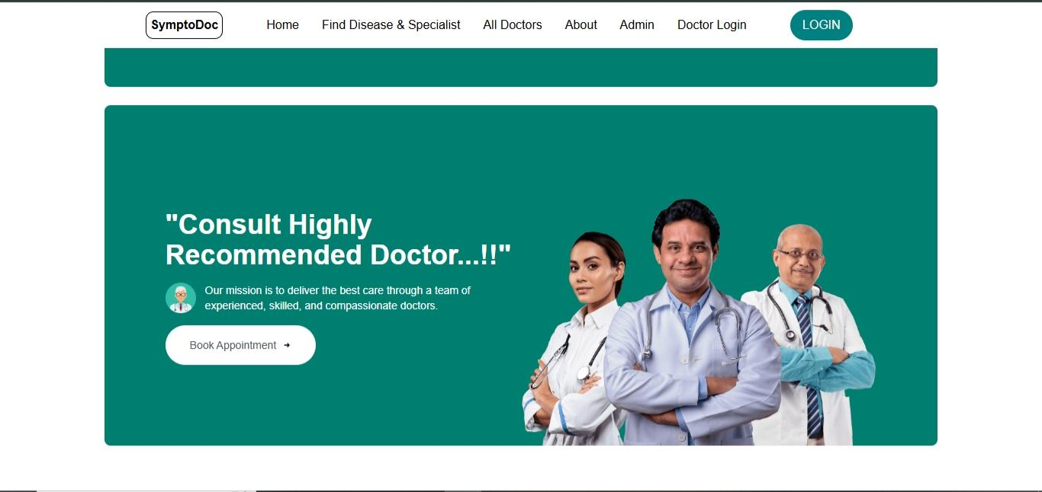
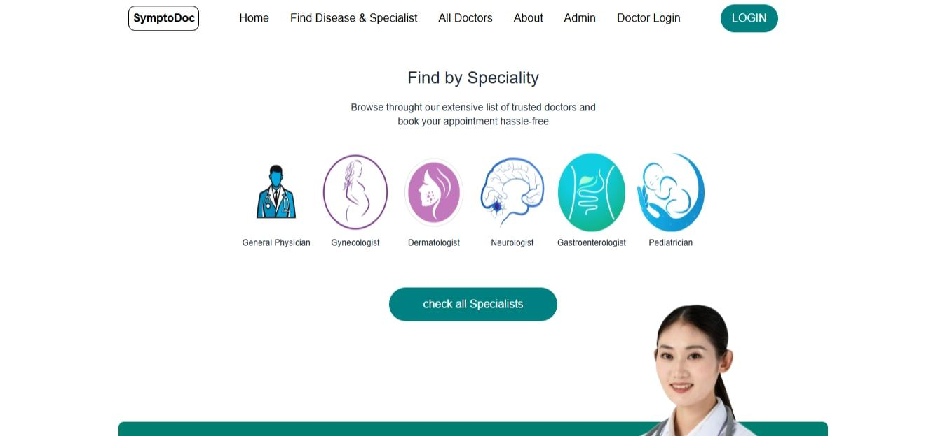
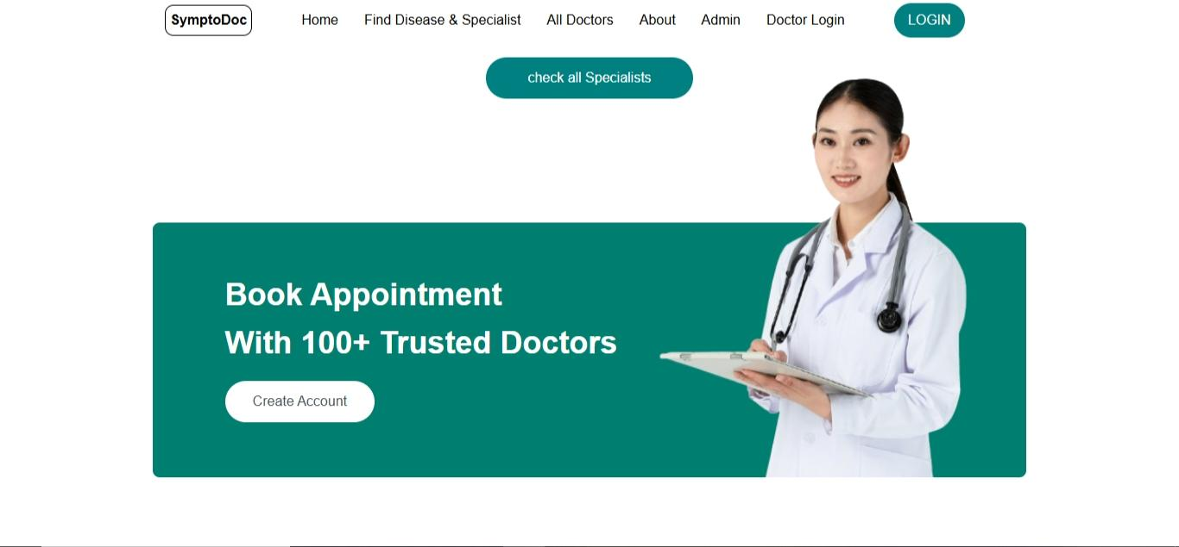

Slide 33
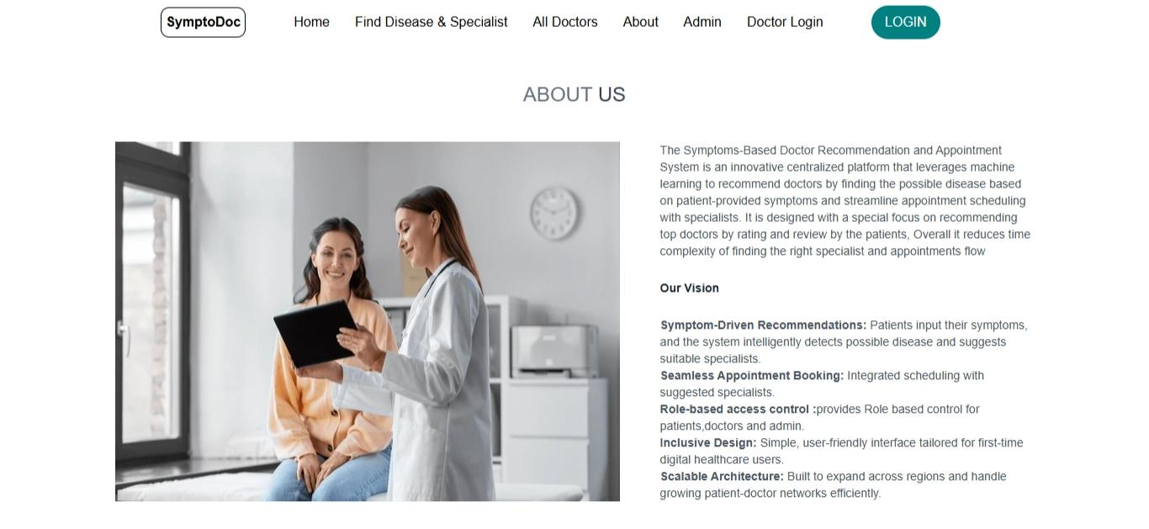
About page

Slide 34
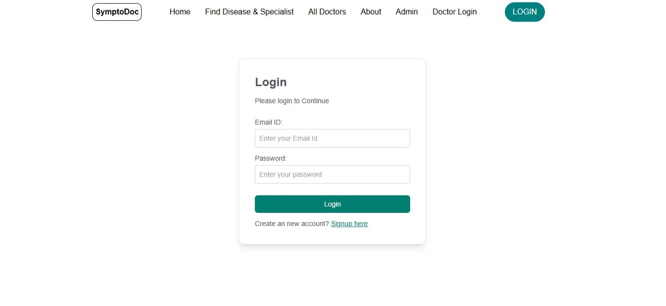
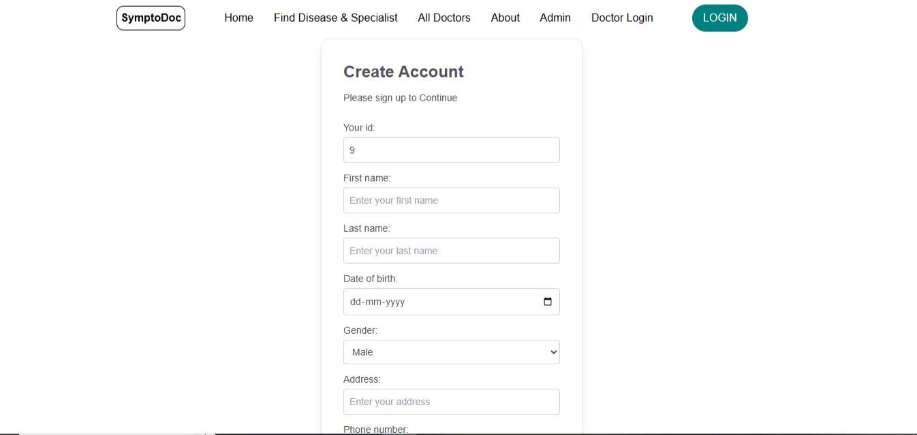
Patient Login
Patient signup

Slide 35
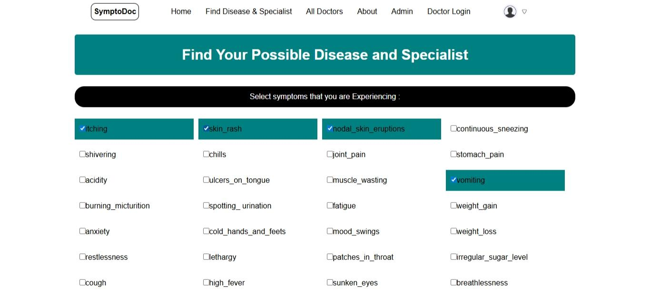
Symptoms page

Slide 36
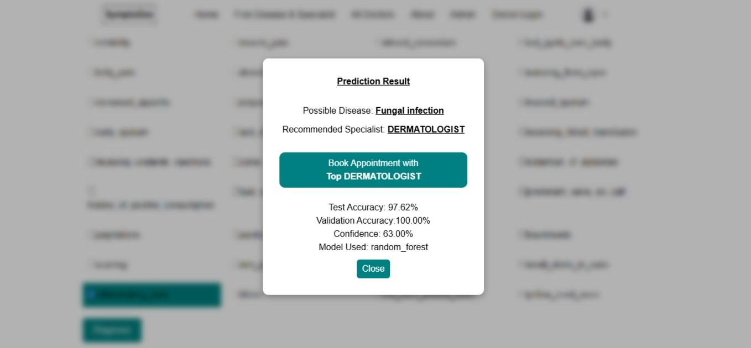
Prediction page

Slide 37
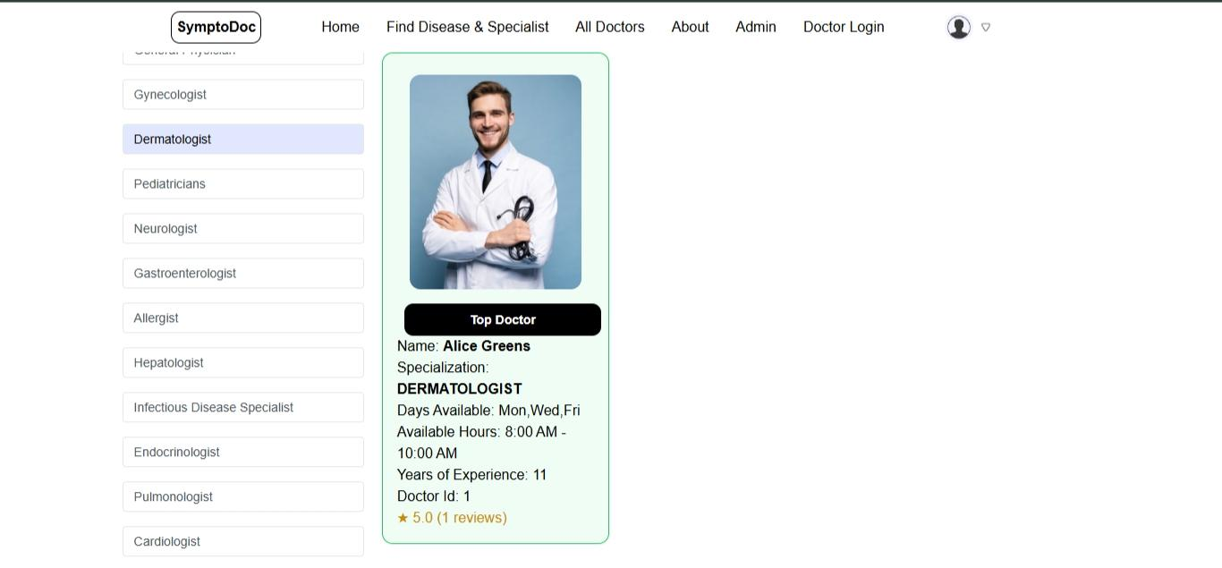
Doctor recommendation

Slide 38
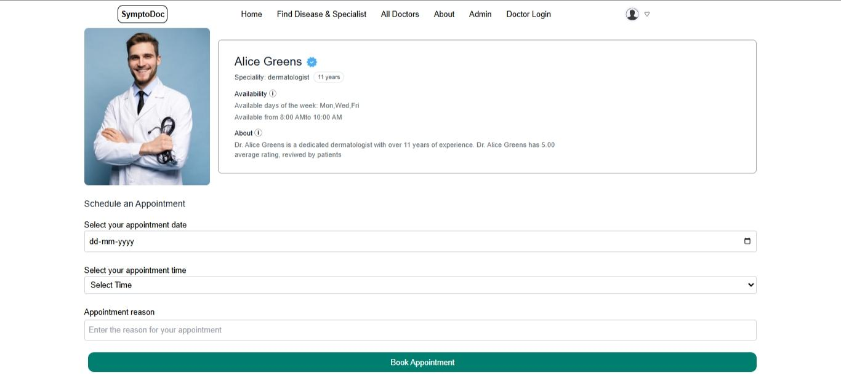
Appointment booking

Slide 39
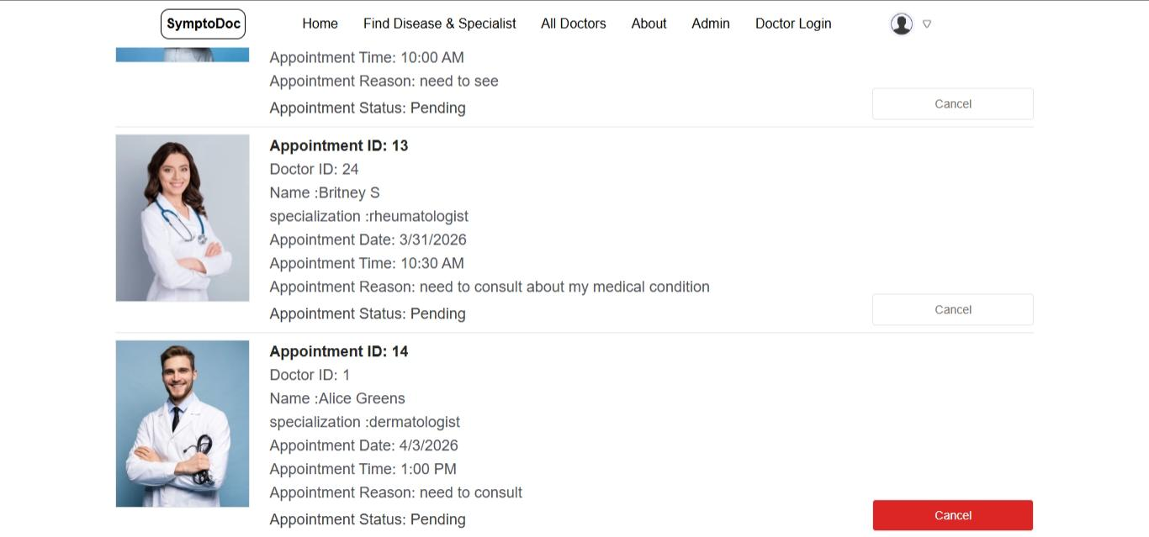
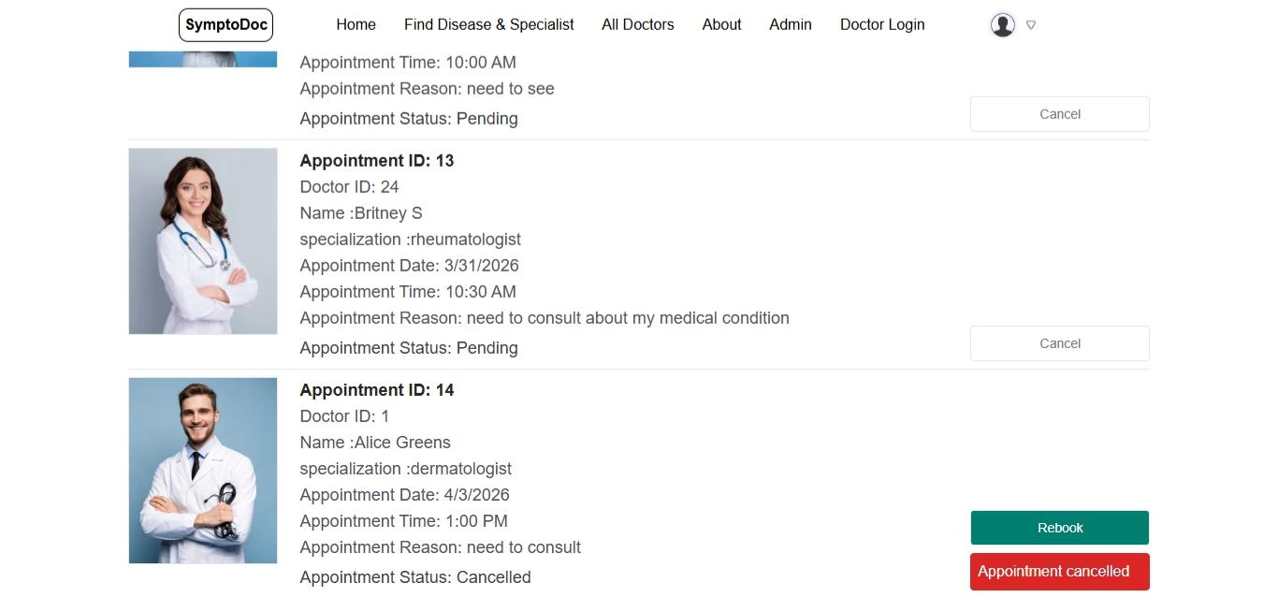
All Appointments
Cancel,Rebook appointments

Slide 40
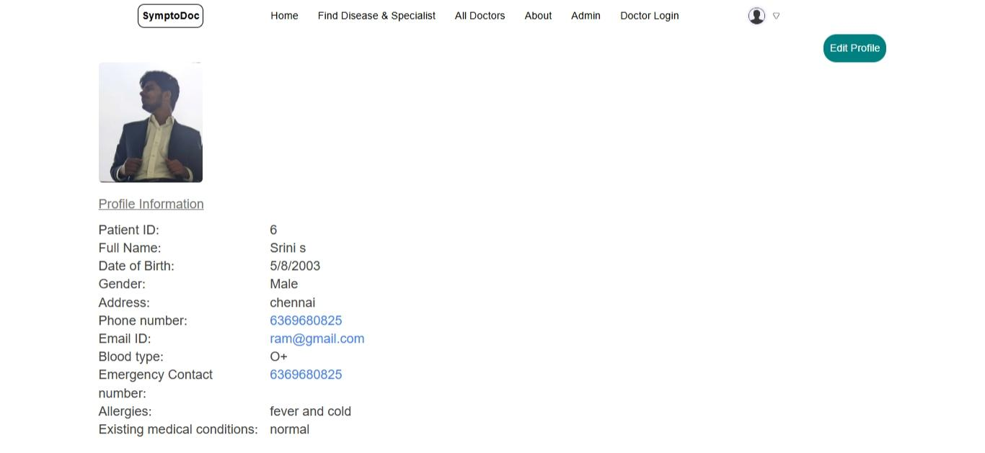
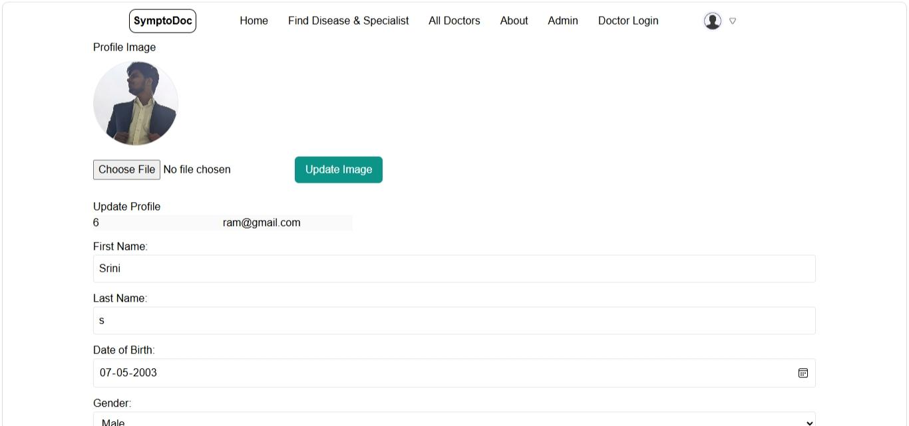
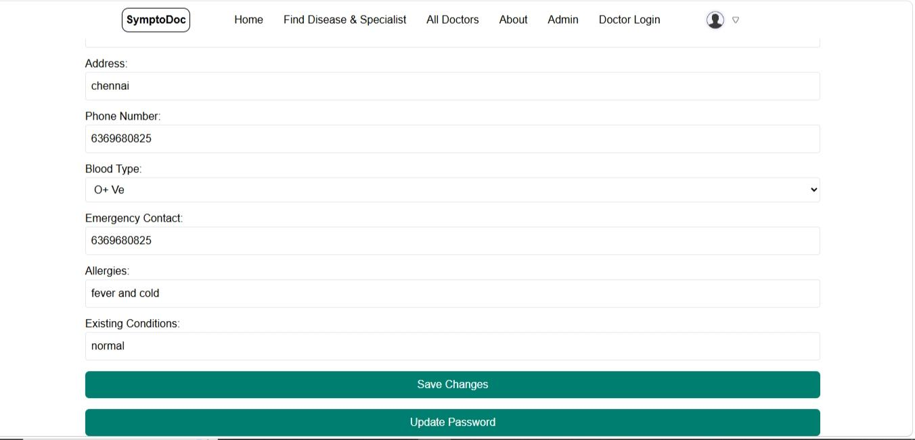
Profile page
Edit profile

Slide 41
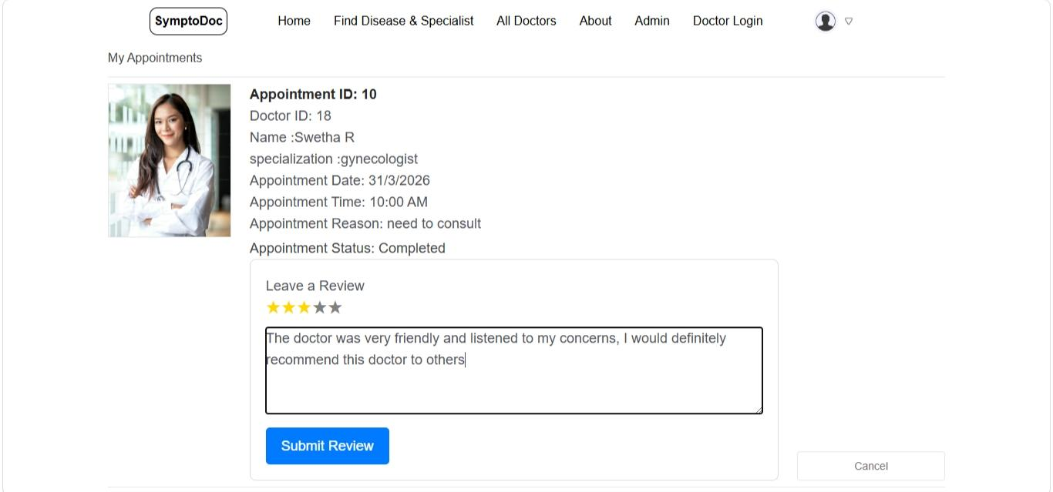
Review page

Slide 42
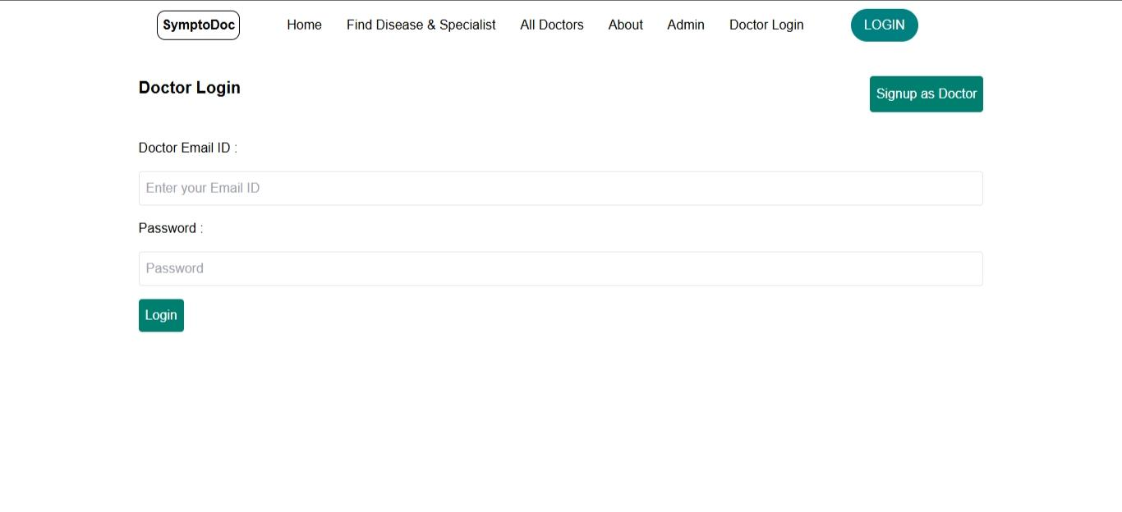
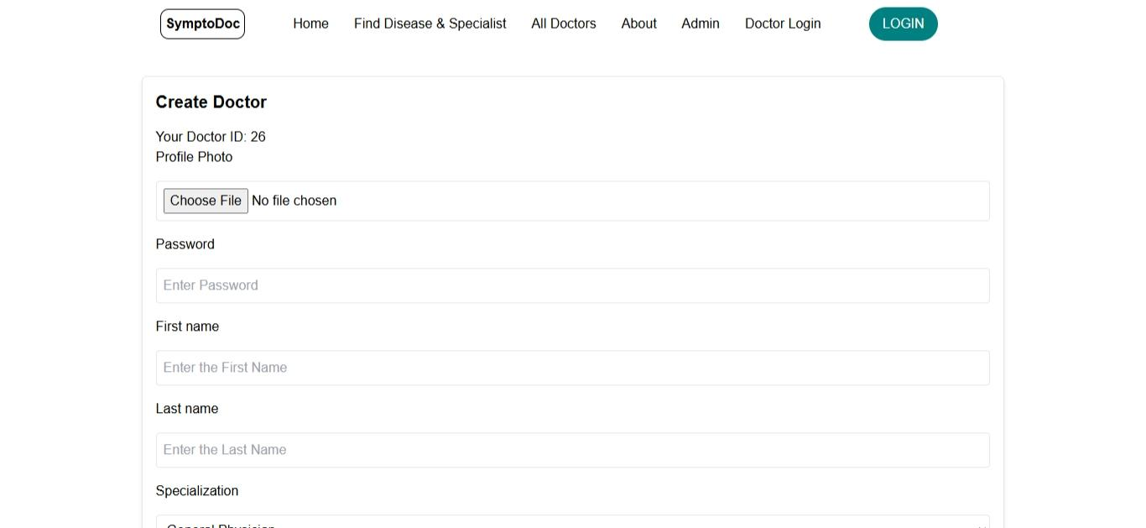
Doctor login
Doctor signup

Slide 43
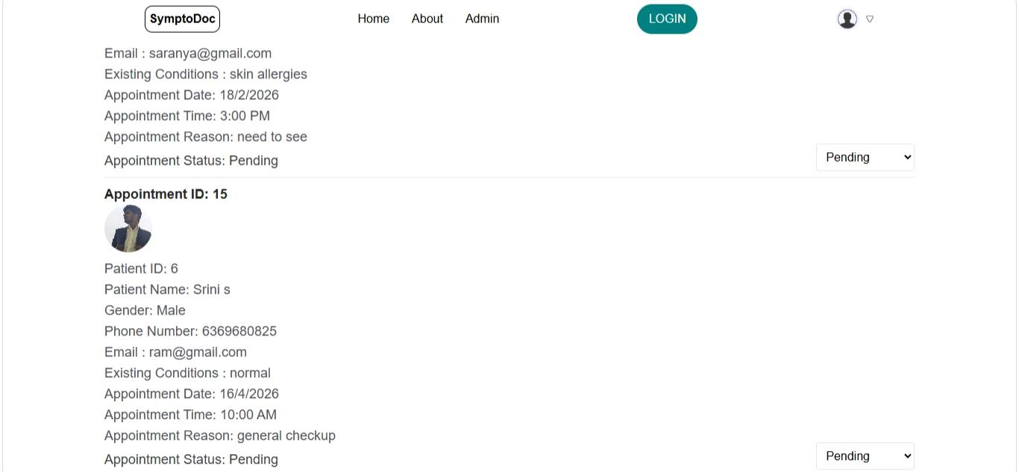
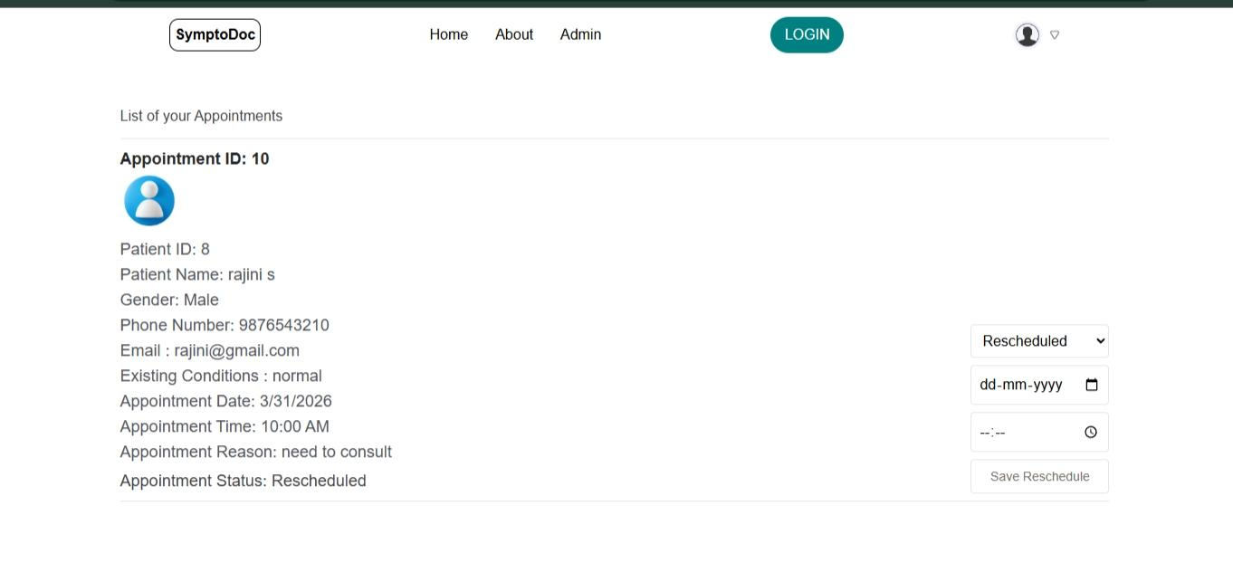
Doctor’s appointments
Update appointments

Slide 44
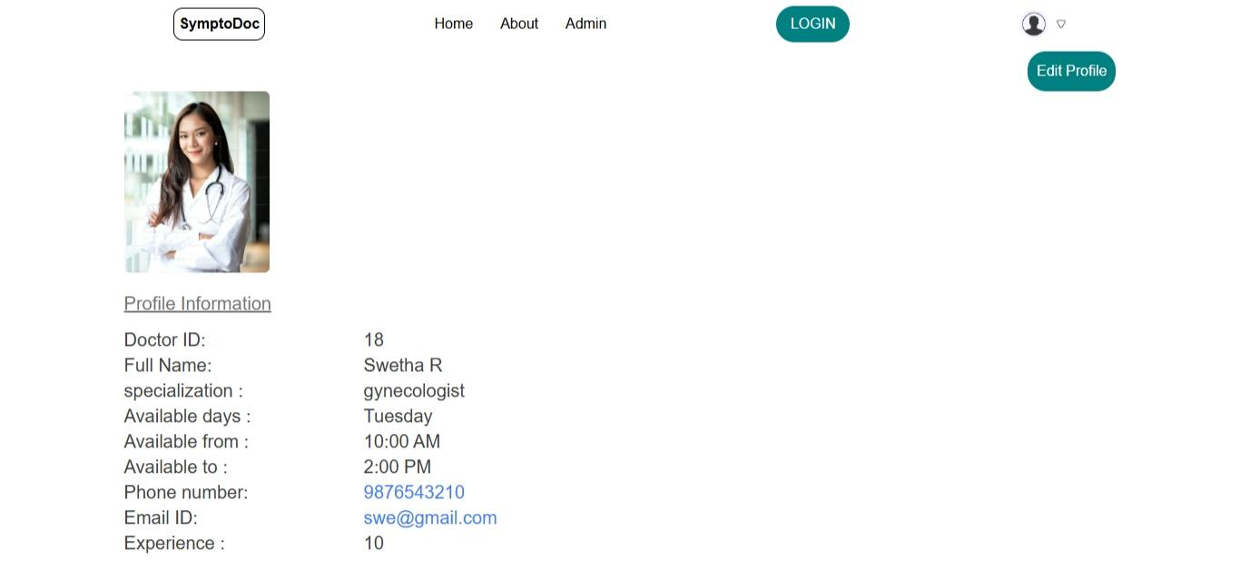
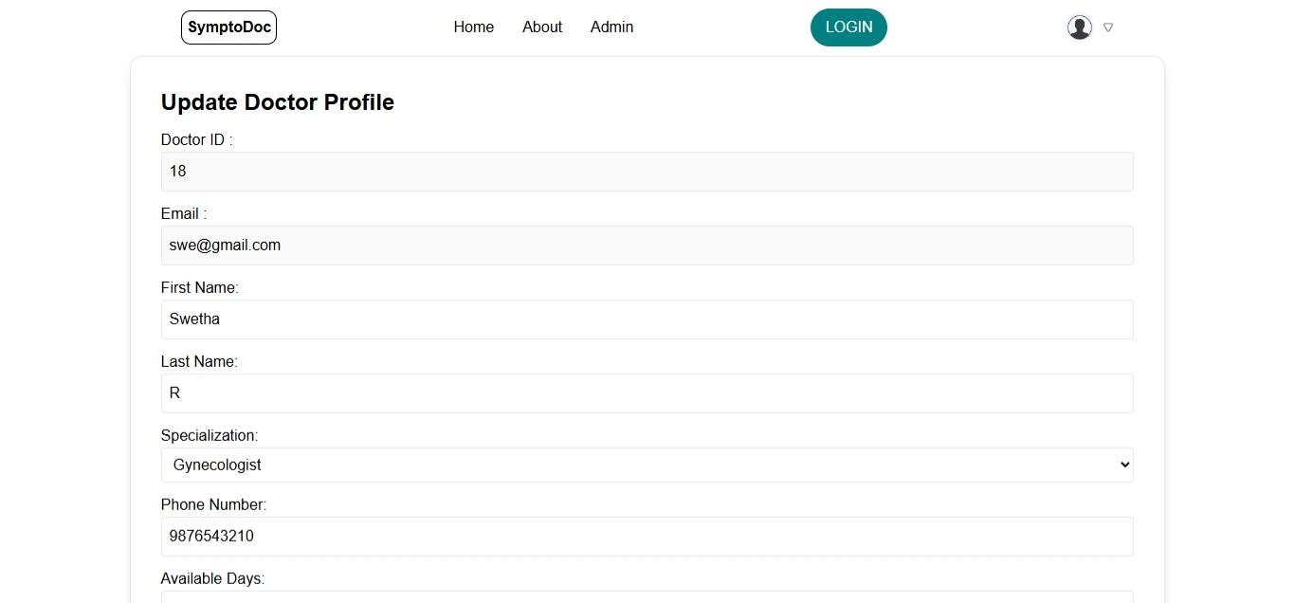
Doctor Profile
Doctor Profile update page

Slide 45
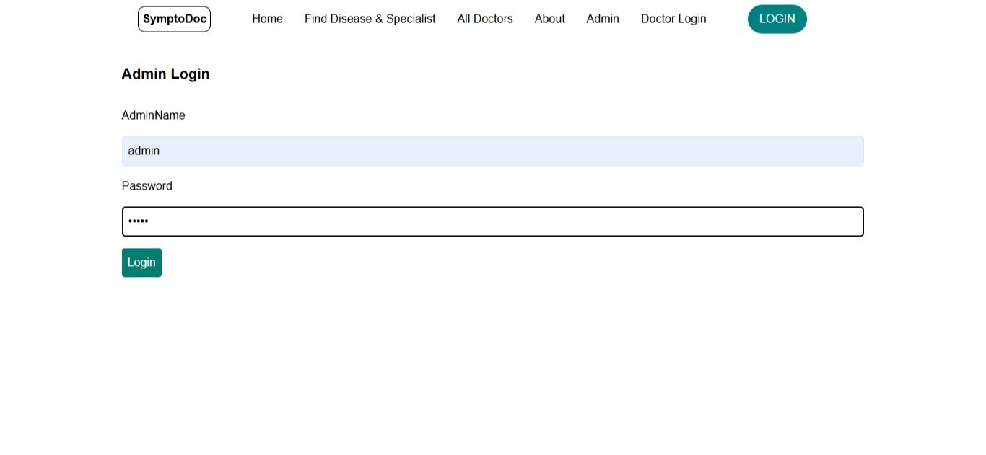
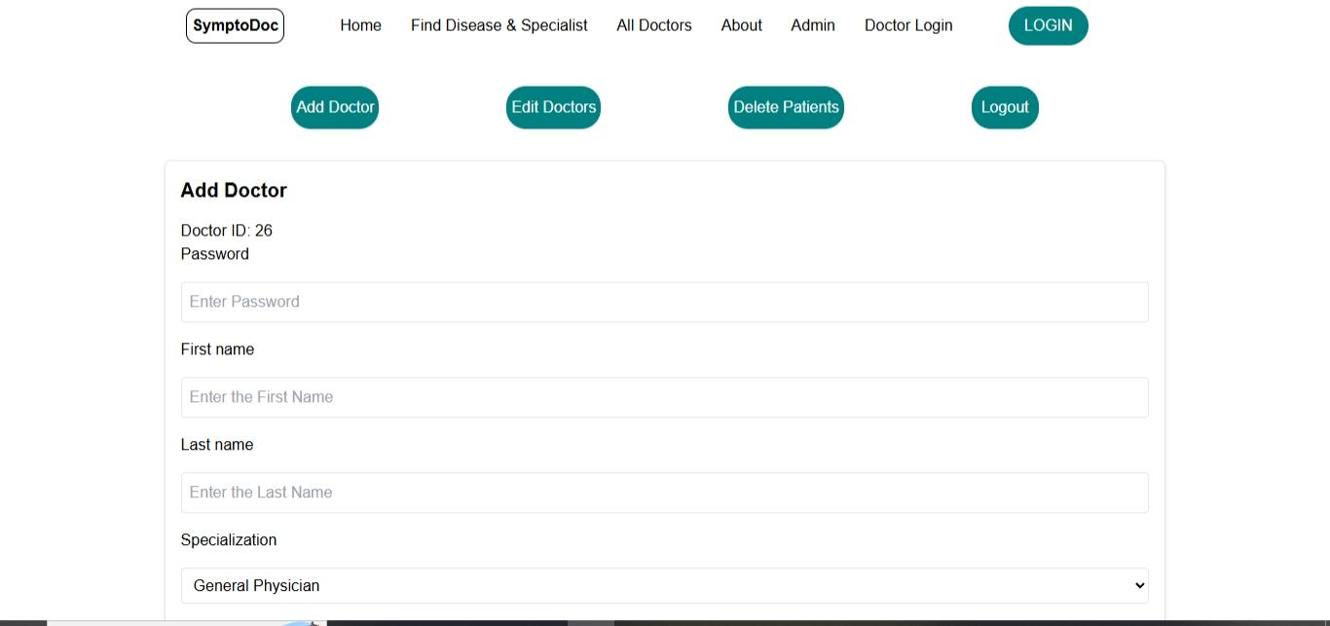
Admin login
Add doctors

Slide 46
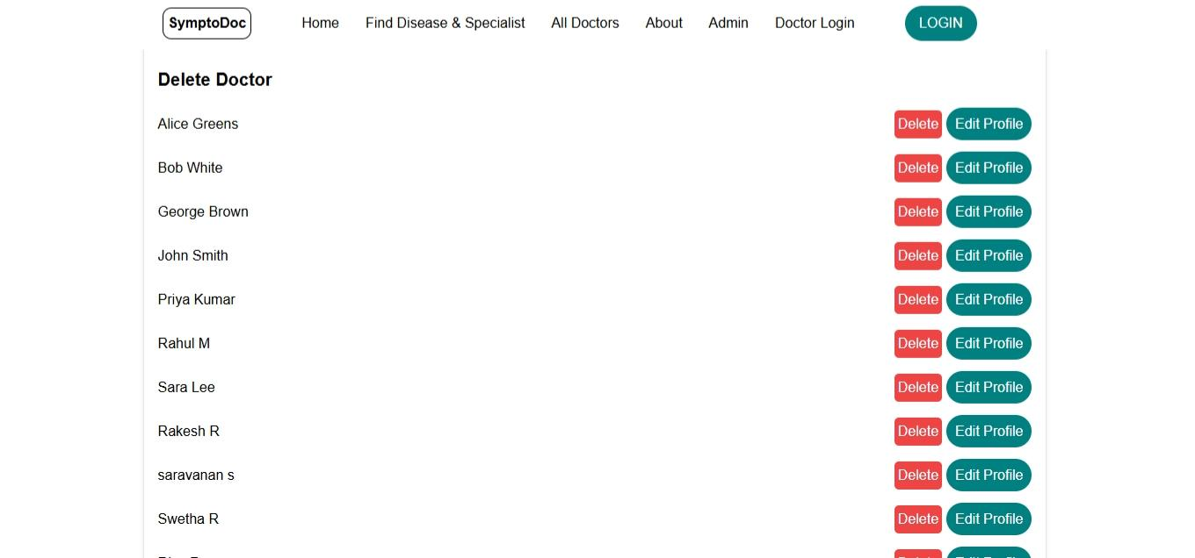
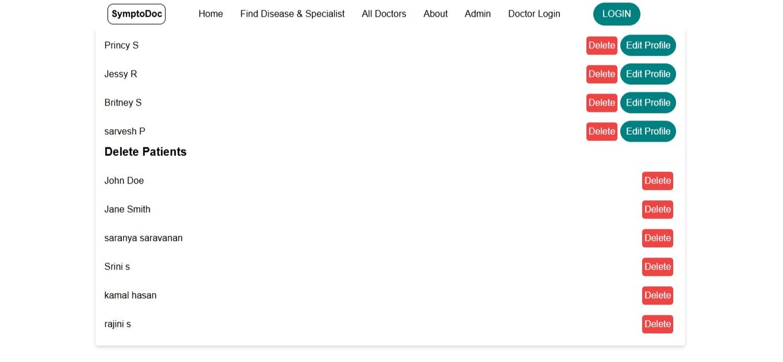
Delete,edit doctors
Remove patients

Slide 47
CONCLUSION
Symptoms-Based Doctor Recommendation and Appointment System
This project delivers an intelligent and user-centric healthcare assistance system that simplifies the process of identifying medical specialists, recommending suitable doctors, and booking appointments. By integrating decision support and role-based access within a single platform, the system reduces patient confusion, saves time, and improves healthcare accessibility. The proposed solution demonstrates an effective approach to modern healthcare management and provides a strong foundation for future advancements.
Anna University, Chennai

