Slide 1
Design of MIMO Discrete All-Pass Filter
DDP Stage - I Presentation
Based on Subspace Nevanlinna Interpolation
Name : Agulla Surya Bharath Roll.No : 17D070055
Guide : Prof. Kumar Appaiah ---- Co-Guide : Prof. Debasattam Pal

Slide 2
Motivation
→ Use of multiple antennas at Tx and Rx (MIMO) enhances the rates in wireless communications .
→ Optimal resource allocation requires channel state knowledge at transmitter - enabled by feedback from receiver .
Channel State Information
T_{x}
Data symbols
R_{X}
T_{X}
Processed data symbols
R_{X}
👎
👍
→ Constraint : Feedback link is highly limited in rate (Limited Feedback)
R_{X}
Full Feedback
T_{X}
Limited Feedback
R_{X}
T_{X}
👎
👍

Slide 3
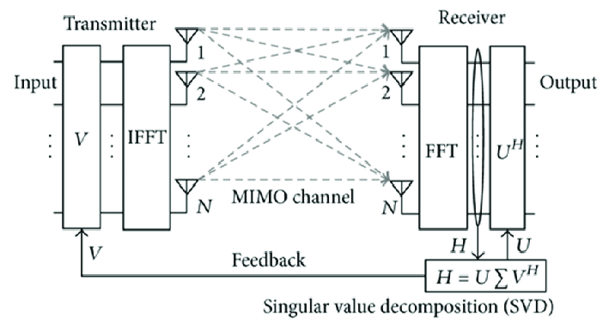
Importance of Unitary Matrices
→ MIMO - OFDM System
→ Multiple subcarriers
→ Unitary matrix feedback - used as precoder
at the transmitter
Figure: Block Diagram for SVD in MIMO-OFDM
→ Large amount of feedback required to send precoder(V) for every sub-carrier frequency
→ Need a technique to reduce unitary matrix feedback rate
Image Source : https://www.researchgate.net/figure/Block-diagram-for-SVD-in-MIMO-OFDM_fig1_273824105

Slide 4
Possible Solutions
Frequency Domain Interpolation^{[9],[10]}
→ OLD
→ Send precoder (unitary) matrices for some subcarriers
→ Interpolate precoder for other subcarriers in frequency domain
Disadvantage : Error prone if sufficient precoders are not fed back ^{[11]}
2. Filter Design method
→ NEW , our work
→ Unitary matrix ≣ All-Pass system
→ Design all-pass filter and send its coefficient values as feedback
Advantage : Realizable filter - compact representation & less complex implementation
[9] D. J. Love, R. W. Heath, V. K. N. Lau, D. Gesbert, B. D. Rao and M. Andrews, "An overview of limited feedback in wireless communication systems," in IEEE Journal on Selected Areas in Communications, vol. 26, no. 8, pp. 1341-1365, October 2008, doi: 10.1109/JSAC.2008.081002
[10] J. Choi, B. Mondal, and R. W. Heath, \Interpolation based unitary pre-coding for spatial multiplexing MIMO-OFDM with limited feedback"
[11] D. J. Love, R. W. Heath, W. Santipach, and M. L. Honig, \What is the value of limited feedback for MIMO channels?"

Slide 5
Block Diagram of functioning of our method
Construct the filter
&
Generate precoders
T_{x}
Pilot symbols
R_{X}
Estimate channel matrix
Compute all precoders
Coefficients all-pass filter
Pick few precoders & design filter
Feedback coefficients
→ Limited feedback achieved & less implementation complexity on Tx side
→ Thus we consider the problem of interpolating "vector" discrete-time (DT) all-pass filters,
satisfying some constraints

Slide 6



Prior Work / Literature Review
.
→ First we look at scalar version of our problem
- Classical Nevanlinna - Pick problem (NP)
NP has a solution iff the Pick matrix P is positive semi definite ( P≥ 0)
f(z₃)
z₃
z₁
f(z₁)
z₂
f(z₂)
- Boundary version of NP^{[1]}
:
Solved using
Blaschke Product
z₃
f(z₃)
Diagonal Elements of P = ⇒ NP fails here
z₁
f(z₁)
z₂
f(z₂)
[1] V. Bolotnikov, “Boundary interpolation by finite Blaschke products,” in Complex Analysis and Dynamical Systems. Springer, 2018, pp. 39–65.

Slide 7



Prior Work / Literature Review
.
Schwarz - Pick Matrix is defined as
→ All-Pass Filter Design for scalar (SISO) case ^{[2]}
Causal, Stable All-pass filter with rational H(z) :
Filter design problem ≣ Blaschke interpolation problem
&
[2] K. Appaiah and D. Pal, “All-pass filter design using blaschke interpolation,” IEEE Signal Process. Lett., vol. 27, pp. 226–230, 2020.

Slide 8
Prior Work / Literature Review
→ Subspace Nevanlinna Interpolation (SNIP) ^{[3]}
Problem Statement :
&
Uses iterative approach to pass the model through all data points
[3] P. Rapisarda and J. C. Willems, “The subspace nevanlinna interpolation problem and the most powerful unfalsified model,” in Proceedings of the 36th IEEE Conference on Decision and Control, vol. 3, 1997, pp. 2029–2033 vol.3.

Slide 9
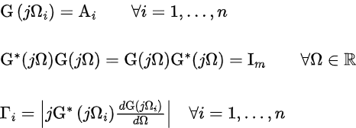
Prior Work / Literature Review
→ Boundary SNIP (Continuous - time )^{[4]}
- Boundary version of NP ⇒ Blaschke Interpolation
- Boundary version of SNIP ⇒ Vector all pass filter design
Problem Statement :
Solvability criteria - derived using dissipative equation
[4] D. Gaharwar, K. Appaiah, and D. Pal. Design of MIMO All-Pass Filters via Subspace Nevanlinna Interpolation . 2021

Slide 10
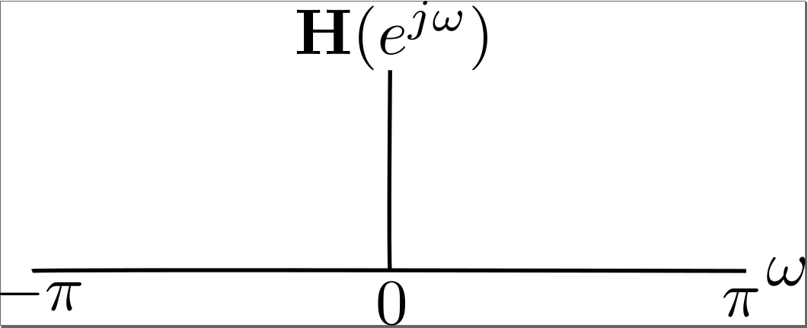
Problem Statement for Discrete case

Slide 11
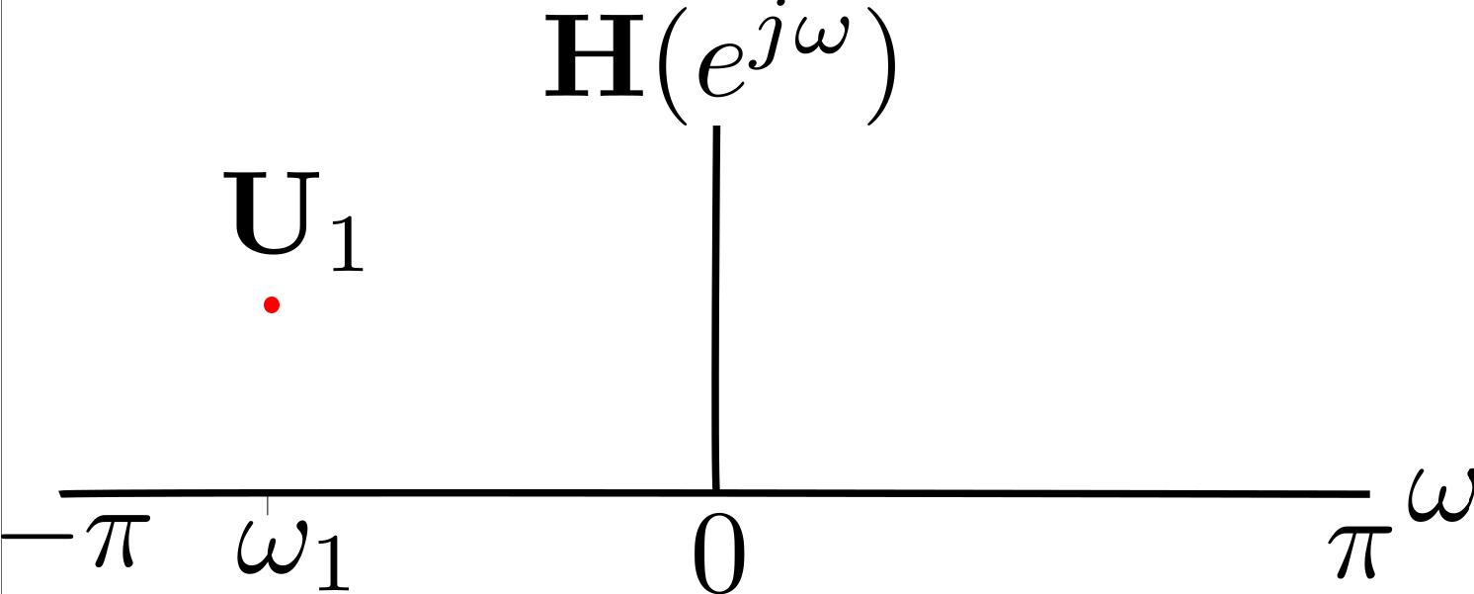
Problem Statement for Discrete case

Slide 12
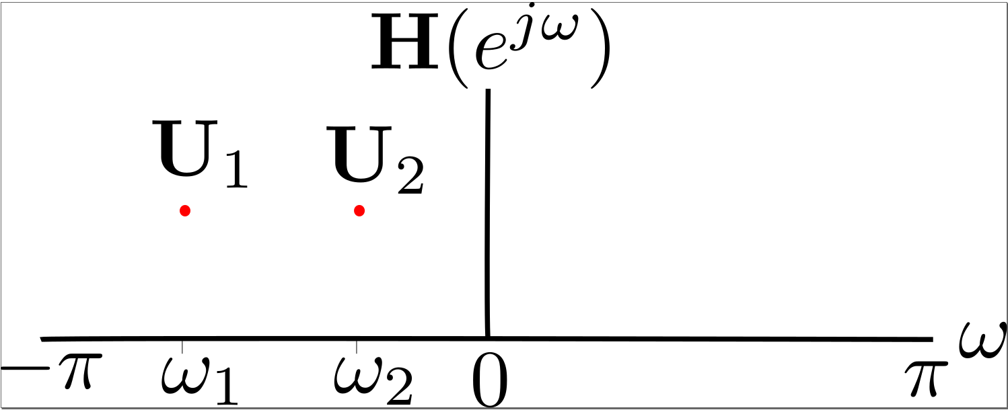
Problem Statement for Discrete case

Slide 13
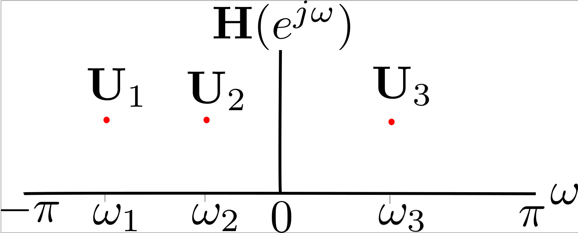
Problem Statement for Discrete case

Slide 14
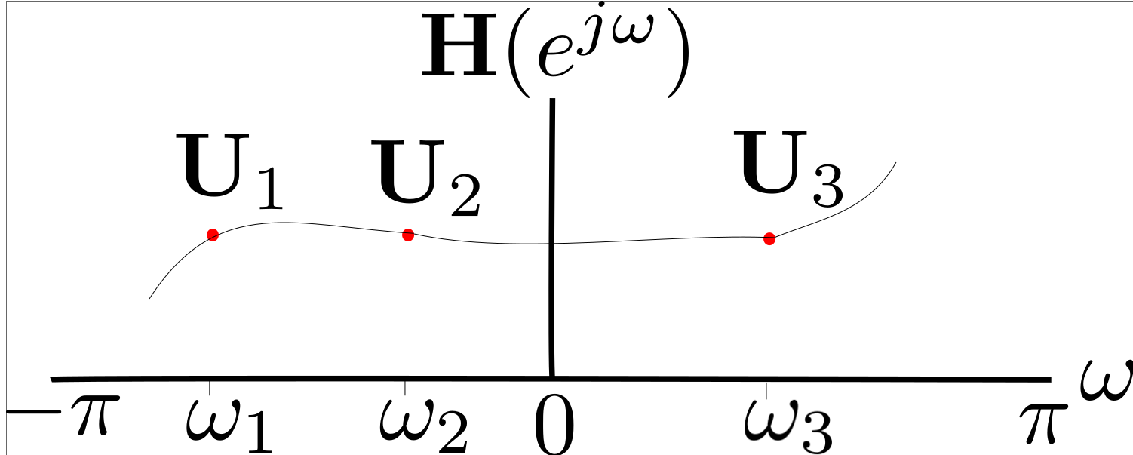
Problem Statement for Discrete case

Slide 15
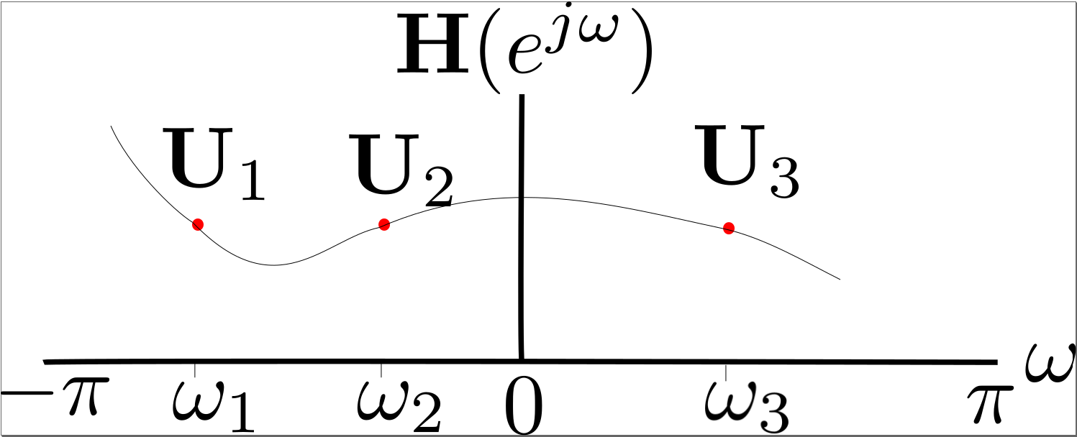
Problem Statement for Discrete case

Slide 16
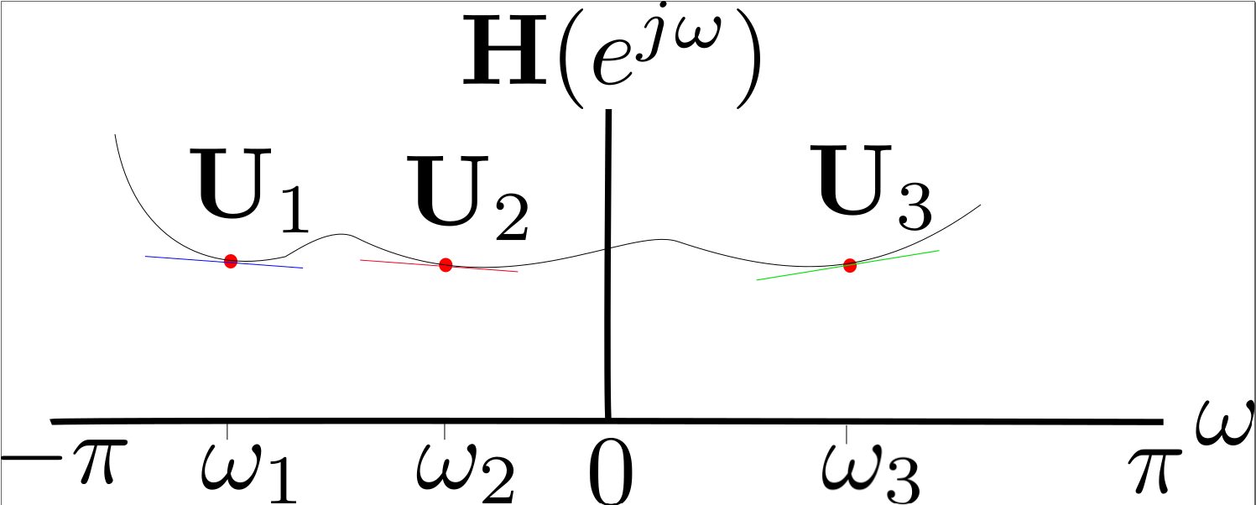
Problem Statement for Discrete case

Slide 17
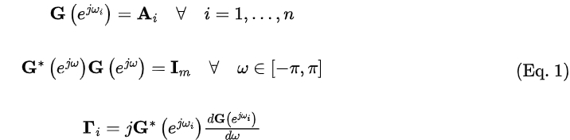
Problem Statement

Slide 18



Formulating the Modified Pick Matrix
→ Modify the data-set to capture contractive subspace ,
→ Modified Pick Matrix of size nm x nm is defined as follows,
( Eq. 2 )
→ Sample Pick matrix : For n = 2 , (2m x 2m)

Slide 19



Solvability Criteria
→ Proof : For (only if) part , For a lossless dissipative dynamical system G
discretize
(hypothesis , yet to be proved)

Slide 20



Positive Definiteness of Pick matrix
.

Slide 21



Induction Based Solution Construction
.
Inductive Step : We assume that our problem is solvable for n - 1 points and prove that the problem is
solvable for n points. For that define,
Modify Data as follows :

Slide 22

Induction Based Solution Construction
.
→

Slide 23
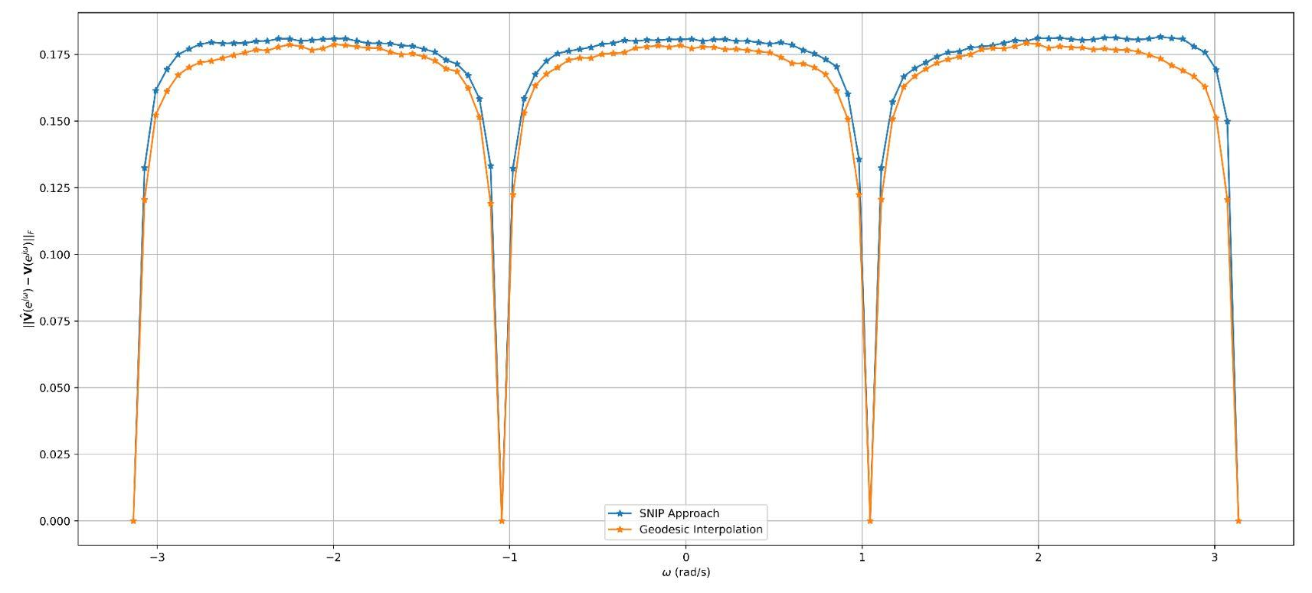
Simulation Results : 4X4 MIMO
Unitary Matrix Data : SVD of Channel Matrix (H ) of MIMO wireless system
Size of Data-set = 4
Error averaged over 1000 channel iterations
Error measure : Frobenius Norm
Model : ITU_Vehicular_A wireless channel
Fig : Comparison of Error with Geodesic Interpolation

Slide 24
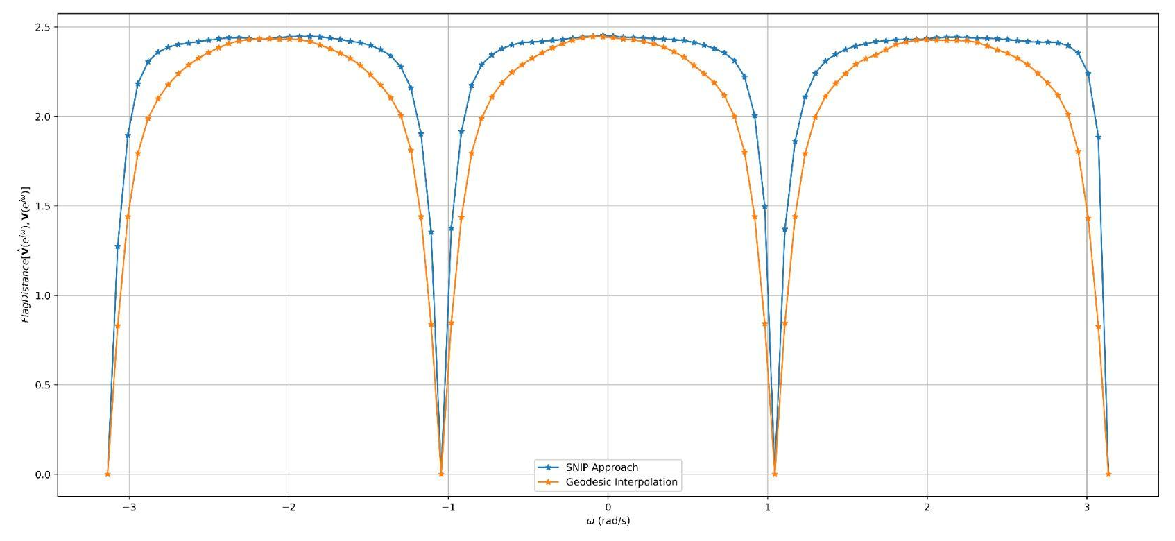

Simulation Results : 4X4 MIMO
Error Measure :
Flag Distance^{[6]}
Fig : Comparison of Flag Distance with Geodesic Interpolation
[6] S. Nijhawan, A. Gupta, K. Appaiah, R. Vaze and N. Karamchandani, "Flag Manifold-Based Precoder Interpolation Techniques for MIMO- OFDM Systems," in IEEE Transactions on Communications, vol. 69, no. 7, pp. 4347-4359, July 2021, doi: 10.1109/TCOMM.2021.3069015.

Slide 25
Future Work
→ Extension to additional filter types .(Eg Skew-Hermitian)
→ Base Step of our solution construction - N(z) & D(z) are polynomials of order 1.
⇒ exploring different orders for an optimal solution
→ The group delays at the interpolating points in the problem statement can be optimized or tuned
-- to control the phase response for the remaining frequencies^{[2]}
→ Model overfitting and undersampling for this discrete-time boundary SNIP
→ Explore the stability of filters
→ Filter performance with additional constraints (Eg: SVD-specific unitary matrices with redundancy)
[2] K. Appaiah and D. Pal, “All-pass filter design using blaschke interpolation,” IEEE Signal Process. Lett., vol. 27, pp. 226–230, 2020.

Slide 26
References
[1] V. Bolotnikov, “Boundary interpolation by finite Blaschke products,” in Complex Analysis and Dynamical Systems. Springer, 2018, pp. 39–65.
[2] K. Appaiah and D. Pal, “All-pass filter design using blaschke interpo lation,” IEEE Signal Process. Lett., vol. 27, pp. 226–230, 2020.
[3] P. Rapisarda and J. C. Willems, “The subspace nevalinna interpolation problem and the most powerful unfalsified model,” in Proceedings of the 36th IEEE Conference on Decision and Control, vol. 3, 1997, pp. 2029–2033 vol.3.
[4] D. Gaharwar, K. Appaiah, and D. Pal. Design of MIMO All-Pass Filters via Subspace Nevanlinna Interpolation.
[5] J. C. Willems, “Dissipative dynamical systems part i: General theory,” Archive for Rational Mechanics and Analysis, vol. 45, no. 5, pp. 321– 351, Jan 1972. [Online]. Available: https://doi.org/10.1007/BF00276493
[6] S. Nijhawan, A. Gupta, K. Appaiah, R. Vaze and N. Karamchandani, "Flag Manifold-Based Precoder Interpolation Techniques for MIMO- OFDM Systems," in IEEE Transactions on Communications, vol. 69, no. 7, pp. 4347-4359, July 2021, doi: 10.1109/TCOMM.2021.3069015.
[7] D. Tse and P. Viswanath, Fundamentals of Wireless Communication. Cambridge University Press, 2005.
[8] D. J. Love and R. W. Heath, “Limited feedback unitary precoding for spatial multiplexing systems,” vol. 51, no. 8, pp. 2967–2976, 2005.
[9] D. J. Love, R. W. Heath, V. K. N. Lau, D. Gesbert, B. D. Rao and M. Andrews, "An overview of limited feedback in wireless communication systems," in IEEE Journal on Selected Areas in Communications, vol. 26, no. 8, pp. 1341-1365, October 2008, doi: 10.1109/JSAC.2008.081002
[10] 1J. Choi, B. Mondal, and R. W. Heath, \Interpolation based unitary pre-coding for spatial multiplexing MIMO-OFDM with limited feedback"
[11] D. J. Love, R. W. Heath, W. Santipach, and M. L. Honig, \What is the value of limited feedback for MIMO channels?"

