Slide 1

Explore Zomato restaurants dataset in the city of Bangalore

Slide 2
Objectives
Questions that can be asked using the above mentioned datasets
What is best location in Bangalore for Chinese Cuisine ?
Which areas have large number of Chinese Restaurant Market ?
Which all areas have less number of restaurant ?
Which is the best place to stay if I prefer Chinese Cuisine ?
What places are have best restaurant in Bangalore?

Slide 3
Data
For this project we need the following data :
Bangalore Restaurants data that contains list Locality, Restaurant name,Rating along with their latitude and longitude.
Data source : Zomato kaggel dataset
Description : This data set contains the required information. And we will use this data set to explore various locality of Bangalore city.
Nearby places in each locality of Bangalore city.
Data source : Fousquare API
Description : By using this api we will get all the venues in each neighborhood.

Slide 4
Approach
Collect the Bangalore data from Zomato kaggel dataset
Using FourSquare API we will find all venues for each neighborhood.
Filter out all venues that are nearby by locality.
Using aggregative rating for each resturant to find the best places.
Visualize the Ranking of neighborhoods using folium library(python)

Slide 5
Results

Slide 6
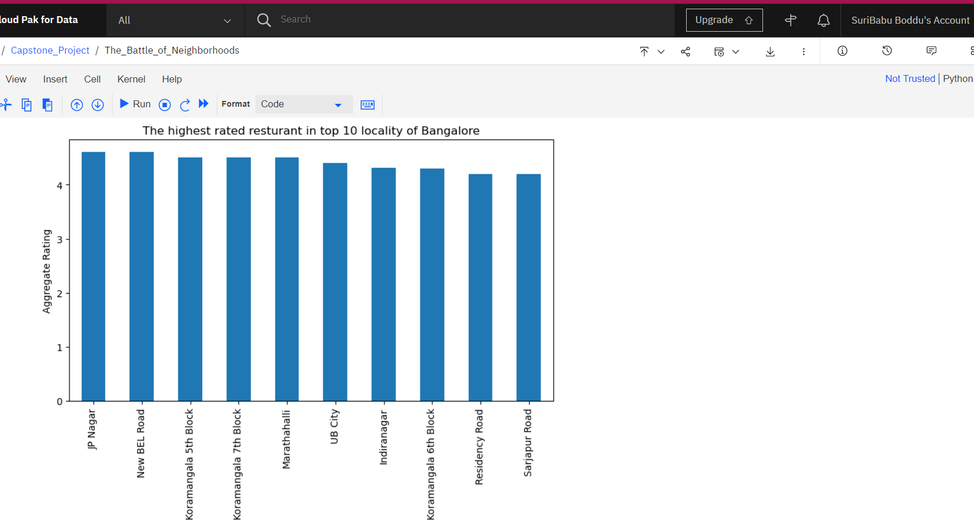

Slide 7
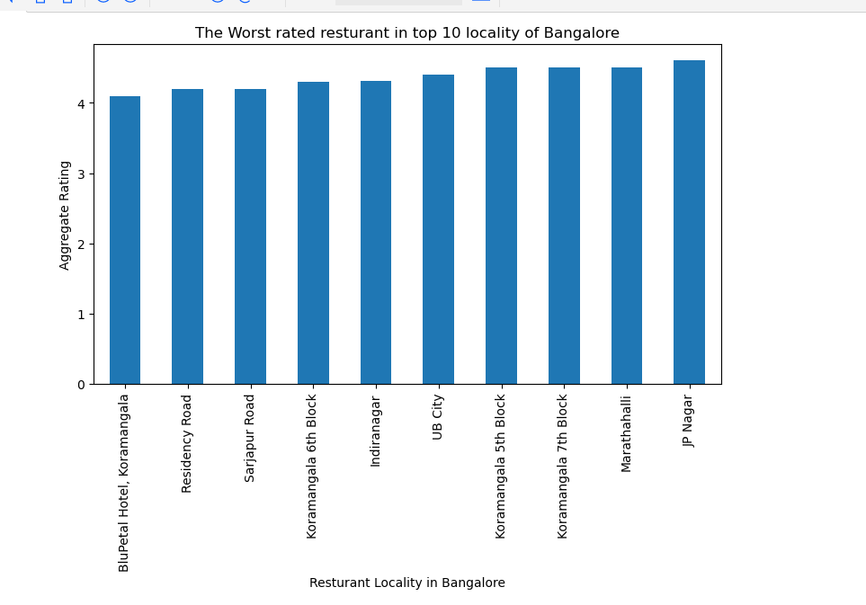

Slide 8
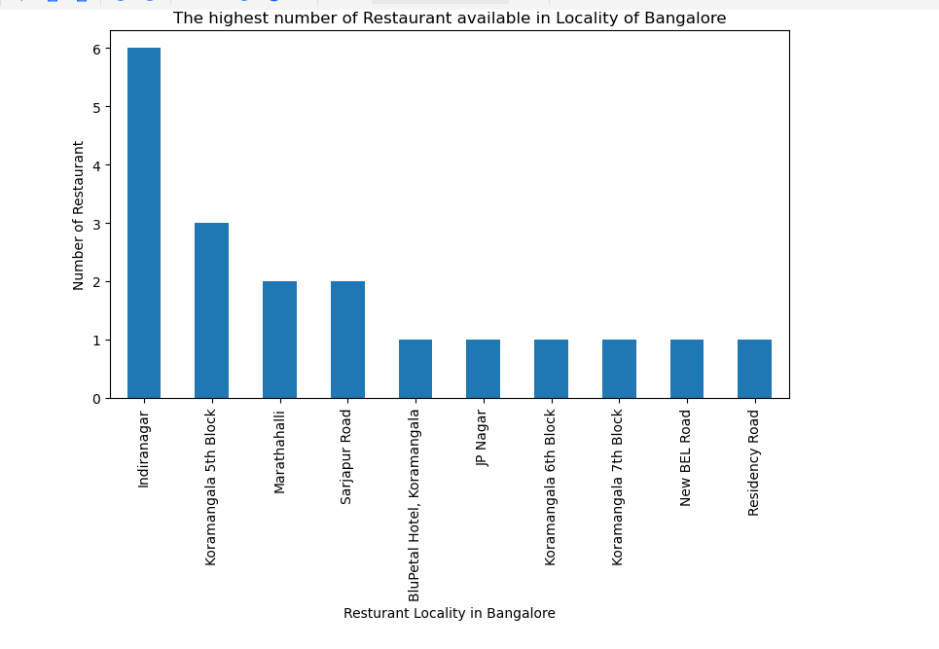

Slide 9
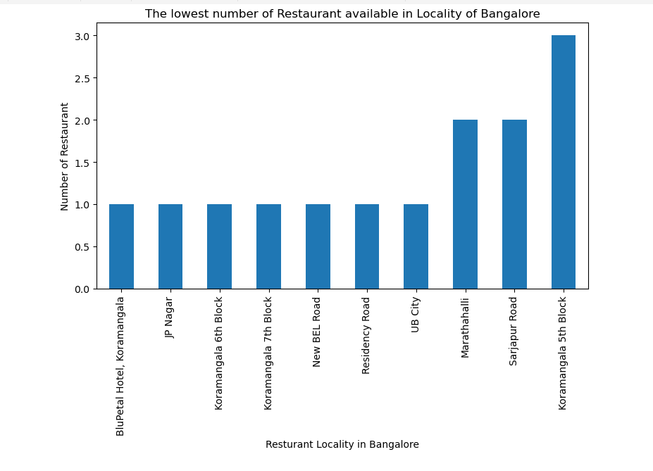

Slide 10
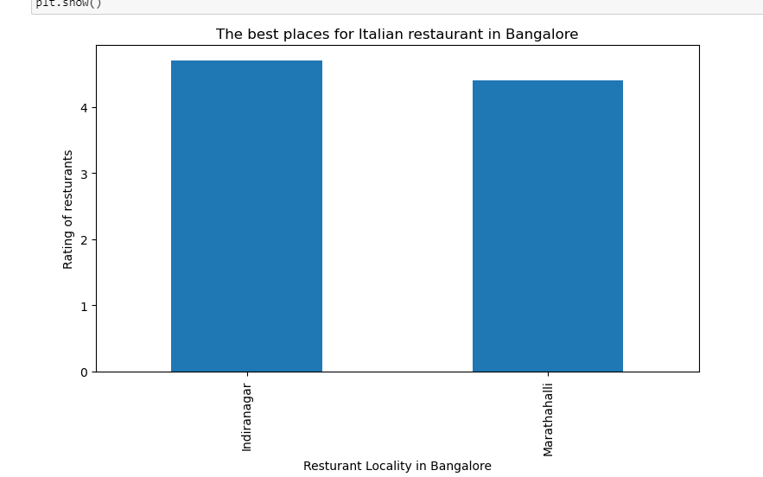

Slide 11
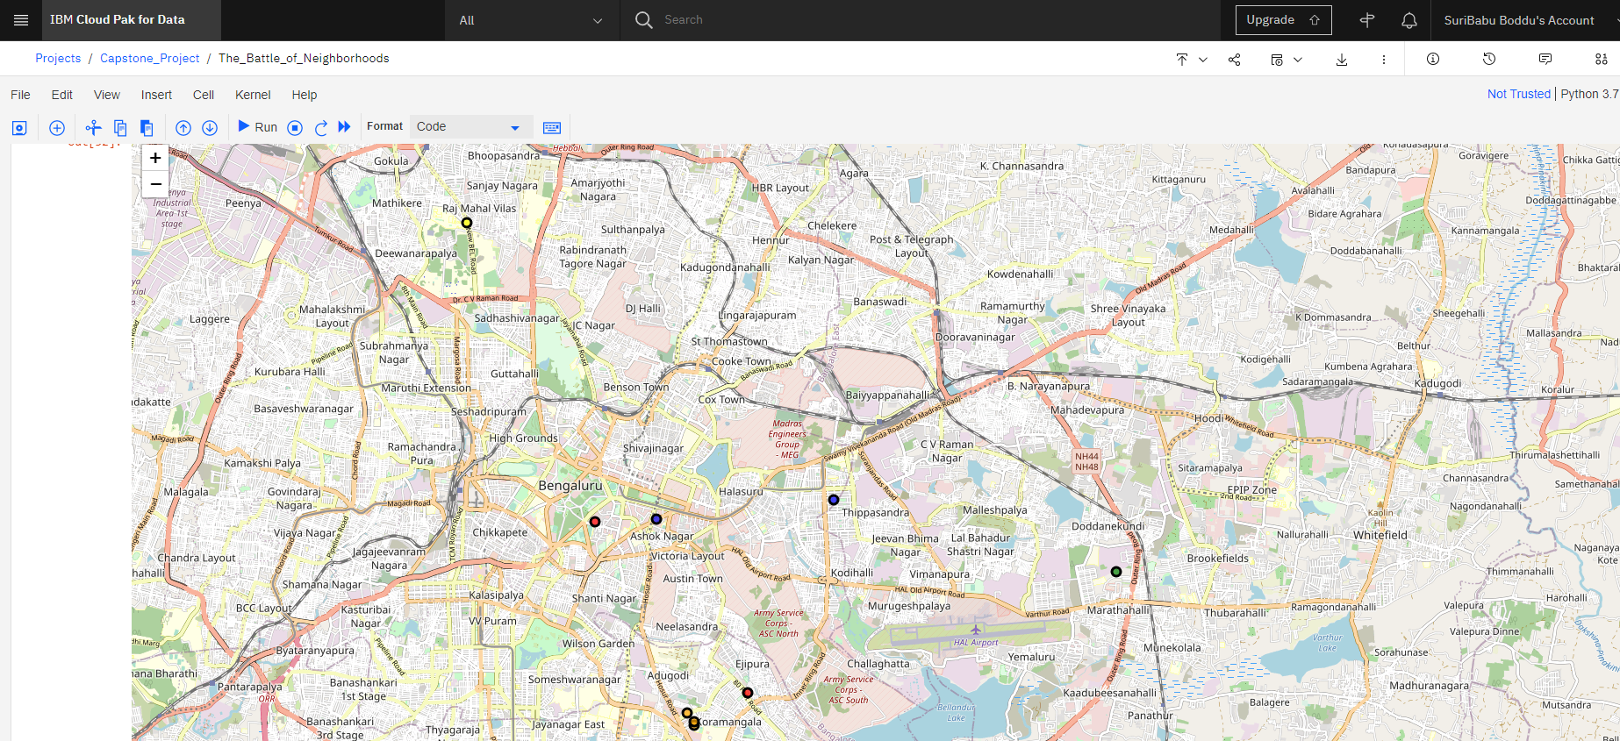

Slide 12
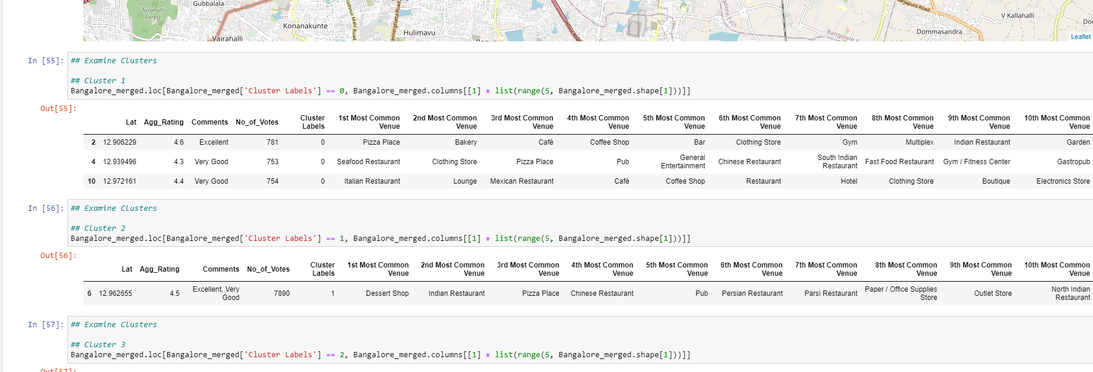

Slide 13
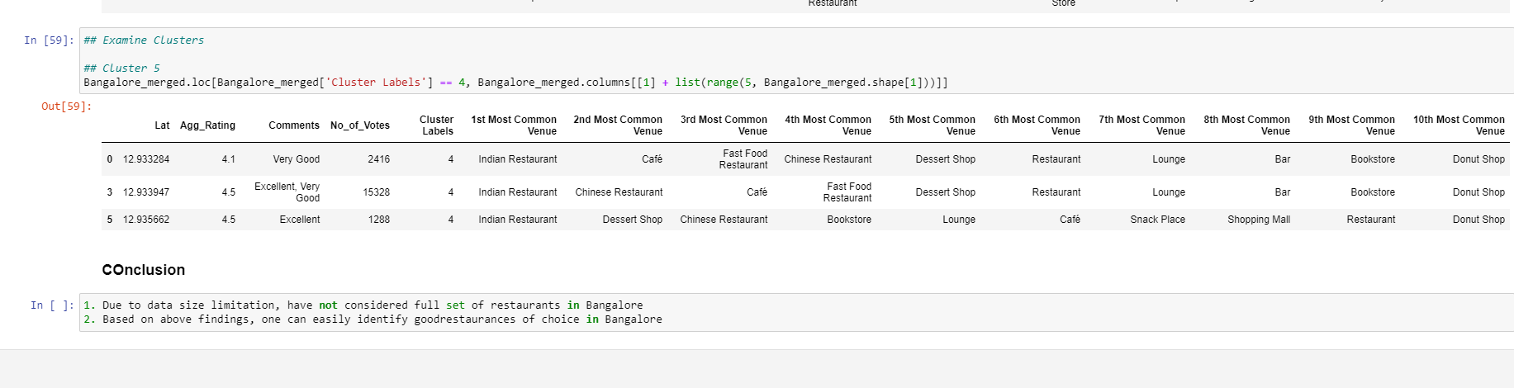

Slide 14
Conclusion
Locations listed of the best neighborhoods for Chinese cuisine.
have the best Chinese Restaurant.
There are the best places for edible person.
have best rated restaurants in Bangalore.

