Slide 1
Tortoise Git Installation Guide

Slide 2
Step 1 :
Open browser and type the link given below in address bar
https://tortoisegit.org/download/

Slide 3
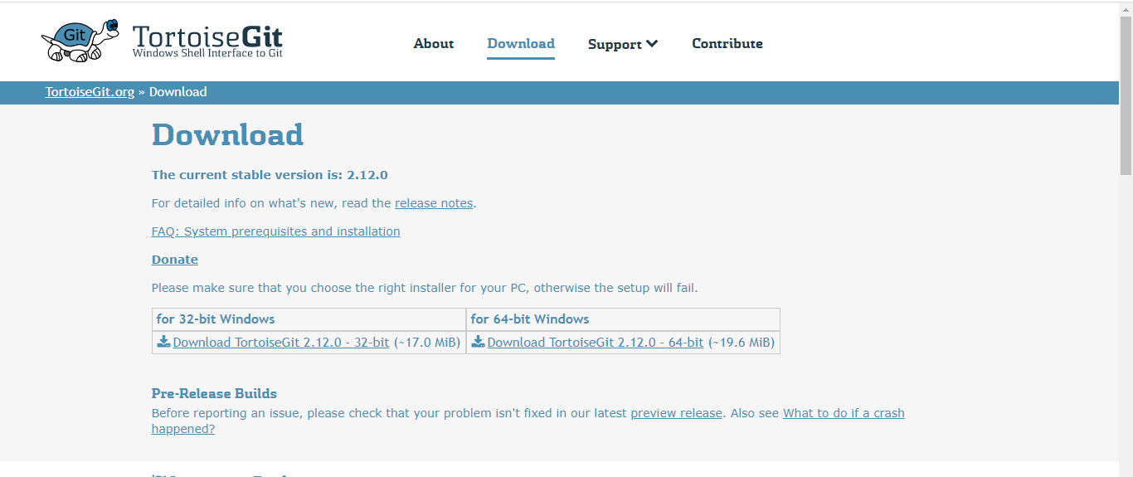
Step 2 :
Select the suitable 32-bit or 64-bit architecture accordingly and click on it.

Slide 4
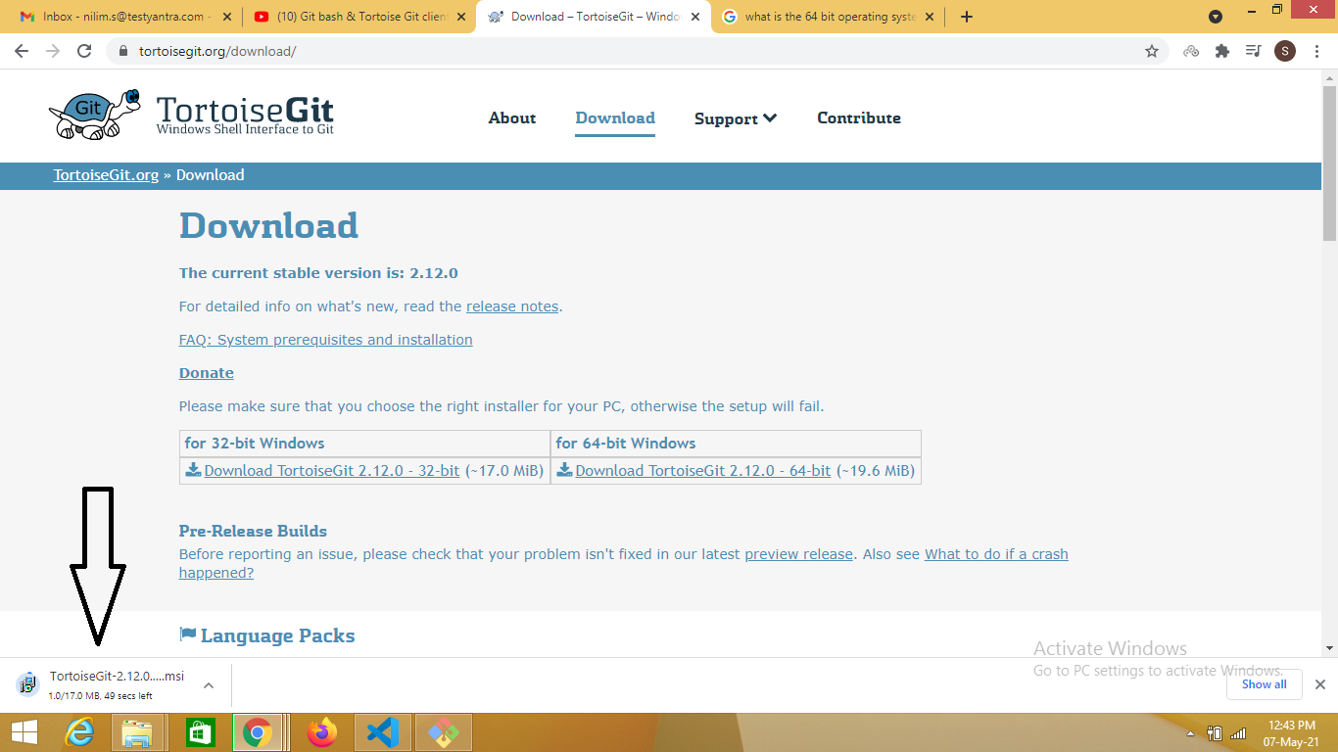
Step 3 :
After selecting suitable OS architecture , downloading will start

Slide 5
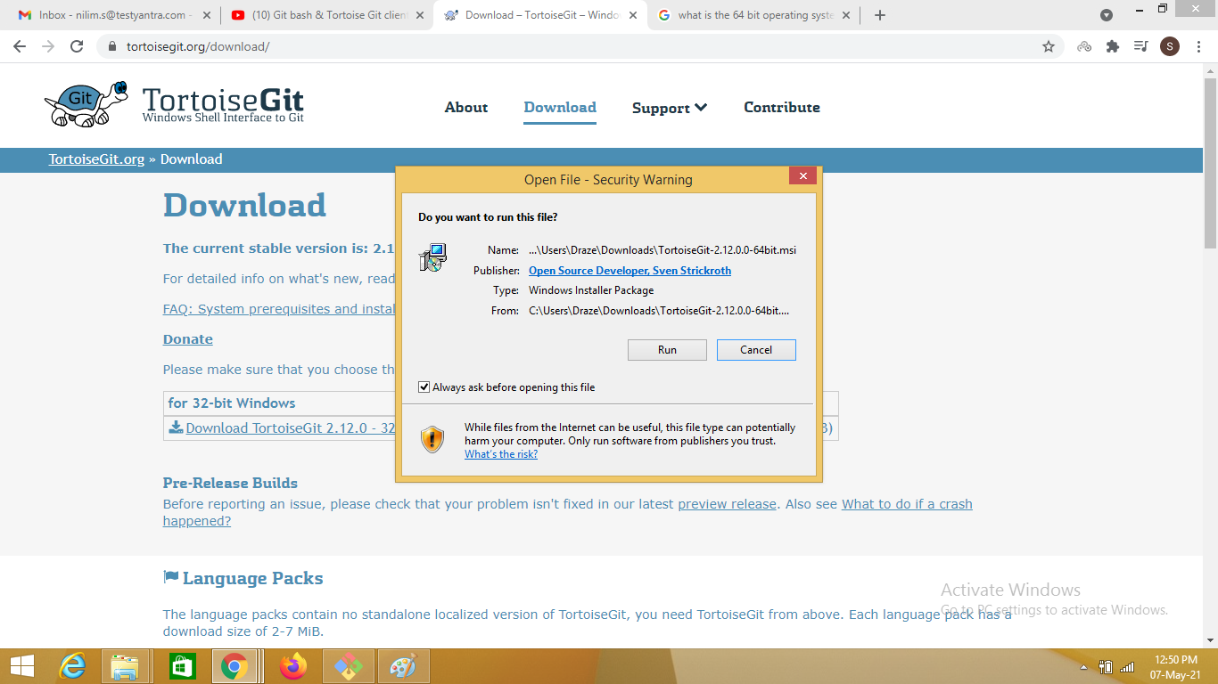
Step 4 :
Once downloaded, click on the setup file and click on run

Slide 6
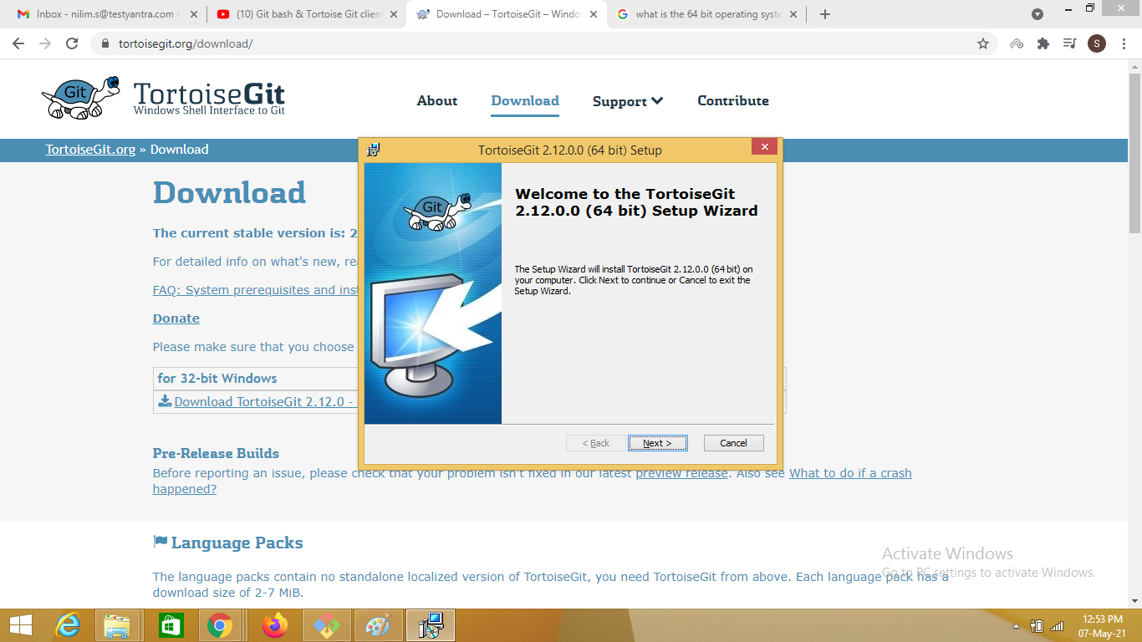
Step 5 :
After clicking on run , continue to click on the next till installation starts

Slide 7
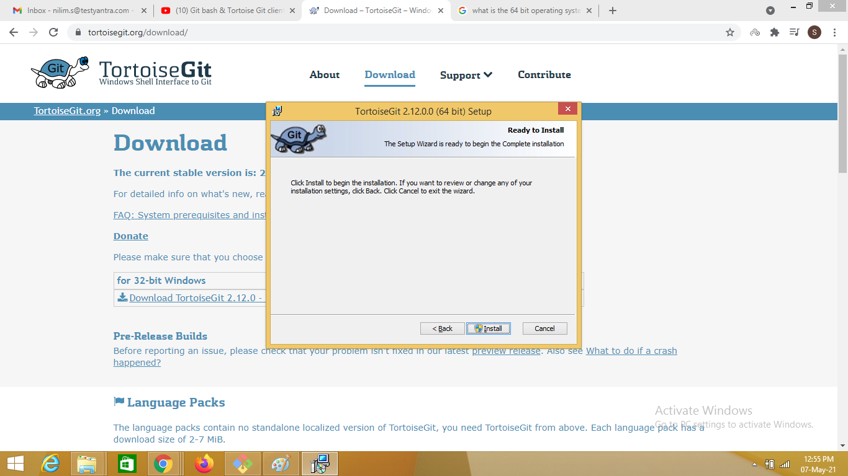
Step 6 :
After clicking on next for all the windows, click on install and start the installation.

Slide 8
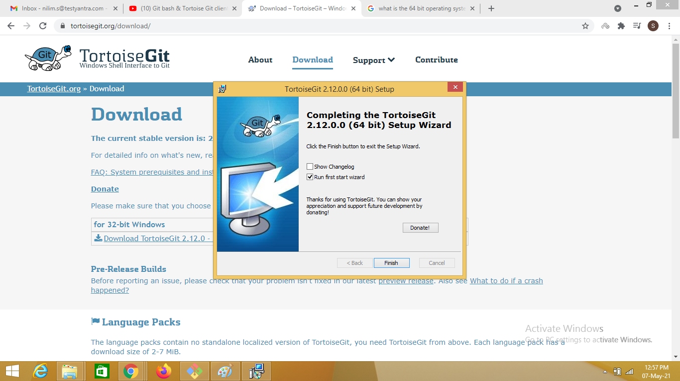
Step 7 :
Once installation is complete, click on finish

