Slide 1
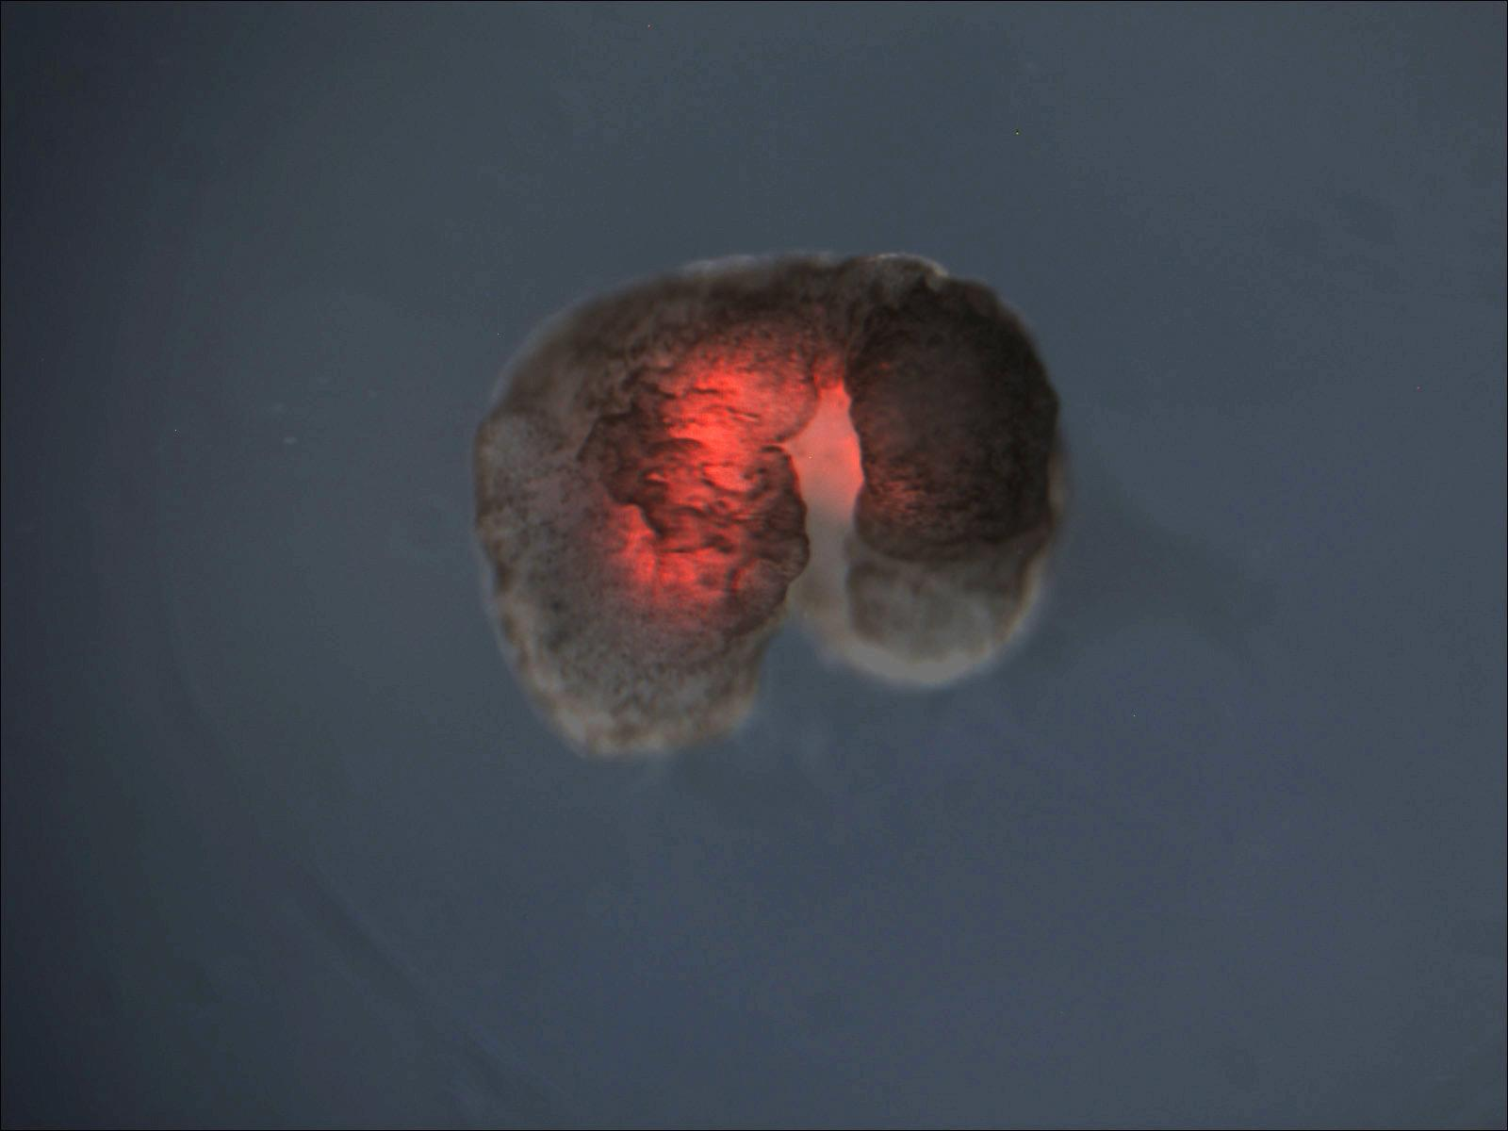
XENOBOTS: AI-DESIGNED LIVING MACHINES
Where Computer Science Meets Biology
Surya Gona
Group: Cool

Slide 2
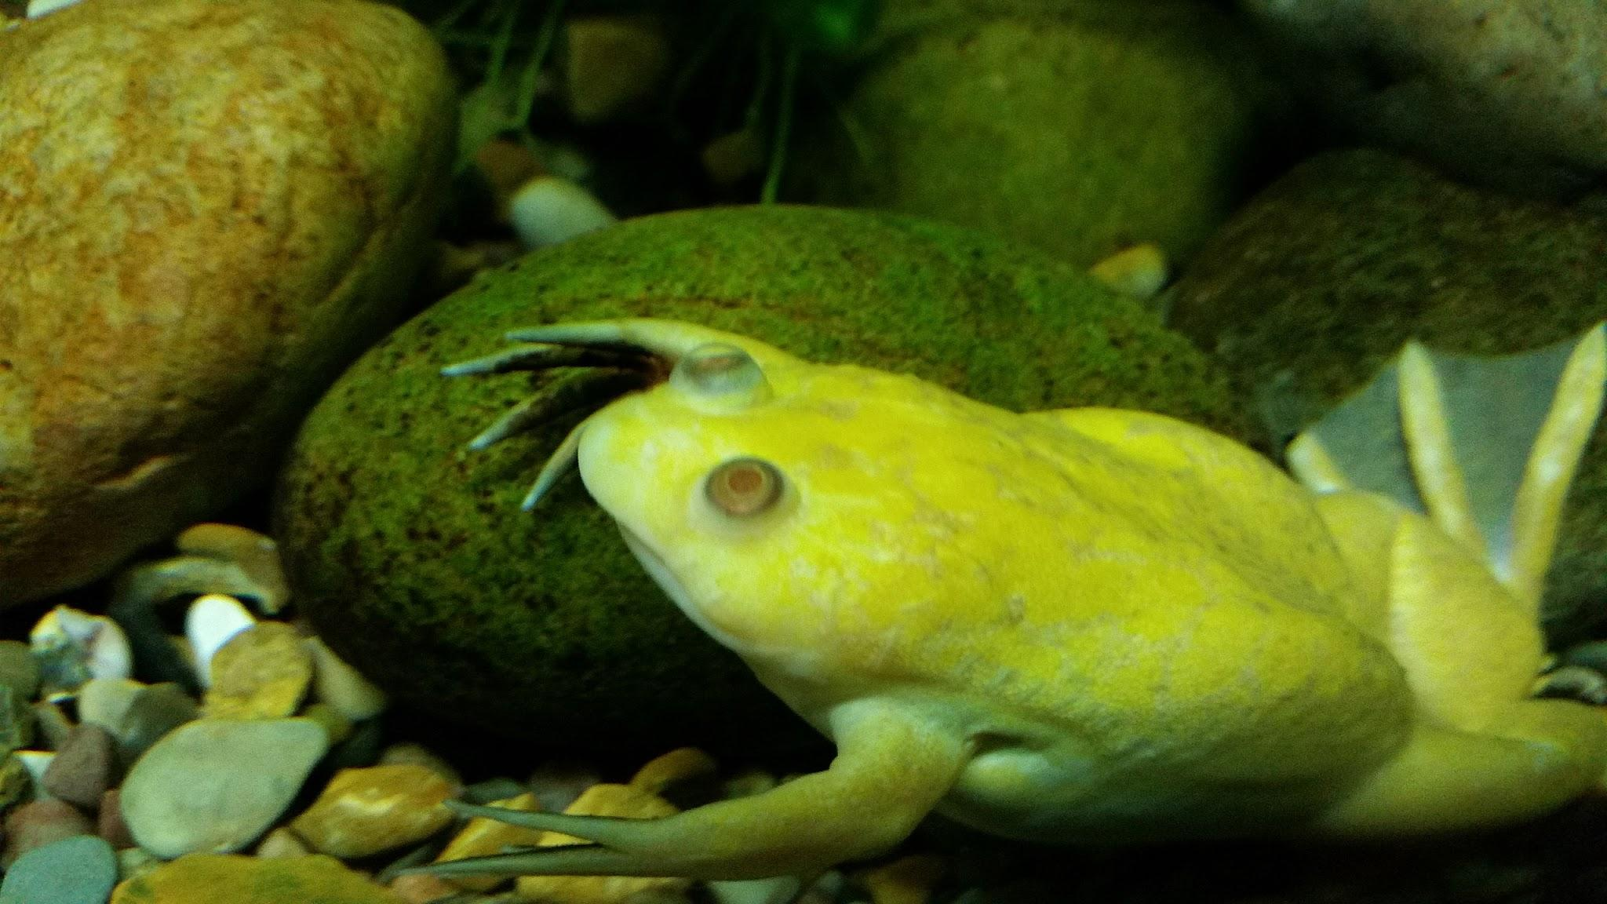
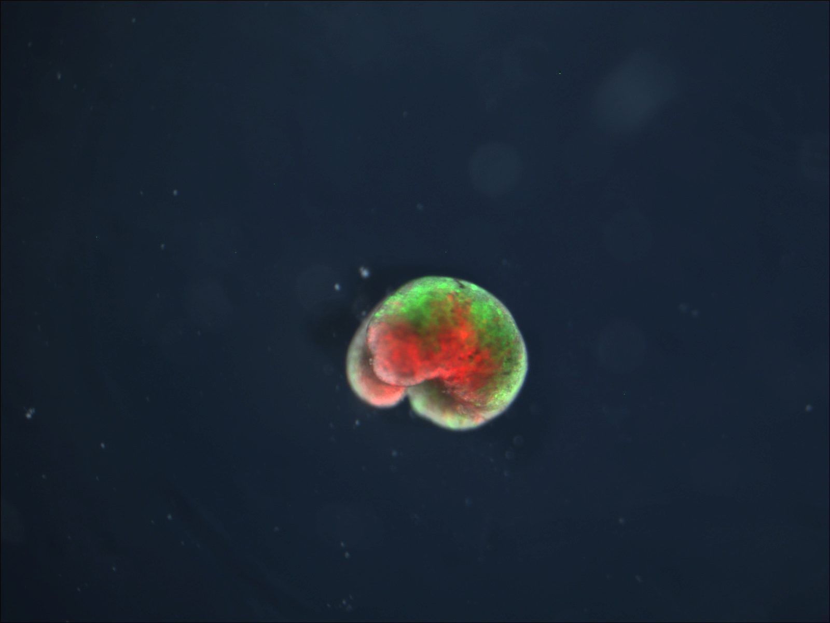
Definition:
What are Xenobots? The world’s first living robots built entirely from frog
Cells (Xenopus laevis) and designed using artificial
intelligence.
Why Are They Revolutionary? Xenobots are not traditional robots or natural organisms. They’re a new class of programmable biological machines blurring the line between life and machinery.
Key Innovations:
AI-Driven Design: Evolutionary algorithms simulate thousands of configurations to evolve optimal shapes and behaviors.
Fully Biological: Constructed from living skin and heart cells no metal or electronics.
Self-Healing & Biodegradable: They regenerate after injury and degrade harmlessly within a week.
Swarm Behavior: Later studies show they can work together to perform tasks like pushing debris.

Slide 3
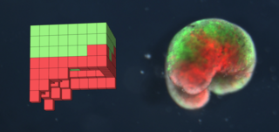
Key Research Findings
Kriegman et al. (2020) – Groundbreaking Study (PNAS)
Locomotion: Xenobots moved via ciliary "paddling" (skin cells) or muscle contractions (heart cells).
Object Manipulation: Some designs could push pellets to a central location—useful for future cleanup tasks.
Self-Repair: When sliced, Xenobots healed and continued functioning, a trait absent in traditional robots.
Blackiston et al. (2021) – Advanced Capabilities (Science Robotics)
Swarm Intelligence: Groups of Xenobots exhibited collective behaviors, like forming temporary structures to transport objects.
Maze Navigation: Demonstrated problem-solving by adapting paths in complex environments.
Scalability: Researchers developed a high-throughput method to create hundreds of Xenobots simultaneously.

Slide 4
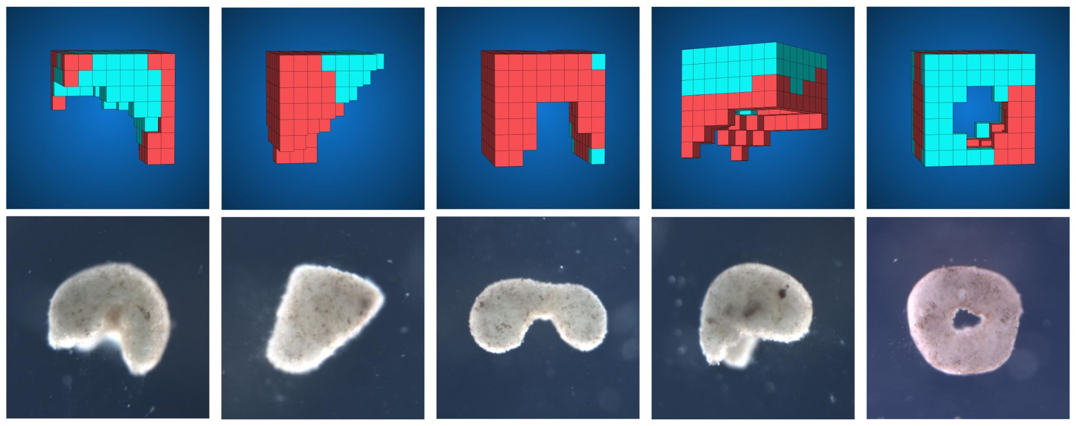
Applications & Ethics
Medicine:
Targeted Drug Delivery: PNAS study noted Xenobots could potentially carry payloads (e.g., drugs) to specific body areas.
Surgical Assistance: Their small size (0.1–1 mm) and biodegradability make them ideal for microsurgery.
Environment:
Microplastic Cleanup: Science Robotics highlighted their ability to aggregate particles, suggesting use in pollution removal.
Toxin Degradation: Early experiments show promise in breaking down organic pollutants.
Ethical Risks (From Peer Discussions in Papers):
Unintended Evolution: Could mutations or environmental interactions lead
to undesired behaviors?
Biosecurity: Potential dual-use risks (e.g., weaponization) require strict oversight.
Regulation Gap: No existing legal framework covers self-replicating, AI-designed
lifeforms.

Slide 5
What’s Next for Xenobots?
Timeline (Based on Researcher Projections):
2024–2026: Testing in controlled environments (e.g., lab-based medical trials).
2027–2029: Integration of neural cells for basic learning (Science Robotics proposed this as a next step).
2030+: Deployment in open ecosystems (e.g., ocean microplastic cleanup).
Key Quote from Researchers:
"Xenobots are neither traditional robots nor known species. They are a new class of artifact: a living, programmable organism." —Kriegman et al., PNAS (2020).

Slide 6
Conclusion
Key Takeaways:
Life as a Programmable Material: AI can now design biological systems with specific functions.
Transformative Potential: From medicine to ecology, Xenobots offer solutions impossible with current technology.
Urgent Need for Ethics: As noted in both studies, societal dialogue must guide development.
Expanded Citations:
Kriegman et al. (2020) – PNAS:
Details on AI design process, self-repair experiments, and locomotion mechanics.
Link: https://www.pnas.org/doi/10.1073/pnas.1910837117
Blackiston et al. (2021) – Science Robotics:
Covers swarm behaviors, scalability, and future neuron integration.
Link: https://www.science.org/doi/10.1126/scirobotics.abf1571

