Slide 1

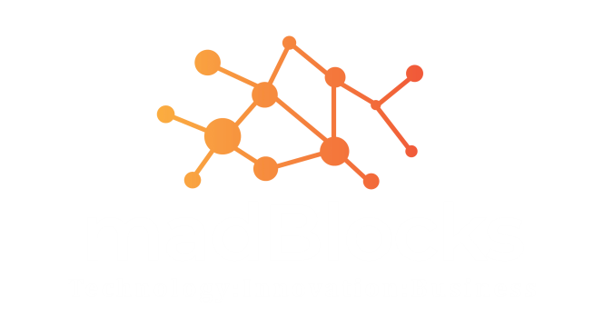
IoT in Healthcare
120 Minutes Talk
Madhu Parvathaneni,
Director & Strategist
Madblocks Technologies Pvt Ltd
https://www.madblocks.tech, mad@madblocks.tech

Slide 2
Session by
Madhu Parvathaneni
Director & Strategy
Madblocks Technologies Pvt Ltd
0-7893015625
mad@madblocks.tech
F/I/T: talktomadblocks
Youtube: MadblocksTechnologies

Slide 3
Today’s Agenda
01
Machine Learning - KNN
2.30PM – 3.00PM
02
KNN Implementation
3.00-3.30PM
03
Flask Framework
3.30PM – 4.00PM

Slide 4
Session – 1:
Machine Learning

Slide 5


Machine Learning
“Learning is any process by which a system improves performance from experience.”
- Herbert Simon
Definition by Tom Mitchell (1998):
Machine Learning is the study of algorithms that
improve their performance P
at some task T
with experience E.
A well-defined learning task is given by <P, T, E>.

Slide 6
Traditional Programming
Data Program
Computer
Output
Machine Learning
Data Output
Computer
Program

Slide 7
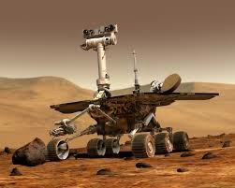
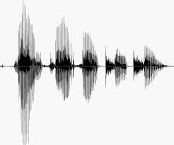
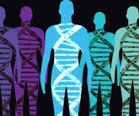
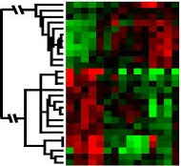
When Do We Use Machine Learning?
ML is used when:
Human expertise does not exist (navigating on Mars)
Humans can’t explain their expertise (speech recognition)
Models must be customized (personalized medicine)
Models are based on huge amounts of data (genomics)

Slide 8
Some more examples of tasks that are best solved by using a learning algorithm
Recognizing patterns:
Facial identities or facial expressions
Handwritten or spoken words
Medical images
Generating patterns:
Generating images or motion sequences
Recognizing anomalies:
Unusual credit card transactions
Unusual patterns of sensor readings in a nuclear power plant
Prediction:
Future stock prices or currency exchange rates

Slide 9
Sample Applications
Web search
Computational biology
Finance
E-commerce
Space exploration
Robotics
Information extraction
Social networks
Debugging software
Healthcare

Slide 10
Defining the Learning Task
Improve on task T, with respect to performance metric P, based on experience E
T: Playing checkers
P: Percentage of games won against an arbitrary opponent
E: Playing practice games against itself
T: Recognizing hand-written words
P: Percentage of words correctly classified
E: Database of human-labeled images of handwritten words
T: Driving on four-lane highways using vision sensors
P: Average distance traveled before a human-judged error
E: A sequence of images and steering commands recorded while observing a human driver.
T: Categorize email messages as spam or legitimate.
P: Percentage of email messages correctly classified.
E: Database of emails, some with human-given labels

Slide 11
Types of Learning
23

Slide 12
Types of Learning
Supervised (inductive) learning
Given: training data + desired outputs (labels)
Unsupervised learning
Given: training data (without desired outputs)
Semi-supervised learning
Given: training data + a few desired outputs
Reinforcement learning
Rewards from sequence of actions

Slide 13



Supervised Learning: Regression
Given (x₁, y₁), (x₂, y₂), ..., (x_{n}, y_{n})
Learn a function f(x) to predict y given x
– y is real-valued == regression
9
8
7
6
5
4
3
2
1
0
1970 1980
September Arctic Sea Ice Extent (1,000,000 sq km)
1990 2000
2010
2020
Year

Slide 14










Supervised Learning: Classification
Given (x₁, y₁), (x₂, y₂), ..., (x_{n}, y_{n})
Learn a function f(x) to predict y given x
– y is categorical == classification
Breast Cancer (Malignant / Benign)
1(Malignant)
0(Benign)
Tumor Size

Slide 15

















Unsupervised Learning
Given x₁, x₂, ..., x_{n} (without labels)
Output hidden structure behind the x’s
– E.g., clustering
31

Slide 16

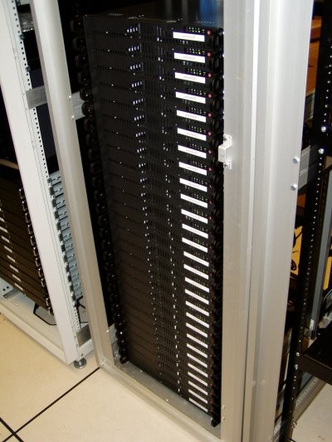
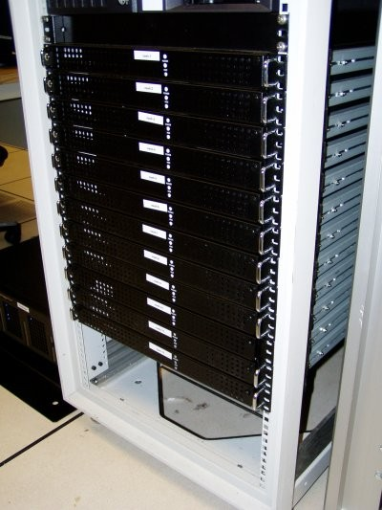




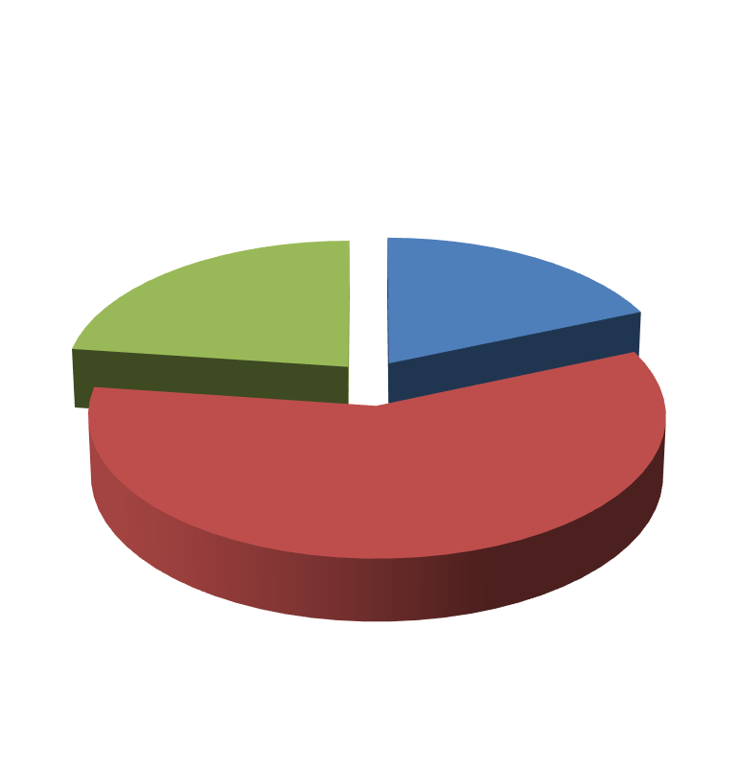

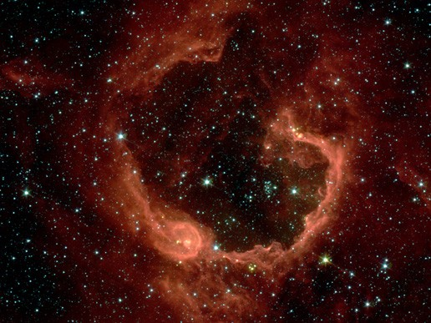


Unsupervised Learning
Organize computing clusters
Social network analysis
Market segmentation
Image credit: NASA/JPL-Caltech/E. Churchwell (Univ. of Wisconsin, Madison)
Astronomical data analysis

Slide 17
Reinforcement Learning
Given a sequence of states and actions with (delayed) rewards, output a policy
Policy is a mapping from states → actions that tells you what to do in a given state
Examples:
Credit assignment problem
Game playing
Robot in a maze
Balance a pole on your hand
36

Slide 18
Framing a Learning Problem
40

Slide 19



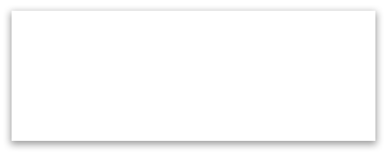


Designing a Learning System
Choose the training experience
Choose exactly what is to be learned
– i.e. the target function
Choose how to represent the target function
Choose a learning algorithm to infer the target function from the experience
Training data
Learner
Environment/ Experience
Knowledge
Testing data
Performance Element

Slide 20
ML in a Nutshell
Tens of thousands of machine learning algorithms
Hundreds new every year
Every ML algorithm has three components:
Representation
Optimization
Evaluation

Slide 21
Various Function Representations
Numerical functions
Linear regression
Neural networks
Support vector machines
Symbolic functions
Decision trees
Rules in propositional logic
Rules in first-order predicate logic
Instance-based functions
Nearest-neighbor
Case-based
Probabilistic Graphical Models
Naïve Bayes
Bayesian networks
Hidden-Markov Models (HMMs)
Probabilistic Context Free Grammars (PCFGs)
Markov networks

Slide 22
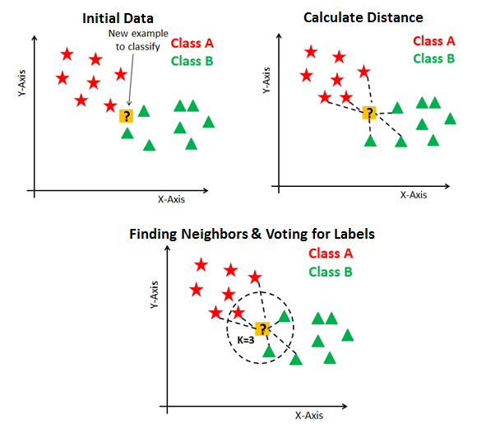
KNN

Slide 23
Implementation of KNN
1. Load the data
2. Initialise the value of k
3. For getting the predicted class, iterate from 1 to total number of training data points
Calculate the distance between test data and each row of training data. Here we will use Euclidean distance as our distance metric since it’s the most popular method. The other metrics that can be used are Chebyshev, cosine, etc.
Sort the calculated distances in ascending order based on distance values
Get top k rows from the sorted array
Get the most frequent class of these rows
Return the predicted class

Slide 24
Questions??
Every engineer has a tendency to tinker on a problem, lets answer few of them.

Slide 25
Thank You
Happy to host you today.

