Slide 1
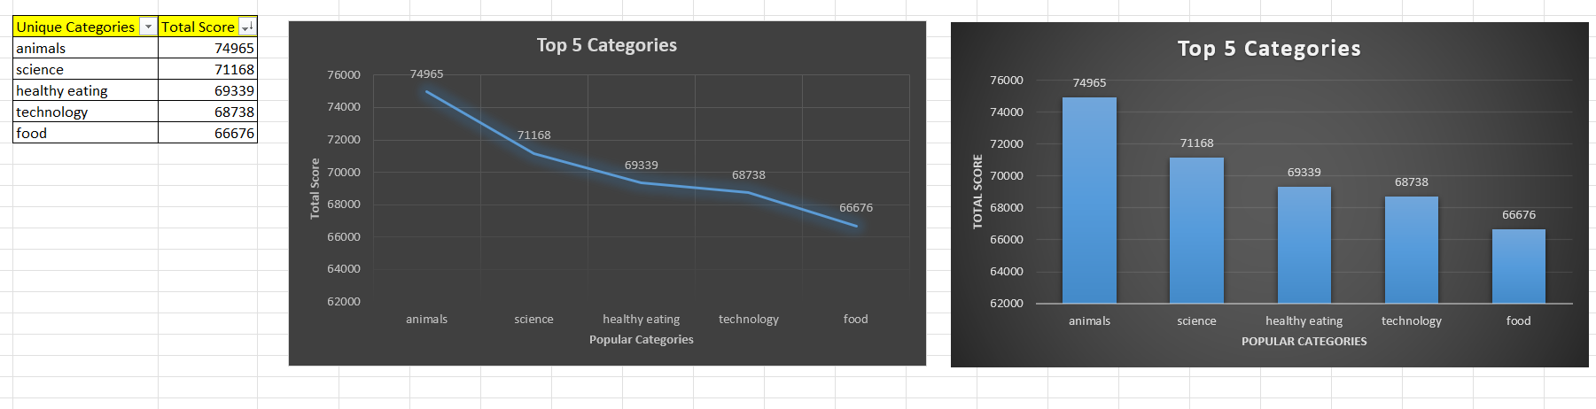
Top 5 Content Categories

Slide 2
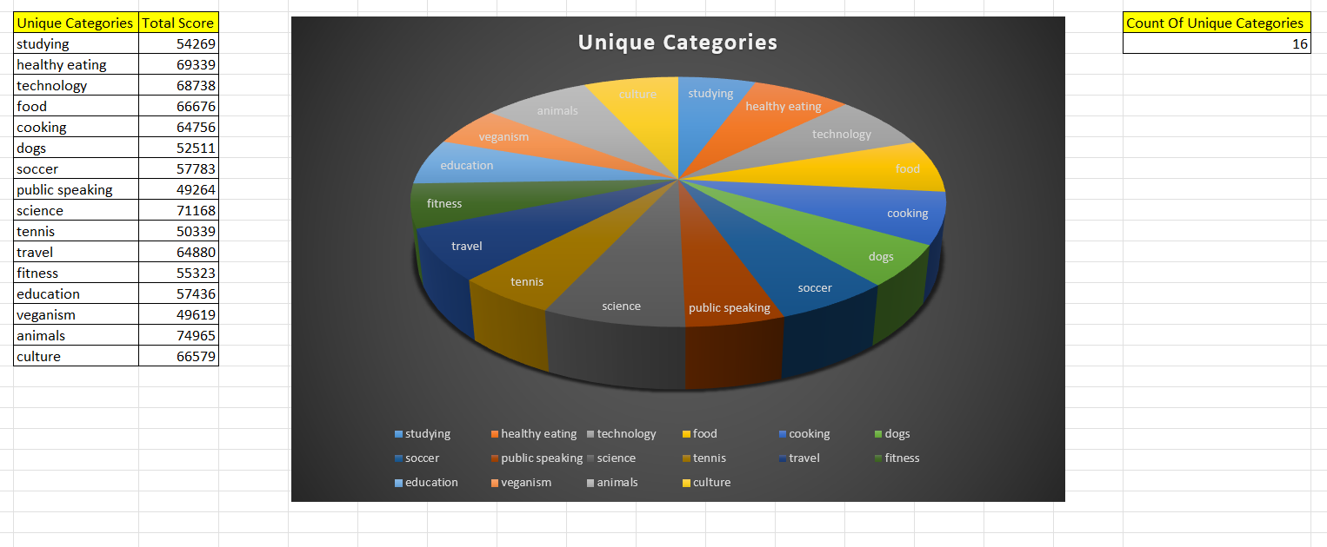
Unique Categories

Slide 3
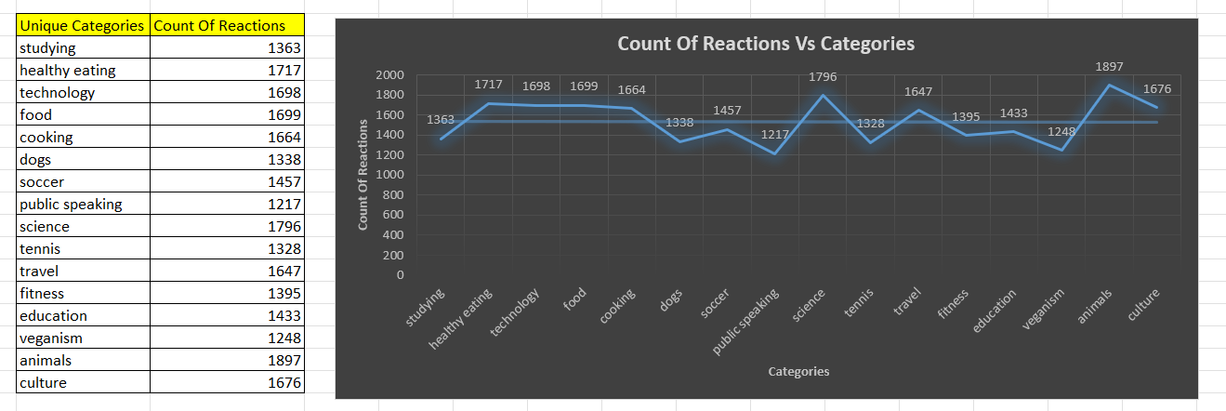
Reactions Vs Categories

Slide 4
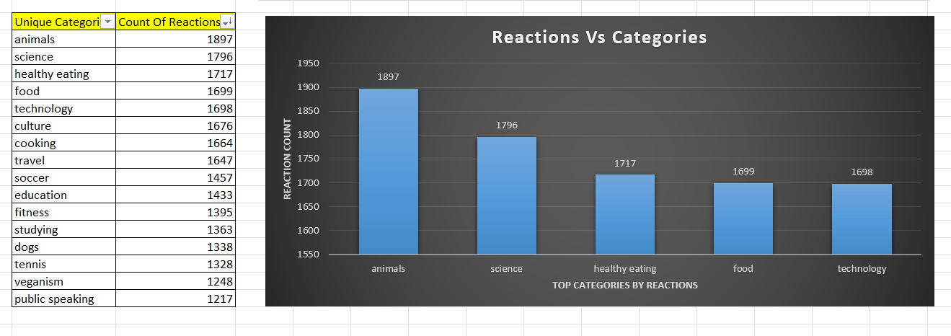
Popular Categories By Reaction Count

Slide 5
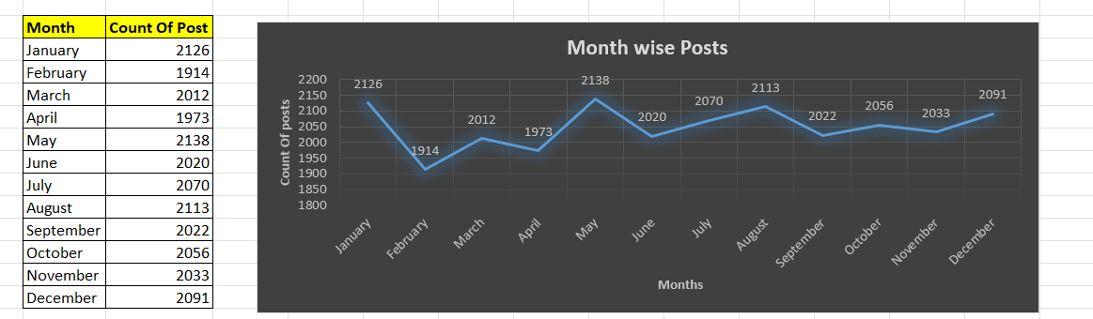
Month Wise Posts

Slide 6
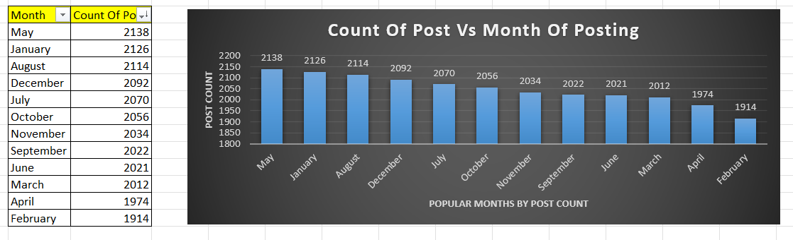
Posts wise Popular Months

