Slide 1







Scala
© 2024 StackRoute – Confidential

Slide 2

Agenda
Introduction of Scala
Features and advantages of Scala
Comparison with other programming languages
Syntax and structure of Scala Programs
Variables & Data types
Functions & Methods
Control Structures
© 2024 StackRoute – Confidential

Slide 3
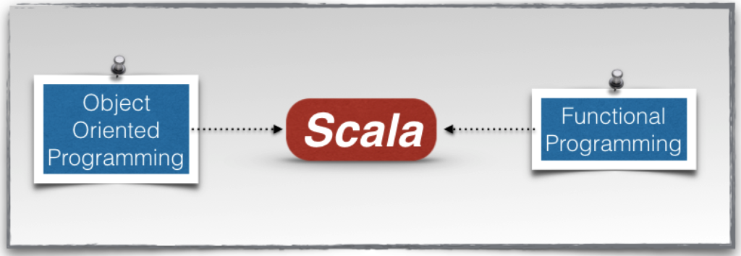

Introduction of Scala
Scala is both a Functional programming and Object Oriented programming language that runs on the JVM!
Who created it?
It was designed by Martin Odersky and the language runs on the Java Virtual Machine (JVM).
© 2024 StackRoute – Confidential

Slide 4
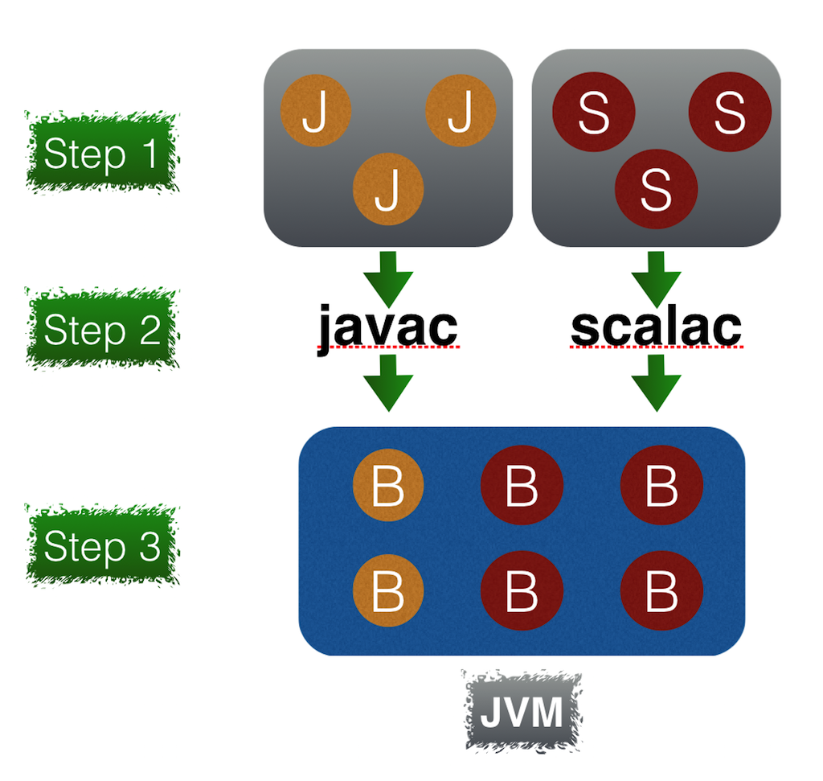
Introduction of Scala
Why do you need the JDK for writing Scala applications?
© 2024 StackRoute – Confidential

Slide 5
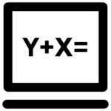





Features of Scala
Functional Programming
Composing functions
Higher Order functions
Pattern Matching
Asynchronous and parallel programming
Dependency Injection
Extensible language
© 2024 StackRoute – Confidential

Slide 6
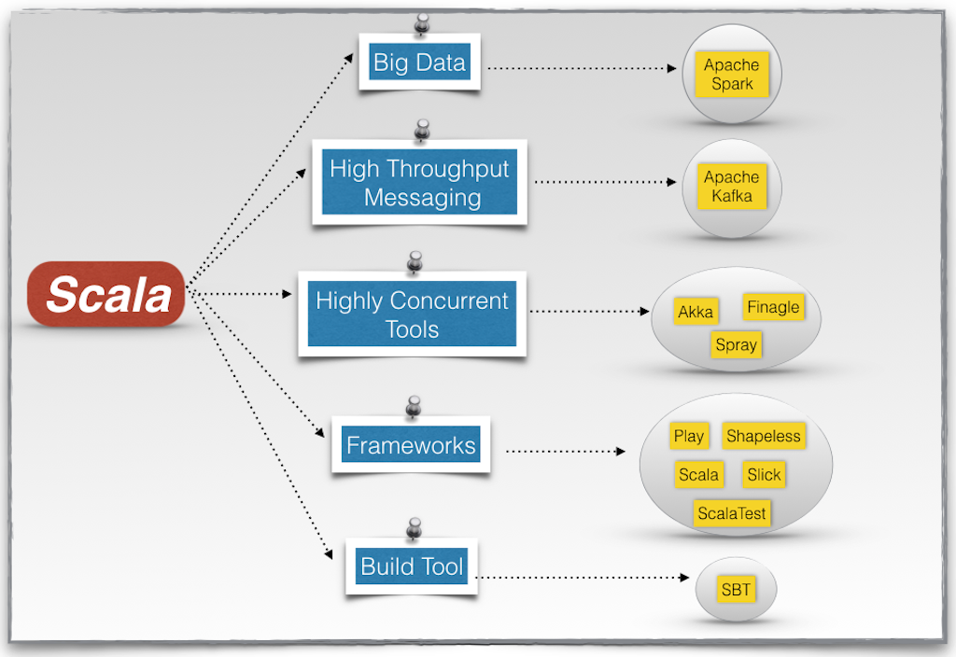
Scala Ecosystem
© 2024 StackRoute – Confidential

Slide 7
COMPARISON
© 2024 StackRoute – Confidential

Slide 8

Syntax and structure of Scala Programs
// Package declaration (optional)
package com.example.helloworld
// Import statements (if any)
import scala.io.StdIn.readLine
// Object definition
object HelloWorld {
// Main method - Entry point of the program
def main(args: Array[String]): Unit = {
// Print a message to the console
println("Hello, World!")
}
}
© 2024 StackRoute – Confidential

Slide 9
Syntax and structure of Scala Programs
Package Declaration
package com.example.helloworld
Defines the package for the file. It’s optional but helps in organizing code.
Import Statements
import scala.io.StdIn.readLine
Used to import other classes and objects. This example imports readLine from Scala’s standard library.
Object Definition
object HelloWorld
Defines a singleton object named HelloWorld. In Scala, an object is a class with a single instance.
Main Method
def main(args: Array[String]): Unit
The main method is the entry point of a Scala application. It takes an array of strings as arguments.
Printing to Console
println("Hello, World!")
The println function prints the given string to the console.
© 2024 StackRoute – Confidential

Slide 10

Variables & Datatypes
In Scala, data types can be broadly categorized into two types: primitive types and complex types.
Primitive Data Types
Scala's primitive data types correspond closely to those in Java, as Scala runs on the JVM. Here are the primary primitive data types in Scala:
Boolean: Represents a boolean value.
Example: true or false
Syntax: val isActive: Boolean = true
Byte: Represents an 8-bit signed integer.
Range: -128 to 127
Syntax: val byteValue: Byte = 10
Short: Represents a 16-bit signed integer.
Range: -32,768 to 32,767
Syntax: val shortValue: Short = 1000
Int: Represents a 32-bit signed integer.
Range: -2^31 to 2^31-1
Syntax: val intValue: Int = 100000
© 2024 StackRoute – Confidential

Slide 11
Variables & Datatypes
Long: Represents a 64-bit signed integer.
Range: -2^63 to 2^63-1
Syntax: val longValue: Long = 10000000000L
Float: Represents a 32-bit IEEE 754 floating-point number.
Syntax: val floatValue: Float = 10.5f
Double: Represents a 64-bit IEEE 754 floating-point number.
Syntax: val doubleValue: Double = 10.5
Char: Represents a 16-bit Unicode character.
Syntax: val charValue: Char = ‘A’
String: Represents a sequence of characters.
Note: While String is technically an object, it is often treated as a primitive type due to its prevalence.
Syntax: val stringValue: String = "Hello, Scala"
© 2024 StackRoute – Confidential

Slide 12
Variables & Datatypes
Complex Data Types
These types are more complex structures, often created by combining primitive types or other complex types:
Unit: Represents the absence of a value (similar to void in Java).
Syntax: val unitValue: Unit = ()
Null: A type with a single value, null. It is the type of the null literal.
Used for reference types.
Syntax: val nullValue: String = null
Nothing: A subtype of every other type (including Null). It is used to indicate abnormal termination.
Typically used for methods that always throw an exception.
def crash(): Nothing = throw new RuntimeException("Crash!")
© 2024 StackRoute – Confidential

Slide 13
Variables & Datatypes
Any: The root of the Scala type hierarchy. Every type in Scala inherits from Any.
Divided into two subclasses: AnyVal (value types) and AnyRef (reference types).
AnyVal: The base class for all value types, including primitive types.
Examples include Int, Double, Boolean, etc.
AnyRef: The base class for all reference types.
Equivalent to java.lang.Object.
All user-defined classes and most of the built-in non-primitive types are subclasses of AnyRef.
© 2024 StackRoute – Confidential

Slide 14
Variables & Datatypes
object DataTypesExample {
def main(args: Array[String]): Unit = {
// Primitive data types
val booleanValue: Boolean = true
val byteValue: Byte = 10
val shortValue: Short = 1000
val intValue: Int = 100000
val longValue: Long = 10000000000L
val floatValue: Float = 10.5f
val doubleValue: Double = 10.5
val charValue: Char = 'A'
val stringValue: String = "Hello, Scala"
// Complex data types
val unitValue: Unit = ()
val nullValue: String = null
// Output the values
println(s"Boolean: $booleanValue")
println(s"Byte: $byteValue")
println(s"Short: $shortValue")
println(s"Int: $intValue")
println(s"Long: $longValue")
println(s"Float: $floatValue")
println(s"Double: $doubleValue")
println(s"Char: $charValue")
println(s"String: $stringValue")
println(s"Unit: $unitValue")
println(s"Null: $nullValue")
}
}
.
© 2024 StackRoute – Confidential

Slide 15
Variables & Datatypes
Variables are the named space in memory, and the compiler allocates reserved location according to the data type of the corresponding variable. The variable is declared with the following syntax in Scala as follows:
val or val variable_name: variable_datatype = value;
Mutable Variables
Mutable variables allow changing the values of variables even after the declaration of variables.
var variable_name : variable_datatype = value;
The syntax of Mutable variable can also be defined as follow:
var variable_name = value;
Examples:
var nameOfThing: String = "Car";
var nameOfThing = "Car";
© 2024 StackRoute – Confidential

Slide 16
Variables & Datatypes
Immutable Variables
Immutable variables are that variable which value cannot be changed once it is created and is declared using 'val' keyword.
val variable_name : variable_data type = value;
val variable_name = value;
Examples:
val numberOfThing: Int = 2;
val numberOfThing = 2;
You can define your variable without the data type of the variable as done above, where the Scala compiler automatically figures it to be an 'Int' data type. The process is called Type Inference
You cannot change the value of the variable as done below:
numberOfThing = 7;
© 2024 StackRoute – Confidential

Slide 17
Functions & Methods
Scala is a functional programming language where it contains both functions as first-class values and methods and has both similarities and dissimilarities. Both the functions and methods are a block of the reusable code also used to store the repeated code in one place, which makes a function call to performs a particular specific task. They also make code easier to debug and modify.
However, functions are an object which is initialized in a variable, but methods start with the 'def' keyword followed by the method name, parameter list, method body with the return value.
Method Declaration and Definition
def 'method_name' ('parameters':'return_type_parameters') : ('return_type_of_method') = {
'method_body'
return 'value'
}
© 2024 StackRoute – Confidential

Slide 18
Functions & Methods
The method in Scala starts with the following parts:
'def': keyword which is used to declare methods.
'method_name': is the name of your method, which is in lower camel case.
'parameters': is method parameters that may have no parameter or one parameter only but are separated by a comma when there is more than one parameter.
'return_type_of_parameters': need to match according to the data type of 'parameters_list' and is compulsory
'return_type_of_method': is optional, but in default, 'Unit' is returned, but the value can be returned with 'return' keyword.
Assignment Symbol('='): is optional, and if used will assign the return value and not using it will make the method not to return anything.
'method_body': is the block of code enclosed inside curly braces '{}' and consists of the required logic or certain task or operations.
return: is the keyword used to return the required values and also terminate the program but is rarely used in Scala.
© 2024 StackRoute – Confidential

Slide 19
Functions & Methods
A Method with Named Arguments
object calculateResult {
def funSub(x:Int, y:Int) : Int =
{
var diff:Int = 0
diff = x - y
// return value
return diff
}
def main(args: Array[String]) {
// Function call
println("Difference of the value is: " + funSub(8,6));
println("Difference of the value is " + funSub(y=6,x=8));
}
}
© 2024 StackRoute – Confidential

Slide 20
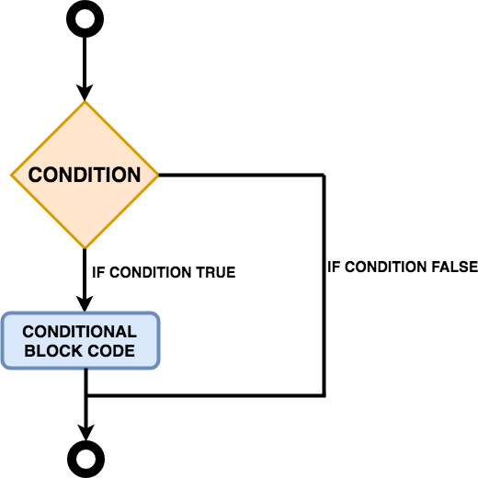
Control structures
IF ELSE in Scala
© 2024 StackRoute – Confidential

Slide 21
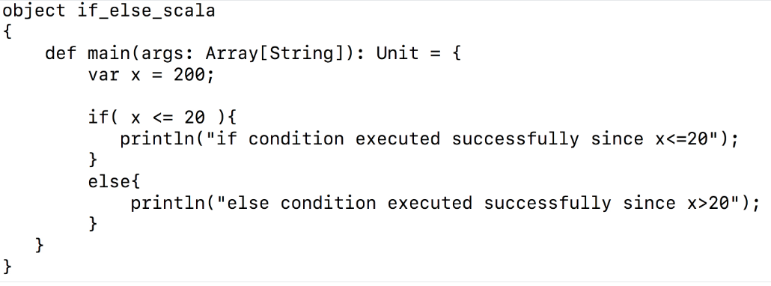
Control structures
IF ELSE in Scala
Using if clause as a statement
© 2024 StackRoute – Confidential

Slide 22
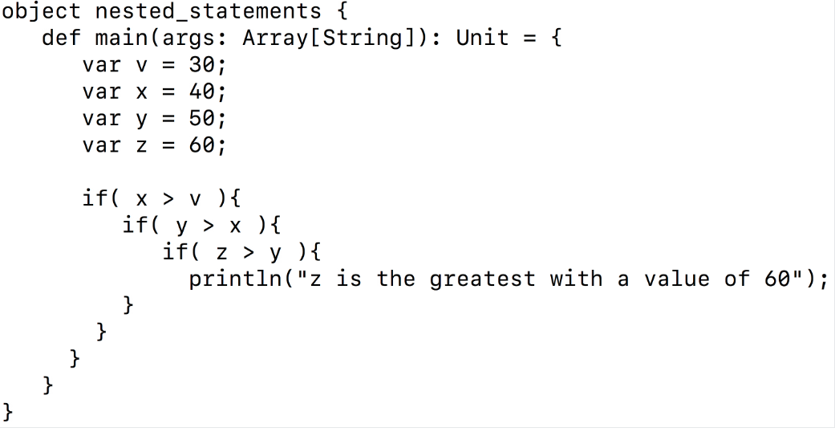
Control structures
© 2024 StackRoute – Confidential

Slide 23
Control structures
© 2024 StackRoute – Confidential

Slide 24
Thank you!
© 2024 StackRoute – Confidential

