Slide 1







Scala
© 2024 StackRoute – Confidential

Slide 2

Agenda
Introduction to pattern matching in Scala
Pattern matching with case classes and case objects
Introduction to functional data processing techniques
Transformations and actions on collections using functional programming
Working with Files and I/O
Reading and writing files in Scala
Introduction to Spark with Scala
© 2024 StackRoute – Confidential

Slide 3
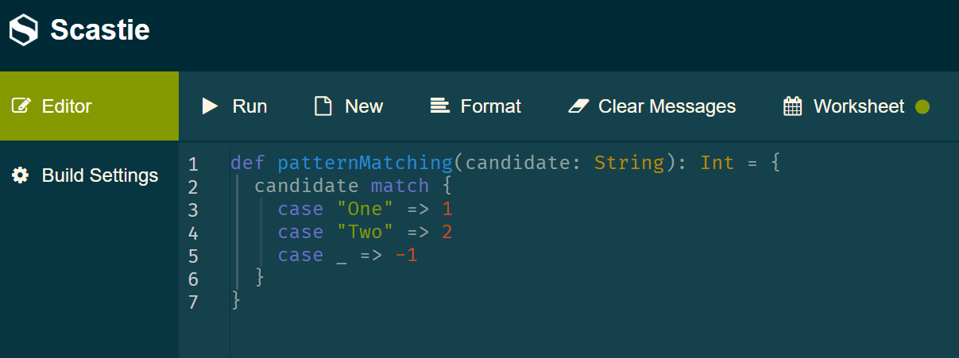

Introduction to pattern matching in Scala
Pattern matching is a powerful feature of the Scala language.
It allows for more concise and readable code while at the same time providing the ability to match elements against complex patterns.
In contrast with “exact matching” as we can have in Java’s switch statements,
pattern matching allows matching a pattern instead of an exact value.
© 2024 StackRoute – Confidential

Slide 4
Introduction to pattern matching in Scala
The match expressions consist of multiple parts:
The value we’ll use to match the patterns is called a candidate
The keyword match
Multiple case clauses consisting of the case keyword, the pattern, an arrow symbol, and the code to execute when the pattern matches
A default clause when no other pattern has matched. The default clause is recognizable because it consists of the underscore character (_) and is the last of the case clauses
© 2024 StackRoute – Confidential

Slide 5
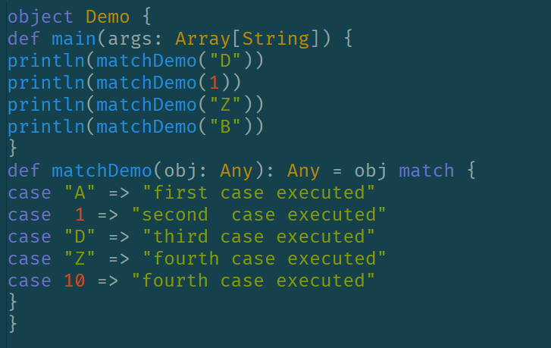
How does Pattern Matching work in Scala?
Pattern Matching in scala in the enhanced version of the switch statement in java. It matches a particular pattern against value passed. We must have at least one case inside the match.
© 2024 StackRoute – Confidential

Slide 6
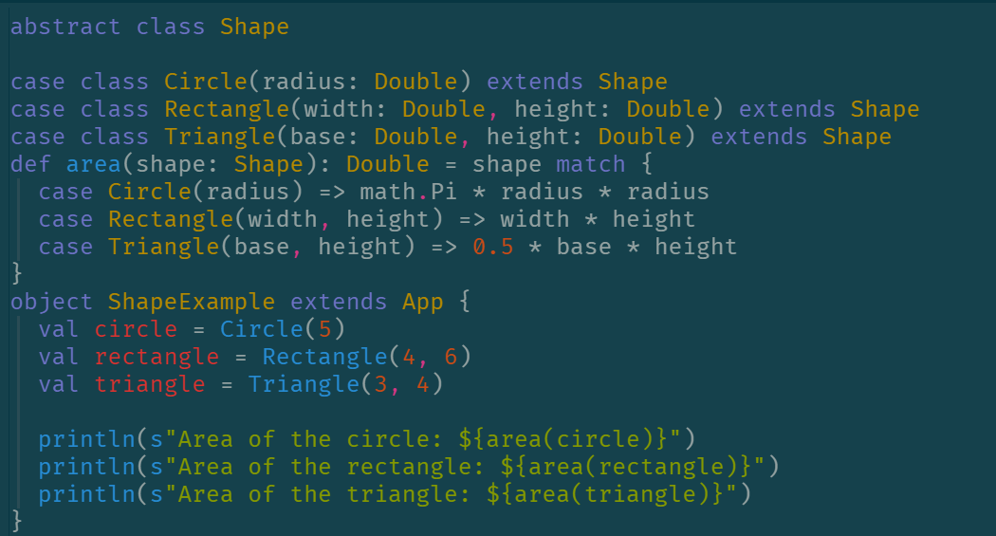
Pattern Matching
Case Classes
Case classes help us use the power of inheritance to perform pattern matching.
The case classes extend a common abstract class.
The match expression then evaluates a reference of the abstract class against each pattern expressed by each case class.
Question--- Why it is called constructor matching???
© 2024 StackRoute – Confidential

Slide 7
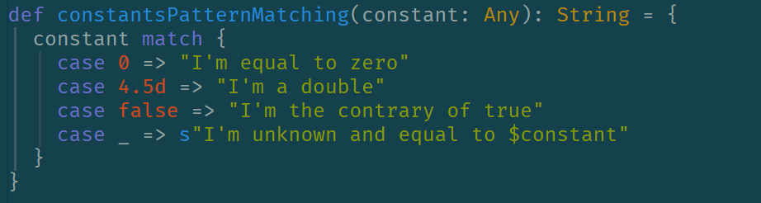
Constants
Scala uses constants to define numbers or boolean values. Patterns can consist of constants.
Practice:
Literal Values: Directly match against literal values like 0, 1, etc.
Named Constants: Match against constants defined in an object or a class.
Enums (Scala 3): Use enums for a more type-safe and concise way to handle related constants.
Case Objects: Use case objects for defining and matching ADTs.
© 2024 StackRoute – Confidential

Slide 8
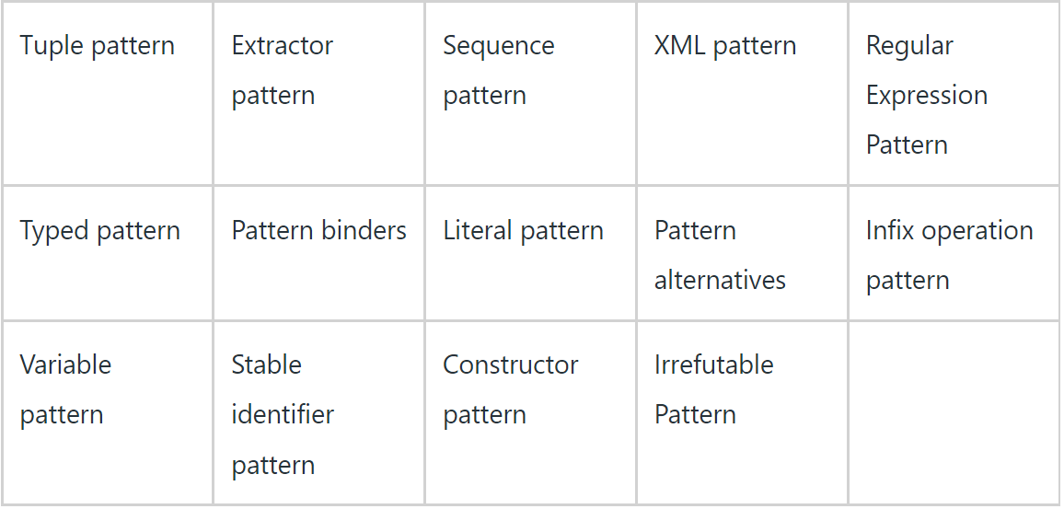

TYPES OF pattern matching
© 2024 StackRoute – Confidential

Slide 9
Introduction to functional data processing techniques
Functional programming is a programming paradigm that uses functions as the central building block of programs. In functional programming, we strive to use pure functions and immutable values.
Immutability means programming using constants, which means the value or state of variables can’t be changed. The same goes with objects: We can create a new object, but we cannot modify the existing object’s state. Thus, immutable objects are more thread-safe than mutable objects.
A pure function has two key properties:
It always returns the same value for the same inputs.
It has no side effects. A function with no side effects does nothing other than simply return a result.
Any function that interacts with the state of the program can cause side effects. The state of the program can be mutable objects, global variables, or I/O operations
Scala is a functional language in the sense that every function is a value. The fundamental concept of functional Scala is functions act as first-class citizens in Scala. There are various functional constructs that we can create in object-oriented programmings, like functions that take or return other functions and methods that are defined inside one another. But in functional programming, these occur naturally and arise quite often. In object-oriented programming, we somewhat rarely encounter these phenomena.
© 2024 StackRoute – Confidential

Slide 10

Transformations and actions on collections using functional programming
In Scala, functional programming with collections allows you to transform and process data using a series of powerful and expressive operations. Here are some of the most common transformations and actions you can perform on collections in Scala:
Transformations:
map: Applies a function to each element of the collection and returns a new collection with the results.
val numbers = List(1, 2, 3, 4)
val doubled = numbers.map(_ * 2)
// doubled: List[Int] = List(2, 4, 6, 8)
flatMap: Similar to map, but the function must return a collection, and the results are concatenated into a single collection.
val nestedNumbers = List(List(1, 2), List(3, 4))
val flat = nestedNumbers.flatMap(identity)
// flat: List[Int] = List(1, 2, 3, 4)
© 2024 StackRoute – Confidential

Slide 11
Transformations and actions on collections using functional programming
filter: Selects elements of the collection that satisfy a predicate.
val numbers = List(1, 2, 3, 4)
val evenNumbers = numbers.filter(_ % 2 == 0)
// evenNumbers: List[Int] = List(2, 4)
collect: Applies a partial function to each element of the collection, returning a new collection with the results for which the partial function is defined.
val mixed = List(1, "two", 3.0, "four")
val strings = mixed.collect { case s: String => s }
// strings: List[String] = List("two", "four")
groupBy: Groups the elements of the collection by a key produced by a function.
val words = List("Scala", "is", "fun", "and", "functional")
val grouped = words.groupBy(_.length)
// grouped: Map[Int, List[String]] = Map(2 -> List(is), 3 -> List(fun, and), 5 -> List(Scala), 10 -> List(functional))
© 2024 StackRoute – Confidential

Slide 12
Transformations and actions on collections using functional programming
Actions
foreach: Applies a function to each element of the collection. It is typically used for side effects.
val numbers = List(1, 2, 3, 4)
numbers.foreach(println)
// Prints: 1 2 3 4
reduce : Reduces the elements of the collection using a binary operator.
val numbers = List(1, 2, 3, 4)
val sum = numbers.reduce(_ + _)
// sum: Int = 10
fold : Like reduce, but with an initial value.
val numbers = List(1, 2, 3, 4)
val sum = numbers.fold(0)(_ + _)
// sum: Int = 10
© 2024 StackRoute – Confidential

Slide 13
Transformations and actions on collections using functional programming
find: Returns the first element that satisfies a predicate, wrapped in an Option.
val numbers = List(1, 2, 3, 4)
val firstEven = numbers.find(_ % 2 == 0)
// firstEven: Option[Int] = Some(2)
exists: Checks if there exists at least one element that satisfies a predicate.
val numbers = List(1, 2, 3, 4)
val hasEven = numbers.exists(_ % 2 == 0)
// hasEven: Boolean = true
forall: Checks if all elements satisfy a predicate.
val numbers = List(1, 2, 3, 4)
val allEven = numbers.forall(_ % 2 == 0)
// allEven: Boolean = false
© 2024 StackRoute – Confidential

Slide 14
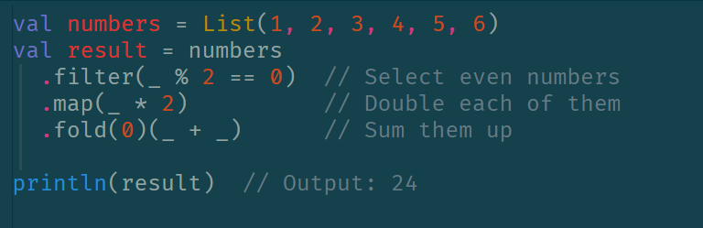
Transformations and actions on collections using functional programming
Combining Transformations and Actions
You can chain multiple transformations and actions together to process collections in a functional style. For example:
© 2024 StackRoute – Confidential

Slide 15
Transformations and actions on collections using functional programming
Transformations: Methods like map, flatMap, filter, collect, and groupBy that return new collections.
Actions: Methods like foreach, reduce, fold, find, exists, and forall that return a single value or perform side effects.
Chaining: Combine multiple operations for complex data processing in a concise and expressive way.
Exercise:
Let's consider a scenario where we have a list of student records, and we want to perform some transformations and actions on this list.
Scenario
We have a list of students, each represented as a case class. We want to:
Filter out students who have failed (score less than 60).
Extract their names and scores.
Calculate the average score of the students who passed.
Collect and print the names of the top 3 scorers.
© 2024 StackRoute – Confidential

Slide 16
Working with Files and I/O
Scala doesn’t have any native writing capability, so writing to a file exclusively involves using Java classes. Because Scala is interoperable with Java, this isn’t a problem for us, but there are some slight differences when calling Java code from Scala that will cause some issues when not handled properly.
FileWriter: The FileWriter is one of the cleanest ways to write to a file. It has a neat and concise syntax that allows us to write various data types, from characters to strings, into a file.
val fileWriter = new FileWriter(new File("/tmp/hello.txt"))
fileWriter.write("hello there")
fileWriter.close()
It’s crucial to close the FileWriter after we finish writing, as failure to do this will yield unstable results. In some cases, we may see a part of what was written, while in other cases, we may see nothing.Closing the FileWriter ensures that all the contents that were to be written are properly flushed and correctly written to the file.
© 2024 StackRoute – Confidential

Slide 17
Working with Files and I/O
PrintWriter
The PrintWriter is another clean way to write to a file. It also has a very neat and concise syntax, along with the added advantage of providing an API-like printf and format to help us write a formatted text that the FileWriter class doesn’t provide.
Let’s see how to use a PrintWriter to write formatted text:
val writer = new PrintWriter(new File("data.txt"))
val s = "big"
val numberOfLines = 3000000
writer.printf("This is a %s program with %d of code", s, new Integer(numberOfLines))
writer.close()
DataOutputStream
The DataOutputStream class helps us to write Java primitive data types efficiently.
Let’s imagine a scenario where we want to write a very long list of double values. A pretty naive approach is to use a regular FileWriter or a PrintWriter, which technically isn’t a bad idea. Let’s use PrintWriter to write 10,000 double values to a file:
© 2024 StackRoute – Confidential

Slide 18
Variables & Datatypes
Complex Data Types
These types are more complex structures, often created by combining primitive types or other complex types:
Unit: Represents the absence of a value (similar to void in Java).
Syntax: val unitValue: Unit = ()
Null: A type with a single value, null. It is the type of the null literal.
Used for reference types.
Syntax: val nullValue: String = null
Nothing: A subtype of every other type (including Null). It is used to indicate abnormal termination.
Typically used for methods that always throw an exception.
def crash(): Nothing = throw new RuntimeException("Crash!")
© 2024 StackRoute – Confidential

Slide 19
Variables & Datatypes
Any: The root of the Scala type hierarchy. Every type in Scala inherits from Any.
Divided into two subclasses: AnyVal (value types) and AnyRef (reference types).
AnyVal: The base class for all value types, including primitive types.
Examples include Int, Double, Boolean, etc.
AnyRef: The base class for all reference types.
Equivalent to java.lang.Object.
All user-defined classes and most of the built-in non-primitive types are subclasses of AnyRef.
© 2024 StackRoute – Confidential

Slide 20
Variables & Datatypes
object DataTypesExample {
def main(args: Array[String]): Unit = {
// Primitive data types
val booleanValue: Boolean = true
val byteValue: Byte = 10
val shortValue: Short = 1000
val intValue: Int = 100000
val longValue: Long = 10000000000L
val floatValue: Float = 10.5f
val doubleValue: Double = 10.5
val charValue: Char = 'A'
val stringValue: String = "Hello, Scala"
// Complex data types
val unitValue: Unit = ()
val nullValue: String = null
// Output the values
println(s"Boolean: $booleanValue")
println(s"Byte: $byteValue")
println(s"Short: $shortValue")
println(s"Int: $intValue")
println(s"Long: $longValue")
println(s"Float: $floatValue")
println(s"Double: $doubleValue")
println(s"Char: $charValue")
println(s"String: $stringValue")
println(s"Unit: $unitValue")
println(s"Null: $nullValue")
}
}
.
© 2024 StackRoute – Confidential

Slide 21
Variables & Datatypes
Variables are the named space in memory, and the compiler allocates reserved location according to the data type of the corresponding variable. The variable is declared with the following syntax in Scala as follows:
val or val variable_name: variable_datatype = value;
Mutable Variables
Mutable variables allow changing the values of variables even after the declaration of variables.
var variable_name : variable_datatype = value;
The syntax of Mutable variable can also be defined as follow:
var variable_name = value;
Examples:
var nameOfThing: String = "Car";
var nameOfThing = "Car";
© 2024 StackRoute – Confidential

Slide 22
Variables & Datatypes
Immutable Variables
Immutable variables are that variable which value cannot be changed once it is created and is declared using 'val' keyword.
val variable_name : variable_data type = value;
val variable_name = value;
Examples:
val numberOfThing: Int = 2;
val numberOfThing = 2;
You can define your variable without the data type of the variable as done above, where the Scala compiler automatically figures it to be an 'Int' data type. The process is called Type Inference
You cannot change the value of the variable as done below:
numberOfThing = 7;
© 2024 StackRoute – Confidential

Slide 23
Functions & Methods
Scala is a functional programming language where it contains both functions as first-class values and methods and has both similarities and dissimilarities. Both the functions and methods are a block of the reusable code also used to store the repeated code in one place, which makes a function call to performs a particular specific task. They also make code easier to debug and modify.
However, functions are an object which is initialized in a variable, but methods start with the 'def' keyword followed by the method name, parameter list, method body with the return value.
Method Declaration and Definition
def 'method_name' ('parameters':'return_type_parameters') : ('return_type_of_method') = {
'method_body'
return 'value'
}
© 2024 StackRoute – Confidential

Slide 24

Introduction to Spark with Scala
© 2024 StackRoute – Confidential

Slide 25
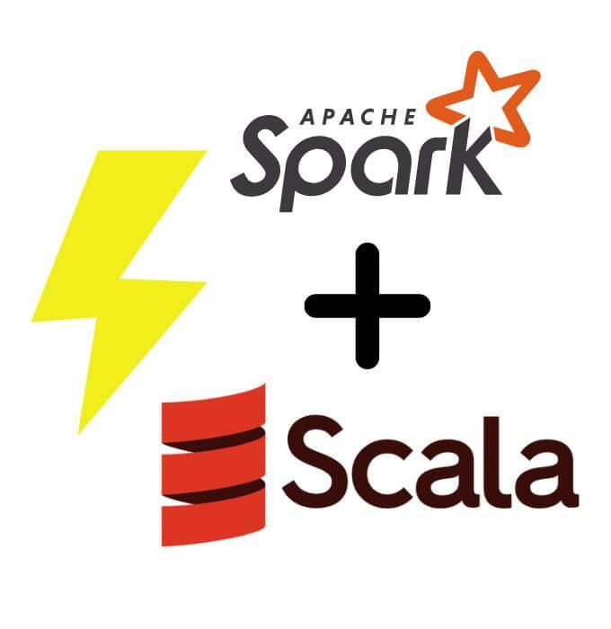
Introduction to Spark with Scala
Apache Spark is a powerful open-source system that is used to process large-scale datasets. It provides high-level APIs in many programming languages like Scala, Java, Python, and R Programming Language.
Scala, or scalable programming language, is widely used for developing Apache Spark applications. Its concise syntax and compatibility with Java make it an excellent choice for working with big datasets and machine-learning problems. Today Scala is used by many companies like LinkedIn, Twitter, Airbnb, Sony, Tumblr, Apple, etc.
Scala and Apache Spark are combined for complex data analysis and hence developing analytics applications. Scala offers features like concise syntax, performance advantages, compatibility with Java, strong community support, etc., making it a good choice for developing dynamic and high-performance spark applications.
© 2024 StackRoute – Confidential

Slide 26
Introduction to Spark with Scala
Some of the key concepts of Apache Spark with Scala are:
Spark session: It is the entry point for interacting with Apache spark that is it serves as a way to create DataFrames, and RDDs and work on spark operations.
RDD: RDD or Resilient Distributed Datasets are an important data structure in SparkSpark. They are a distributed collection of objects that can be processed in parallel.
Transformations: These are tasks or operations that are applied to RDDs to create new RDDsTransformation does not run immediately. Examples are map, filter, join, sortBy, etc.
Actions: Action operations can perform calculations and return the result as count, collect, take, etc. Unlike transformations, actions are executed immediately.
DataFrames: DataFrames provide a high-level, tabular data structure abstraction in Apache Spark with Scala. They structure data into named columns which is similar to a relational database.
SparkSQL: SparkSQL provides a programming platform for querying organized and semi-organized data using SQL Syntax. With this interface, the user can work on SQL-like operations On Apache Spark with Scala.
© 2024 StackRoute – Confidential

Slide 27
Implementing Data Structures using Scala in Spark
Many Data structures can be implemented using Apache Spark with Scala. Some examples of this implementation are:
Lists: Lists are ordered collections of elements that can contain duplicates.
val listSCALA = List(5, 4, 3, 2, 1)
For multi-dimensional lists
val listSCALA = List(List(1, 2, 3), List(4, 5, 6), List(7, 8, 9))
2. Arrays: Arrays are data structures with a fixed size that can hold data of the same type.
val arraySCALA =Array(11, 12, 13, 14, 15, 16, 17, 18, 19, 20)
3. Sets: Sets are collections of unique data.
val setSCALA = Set(0, 1, 1, 2, 3, 5, 8, 13)
© 2024 StackRoute – Confidential

Slide 28
Implementing Data Structures using Scala in Spark
4. Tuples: Tuples are unchangeable ordered collections of elements of different data types.
val tupleSCALA = List((65, "A"), (66, "B"), (67, "C"))
5. Maps: Maps are key-value pairs where each key is associated with a value.
val mapSCALA = Map(97 -> "a", 98 -> "b", 99 -> "c").toSeq
6. Sequences: Sequences are ordered collections of Data.
val sequenceSCALA = Seq(2, 4, 6, 8, 10)
The choice of Data structure depends on the use case and data type of data.
© 2024 StackRoute – Confidential

Slide 29
Implementing RDD in Apache Spark using Scala
RDD in Apache Spark stands for Resilient Distributed Dataset. This is a fundamental data structure in Apache Spark that can handle and process data in a distributed and fault-tolerant manner.
Resilient Distributed Dataset is a collection of objects that can be processed parallel across a cluster of machines. RDD is an immutable data structure; that is, it cannot be changed once created.
To implement RDD in Apache Spark with Scala, you can follow these steps:
1. First import the required Spark libraries.
import org.apache.spark.{SparkConf, SparkContext}
2. Create a SparkConf object to configure the Spark application.
val confRDD = new SparkConf().setAppName("RDDEx").setMaster("local[*]")
© 2024 StackRoute – Confidential

Slide 30
Implementing RDD in Apache Spark using Scala
Next, you should create a SparkContext object using the SparkConf.
val sc = new SparkContext(confRDD)
The SparkContext is like an entry point for interacting with SparkSpark.
4. Next, create an RDD from a collection.
val dataVal = List(1, 2, 3, 4, 5)
val rddSCALA = sc.parallelize(dataVal)
© 2024 StackRoute – Confidential

Slide 31
Implementing RDD in Apache Spark using Scala
5. Now, you can perform transformations and actions on RDD.
While transformations create a new RDD from an initial one like a map, filter, etc.
val transformRDD = rddSCALA.map(x => x * 5)
Action operations can perform calculations and return the result as count, collect, take, etc.
val countRDD = transformRDD.count()
6. Next, you can stop the SparkContext using the below command:
sc.stop()
© 2024 StackRoute – Confidential

Slide 32
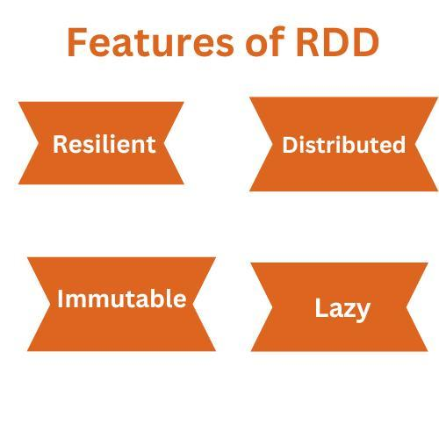
Features of rdd
© 2024 StackRoute – Confidential

Slide 33
Features of rdd
1. Resilient: RDD is resilient, it can be recomputed in the event that one or more nodes fail.
2. Distributed: RDD is a distributed dataset that can be divided among a number of cluster nodes
3. Immutable: RDD cannot be changed once it has been created. If any alterations are necessary, transformation can be used to create a new RDD.
4. Lazy: Apache Spark RDD just depicts the data produced by computation. It doesn't start any computations on its own; instead, processing RDD data with transformations and actions can result in the creation of new RDDs.
© 2024 StackRoute – Confidential

Slide 34
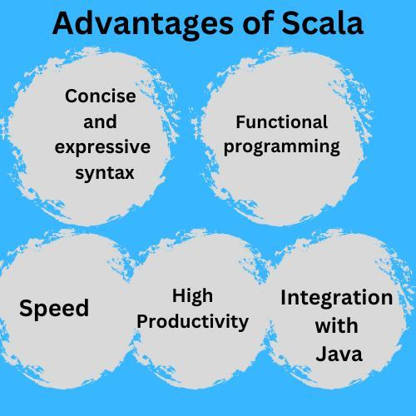
Advantages of Scala for Apache Spark
Concise and expressive syntax: Scala's concise and clear syntax makes it easier to write short and readable code.
Functional programming: The functional programming feature of Scala, such as pattern matching, pure functions, immutability, etc., make it easier to work with spark operations.
High productivity: Working with Scala turns out to be more productive when compared to other programming languages like Java.
Speed: Scala has better optimization capabilities, resulting in faster responses than Python and R.
Integration with Java: Scala is highly compatible with Java; the user can easily use the Java libraries and code in your Spark application.
© 2024 StackRoute – Confidential

Slide 35
Thank you!
© 2024 StackRoute – Confidential

