Slide 1
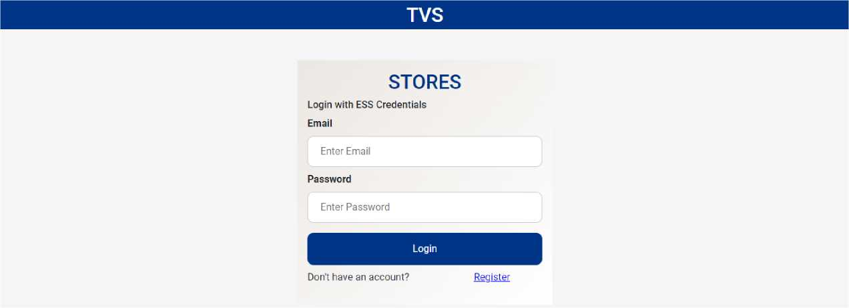
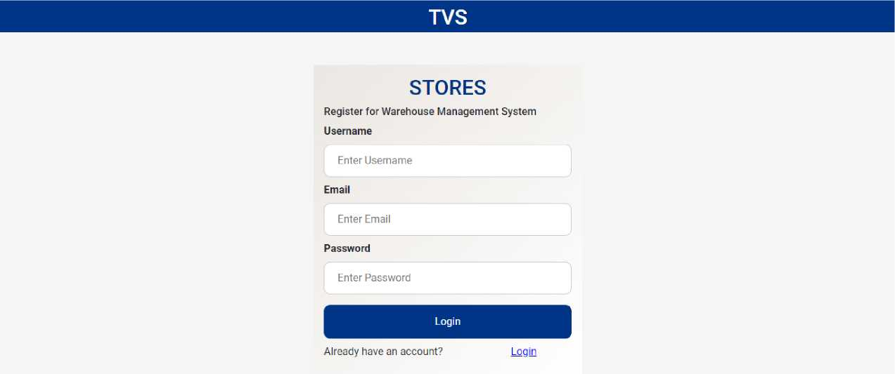
Development
Login Page
Register Page
Dashboard

Slide 2
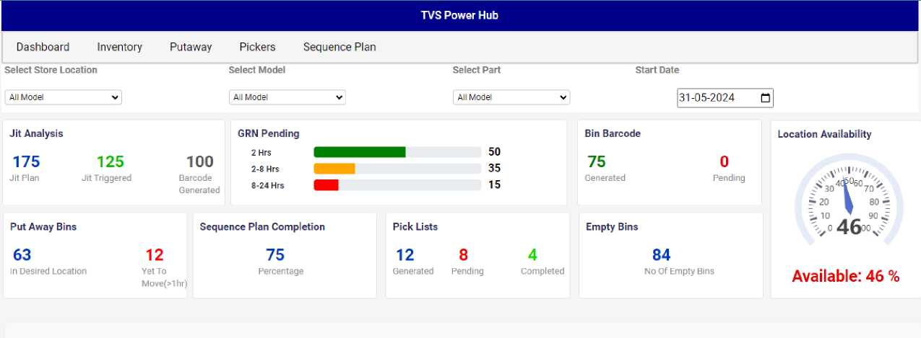
Last 10 Inward Parts
This List Will Appear After The Invoices GRN Has Been Generated
invoice Number
SINo | Invoice Number | Barcode Number | PO Number | Part Number | Part Description | Bin... | Rec... | Supplier Code ... | Vehicle Number | Received By | Action
1 | INV-2024-0001 | 234567890123... | PO-TVS-1234 | TVS-ENG-0 001 | Engine Block,... | 10 | 20 | SUP-ABC-Acm.., | MH-01-TVS2345 | John Doe | Receive
2 | INV-2024-0002 | 234567890123... | PO-TVS-2345 | TVS-ELEC-0 012 | Headlight Asse... | 5 | 10 | SUP-XYZ - XYZ... | KA-05-TVS1234 | Jane Smith | Receive
3 | INV-2024-0003 | 234567890123... | PO-TVS-3456 | TVS-P LA-0023 | Plastic Fairing... | 20 | 20 | SUP-MNO-MN... | TIM-10-TVS5678 | David Lee | Receive
4 | INV-2024-0004 | 234567890123... | PO-TVS-4567 | TVS-WHE-0034 | Wheel Rim, Mo... | 15 | 15 | SUP-DEF- DEF | KL-15-TVS9012 | Michael Chen | Receive
5 | INV-2024-0005 | 234567890123... | PO-TVS-5678 | TVS-BAT-0045 | Battery, Motore... | 8 | 10 | SUP-GHI - GHI... | AP-20-TVS3456 | Emily Jones | Receive
6 | INV-2024-0006 | 789012345678... | PO-TVS-6789 | TVS-OIL-0056 | Engine Oil, Mot... | 25 | 25 | SUP-JKL- JKL ... | HR-25-TVS7890 | Daniel Garcia | Receive
7 | INV-2024-0007 | 456789012345... | PO-TVS-7890 | TVS-C HA-00 67 | Motorcycle Ch... | 5 | 8 | SUP-PQR - PQR... | MH-01-TVS2345 | John Doe | Issue
Inventory

Slide 3
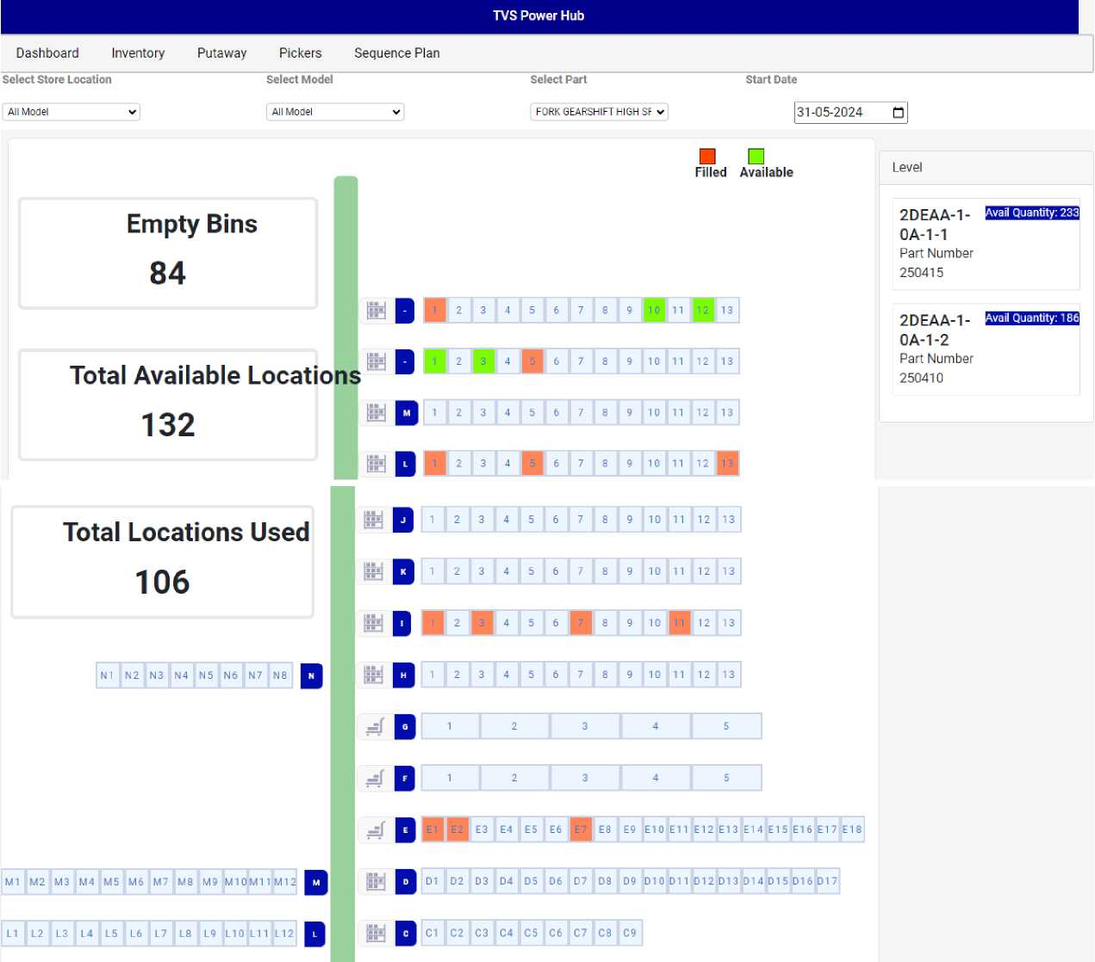

B1 | B2 | B3 | BA | B5 | B6 | B7 | B8 | B9
A1 | A2 | A3 | A4 | AS | A6 | A7 | A8 | A9 | A1 0 | All

Slide 4
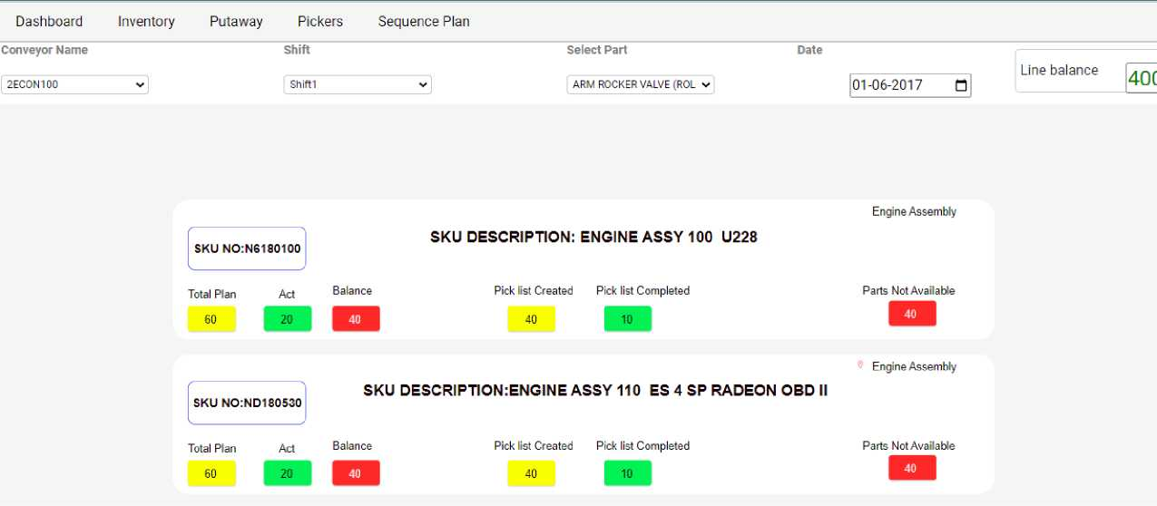
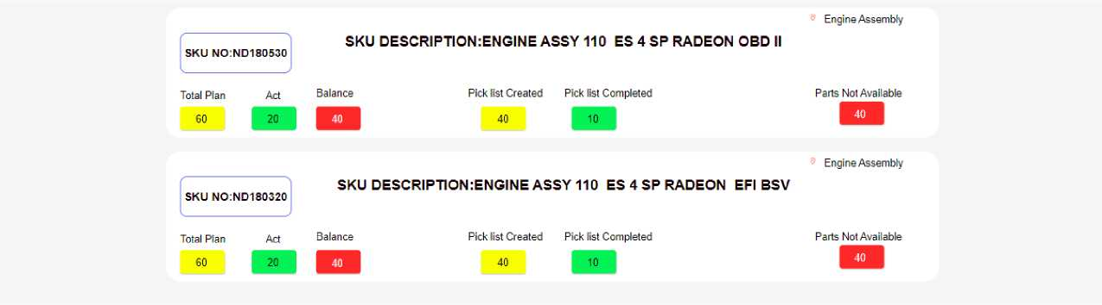
Sequence Plan
Putaway

Slide 5
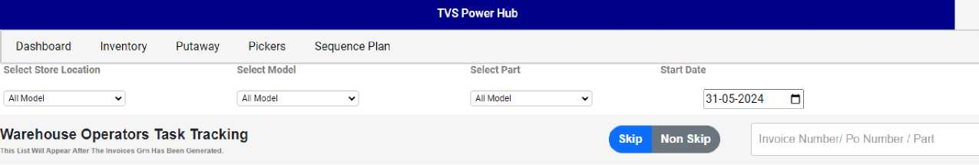
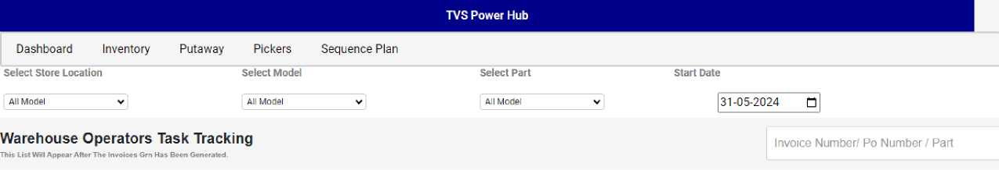
Pickers
Design

Slide 6
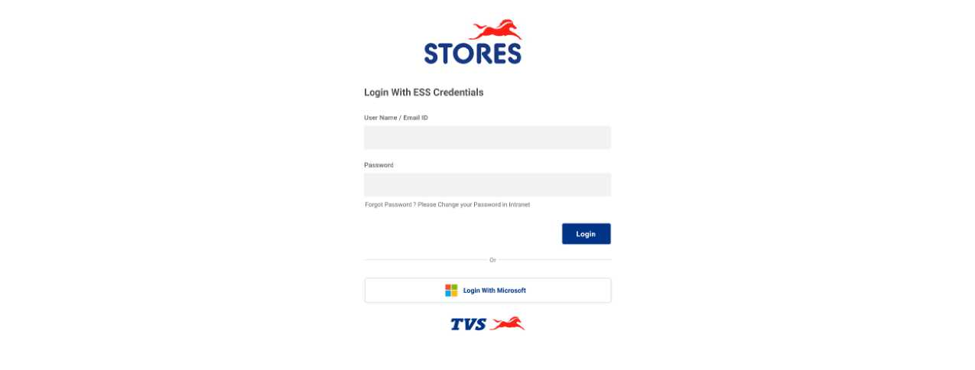
Login
Dashboard

Slide 7
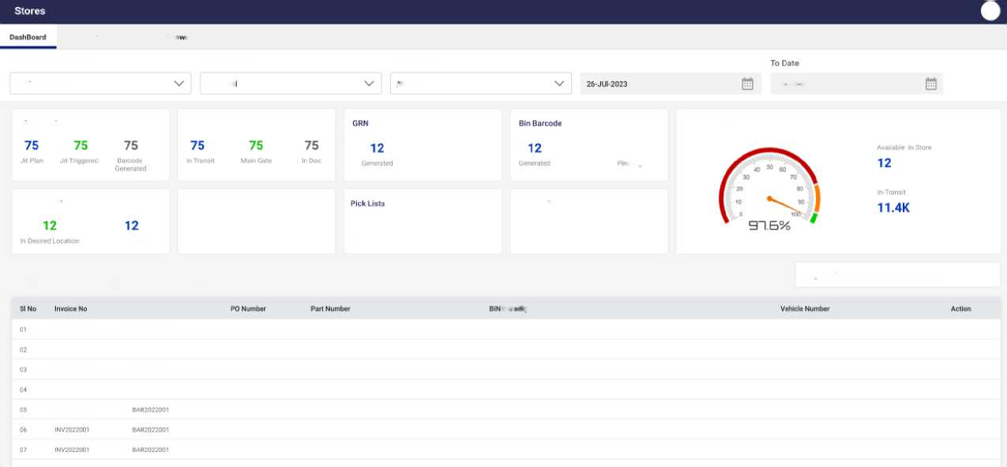
Inventory
Pickers
I-' 11! - i i V
Sequence Plan
Select Store Location
Select Model
Select Part
From Date
Vehicle Stores
All Mode
-.11 F;: r 1
26 JUI2023
Jit Analysis
Truck Transil Status
8
Pend mg
8
•' 'i:lnr
Location Availability
Put Away Bins
Sequence Plan
75
Percentage
12 8 4
Generated Pending Completed
Empty Bins
12
No Of Empty Bins
Yet To Move
Last 10 Inward Parts
Cl Invoice Number/ Po Number / Part
Thu List Will Appear After The Invoices Cm Has Been Generated
INV2022001
Barcode Number
Part Description
Q-.i I I' l.
WMM QNMM
Supplier Code - Name
Received by
INV2022001
BAR2022001
INV2022001
BAR2022001
INV2022001
BAH2022001
INV2022001
BAR2022001
Inventory

Slide 8
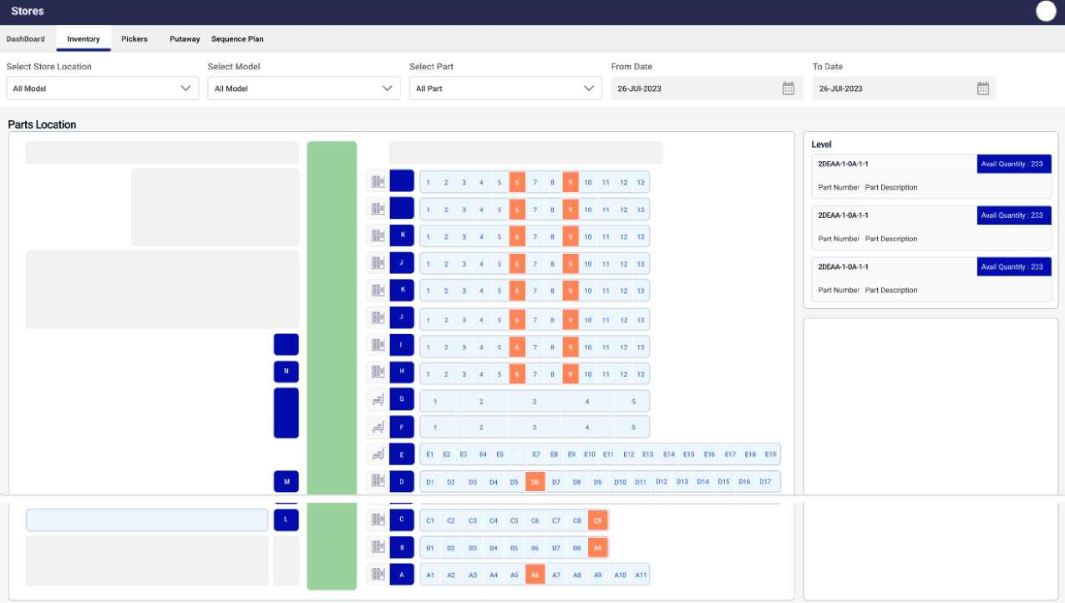
Sequence Plan

Slide 9
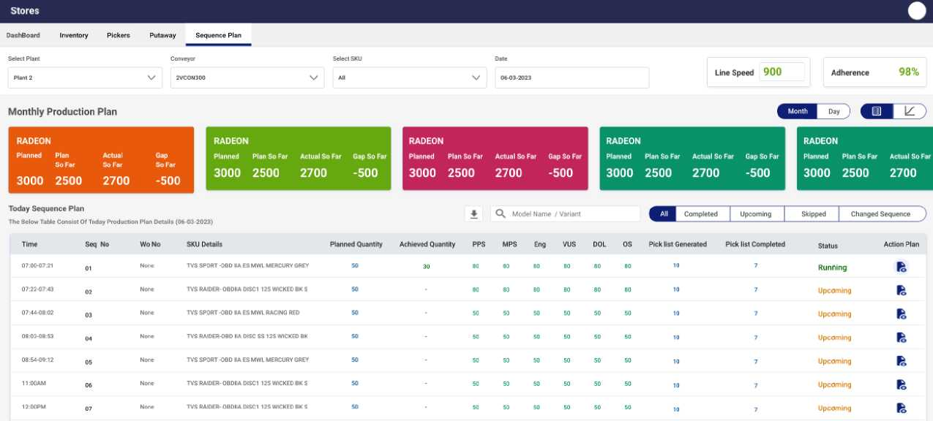
Pickers

Slide 10
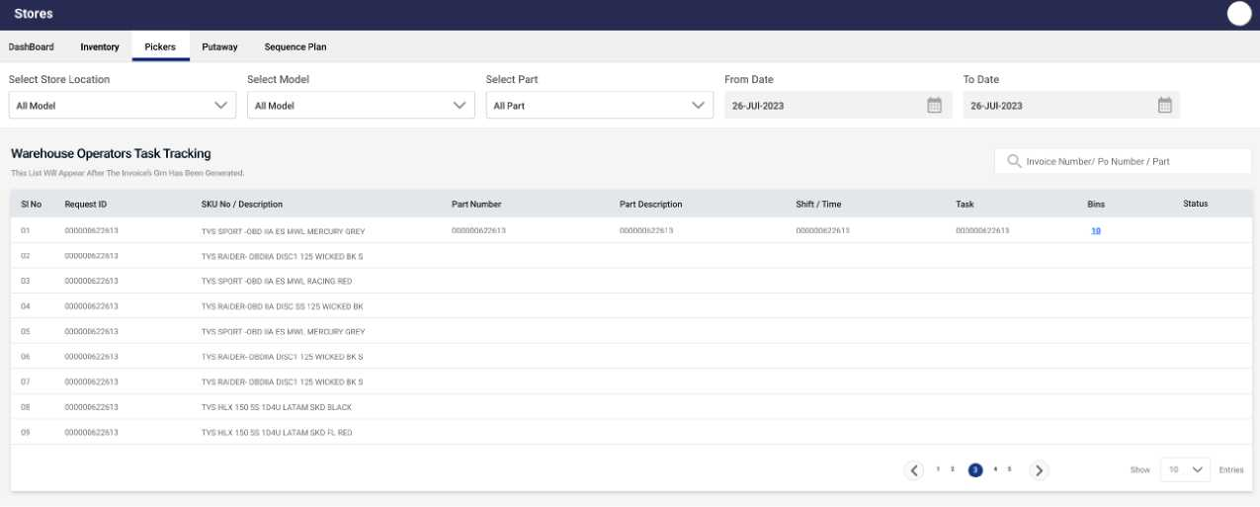
Putaway

Slide 11
