Slide 1
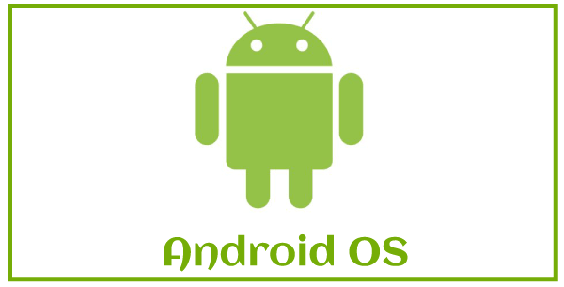
What is android operating system?
The Android operating system (OS) is a Linux-based mobile operating system developed by Google primarily for touchscreen mobile devices such as smartphones and tablets. It is designed to be open-source and is based on the Linux kernel.
key aspects of the Android operating system:
Linux Kernel: Android uses the Linux kernel as its core, which provides the underlying system services such as security, memory management, process management, and hardware drivers.
Open Source: Android is open-source, allowing manufacturers and developers to customize and modify the operating system according to their needs. This flexibility has contributed to its widespread adoption across various devices and markets.
Application Framework: Android provides a rich application framework that allows developers to create innovative apps using Java or Kotlin programming languages. The framework includes high-level APIs for tasks such as UI design, data storage, connectivity, multimedia, and more.

Slide 2
User Interface: Android features a customizable user interface with a focus on touch gestures. It includes support for widgets, notifications, and multi-tasking, providing users with a dynamic and interactive experience.
Google Play Store: The primary distribution platform for Android apps is the Google Play Store, where users can download a vast array of applications, games, and digital content. Other app distribution channels also exist, such as third-party app stores and direct installations.
Security: Android incorporates various security features to protect users and their data. This includes app sandboxing (each app runs independently in its own secure space), permissions model, encryption, secure boot, and regular security updates.
Updates: Android releases regular updates to improve performance, fix bugs, and enhance security. These updates are typically distributed by device manufacturers and carriers, which can lead to variations in update availability and timing across different devices.
Google Services: Android integrates tightly with Google services such as Google Search, Google Maps, Gmail, and others, providing seamless access to these services from Android devices

Slide 3
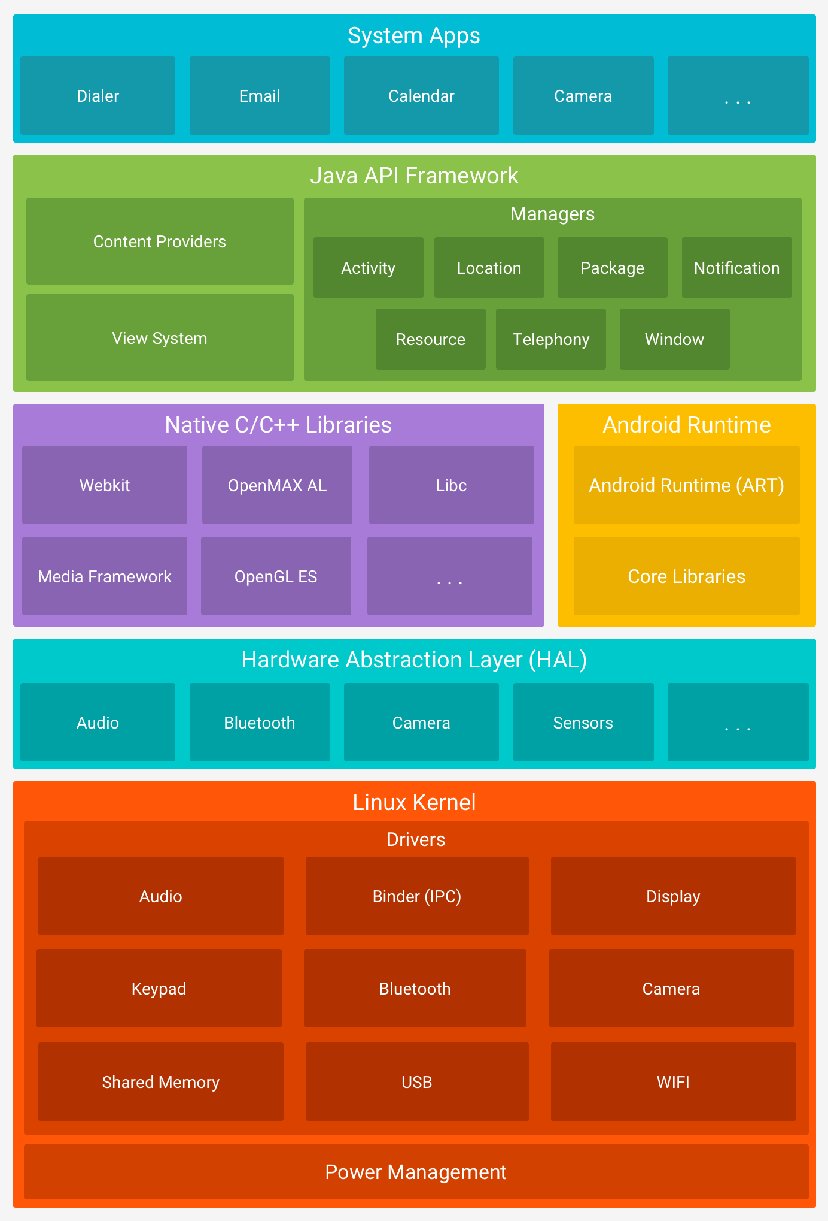
Android architecture
1.Linux kernel
2.HAL
3.Native C/C++ libraries
4.ART
5.Application Framework
6.Applications

Slide 4
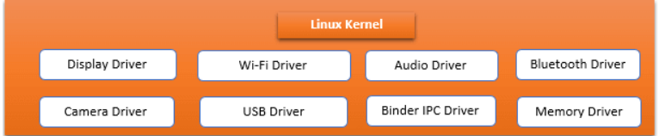
Linux kernel:
Linux Kernel is heart of the android architecture. It manages all the available drivers such as display drivers, camera drivers, Bluetooth drivers, audio drivers, memory drivers, etc. which are required during the runtime. The Linux Kernel will provide an abstraction layer between the device hardware and the other components of android architecture. It is responsible for management of memory, power, devices etc. The features of Linux kernel are:
Security: The Linux kernel handles the security between the application and the system.
Memory Management: It efficiently handles the memory management thereby providing the freedom to develop our apps.
Process Management: It manages the process well, allocates resources to processes whenever they need them.
Network Stack: It effectively handles the network communication.
Driver Model: It ensures that the application works properly on the device and hardware manufacturers responsible for building their drivers into the Linux build.

Slide 5
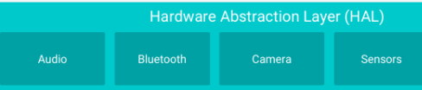
HAL Layer :
Hardware Abstraction Layer (HAL):
Sits between the Android framework and the Linux kernel.
Provides standard interfaces for hardware components, allowing the Android framework to be hardware-agnostic.
In the HAL (Hardware Abstraction Layer) layer of Android architecture, various drivers are implemented to interface with the underlying hardware. These drivers provide the necessary functions to communicate between the Android framework and the actual hardware components.

Slide 6
Common Drivers in the HAL Layer
Camera Driver
Manages camera hardware.
Controls camera operations such as capturing images, video recording, and adjusting camera settings.
Audio Driver
Manages audio hardware.
Controls audio playback, recording, volume adjustments, and routing.
Sensors Driver
Manages various sensors like accelerometers, gyroscopes, proximity sensors, and ambient light sensors.
Provides data to applications and system services that require sensor information.
GPS Driver
Manages GPS hardware.
Provides location data to applications and system services for navigation and location-based services.
Bluetooth Driver
Manages Bluetooth hardware.
Controls Bluetooth communication, pairing, and data transfer between devices.

Slide 7
Wi-Fi Driver
Manages Wi-Fi hardware.
Controls Wi-Fi connectivity, scanning for networks, and data transfer over Wi-Fi.
Display Driver
Manages display hardware.
Controls screen resolution, brightness, refresh rate, and rendering of the graphical user interface.
Touchscreen Driver
Manages touchscreen hardware.
Interprets touch inputs and gestures and relays this information to the system.
Telephony Driver
Manages telephony hardware.
Controls functions related to cellular communication, including making calls, sending texts, and data connectivity.
USB Driver
Manages USB hardware.
Controls USB connectivity, including data transfer, charging, and peripheral device management.
Power Management Driver
Manages power hardware.
Controls battery usage, charging, and power-saving features.
Fingerprint Sensor Driver
Manages fingerprint sensor hardware.
Controls fingerprint authentication and security features.
Graphics Driver
Manages GPU (Graphics Processing Unit) hardware.
Controls rendering of graphics, including 2D and 3D rendering, used in games and user interfaces.

Slide 8
Example of HAL Implementation
Camera HAL
Camera Application: User interacts with the camera application to take a photo.
Application Framework: The request is sent to the Camera Manager in the application framework.
HAL Interface: The Camera Manager interacts with the camera HAL interface to process the request.
Vendor Implementation: The camera HAL implementation, provided by the hardware vendor, translates the request into hardware-specific operations.
Linux Kernel: The vendor implementation communicates with the camera driver in the Linux kernel to capture the photo.
Hardware: The camera hardware captures the photo and sends the data back up the stack to the user application.

Slide 9
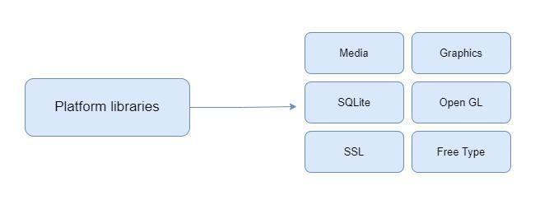
Platform libraries
The Platform Libraries includes various C/C++ core libraries and Java based libraries such as Media, Graphics, Surface Manager, OpenGL etc. to provide a support for android development.
Media library provides support to play and record an audio and video formats.
Surface manager responsible for managing access to the display subsystem.
SGL and OpenGL both cross-language, cross-platform application program interface (API) are used for 2D and 3D computer graphics.
SQLite provides database support and FreeType provides font support.
Web-Kit This open source web browser engine provides all the functionality to display web content and to simplify page loading.
SSL (Secure Sockets Layer) is security technology to establish an encrypted link between a web server and a web browser.

Slide 10
Native C and C++ Libraries in Android Architecture
Purpose: The C library (libc) implementation for Android.
Functionality: Provides standard C library functions (e.g., memory allocation, string handling, file I/O) optimized for embedded systems.
Media Framework:
Purpose: Supports audio and video playback and recording.Components: Includes libraries like libstagefright, libmedia, and libaudiotrack.
Functionality: Handles media codecs, media extraction, and rendering.
Surface Manager:
Purpose: Manages access to the display subsystem and compositing of 2D and 3D graphic layers
.Functionality: Ensures efficient rendering of user interfaces and graphics.
OpenGL ES:
Purpose: A graphics library for rendering 2D and 3D graphics.
Functionality: Provides hardware-accelerated graphics rendering, crucial for gaming and graphical applications.
SQLite:
Purpose: A lightweight relational database library.
Functionality: Provides local data storage for applications, enabling them to perform SQL operations on the device.
WebKit:
Purpose: An open-source web browser engine.
Functionality: Powers the Android WebView component, enabling web content rendering within apps.
SSL (Secure Sockets Layer):
Purpose: Provides cryptographic functions and secure communication.
Functionality: Ensures secure data transmission over networks
FreeType:
Purpose: A font rendering library.
Functionality: Supports rendering of fonts in various formats, crucial for text display.

Slide 11
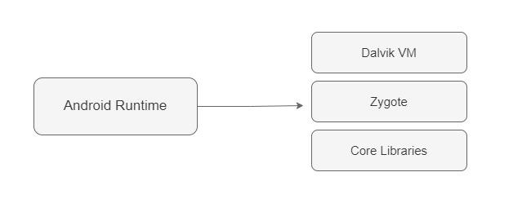
Application runtime
Android Runtime environment is one of the most important part of Android. It contains components like core libraries and the Dalvik virtual machine(DVM). Mainly, it provides the base for the application framework and powers our application with the help of the core libraries. Like Java Virtual Machine (JVM), Dalvik Virtual Machine (DVM) is a register-based virtual machine and specially designed and optimized for android to ensure that a device can run multiple instances efficiently. It depends on the layer Linux kernel for threading and low-level memory management. The core libraries enable us to implement android applications using the standard JAVA or Kotlin programming languages.

Slide 12
Application framework
Application Framework provides several important classes which are used to create an Android application. It provides a generic abstraction for hardware access and also helps in managing the user interface with application resources. Generally, it provides the services with the help of which we can create a particular class and make that class helpful for the Applications creation. It includes different types of services activity manager, notification manager, view system, package manager etc. which are helpful for the development of our application according to the prerequisite.
The application framework in Android architecture is a crucial layer that provides the building blocks necessary for creating Android applications.
Framework: Provides the APIs that application developers use to build their apps, as detailed
Components of the Application Framework
Activity Manager: Manages the lifecycle of applications and activities.Controls the task and back stack of activities.Ensures that the app maintains a consistent user experience
Window Manager: Manages windows and their interaction with the screen.Handles tasks like screen rotation, window transitions, and touch events.
Content Providers: Manages access to a structured set of data.Facilitates data sharing between different applications.Provides a standard interface to query, insert, update, and delete data.
View System: Provides the building blocks for user interfaces.Includes UI components like buttons, text fields, images, and more.Manages the rendering of these components on the screen
Notification Manager: Allows applications to display custom alerts in the status bar.Handles the creation, updating, and removal of notifications.

Slide 13
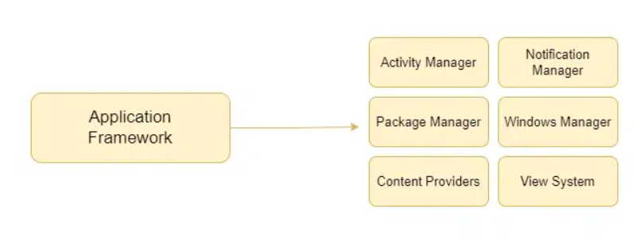
Package Manager: Maintains information about all installed applications on the device.Facilitates the installation, updating, and removal of applications.
Telephony Manager: Provides information about the telephony services on the device.Includes functionality for making calls, accessing network details, and managing SIM card operations
Resource Manager: Manages access to non-code resources such as strings, color settings, and layout files.Facilitates the localization and configuration of resources for different device configurations
Location Manager: Provides access to the location services, enabling geographic position tracking.Supports different location providers like GPS and network-based location.

Slide 14
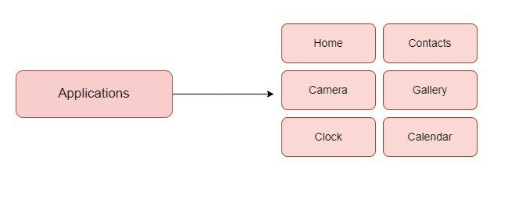
Applications:
Applications is the top layer of android architecture. The pre-installed applications like home, contacts, camera, gallery etc and third party applications downloaded from the play store like chat applications, games etc. will be installed on this layer only. It runs within the Android run time with the help of the classes and services provided by the application framework.

Slide 15
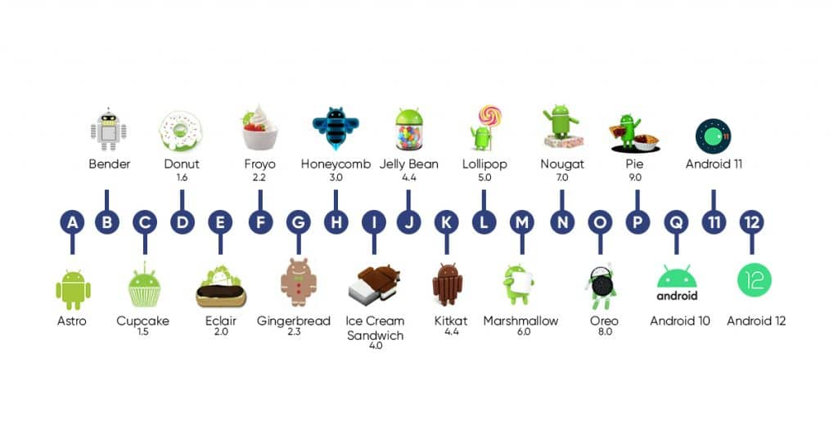
Andriod versions:

Slide 16



