Slide 1
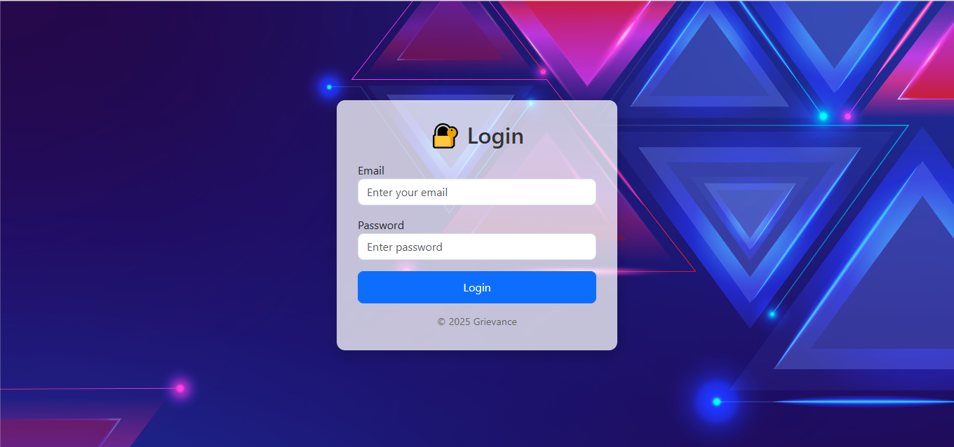
Login

Slide 2
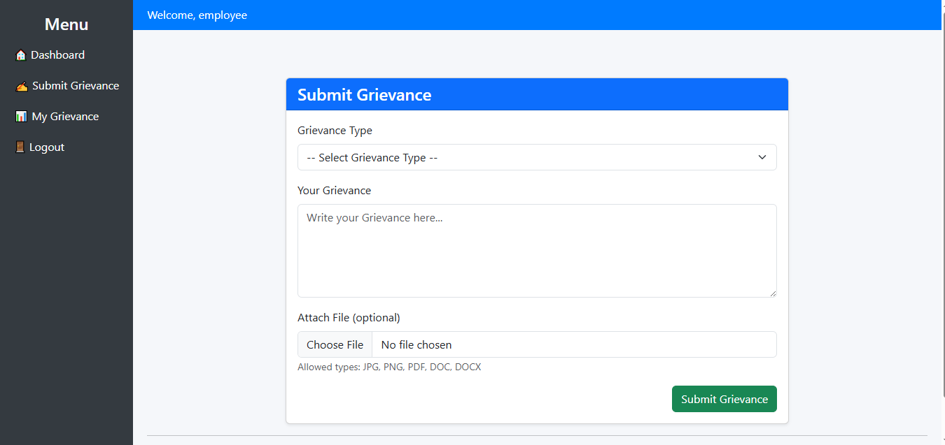
Submit Grievance(Employee)

Slide 3
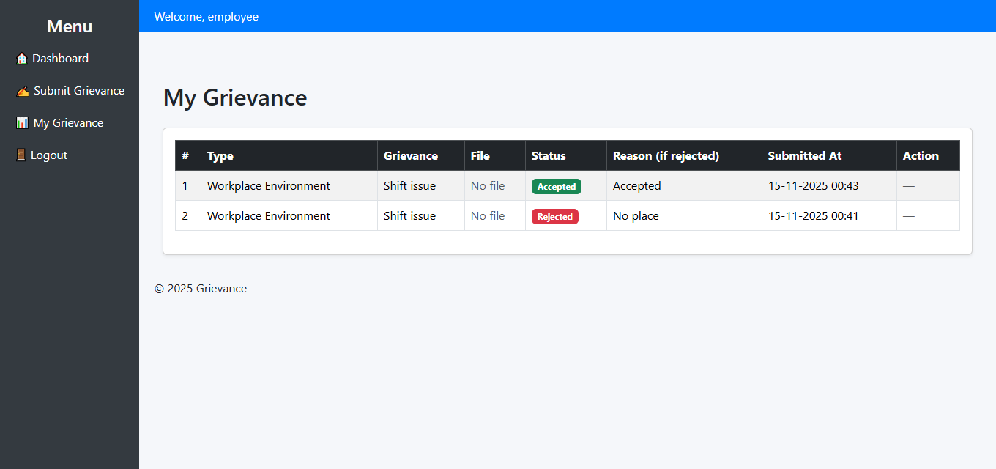
Grievance List(Employee)

Slide 4
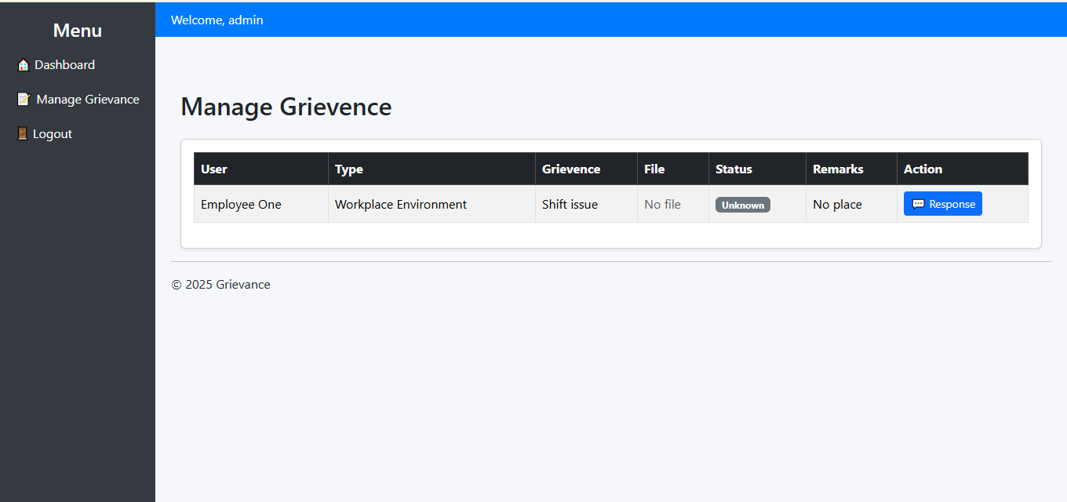
Manage Grievence(Admin)

Slide 5
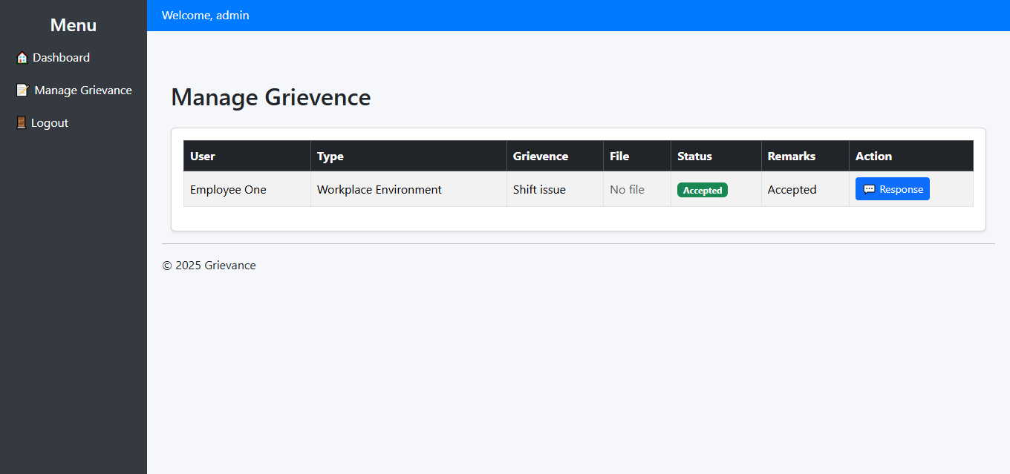
Manage Grievence(Manager)

Slide 6
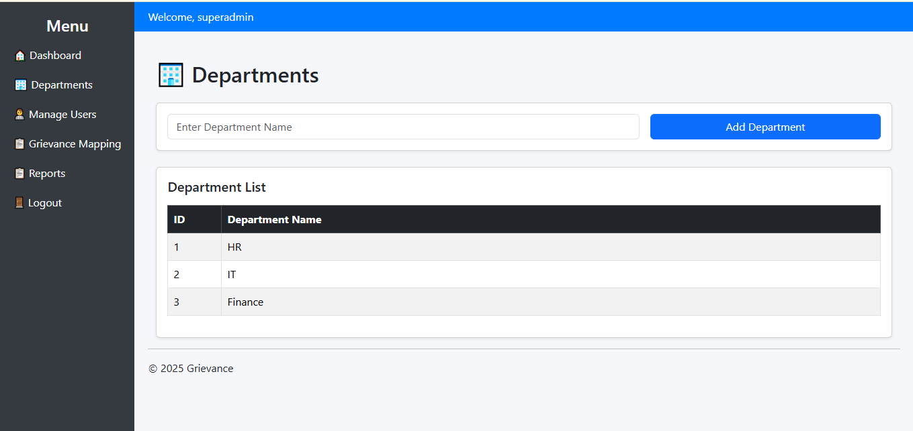
Add and Manage Departments(Super Admin)

Slide 7
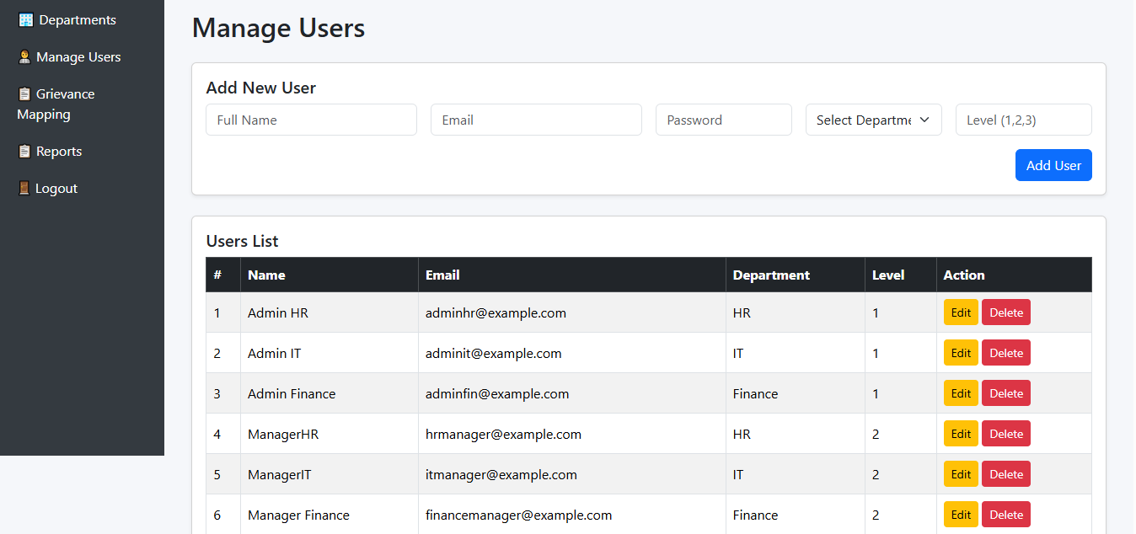
Add and Manage(Users)

Slide 8
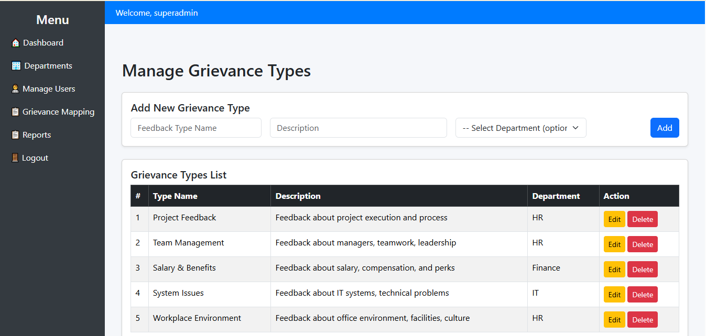
Manage Grievance and Mapping Department

Slide 9
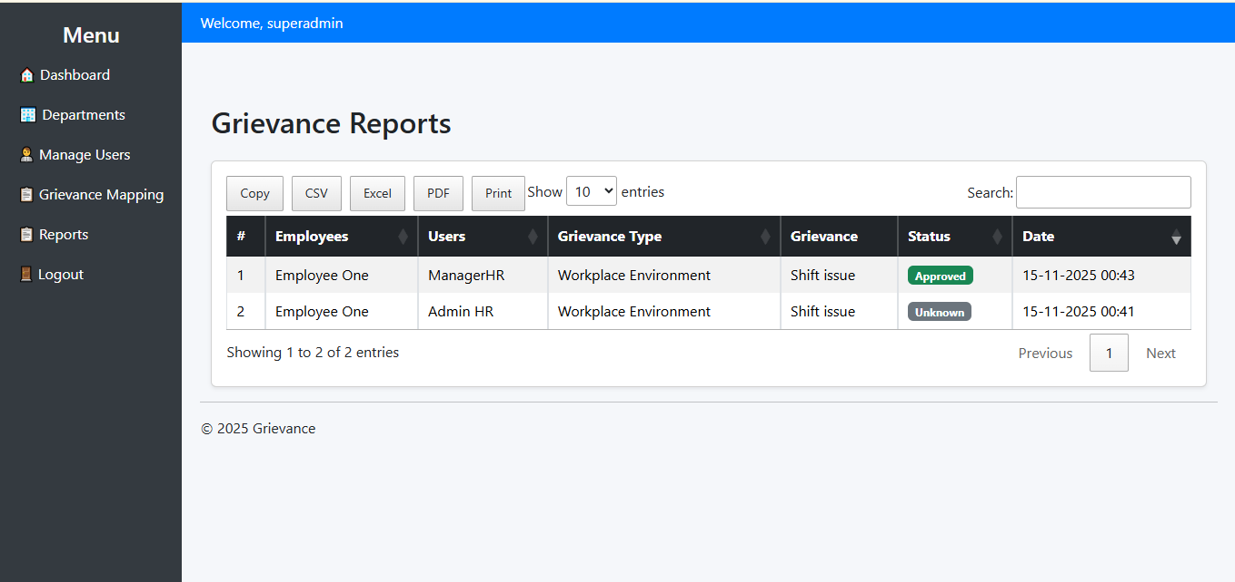
Reports

