Slide 1
Spotify Churn Analysis
Dataset Analysis & Visualization using PySpark
A. Surya Prakash
2211CS010023

Slide 2
Dataset Information
- Dataset Source: https://www.kaggle.com/datasets/nabihazahid/spotify-dataset-for-churn-analysis
- Number of Records: 8000
- Major Columns:
user_id: Unique identifier for the user.
age: Age of the user.
country: Country of the user.
subscription_type: Type of subscription (e.g., Free, Premium, Student, Family).
is_churned: The target variable, a binary flag (0 or 1) indicating if the user has churned.

Slide 3
Introduction
This project utilizes PySpark, a powerful framework for large-scale data processing, to analyze a dataset of Spotify user behavior and predict churn (when a user stops subscribing or using the service). The core objective is to identify key factors that drive users to leave the platform. The analysis involves exploring user demographics (age, gender, country), subscription details (subscription_type, device_type), and usage patterns (listening_time, songs_played_per_day, skip_rate, ads_listened_per_week). The project follows a typical Big Data methodology, starting with data loading and cleaning, performing Exploratory Data Analysis (EDA) to uncover trends—such as the churn rate across different user segments—and finally, applying a machine learning model, specifically Logistic Regression, to build a predictive model for the binary target variable, is_churned. The ultimate goal is to generate actionable insights, such as identifying the high-risk 'Student_Mobile' user segment, to help Spotify in developing targeted retention strategies

Slide 4
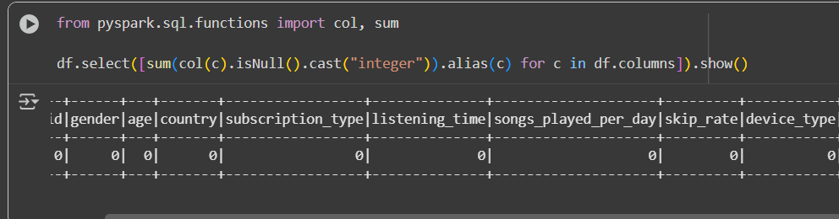
Initial Analysis
- Checked for missing and invalid values (e.g., 'NA')
- Replaced/removed nulls and converted columns to numeric types
- Dataset cleaned and ready for visualization

Slide 5
Exploratory Data Analysis
Perform detailed analysis and visualization to identify patterns, trends, and relationships in the data. This involves calculating aggregations, creating visualizations (using libraries like Matplotlib or Seaborn after converting to Pandas DataFrame if needed), and exploring the target variable (churn).
Calculate the overall churn rate, churn rate by categorical features, and descriptive statistics for numerical features based on churn status. Then, convert the results for categorical churn rates and numerical statistics to Pandas DataFrames for visualization.

Slide 6
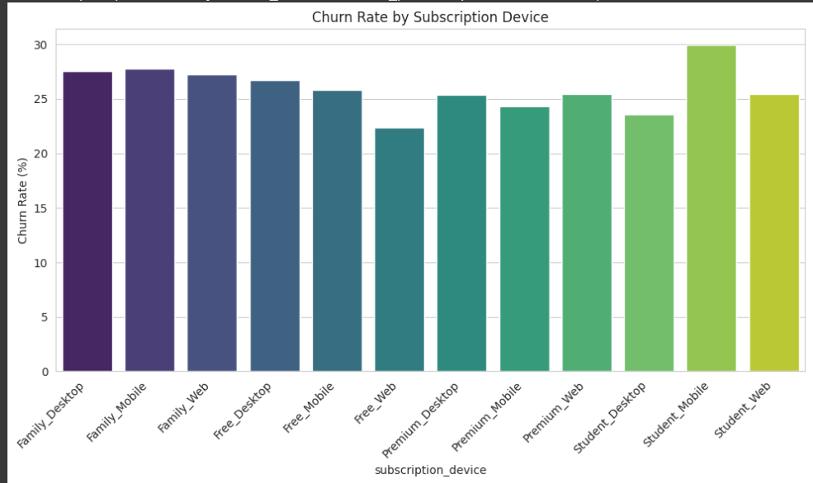
Visualizations

Slide 7
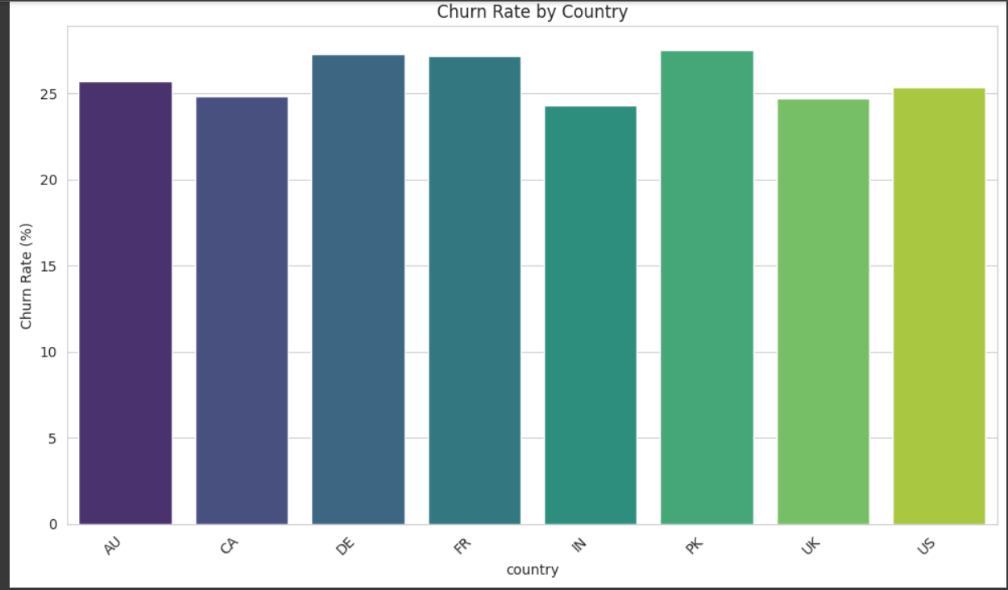

Slide 8
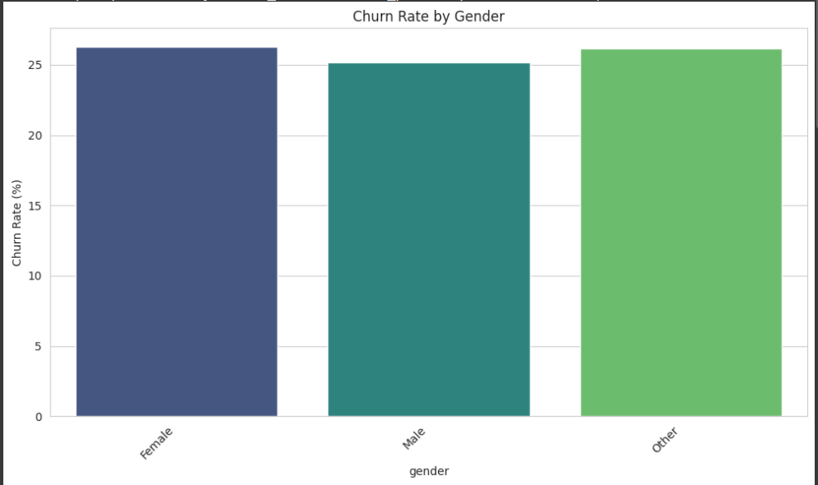

Slide 9
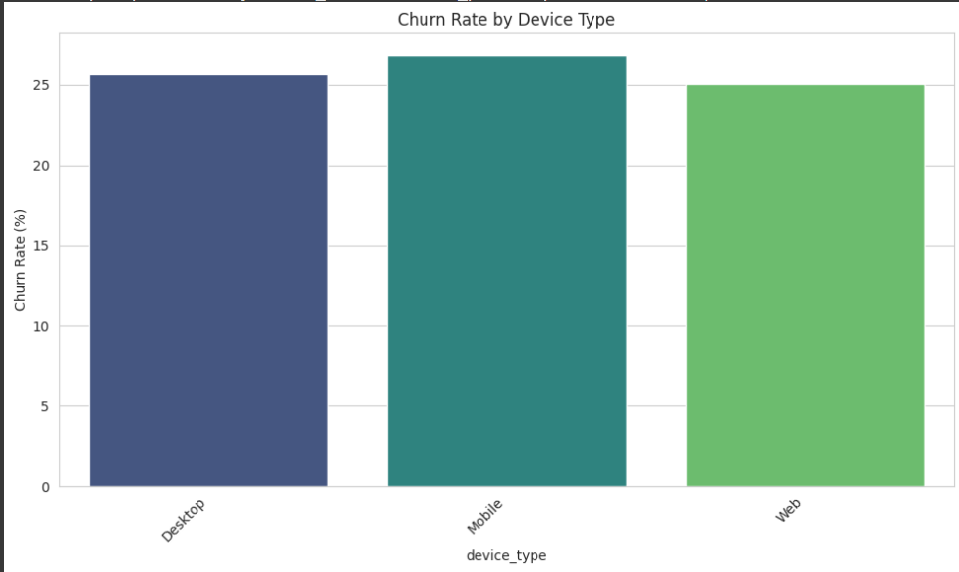

Slide 10
Conclusion
This big data analysis project successfully leveraged PySpark to explore and model user churn behavior using the Spotify dataset. The Exploratory Data Analysis (EDA) identified crucial segments, particularly highlighting the 'Student_Mobile' users who demonstrated a notably higher churn rate (29.92%) compared to the overall average (25.89%).
Therefore, the key conclusion is that future efforts should focus on designing targeted retention strategies for the high-risk 'Student_Mobile' segment and exploring more sophisticated feature engineering or non-linear machine learning models to improve the accuracy and actionability of the churn prediction system.

