Slide 1


Problem Statement Title: Development of Small Scale Wind energy device
Problem Code: 1361
Category: Hardware Team Name: Watts Happening
Team Leader Name: Subhikshni V S Theme Name: Renewable / Sustainable Energy

Slide 2
Idea/Approach Details
Our solution leverages Vertical Axis Wind Turbines (VAWT) to address urban energy challenges.
VAWT Advantages: Compact, omnidirectional, and suited for low wind speeds, ideal for urban settings.
Integration: Install VAWTs along roads, railways, and public spaces.
Technology Accessibility: Raise awareness through user-friendly apps and educational collaborations.
Regulatory Support: Advocate for urban renewable energy policies and permit streamlining.
Competition: Encourage local businesses and innovation in wind energy.
Reducing Costs: Standardized VAWT models and maintenance partnerships.
Market Infrastructure: Collaborate with energy providers and establish microgrids.

Slide 3
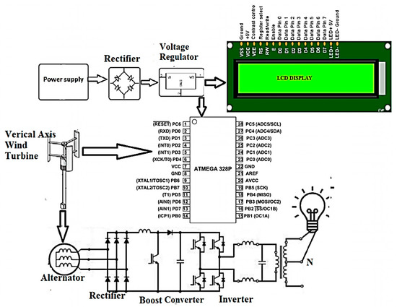
Process flow chart / Simulated image of prototype

Slide 4
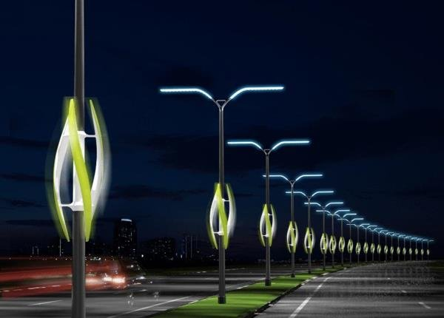
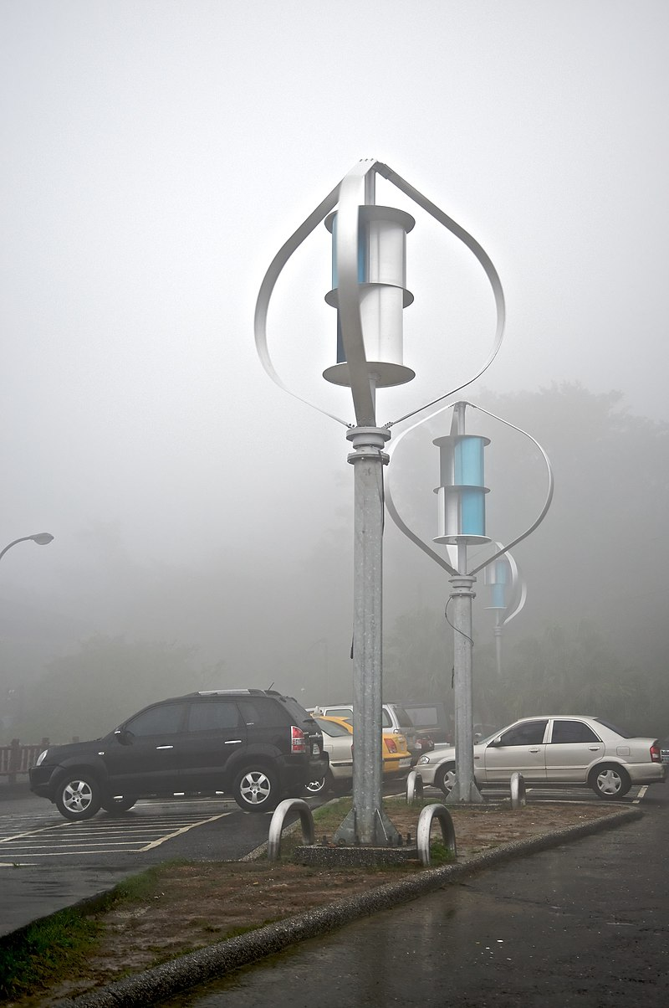
Process flow chart / Simulated image of prototype

Slide 5
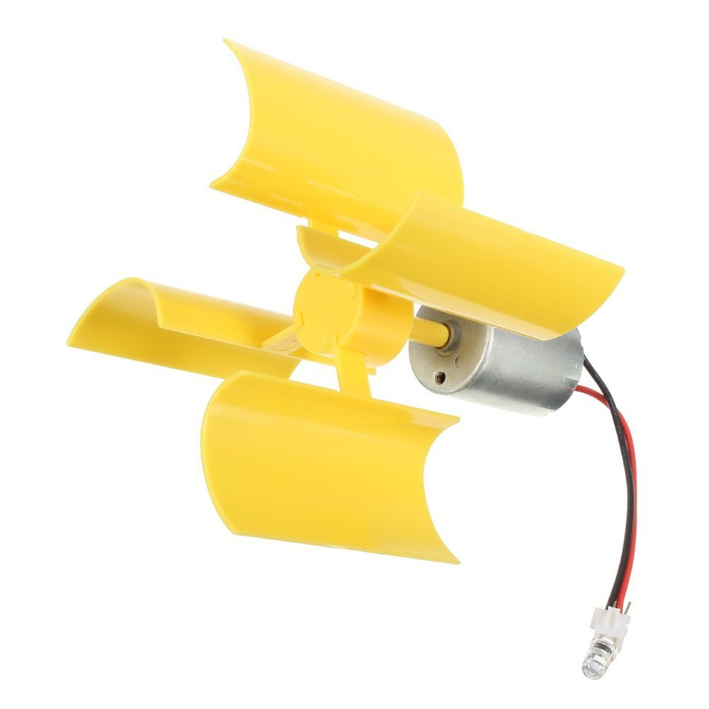
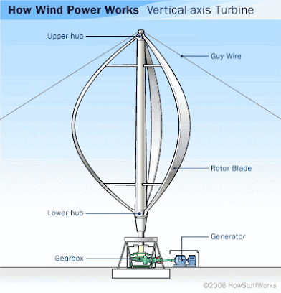
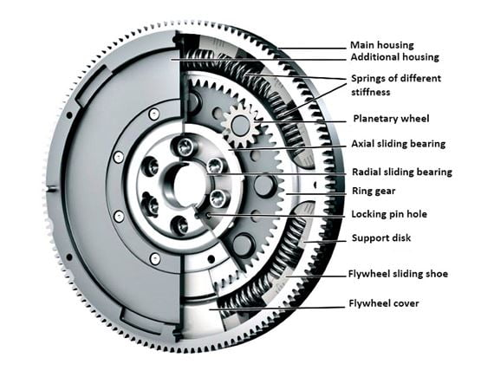
Technology stack (Tools)
2 milli meter rod 2 meter
DC motor
Wire
Flywheel
Reduction gearbox
Aluminum sheet
12v Controller
Base / Support

Slide 6
Use Cases
Urban Energy Generation: VAWTs can provide renewable energy in crowded urban environments.
Rooftop Power Generation: They are suitable for rooftop installations in homes and commercial buildings.
Low Wind Speed Regions: VAWTs can capture energy efficiently in areas with lower wind speeds.
Off-Grid Applications: They supply power to remote locations and off-grid setups.
Marine Energy: VAWTs can be used in marine environments for various applications.
Aesthetic Installations: They can serve as visually appealing or artistic structures.
Educational Demonstrations: VAWTs are used for educational purposes to teach about wind energy.
Hybrid Energy Systems: They can be integrated into hybrid systems for reliable power.
Telecommunications Towers: VAWTs provide energy for communication infrastructure.
Research Vessels: Used to power scientific research vessels at sea.

Slide 7
Team Member Details
Team Leader Name: Subhikshni
Branch: B.tech Stream : AI & DS Year: III
Team Member 1 Name: Surya
Branch: B.tech Stream : AI & DS Year: III
Team Member 2 Name: Roopan Vishnu
Branch: B.tech Stream : AI & DS Year: III
Team Member 3 Name: Thejaswini
Branch: B.tech Stream : AI & DS Year: III
Team Member 4 Name: Sai Baba Rashmitha
Branch: B.tech Stream : AI & DS Year: III
Team Member 5 Name: Saga Srihitha
Branch: B.tech Stream : AI & DS Year: III

