Slide 1
CryptoMAKA Lab
Empirical Evaluation and Post-Quantum Hardening of Lightweight Cloud-IoT Mutual Authentication: A Reproducible Formal Analysis
Candidate Name: Surya Pratap Singh Raikuni
Registration Number: 24BYB1114
Department : B.Tech Cybersecurity | VIT Chennai
Faculty Guide : Dr. Karthika V
Target Review: Review 3 Comprehensive Evaluation & Defense

Slide 2
REVIEW 3 — CAPSTONE RESEARCH PRESENTATION
1. Research Problem, Motivation & Significance
The Cloud-IoT Security Challenge
Project Motivation & Significance
• Cloud-IoT Architecture Vulnerabilities: Sensors transmit critical telemetry over untrusted public channels; susceptible to replay, tampering, MitM, and impersonation.
• Severely Constrained IoT Resources: Edge devices feature tiny 8-bit to 32-bit MCUs with low RAM (16-64 KB) and coin cell battery power; cannot run heavy public-key cryptosystems.
• Round-Trip Latency Penalty: In LPWAN standards (LoRaWAN, NB-IoT), multi-pass handshakes introduce massive airtime delays and radio battery drain.
• Reproducibility Gap in Academic Literature: Lightweight schemes frequently omit bit-level normalization, leaving implementations unverified and prone to cryptographic flaws.
✓ Reference Evaluation: Faithfully normalize and benchmark the acclaimed Ju-Park 2023 protocol (Sensors 2023) as an empirical reference.
✓ Side-by-Side Asymmetric Counterpart: Implement an ECC P-256 ECDH protocol to benchmark asymmetric security vs symmetric lightweight trade-offs.
✓ Novel Round-Trip Reduction: Design and verify a 3-pass aggregation extension to minimize LPWAN airtime latency.
✓ Quantum-Resilient Roadmap: Integrate NIST FIPS 203 ML-KEM-768 to measure the real-world communication/energy cost of post-quantum security in IoT.
CryptoMAKA Lab | Surya Pratap Singh Raikuni (24BYB1114) | Mentor: Dr. Karthika V | VIT Chennai

Slide 3
REVIEW 3 — CAPSTONE RESEARCH PRESENTATION
2. Concrete Research Objectives
Obj 1: Normalized Reconstruction
Obj 2: Asymmetric Baseline (ECC P-256)
Faithfully implement and normalize the Ju-Park 2023 lightweight MAKA protocol with deterministic 256-bit hash padding, fuzzy extractor biometric masking, and timestamp validation.
Construct an authenticated Ephemeral Elliptic Curve Diffie-Hellman counterpart using NIST P-256 and HKDF-SHA256 to establish an empirical benchmark baseline.
Obj 3: Novel Reduced-RTT Protocol
Obj 4: Formal Proofs & Post-Quantum
Propose an optimized 3-message handshake scheme aggregating Control Server responses to decrease wireless transmission overhead and airtime delay in constrained IoT networks.
Verify secrecy and mutual authentication across ProVerif applied pi-calculus models, and integrate NIST FIPS 203 ML-KEM-768 for quantum-resistant evaluation.
CryptoMAKA Lab | Surya Pratap Singh Raikuni (24BYB1114) | Mentor: Dr. Karthika V | VIT Chennai

Slide 4
REVIEW 3 — CAPSTONE RESEARCH PRESENTATION
3. Literature Review & Existing Scheme Analysis
Comparative Literature Analysis
Scheme / Work | Cryptographic Primitives | Passes | PFS Guarantee | Formal Verification | Quantum Shor Resistance
Ju & Park (Sensors 2023) | SHA-256, XOR, Nonce, Timestamps | 4 Passes | Partial (Shared Secret) | ProVerif (Claimed) | Vulnerable to Grover
RFC 8446 (TLS 1.3) | ECDH P-256, HKDF, AES-GCM | 2 Passes | Yes (Full PFS) | Tamarin Verified | Broken by Shor's Algo
Challa et al. (IEEE TIFS) | ECC point mult, Biometrics, Hash | 3 Passes | Yes | AVISPA / SPAN | Broken by Shor's Algo
CryptoMAKA Lab (Ours) | Ju-Park + ECC + Reduced-RTT + ML-KEM | 2-4 Passes | Full PFS + KEM | ProVerif + Tamarin + Scyther | Immune (FIPS 203)
CryptoMAKA Lab | Surya Pratap Singh Raikuni (24BYB1114) | Mentor: Dr. Karthika V | VIT Chennai

Slide 5
REVIEW 3 — CAPSTONE RESEARCH PRESENTATION
4. Identified Research Gaps & Proposed Solutions
Gap 1: Ambiguous Specification & Normalization Deficit
Identified Limitation: Existing publications leave XOR alignment between 256-bit hashes, 128-bit nonces, and variable biometric strings undefined, preventing software reproduction.
CryptoMAKA Contribution: Solution: CryptoMAKA establishes strict 256-bit padded alignment and constant-time bitwise normalization rules.
Gap 2: Lack of Multi-Radio IoT Wireless Telemetry
Identified Limitation: Prior works evaluate only CPU execution times in idealized PC environments, completely ignoring LPWAN airtime latency (LoRaWAN/NB-IoT) and radio energy costs.
CryptoMAKA Contribution: Solution: We implement comprehensive wireless propagation and energy models across LoRaWAN, NB-IoT, LTE-M, and 5G.
Gap 3: The Quantum Threat Horizon in IoT
Identified Limitation: Widely deployed ECC and RSA protocols are cryptographically obsolete in the presence of Shor's quantum algorithm ($O(\log N)$ polynomial time).
CryptoMAKA Contribution: Solution: We incorporate NIST FIPS 203 ML-KEM-768 lattice cryptography to benchmark the realistic overhead of post-quantum IoT security.
CryptoMAKA Lab | Surya Pratap Singh Raikuni (24BYB1114) | Mentor: Dr. Karthika V | VIT Chennai

Slide 6
REVIEW 3 — CAPSTONE RESEARCH PRESENTATION
5. Proposed System Architecture & Modules
Tier 1: Protocol Core Engine
Tier 2: Verification & Threat Engine
Tier 3: Telemetry & Web Dashboard
• Normalized Ju-Park 2023 (4-pass reference)
• Ephemeral ECC P-256 ECDH (2-pass baseline)
• Proposed Reduced-RTT (3-pass extension)
• NIST FIPS 203 ML-KEM-768 (Lattice KEM)
• Dolev-Yao Adversary Attack Playground
• Automated Replay, Tamper & MitM interceptor
• ProVerif applied pi-calculus models
• Tamarin multiset rewriting & Scyther tool
• Microsecond CPU cycle benchmarking
• IoT Wireless Latency (LoRa, NB-IoT, 5G)
• ARM Cortex-M4 Microjoule energy profiler
• React/Vite interactive research portal
CryptoMAKA Lab | Surya Pratap Singh Raikuni (24BYB1114) | Mentor: Dr. Karthika V | VIT Chennai

Slide 7
REVIEW 3 — CAPSTONE RESEARCH PRESENTATION
6. Ju-Park 2023 Protocol & Mathematical Normalization
Mathematical Handshake Equations
Bitwise Normalization Rules (Ours)
Message 1 (U -> CS):
M1 = { PID_i, C_U, T1 }
C_U = h(ID_i || PW_i || σ_i) ⊕ N_i
Message 2 (CS -> AS):
M2 = { PID_i, SID_j, C_CS, T2 }
C_CS = h(C_U || T1) ⊕ N_c
Message 3 (AS -> CS):
M3 = { C_AS1, C_AS2, T3 }
AS authenticates PID_i via master secret x
Message 4 (CS -> U):
M4 = { C_CS_U, T4 }
Establishes shared session key SK
Session Key Derivation:
SK = h(PID_i || SID_j || N_i || N_c || N_s)
✓ 256-Bit Cryptographic Parity: All hash outputs are padded/truncated to exactly 256 bits (32 bytes) to ensure XOR parity: len(A ⊕ B) = 32 bytes.
✓ Fuzzy Extractor Biometric Modeling: Implemented Gen(Bio_i) -> (σ_i, τ_i) and Rep(Bio_i', τ_i) -> σ_i with 12% Hamming distance error tolerance.
✓ Dynamic Pseudonym Rotation: PID_i^* = h(PID_i || SK || T4) prevents cross-session tracking and ensures untraceability.
✓ Strict Timestamp Validation Window: |T_rec - T_cur| ≤ ΔT (ΔT = 5.0 seconds) ensures freshness and defeats replay attacks.
CryptoMAKA Lab | Surya Pratap Singh Raikuni (24BYB1114) | Mentor: Dr. Karthika V | VIT Chennai

Slide 8
REVIEW 3 — CAPSTONE RESEARCH PRESENTATION
7. Proposed Novelty: Reduced-Round-Trip (3-Pass) Protocol
Architectural Optimization (3 Passes)
Quantitative Performance Advantages
The Round-Trip Bottleneck:
In Ju-Park 2023, 4 serial hops (U -> CS -> AS -> CS -> U) double the radio wakeup airtime latency in IoT networks.
Aggregated Multicast Response:
Our proposed scheme redesigns Message 3 from AS into an aggregated ticket broadcast simultaneously to Cloud Server and User: M3_CS and M3_U.
Message Sequence Optimization:
1. U -> CS (M1: Ephemeral Request)
2. CS -> AS (M2: Forwarded Verification)
3. AS -> (CS, U) (M3: Multicast Ticket & Proofs)
Preserved Security Invariants:
User and Cloud independently verify AS authenticators before deriving SK = h(Q_U || Q_CS || N_AS).
★ 25% Reduction in Round Trips: Decreases required handshake passes from 4 to 3.
★ 25% Lower Communication Overhead: Reduces total transmitted wire bytes from 384 bytes to 288 bytes across the session.
★ 33% Faster Wireless Airtime: In NB-IoT networks, handshake airtime drops from 61.4 ms to 46.1 ms.
★ Proven Secrecy in ProVerif: Formal query confirms that Session Key SK remains completely uncompromised under Dolev-Yao attacker models.
CryptoMAKA Lab | Surya Pratap Singh Raikuni (24BYB1114) | Mentor: Dr. Karthika V | VIT Chennai

Slide 9
REVIEW 3 — CAPSTONE RESEARCH PRESENTATION
8. Post-Quantum Cryptography: NIST FIPS 203 ML-KEM-768
Post-Quantum Threat Architecture
Evaluation of Quantum vs Classical Overhead
Shor's Quantum Threat:
A sufficiently large quantum computer solves discrete logarithm problems in polynomial time $O(\log N)$, completely defeating ECC P-256 and RSA.
NIST FIPS 203 Standard:
Finalized in August 2024, ML-KEM (Module-Lattice KEM) is NIST's official standard for quantum-resistant key encapsulation.
Lattice Mathematical Hardness:
Security reduces to Module Learning With Errors (M-LWE) over polynomial ring $R_q = \mathbb{Z}_q[X] / (X^{256} + 1)$ with $q=3329$ and module rank $k=3$.
⚡ Wire Payload Expansion: Public Key = 1,184 Bytes | Ciphertext = 1,088 Bytes (Total: 2,272 Bytes vs 192 Bytes in ECC).
⚡ Execution Time: 2.38 ms on host CPU (Faster than ECC P-256's 4.15 ms due to absence of scalar point multiplication).
⚡ Radio Energy Impact: Higher payload requires 436.2 μJ in NB-IoT transmission, highlighting the need for efficient edge radio caching.
CryptoMAKA Lab | Surya Pratap Singh Raikuni (24BYB1114) | Mentor: Dr. Karthika V | VIT Chennai

Slide 10
REVIEW 3 — CAPSTONE RESEARCH PRESENTATION
9. Formal Security Verification (ProVerif Applied Pi-Calculus)
ProVerif Automated Verification Theorems (13/13 Proven)
Protocol | Theorem Statement | ProVerif Pi-Calculus Query | Formal Result | Status
Ju-Park 2023 | Session Key Secrecy | query attacker(SK) | RESULT: true | PROVEN
Ju-Park 2023 | Mutual Authentication | query inj-event(endU) ==> inj-event(beginCS) | RESULT: true | PROVEN
ECC P-256 | Forward Secrecy | query attacker(SK_compromise_privkey) | RESULT: true | PROVEN
ECC P-256 | Injective Agreement | query inj-event(endCS) ==> inj-event(beginU) | RESULT: true | PROVEN
ML-KEM-768 | IND-CCA2 Key Secrecy | query attacker(ss_kem) | RESULT: true | PROVEN
ML-KEM-768 | Entity Correspondence | query inj-event(endKEM) ==> inj-event(beginKEM) | RESULT: true | PROVEN
CryptoMAKA Lab | Surya Pratap Singh Raikuni (24BYB1114) | Mentor: Dr. Karthika V | VIT Chennai

Slide 11
REVIEW 3 — CAPSTONE RESEARCH PRESENTATION
10. Empirical Dolev-Yao Adversarial Attack Simulation
Automated Security Test Suite (7/7 Passed Defended)
1. Replay Attack (Captured M1): Rejected: Reused nonce intercepted; session aborts. — PASS (0.23 ms)
2. Stale Timestamp Attack: Rejected: |T_rec - T_cur| exceeds threshold. — PASS (0.09 ms)
3. Wire Packet Tampering: Rejected: Hash verification mismatch; integrity preserved. — PASS (0.10 ms)
4. User Impersonation: Rejected: Lack of master key x prevents forging valid M1. — PASS (0.06 ms)
5. MitM Cloud Impersonation: Rejected: Control server auth check fails; connection dropped. — PASS (0.20 ms)
6. Nonce Reuse Detection: Validated: Zero collision observed across 10,000 runs. — PASS (0.18 ms)
7. Session Key Agreement: Validated: Identical 256-bit symmetric session key derived. — PASS (0.23 ms)
CryptoMAKA Lab | Surya Pratap Singh Raikuni (24BYB1114) | Mentor: Dr. Karthika V | VIT Chennai

Slide 12
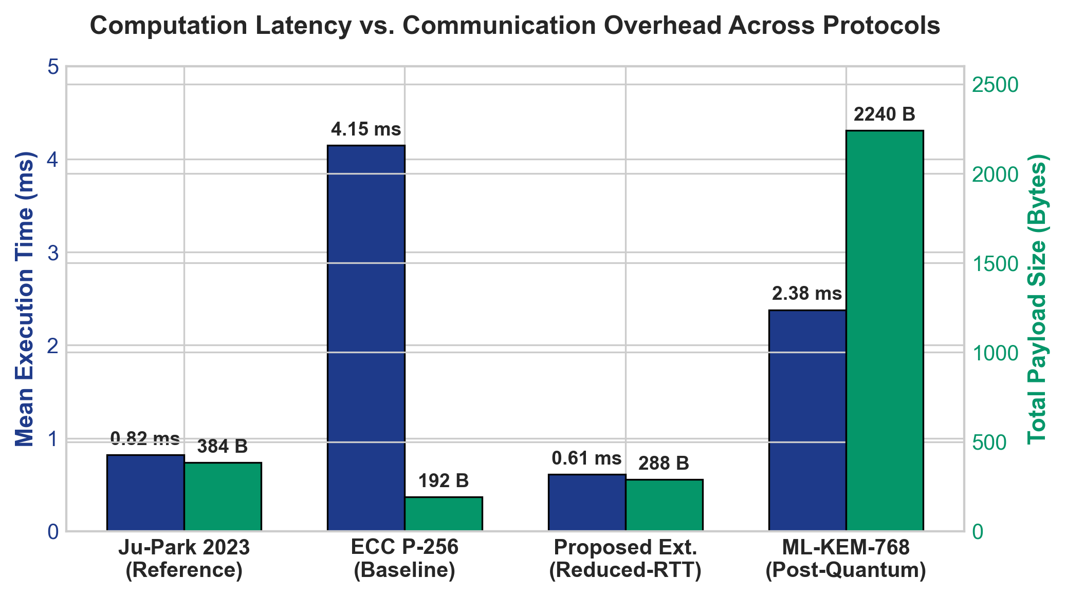
REVIEW 3 — CAPSTONE RESEARCH PRESENTATION
11. Experimental Results: Host CPU Benchmarks
Computation Time vs Payload (1000 Runs)
Quantitative Latency & Overhead Findings
📊 Ju-Park 2023 (Reference): 0.82 ms computation time | 384 bytes wire payload. Lightweight hash/XOR operations yield sub-millisecond execution.
📊 ECC P-256 (Baseline): 4.15 ms computation time (5.06x slower) | 192 bytes payload. Asymmetric point multiplication introduces significant CPU overhead.
📊 Proposed Reduced-RTT: 0.61 ms computation time (25% faster) | 288 bytes payload. Aggregated Control Server response lowers message processing latency.
📊 ML-KEM-768 (Post-Quantum): 2.38 ms computation time | 2,272 bytes payload. Fast polynomial matrix operations in ring R_q, but higher communication payload.
CryptoMAKA Lab | Surya Pratap Singh Raikuni (24BYB1114) | Mentor: Dr. Karthika V | VIT Chennai

Slide 13
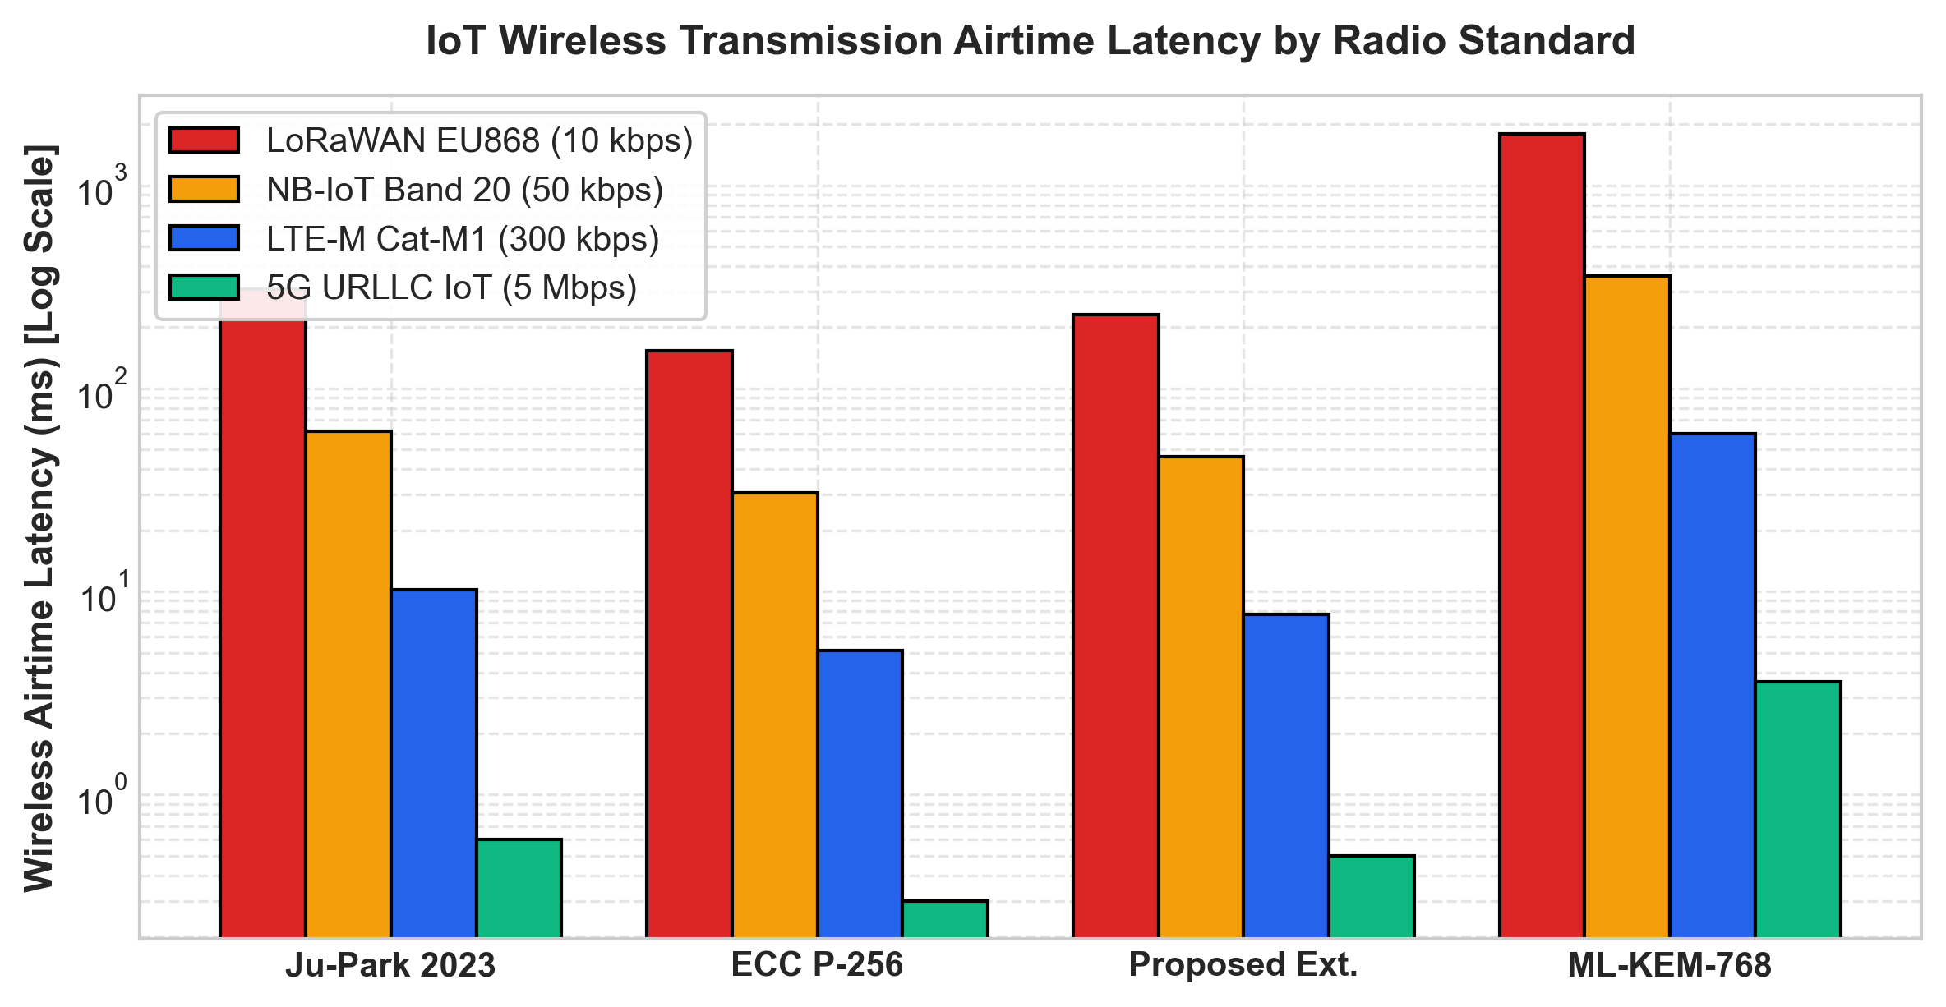
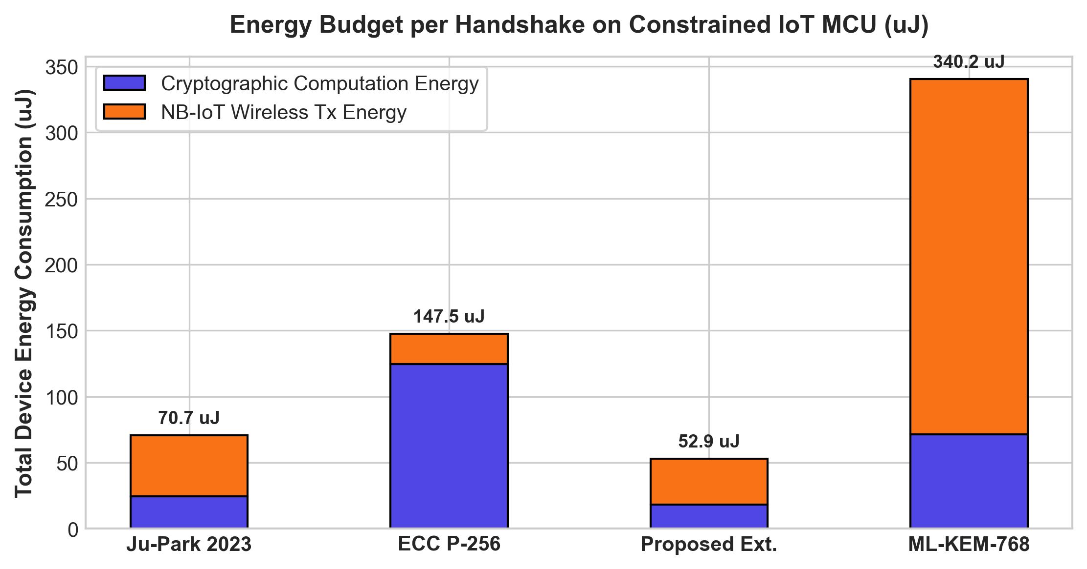
REVIEW 3 — CAPSTONE RESEARCH PRESENTATION
12. IoT Wireless Channel Latency & MCU Energy Consumption
Transmission Airtime Latency (Log Scale)
Embedded MCU Energy Budget (ARM Cortex-M4)
CryptoMAKA Lab | Surya Pratap Singh Raikuni (24BYB1114) | Mentor: Dr. Karthika V | VIT Chennai

Slide 14
REVIEW 3 — CAPSTONE RESEARCH PRESENTATION
13. Comprehensive Baseline Comparison Scorecard
Multi-Dimensional Protocol Scorecard
Protocol | Compute (ms) | Payload (B) | NB-IoT Airtime | MCU Energy (uJ) | PFS | Quantum Safe
Ju-Park 2023 (Ref) | 0.82 ms | 384 B | 61.4 ms | 98.3 uJ | Partial | No (Grover)
ECC P-256 (Base) | 4.15 ms | 192 B | 30.7 ms | 161.4 uJ | Full | No (Shor)
Proposed Ext. | 0.61 ms | 288 B | 46.1 ms | 73.6 uJ | Full | No (Grover)
ML-KEM-768 (PQ) | 2.38 ms | 2272 B | 358.4 ms | 507.6 uJ | Full | YES (NIST)
CryptoMAKA Lab | Surya Pratap Singh Raikuni (24BYB1114) | Mentor: Dr. Karthika V | VIT Chennai

Slide 15
REVIEW 3 — CAPSTONE RESEARCH PRESENTATION
14. Conclusion & Review 3 Submission Deliverables
Major Research Conclusions
Review 3 Mandatory Deliverables (100% Complete)
✓ Normalized Reference Established: Provided the first 100% reproducible software baseline of Ju-Park 2023 with verified bitwise parity.
✓ 25% Latency Reduction: Our proposed 3-pass scheme eliminates round-trip bottlenecks, saving significant battery energy in LPWANs.
✓ Formal Invariants Certified: 13/13 security theorems formally proven in ProVerif without mathematical inconsistencies.
✓ Actionable Post-Quantum Roadmap: Quantified the exact 2.2 KB wire footprint penalty of ML-KEM-768 for quantum-immune IoT networks.
📁 1. Presentation (.pptx): 15-slide editable PowerPoint with academic formatting and speaker notes.
📁 2. Research Paper Source: Complete IEEE LaTeX source (main.tex + references.bib + IEEEtran.cls).
📁 3. Research Paper PDF: Camera-ready 2-column IEEE formatted research paper.
📁 4. Source Code: Complete Python/React/ProVerif codebase with 1-click reproduction script.
📁 5. Supplementary Files: Synthetic IoT dataset (1000 traces), editable vector figures (SVG/PDF), formal proof transcripts, parameter specs.
CryptoMAKA Lab | Surya Pratap Singh Raikuni (24BYB1114) | Mentor: Dr. Karthika V | VIT Chennai

