Slide 1
Process and Related Information
Shriram K Vasudevan

Slide 2
Agenda
Process Concept
Process Scheduling
Operations on Processes
Interprocess Communication

Slide 3
Process Concept
We have already spent a lot of time on process during the session on File Descriptor. Let’s spend a little time here to get it re-touched!
Textbook uses the terms job and process almost interchangeably
Process – a program in execution; process execution must progress in sequential fashion. A program will be meaningful when it is compiled and executed. A program when run is a process!

Slide 4
Contd.,
A process includes:
program counter
stack
data section
Job and process are the same. Do not get confused. It’s fine to use both interchangeably and we prefer process over job.
Question for you!!
When you open a notepad, do you think it is the only process running in the machine?
Answer is no!! We have already proven the same.

Slide 5
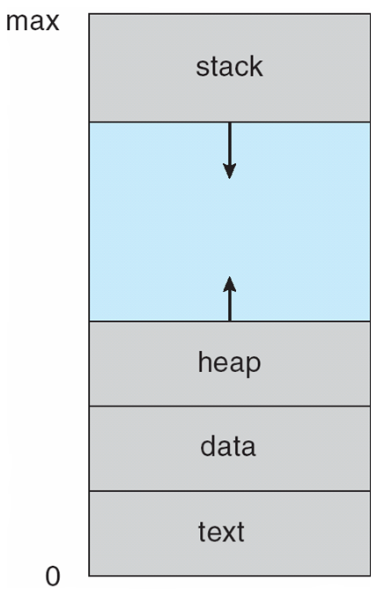
Contd.,
A process is more than the program code, which is sometimes known as the “text section”.
It also includes the current activity, as represented by the value of the “program counter” and the contents of the processor's registers.
A process generally also includes the “process stack”, which contains temporary data (such as function parameters, return addresses, and local variables), and a data section, which contains global variables.

Slide 6
Contd.,
A program is a “passive” entity, such as a file containing a list of instructions stored on disk (often called an executable file), whereas a process is an “active” entity, with a program counter specifying the next instruction to execute and a set of associated resources.
A program becomes a process when an executable file is loaded into memory.
Two common techniques for loading executable files are double-clicking an icon representing the executable file and entering the name of the executable file on the command line (as in prog. exe or a. out.)

Slide 7
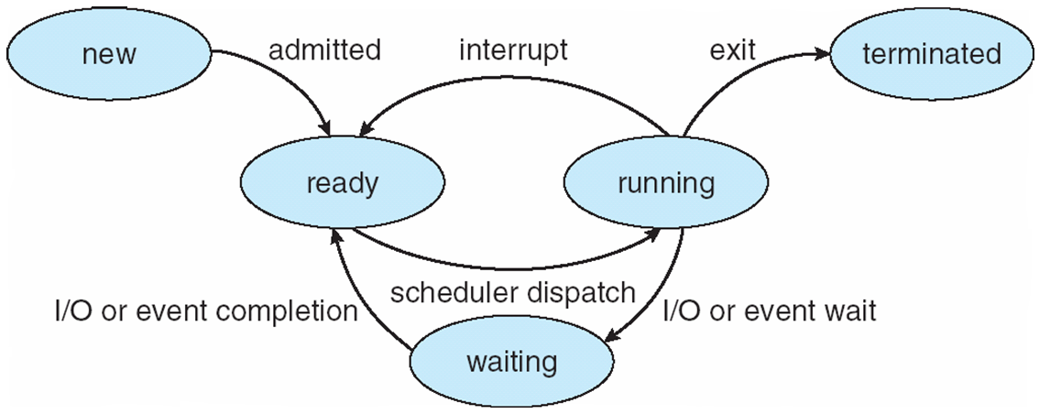
Contd.,
As a process executes, it changes state
new: The process is being created
running: Instructions are being executed
waiting: The process is waiting for some event to occur
ready: The process is waiting to be assigned to a processor
terminated: The process has finished execution
It is important to realize that only one process can be running on any processor at any instant.
Many processes may be ready and waiting, however.

Slide 8
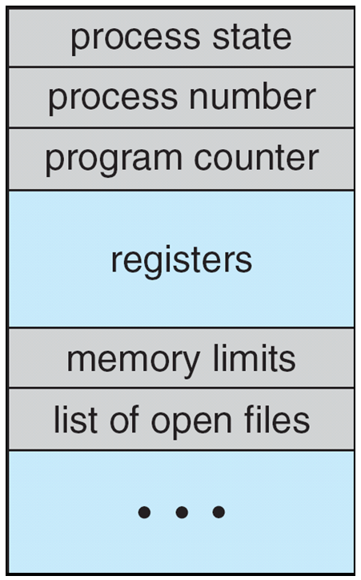
Process Control Block
Information associated with each process
Process state
Program counter
CPU registers
CPU scheduling information
Memory-management information
Accounting information
I/O status information
Lets C how Process Control Block Looks Like!!!

Slide 9
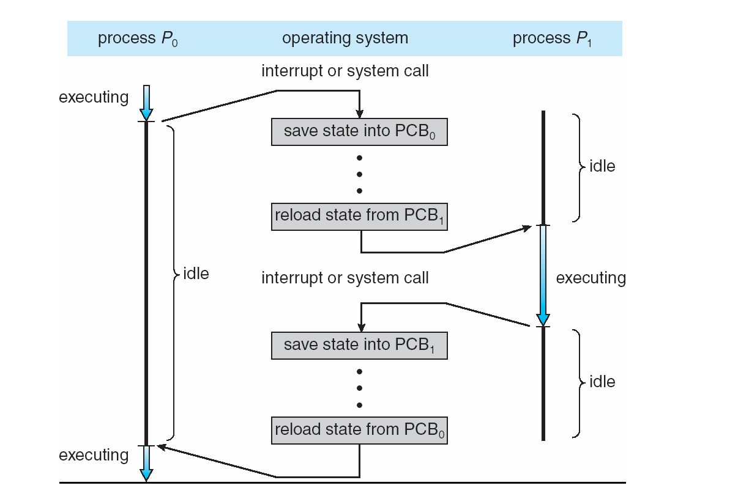
Contd.,
Process state: The state may be new, ready running, waiting, halted, and so on.
Program counter: The counter indicates the address of the next instruction to be executed for this process.
CPU registers: The registers vary in number and type, depending on the computer architecture.
They include accumulators, index registers, stack pointers, and general-purpose registers, plus any condition-code information.
Along with the program counter, this state information must be saved when an interrupt occurs, to allow the process to be continued correctly afterward

Slide 10
Contd.,
CPU-scheduling information: This information includes a process priority, pointers to scheduling queues, and any other scheduling parameters.
Memory-management information: This information may include such information as the value of the base and limit registers, the page tables, or the segment tables, depending on the memory system used by the operating system.
Accounting information: This information includes the amount of CPU and real time used, time limits, account numbers, job or process numbers, and so on.
I/O status information: This information includes the list of I/O devices allocated to the process, a list of open files, and so on.

Slide 11
Process Scheduling
The objective of multiprogramming is to have some process running at all times, to maximize CPU utilization.
The objective of time sharing is to switch the CPU among processes so frequently that users can interact with each program while it is running.
To meet these objectives, the process scheduler selects an available process (possibly from a set of several available processes) for program execution on the CPU.
For a single-processor system, there will never be more than one running process. If there are more processes, the rest will have to wait until the CPU is free and can be rescheduled.

Slide 12
Scheduling Queues
As processes enter the system, they are put into a job queue, which consists of all processes in the system.
The processes that are residing in main memory and are ready and waiting to execute are kept on a list called the ready queue.
This queue is generally stored as a linked list.
A ready-queue header contains pointers to the first and final PCBs in the list. Each PCB includes a pointer field that points to the next PCB in the ready queue.
Job queue – set of all processes in the system
Ready queue – set of all processes residing in main memory, ready and waiting to execute
Device queues – set of processes waiting for an I/O device. Processes migrate among the various queues

Slide 13
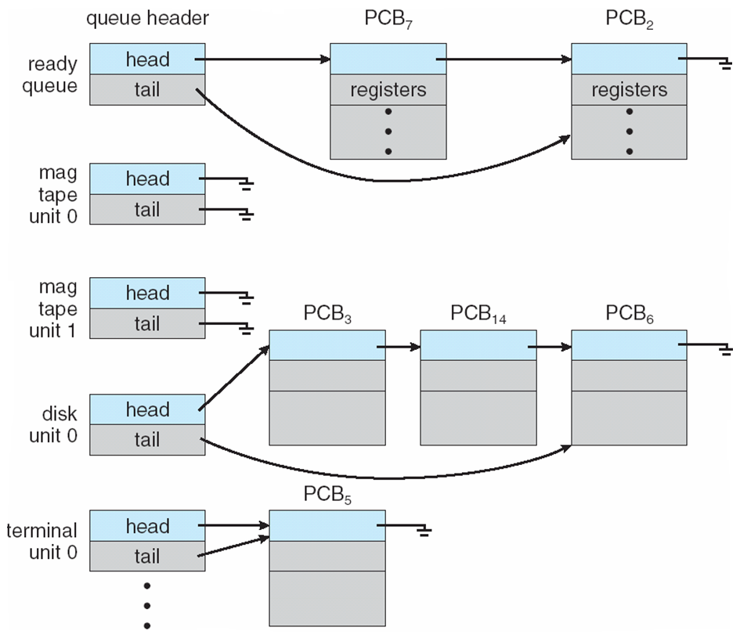
Contd.,
The system also includes other queues.
When a process is allocated the CPU, it executes for a while and eventually quits, is interrupted, or waits for the occurrence of a particular event, such as the completion of an I/0 request.
Suppose the process makes an I/O request to a shared device, such as a disk.
Since there are many processes in the system, the disk may be busy with the I/0 request of some other process.
The process therefore may have to wait for the disk. The list of processes waiting for a particular I/0 device is called a device queue. Each device has its own device queue.

Slide 14
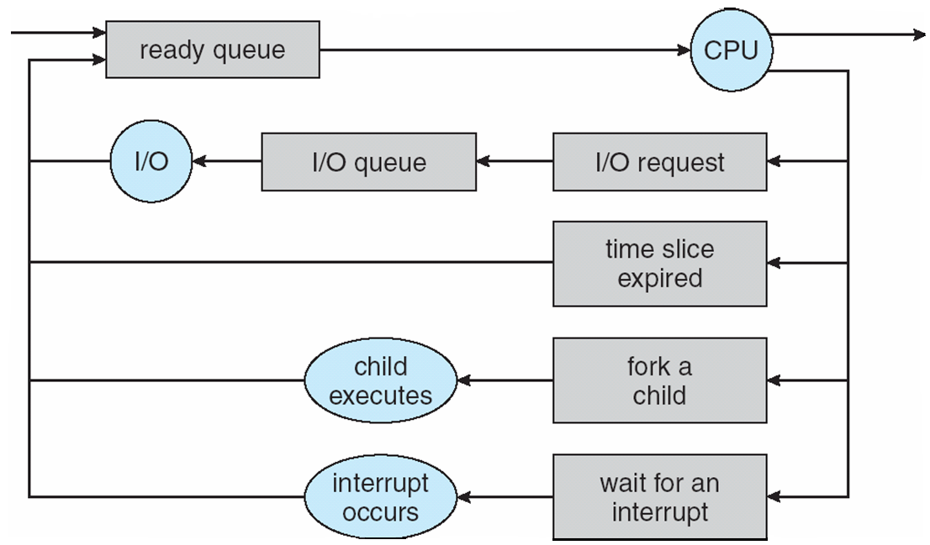
Contd.,
Each rectangular box represents a queue. Two types of queues are present: the ready queue and a set of device queues.
The circles represent the resources that serve the queues, and the arrows indicate the flow of processes in the system.
A new process is initially put in the ready queue. It waits there until it is selected for execution, or is dispatched.

Slide 15
Contd.,
Once the process is allocated the CPU and is executing, one of several events could occur:
The process could issue an I/0 request and then be placed in an I/0 queue.
The process could create a new sub process and wait for the subprocess's termination.
The process could be removed forcibly from the CPU, as a result of an interrupt, and be put back in the ready queue.

Slide 16
Schedulers
What does a scheduler do?
A process migrates among the various scheduling queues throughout its lifetime. The operating system must select, for scheduling purposes, processes from these queues in some fashion.
The selection process is carried out by the appropriate scheduler.
Am the best example buddy!! (Check my Timetable)
Long-term scheduler (or job scheduler) – selects which processes should be brought into the ready queue
Short-term scheduler (or CPU scheduler) – selects which process should be executed next and allocates CPU

Slide 17
Contd.,
Distinction between these two schedulers lies in frequency of execution.
The short-term scheduler must select a new process for the CPU frequently. A process may execute for only a few milliseconds before waiting for an I/0 request.
Often, the short-term scheduler executes at least once every 100 milliseconds. Because of the short time between executions, the short-term scheduler must be fast.
If it takes 10 milliseconds to decide to execute a process for 100 milliseconds, then 10 I (100 + 10) = 9 percent of the CPU is being used (wasted) simply for scheduling the work.

Slide 18
Contd.,
The long-term scheduler executes much less frequently; minutes may separate the creation of one new process and the next.
long-term scheduler make a careful selection.
CPU-bound process - in contrast, generates I/0 requests infrequently, using more of its time doing computations
I/O-bound process - spends more of its time doing I/O than it spends doing computations.
So what??
long-term scheduler select a good process mix of I/O-bound and CPU-bound processes.
If all processes are I/0 bound, the ready queue will almost always be empty, and the short-term scheduler will have little to do.
If all processes are CPU bound, the I/0 waiting queue will almost always be empty, devices will go unused, and again the system will be unbalanced.
The system with the best performance will thus have a combination of CPU-bound and I/O-bound processes.

Slide 19
Process Creation
Lets Fork it!!
All these are to be practically tested buddies!
How does fork ()??
Lets do some magic here! ☺
Fork internally calls clone function.
fork system call when called, it will return 2 return values.
one is > 0 that is for parent.
one is ==0 that is for child.
With this identity we can spot which is child and which is parent.
It is not mandatory that parent should be executed first always.
Child can also get execution time.
Orphan and Zombie!! (ps –al)

Slide 20
Contd.,
Parent process create children processes, which, in turn create other processes, forming a tree of processes
Generally, process identified and managed via a process identifier (pid)
Resource sharing
Parent and children share all resources
Children share subset of parent’s resources
Parent and child share no resources
Execution
Parent and children execute concurrently
Parent waits until children terminate

Slide 21
Contd.,
Process executes last statement and asks the operating system to delete it (exit)
Output data from child to parent (via wait)
Process’ resources are DE allocated by operating system
Parent may terminate execution of children processes (abort)
Child has exceeded allocated resources
Task assigned to child is no longer required
If parent is exiting
Some operating system do not allow child to continue if its parent terminates
All children terminated - cascading termination

Slide 22
Interprocess Communication
Processes within a system may be independent or cooperating
Cooperating process can affect or be affected by other processes, including sharing data
Reasons for cooperating processes:
Information sharing
Computation speedup
Modularity
Convenience
Cooperating processes need interprocess communication (IPC)
Two models of IPC
Shared memory
Message passing and Many more.. We call it system V IPC.

Slide 23
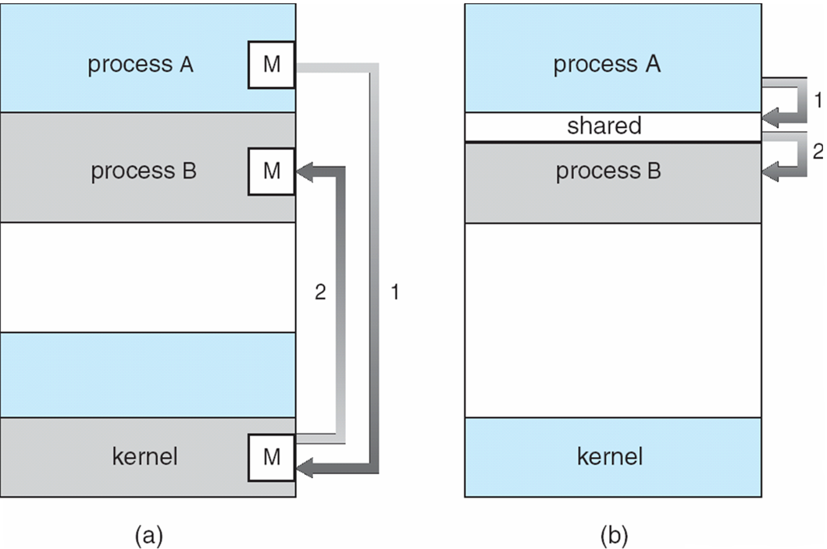
A Diagram…

Slide 24
Sample IPC Mechanisms.
Pipe
Named Pipe or FIFO
Signals
Message Queue
Semaphores (Work In lab.. I will teach theory and u code!!)
Shared Memory
Lets learn one by one!! Few you may have to learn yourself!! ☺

Slide 25
Pipe
Named Pipe (FIFO)

Slide 26
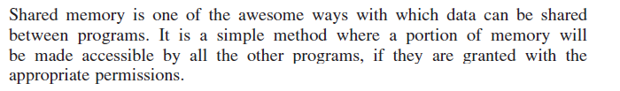
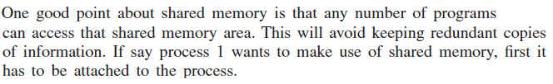
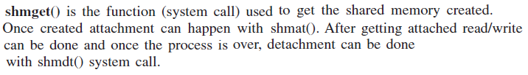
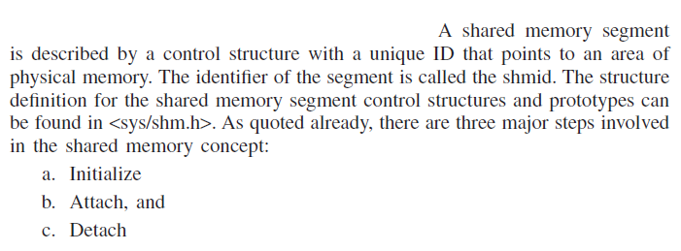
Shared Memory
Shared Memory - Write
Shared Memory - Read

Slide 27
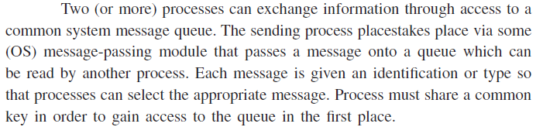
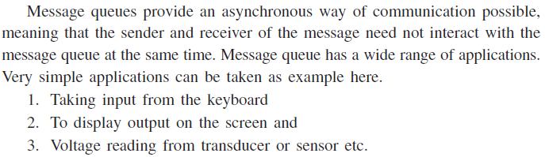
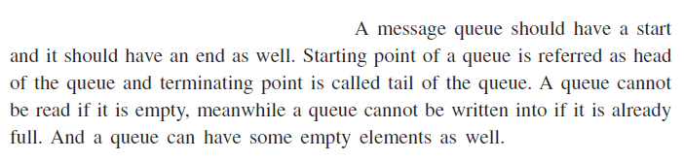
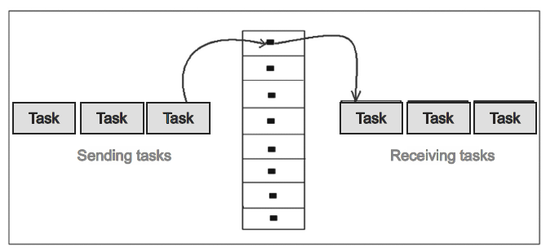
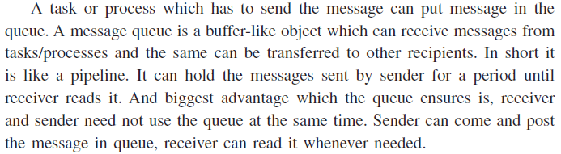
Queue
Receiver
Sender

Slide 28
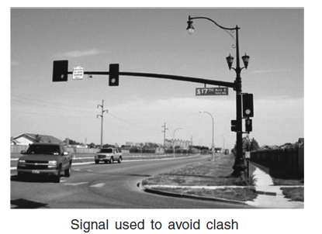
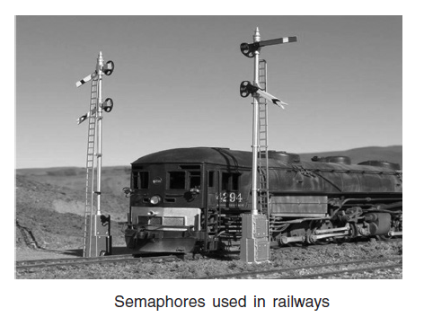
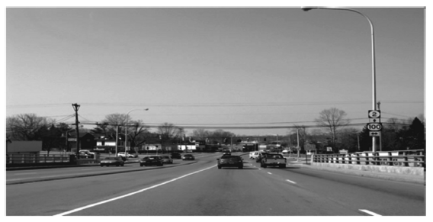
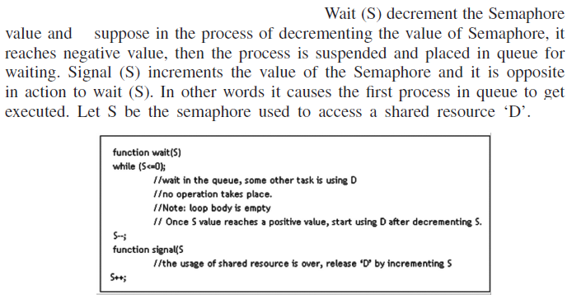
Semaphores

Slide 29
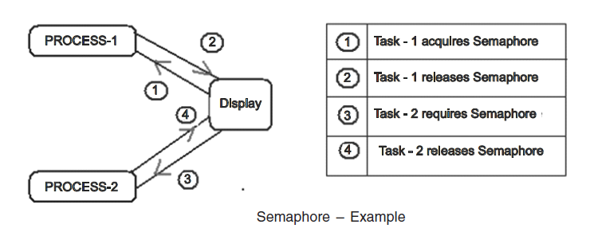
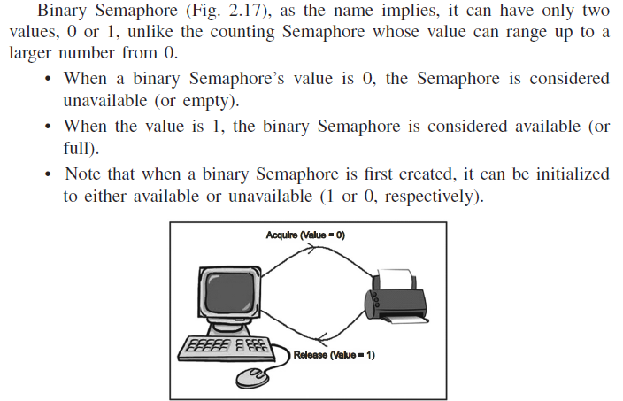
Contd.,
YOU CODE NOW!! I LET YOU FREE TO USE ANY RESOURCE! THIS IS AN IMPORTANT QUESTION IN LAB AND THEORY FRIENDS!!! ☺

Slide 30
Signaling – Lets learn it! Its important! A Brief introduction, There is a long way to go..
Why Signal?
Signal is an important way of communication between processes.
A signal can be an intimation that is generated internal or external process.
For an example when a CTRL + C is issued in the terminal, a signal called sigint will be generated.
How many signals are there? Hold on baby!
=> just try kill –l. It will display all the signals.
When a signal is generated what can be the further actions?
There are three possible actions.
Signal can go ahead and do its default action.
Signal can be ignored
Signal can be asked to go for signal handler.

Slide 31
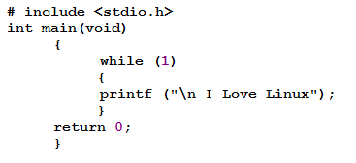
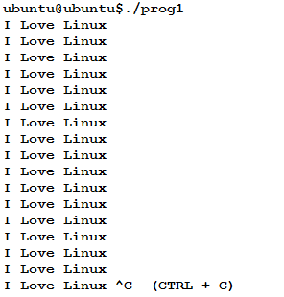
Contd., I LOVE LINUX
A sample program for printing “I LOVE LINUX” is executed and CTRL + C is issued. There SIGINT will be generated and the process will be finished.

Slide 32
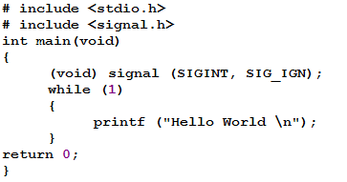
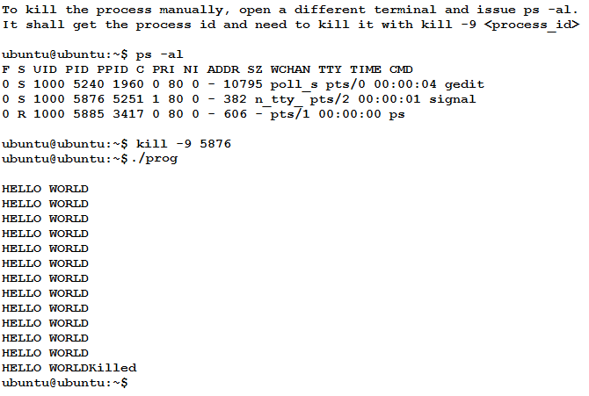
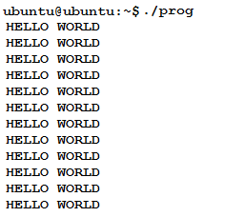
Usage of SIG_IGN (Ignore)
attempt has been made to ignore the signal SIGINT (CTRL + C). After execution with ./prog, reader can issue CTRL+C from keyboard. It will be ignored and will not have any effect. To stop the process, manual killing is required

Slide 33
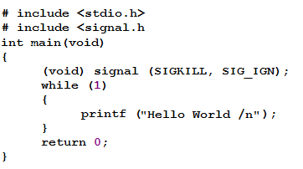
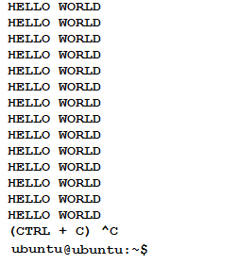
Usage of SIG _IGN for unstoppable signals
A small program again has been presented below for the reader to understand that SIGKILL can’t be ignored.
In the execution, with ./prog, issue CTRL + C, it will be killed immediately and it will prove tha0t SIGKILL can’t be ignored.

Slide 34
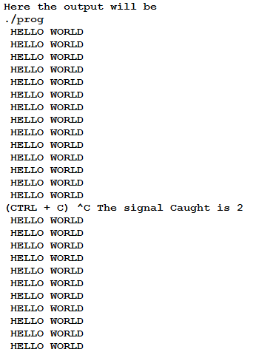
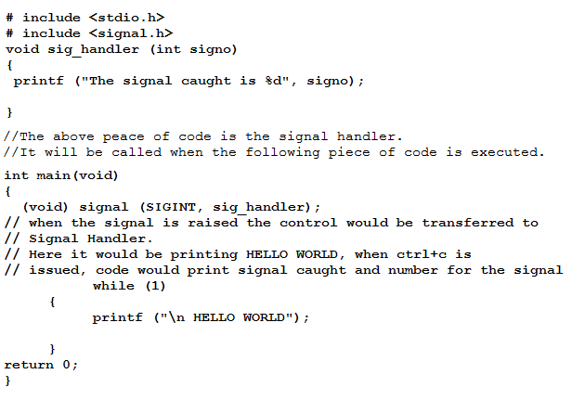
Signal handler usage
When the signal is encountered the signal handler would be called. A simple example would prove this concept.

Slide 35
Lets go to the final part of Unit – I

