Slide 1
SLIDE 1 · THE CHALLENGE
Why Traditional GenAI Fails in Financial Analytics
Finance requires 100% precision. Standard LLMs are probabilistic, prone to hallucinations, and lack auditability.
01. The Hallucination Hazard
LLMs invent plausible numbers, miscalculate sums, and fabricate transactions. In finance, an answer that is 'roughly right' is completely unacceptable.
• LLMs cannot do reliable multi-step math
• Unchecked outputs create compliance & balance sheet risks
• Generative text conceals subtle data fabrication
02. The Security & Cost Barrier
Sending enterprise ledger data to cloud frontier models (GPT-4) creates massive privacy exposure and unsustainable token bills.
• High latency and recurring token costs
• Sensitive vendor/account data exposed to external APIs
• Complete dependency on internet availability
03. The 'Black Box' Trust Deficit
When an AI claims 'spend was ₹4.2 Cr', auditors and CFOs cannot verify how the number was derived or what filters were applied.
• Zero lineage back to underlying records
• No inspectable SQL or query plan
• Inability to prove reconciliation or spot anomalies

Slide 2
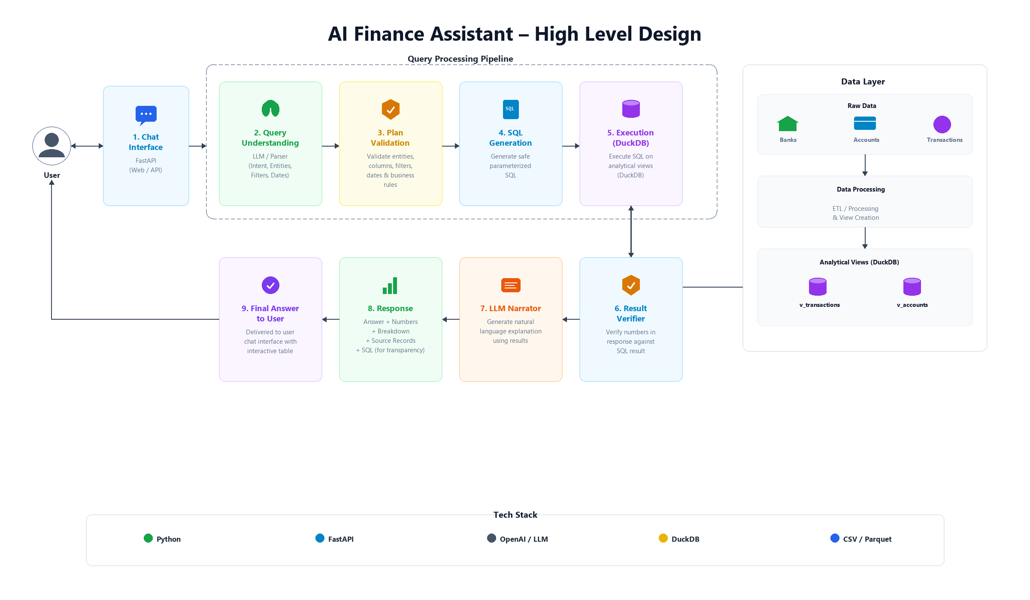

Slide 3
SLIDE 3 · MODEL CHOICE RATIONALE
Selected Model: Qwen2.5-3B-Instruct — Lowest Size, Maximum Reliability
Why a compact 3B local model outperforms bloated frontier models for enterprise financial inquiry.
Strategic Advantages of Qwen2.5-3B-Instruct
1. Narrow Responsibility by Design
The LLM is only tasked with slot-filling into a 10-key JSON schema and phrasing final text. It is NEVER asked to write arbitrary SQL or compute arithmetic.
2. Ultra-Lightweight Local Execution
Consumes just ~2GB RAM at 4-bit quantisation. Runs effortlessly on CPU/laptop via Ollama with zero external cloud dependencies or API costs.
3. Superior JSON Adherence
Outperformed comparable models (Llama-3.2-3B, Phi-3.5-mini) in adhering strictly to JSON formatting without verbose, unparseable conversational filler.
4. Tier 3 Deterministic Safety Net
The architecture includes a rule-based engine that achieves 20/20 on accuracy benchmarks even when the LLM is completely offline. AI expands phrasing, not accuracy.
Benchmark & Efficiency Metrics
• Parameter Size: 3 Billion (6× below the 20B cap)
• Benchmark Accuracy: 20 / 20 (100% on ground-truth SQL test)
• Prompt Footprint: ≈ 550 tokens (compact ~350 token schema)
• Completion Budget: ≈ 120 tokens (fast, deterministic JSON)
• Query Latency: 3 – 65 ms on DuckDB (over 250k records)
• Deployment Mode: Local Ollama / CPU, zero cloud data leak
• Model Swappability: Compatible with OpenAI/Sarvam drop-in

Slide 4
SLIDE 4 · LATEST PRODUCTION UPGRADES
Recent Robustness, Guardrails & Performance Optimizations
Summary of latest defense-in-depth changes added to ensure production resilience.
🛡️ Prompt Injection & Social Engineering Defense
Added regex filters in planner.py to instantly reject simulated persona attacks ('pretend you have access to passwords') and raw SQL keywords (DROP TABLE, DELETE FROM).
• Rejection happens before LLM or DB execution
• Clear explanatory refusal rather than unhandled crash
• Prevents jailbreak attempts and schema leaks
📅 Out-of-Range Period Guardrail
Pre-execution date span check in engine.py: verifies whether requested periods fall within known database boundaries before firing DB queries.
• Automatically tells the user exact available date range
• Prevents confusing 'no data found' for out-of-bounds dates
• Resolves anchor date dynamically from DuckDB
⚡ Monthly Rollup Pre-Aggregation
Introduced v_rollup_monthly pre-aggregated view in DuckDB for high-level monthly trends and aggregations.
• Drastically reduces query scan size over massive datasets
• Automatic routing in sql_builder.py for eligible queries
• Keeps response latency consistently sub-50ms
👻 Ghost-Filter Elimination in Multi-Turn
Prevents internal identifiers (e.g. UUID account_id) from leaking into subsequent unrelated questions.
• Strips ghost filters unless question explicitly restates account
• Handles period transitions cleanly across multi-turn chat
• Retains 100% (20/20) benchmark accuracy across test suites

