Slide 1

Seasonal Agriculture Performance Analysis
Chollangi Devi Sri Surya Sankar
Kakinada Institute of Engineering and Technology
AICTE STU ID : STU66750ca69d2db1718946982

Slide 2

PROBLEM STATEMENT
Agricultural activities are influenced by seasonal variations in environmental conditions, farming practices, resource availability and market conditions. As a result, agricultural performance may differ from one season to another.
However, raw agricultural data does not clearly explain how agricultural performance changes across seasons or what patterns can be observed in different seasonal conditions.
The problem is to analyze the given agricultural dataset and investigate seasonal differences in agricultural performance by identifying meaningful patterns, trends, relationships and variations within the available data.

Slide 3
PROJECT DESCRIPTION
Seasonal Agriculture Performance Analysis is a data analysis project that studies how agricultural performance changes across the Kharif, Rabi, and Zaid seasons.
The project analyzes 4,000 agricultural records covering environmental conditions, soil characteristics, farming practices, irrigation, water usage, crop yield, production, revenue, cost, profit, and disease/pest risk.
Using Python, NumPy, Pandas, Matplotlib, and Seaborn, the project identifies seasonal patterns, compares agricultural and economic performance, examines relationships between environmental and farming factors, and highlights unusual variations.
The analysis provides data-driven insights and recommendations to support better seasonal crop planning, efficient resource utilization, water management, and improved agricultural profitability.

Slide 4

WHO ARE THE END USERS?
Farmers – For crop selection, seasonal planning, and efficient resource usage.
Agricultural Planners – For analyzing seasonal trends and planning agricultural activities.
Government & Agricultural Departments – For policy-making and resource planning.
Agricultural Researchers – For studying seasonal, environmental, and crop performance patterns.
Irrigation & Resource Managers – For improving water usage and irrigation efficiency.
Agribusiness Companies – For evaluating crop performance, costs, revenue, and profitability.

Slide 5

TECHNOLOGIES USED
Python – Main programming language for data analysis.
NumPy – Numerical calculations and statistical operations.
Pandas – Data loading, cleaning, and data manipulation.
Matplotlib – Creating data visualizations and charts.
Seaborn – Statistical visualization and graphical analysis.
Google Colab – Cloud-based environment used to develop and run the project.
Git & GitHub – Version control and project hosting.

Slide 6
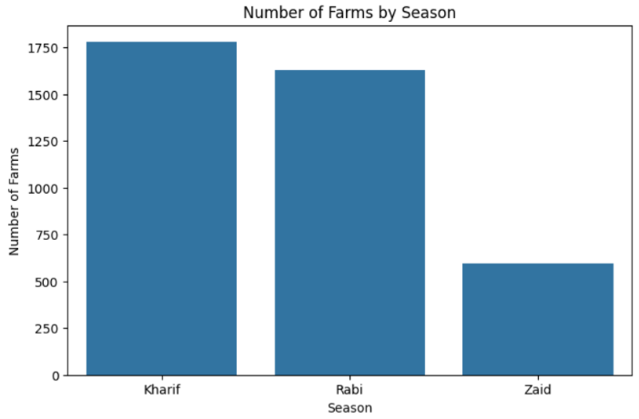
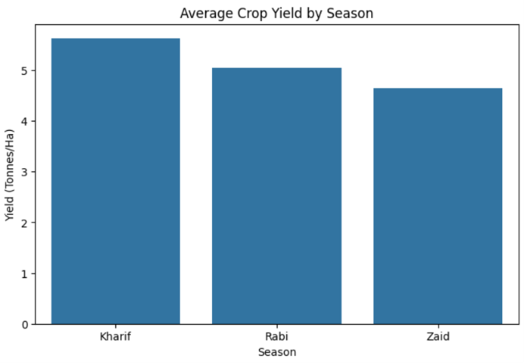
RESULTS

Slide 7
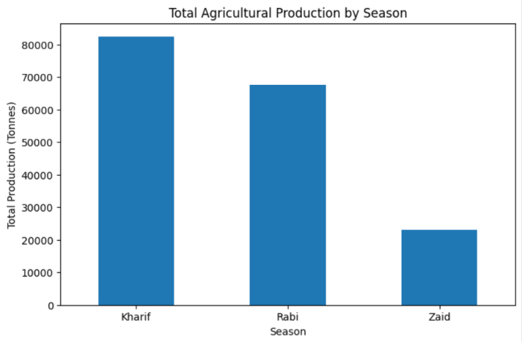
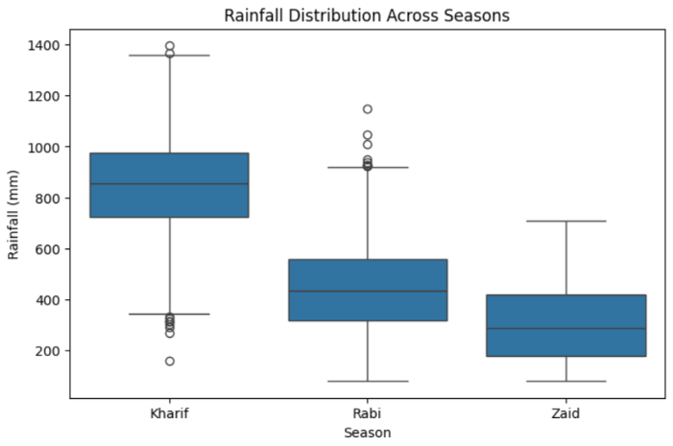
RESULTS

Slide 8
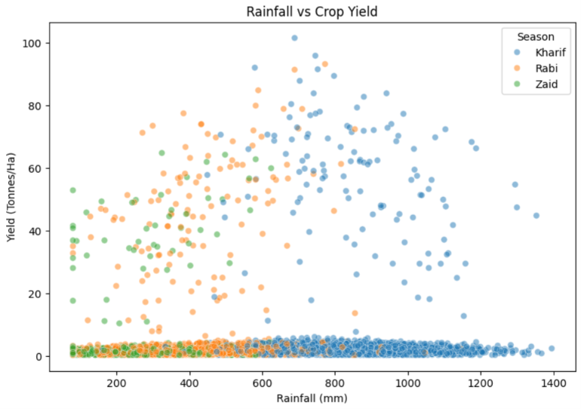
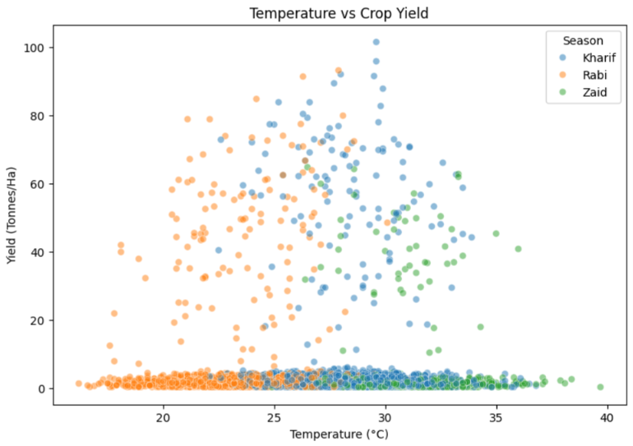
RESULTS

Slide 9
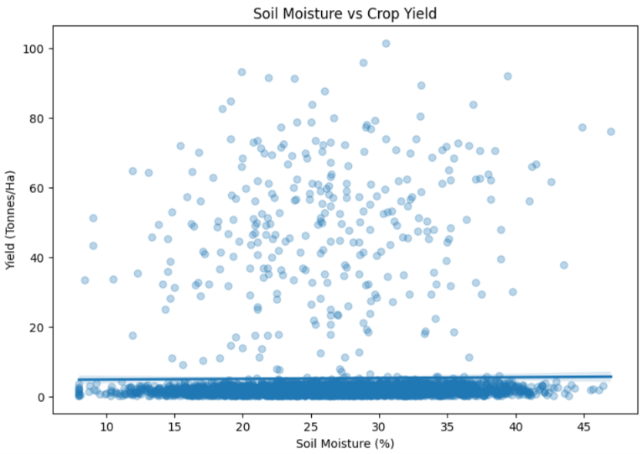
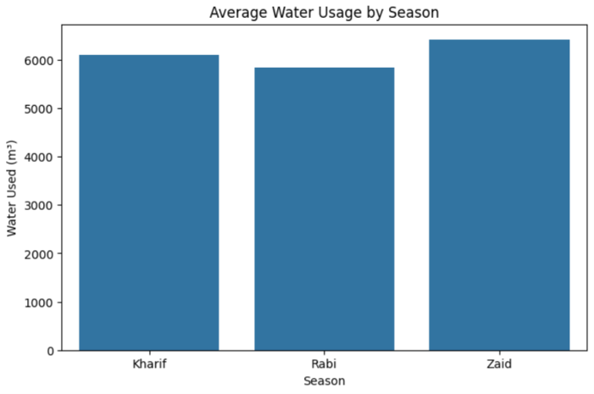
RESULTS

Slide 10
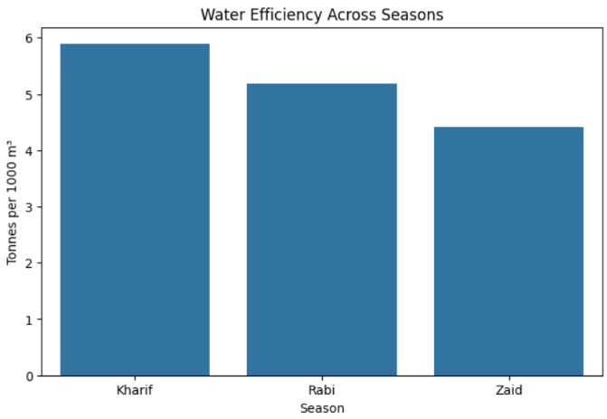
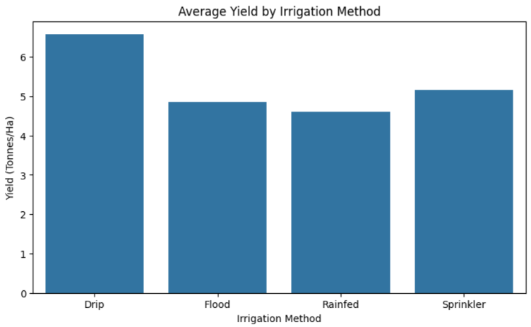
RESULTS

Slide 11
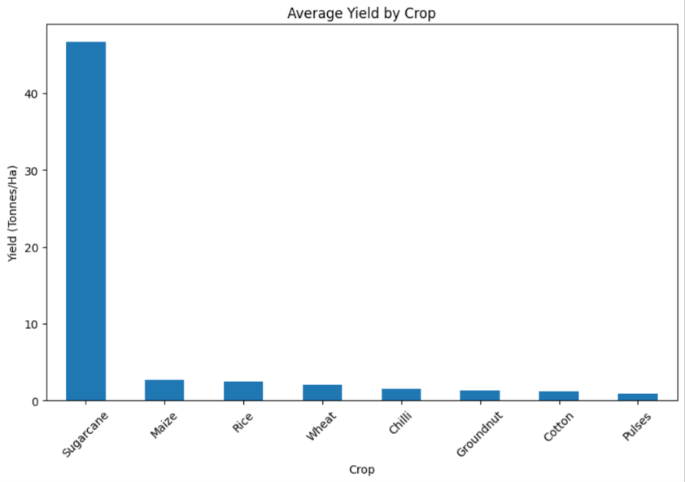
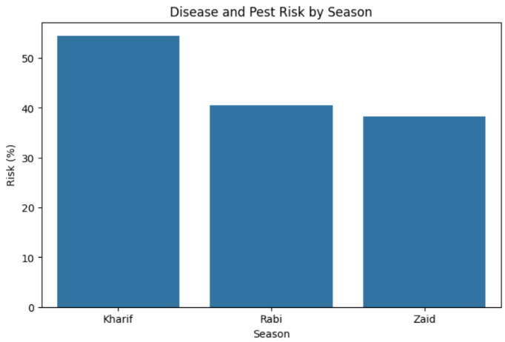
RESULTS

Slide 12
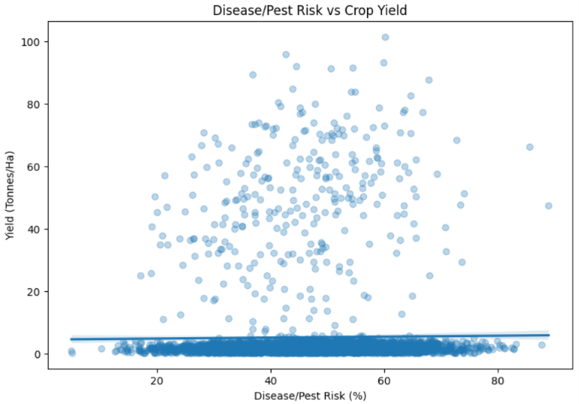
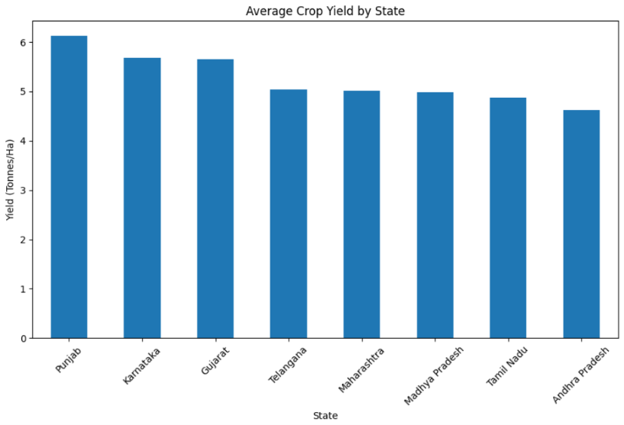
RESULTS

Slide 13
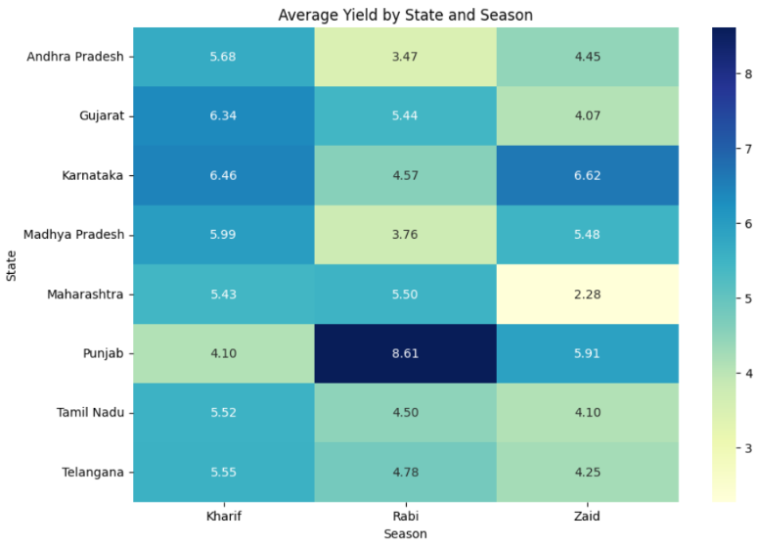
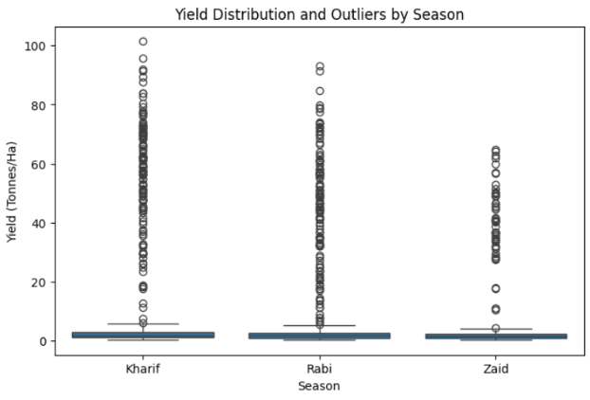
RESULTS

Slide 14
Future scope
Predictive Analysis – Develop machine learning models to predict crop yield and seasonal profitability.
Crop Recommendation – Recommend suitable crops based on season, soil, weather, and resource availability.
Weather Integration – Incorporate real-time weather data for better seasonal planning.
Regional Analysis – Perform detailed analysis at state and district levels.
Market Analysis – Integrate real-time market prices to estimate expected revenue and profit.
Interactive Dashboard – Build an interactive dashboard for farmers, planners, and agricultural departments.
Early Risk Detection – Improve disease and pest risk analysis to support preventive action.

Slide 15
GitHub Link
https://github.com/SuryaSankar18/Seasonal_Agriculture_Performance_Analysis.git
📂 Repository Contains
📓 Google Colab Notebook
📊 Agriculture Dataset
📝 Problem Statement File
📋 README File
🖥️ Project PPT Presentation

Slide 16

VOIS Course completion certificate - Course name- Data Visualization

Slide 17
Thank you
.
.

