Slide 1
Reducing the amount of push notifications for e-commerce apps
PIP104 University Project-II
Final Review
Batch Number: CIT-G22
Roll Number | Student Name
20211CIT0020 | B.SURYA TEJA
20211CIT0020 | GALI PAVAN KUMAR REDDY
20211CIT0191 | DONEPARTHI JIMITESH NITIN KUMAR
20211CIT0033 | KUNCHAM RAVI TEJA
Under the Supervision of,
Dr . SYED SIRAJ AHMED
School of Computer Science and Engineering
Presidency University
Name of the Program: Btech CSE(IOT)
Name of the HoD: Dr . Anandaraj S P
Name of the Program Project Coordinator: Dr. Sharmasth Vali Y
Name of the School Project Coordinators: Dr. Sampath A K / Dr. Abdul Khadar A / Mr. Md Ziaur Rahman

Slide 2
ABSTRACT
Push notifications are a powerful way to engage users and increase sales in e-commerce apps, but sending too many, especially irrelevant ones, can lead to user fatigue and app uninstalls. This project aims to find the right balance by reducing notifications while keeping them impactful.
Using Flutter for cross-platform development and Firebase for backend support, we built a system that delivers timely, personalized notifications. Firebase Cloud Messaging handles notification delivery, while tools like Firestore and Realtime Database ensure a smooth, real-time app experience.
Machine learning plays a key role in understanding user behavior and preferences. By analyzing purchase patterns and grouping users into segments, the system sends only relevant and valuable notifications. This focus on personalization and context reduces unnecessary messages.
The results show that fewer, better notifications improve user satisfaction, retention, and engagement. By combining modern tools like Flutter, Dart, and Firebase, this approach solves a common challenge in e-commerce while keeping users happy and connected.

Slide 3
Introduction
General Overview
Push notifications have become an essential tool for businesses to communicate with smart phone customers in the ever-changing ecosystem of mobile apps. These ads provide direct interaction with consumers and provide content that can enhance their app experience.
However, advertisers seeking to increase consumer acceptance must strike a difficult balance between providing value and minimizing distraction.The aim is to guide advertisers towards a more user-centric approach and highlight the importance of personalization and control to maximize the mobile experience.
The growing use of push notifications in mobile apps creates challenges for advertisers and developers as setting the right frequency becomes critical for user acceptance.

Slide 4
Importance of Push Notifications in Food Delivery Apps
Order Updates: Real-time status updates for orders.
Promotions: Notify users about discounts and personalized deals.
Engagement: Encourage app usage with reminders, rewards, or new features.
Critical Alerts: Inform users of issues like delays or unavailable items.
Challenges of Excessive Notifications
Notification Fatigue: Overloading users with messages leads to frustration.
Relevance Issues: Generic messages result in low engagement.
Technical Limitations: High-volume notifications require robust systems.
Segmentation Problems: Poor targeting reduces user satisfaction.
Enhancing User Experience Through Personalized Notifications
User-Centric Focus: Tailor notifications to individual preferences to boost engagement.
AI & Behavioral Insights: Leverage machine learning to predict user needs and deliver timely updates.
Best Practices: Focus on timing and value for non-intrusive, meaningful messages.
Real-Time Updates: Ensure users are informed, reducing anxiety and building trust.
Security & Privacy: Respect user data with transparent handling and compliance.

Slide 5
Advantages of Reducing Notifications
Improved User Experience: Less clutter and no fatigue.
Meaningful Engagement: Higher relevance and better retention.
Enhanced Brand Image: Respectful and thoughtful communication builds trust.
Higher Quality Notifications: Focus on valuable content increases open rates.
Disadvantages of Reducing Notifications
Reduced Engagement: Missed opportunities for timely promotions.
Lower Conversion: Fewer alerts might result in missed deals.
Brand Visibility: Reduced presence could lead to user disengagement.
Critical Delays: Fewer notifications might hinder timely problem-solving.
Limited Personalization: Less frequent offers may weaken user interest.

Slide 6
Software Components :
SL.NO | Technologies | Version
1 | Visual Studio Code | 1.86
2 | Android Studio | 2024.2.1
3 | Flutter SDK | 3.27
4 | Dart SDK | 3.6.0
5 | Firebase | V9
Key Tools and Technologies :
Firebase: Offers robust tools for notifications, analytics, predictions, and real-time updates.
Flutter: Simplifies cross-platform development, saving time and resources.
Dart: A modern language for efficient app development.
Android Studio Emulator: Enables testing without physical devices.

Slide 7
Literature Review
R.V. Karthik and Sannasi Ganapathy proposed a modle in their study, the researchers sought to tackle the limitations of traditional recommendation systems, which often struggle to accurately capture vague or unclear customer preferences. They proposed an innovative system that integrates sentiment analysis, ontology, and fuzzy logic to provide a deeper understanding of customers' interests and behaviors.
The system uses sentiment analysis to evaluate customer reviews and determine the emotional tone of feedback, helping to capture more precise customer preferences. Ontology is then applied to structure knowledge by defining the relationships between products, categories, and user preferences, enabling the system to generate more insightful recommendations. Fuzzy logic is employed to handle uncertainty and imprecision in customer data—such as vague preferences like “sometimes liking spicy food”—ensuring that the system still offers relevant product suggestions based on these unclear cues.
The study's findings revealed that this hybrid approach significantly improved the personalization of product recommendations. By combining emotional insights from sentiment analysis, structured knowledge from ontology, and the flexibility of fuzzy logic, the system was able to offer more tailored and meaningful product suggestions. Customers received not only items that aligned with their expressed preferences but also those they might not have realized they wanted, leading to a more enjoyable and satisfying shopping experience.

Slide 8
Gautam Chauhan, et.al., proposed a model the authors identified that excessive or irrelevant push notifications often frustrate users, leading to app uninstalls. To address this, they designed a personalized recommender system that uses customer behavior, preferences, and past interactions to send tailored notifications. Rather than sending generic messages, the system delivers relevant notifications based on users' interests, like offering a discount on fitness gear for a frequent shopper of athletic products.
Using machine learning algorithms, the system analyzes user data to predict useful notifications, making them feel more like helpful reminders. The approach led to higher engagement, with better click-through rates and retention, proving that quality notifications can strike a balance between keeping users informed and avoiding notification fatigue.
This research demonstrates how leveraging technology for personalized push notifications can enhance user experience, trust, and loyalty in e-commerce platforms.

Slide 9
Nabilah ZhafiraViderisa, et.al., invented a model there study focused on designing push notifications that are relevant and useful by using a User-Centered Design (UCD) approach. The researchers gathered insights directly from users about their preferences, shopping habits, and what types of notifications they found helpful. By analyzing user behavior, such as browsing history and purchase patterns, the system ensured notifications were tailored to individual interests, like offering fashion discounts to frequent clothing shoppers.
Timing and frequency were also key elements, with the team working with users to strike the right balance—notifications that are informative without being overwhelming. The findings showed that involving users in the design process improved notification effectiveness, leading to greater user satisfaction and engagement.
This study underscores the value of personalized, well-designed push notifications in e-commerce. By focusing on user preferences, businesses can strengthen customer relationships, improve retention, and boost sales, benefiting both users and platforms.

Slide 10
Objectives
Make Notifications Personal Send notifications that match each user's interests, like favorite dishes or special offers. Use Firebase Cloud Messaging (FCM) for personalization and Flutter for a polished look.
Reduce Unnecessary Notifications Only send important updates. Firebase Analytics helps understand user needs, while Flutter makes managing notifications easy.
Perfect Timing Send notifications when they’re most useful, like lunchtime offers or cart reminders. Use Firebase Predictions and machine learning for optimal timing.
Build Trust with Personalization Use Firebase segmentation to send highly relevant alerts, like discounts on favorites or restocked items.
Encourage Daily Use Analyze user habits with Firebase Analytics to refine the app’s features. Flutter ensures smooth performance.

Slide 11
6. Put Users in Control Let users customize notification preferences, including types and frequency, with Firebase’s database and Flutter’s user-friendly design.
7. Learn and Improve Continuously Use A/B testing and user feedback to refine notification strategies over time.
8. Simplify for Developers Use Firebase automation and Flutter’s single codebase to streamline updates and notification management.

Slide 12
Methodology
Goal: Reduce unnecessary notifications while keeping them personalized, timely, and relevant to improve user engagement and satisfaction.
App Design:
Login & Registration: Easy and user-friendly setup for new and returning users.
Home Page: Organized food categories, deals, and high-quality images for smooth browsing.
Customizable Orders: Detailed item descriptions, reviews, and add-ons for personalization.
Order Management:
Flexible cart for adjustments and real-time price updates.
Secure payment system with encrypted transactions.
Instant payment confirmation with order details and delivery time.
Smart Notifications:
Personalized Alerts: Notifications based on user behavior and preferences.
Timing Matters: Send messages during relevant times (e.g., lunchtime).
Less Spam: Consolidate related updates into one clear notification.

Slide 13
Reducing Overload:
Trigger notifications only for important events (e.g., order updates, special offers).
Use silent notifications for non-urgent updates like delivery tracking.
Provide a "Notification Center" for users to check alerts at their convenience.
User Feedback & Metrics:
Collect user ratings on notifications to improve relevance.
Analyze data like open rates and retention for better strategies.
Test different notification styles and timing using A/B testing.
Machine Learning:
Predict user preferences and send personalized offers at the right times.
Use behavioral data to optimize notification delivery.
Long-Term Focus:
Minimize notification fatigue with relevant and spaced alerts.
Build trust and loyalty through a balanced, user-first approach.

Slide 14
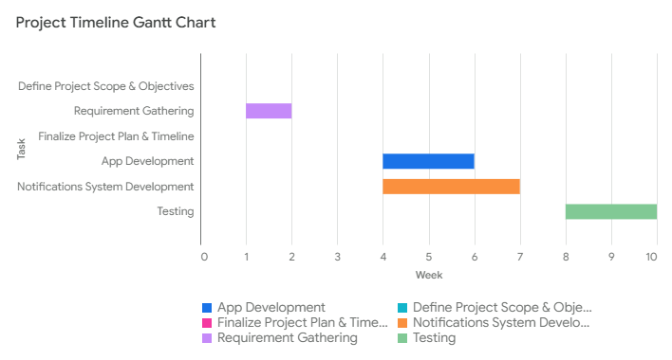
TIMELINE FOR EXECUTION OF PROJECT
Project Planning and Research: Week 1, Week 2
Define Project Scope and Objectives: Week 1
Requirement Gathering: Week 1, Week 2
Finalize Project Plan and Timeline: Week 3
Development Phase: Week 4, Week 5, Week 6, Week 7, Week 8, Week 9
App Development: Week 4, Week 5, Week 6
Notifications system Development: Week 4, Week 5, Week 6, Week 7
Testing: Week 8, Week 9, Week 10

Slide 15
Expected Outcomes
Increased Awareness: Enhanced understanding of the customers data like: History, Product views etc.
Better Analytics: With fewer notifications ,it becomes easier to analyze user behavior and preference, leading to more effective marketing strategies
Increased Engagement Rates: Targeted and relevant notifications can lead to higher engagement, as users are more likely to interact with fewer.
User Experience: Fewer notifications can help reduce user annoyance and leading to a more positive perception of the app.
Reduced Uninstall Rates:
Minimizing annoying notifications can decrease the likelihood of users uninstalling the app out of frustration.
Cost Saving: Reducing the volume of notifications may lead to cost savings related to infrastructure and resources needed to manage and send to customers.

Slide 16
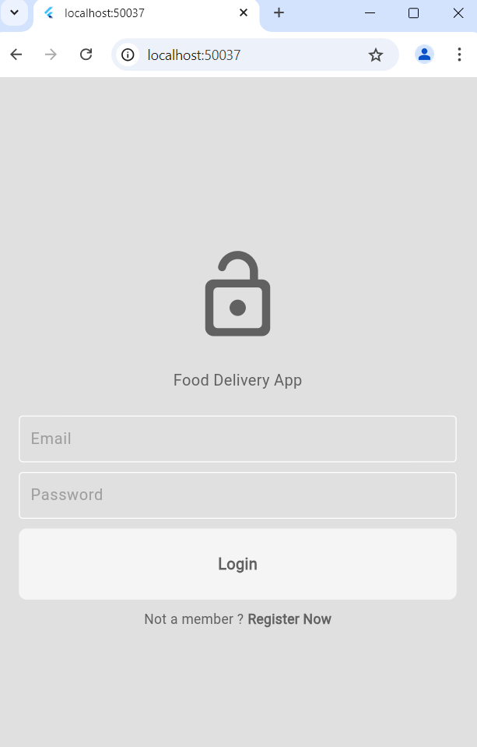
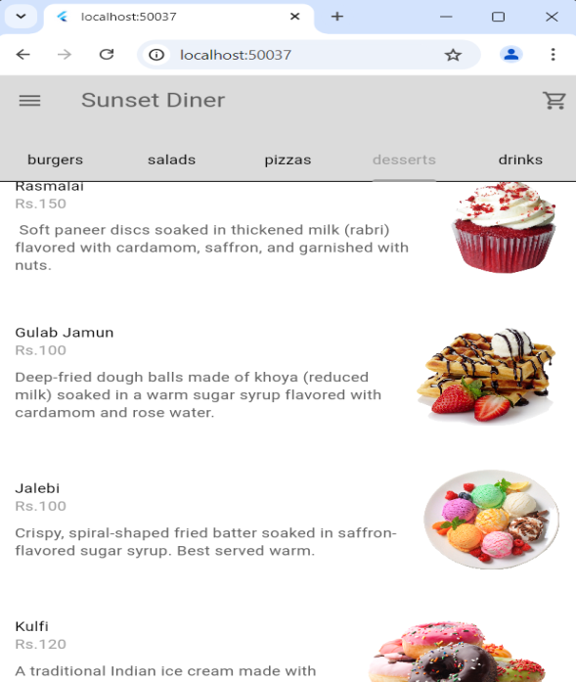
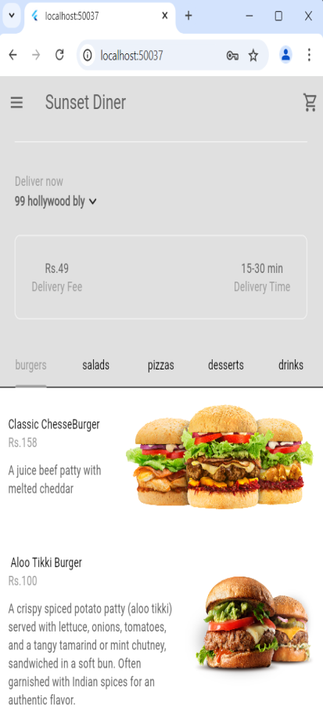
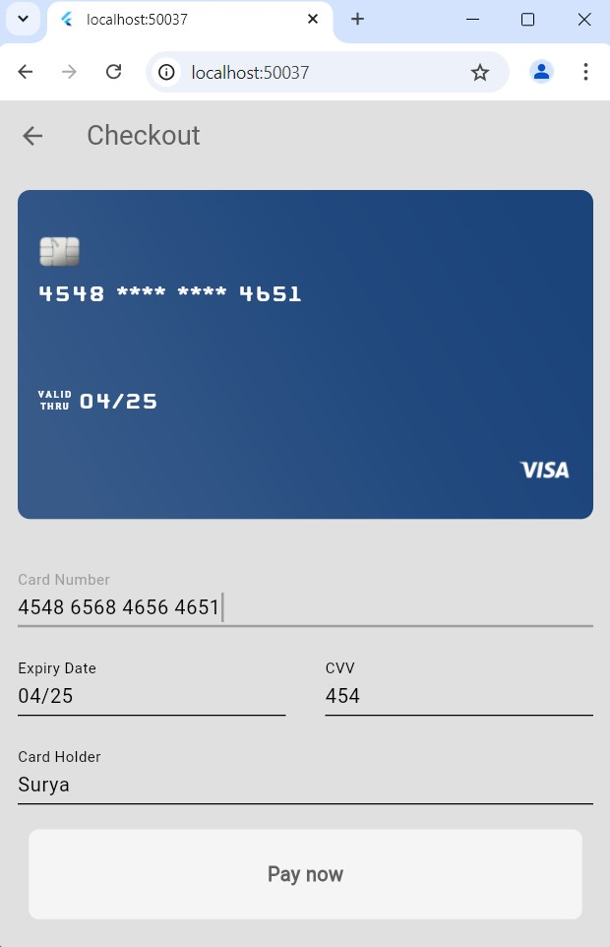
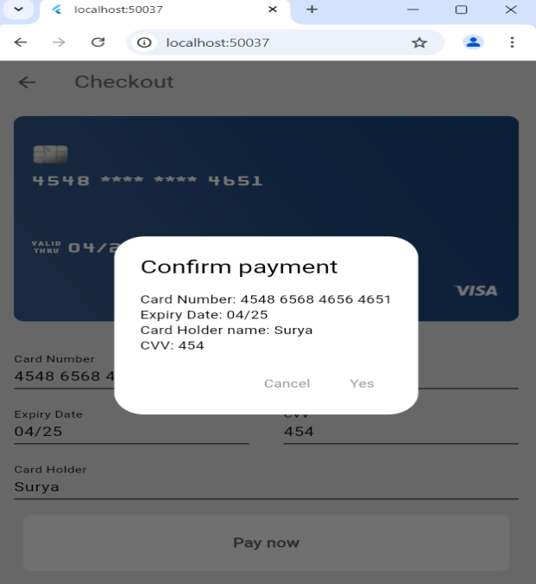
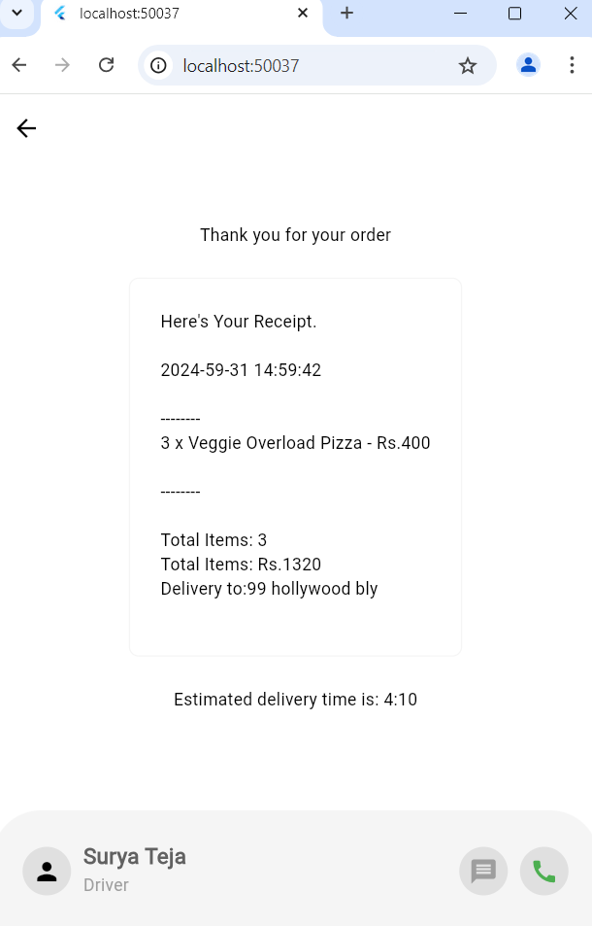

Slide 17
CONCLUSION
In today’s fast-paced digital world, push notifications are a key tool for e-commerce apps to keep users engaged. However, success isn’t just about sending messages—it’s about sending the right messages at the right time.
This project shows how a user-first approach to notifications can improve both the user experience and engagement. Using tools like Flutter for app development and Firebase for backend support, we created a system that focuses on personalization, timing, and giving users control.
The results were clear: fewer users felt overwhelmed, more users were satisfied, and conversion rates improved. Letting users manage their notification preferences built trust and loyalty.
Looking ahead, this system sets the stage for using AI, advanced behavior tracking, and better accessibility to keep improving. It’s more than just solving notification fatigue—it’s about creating meaningful, respectful connections between brands and users. This approach helps build a better digital experience for everyone.

Slide 18
References
[1] R.V. Karthik, Sannasi Ganapathy, "A fuzzy recommendation system for predicting the customers interests using sentiment analysis and ontology in e- commerce" published in Applied Soft Computing, Volume 108, September 2021, 107396.
[2] Gautam Chauhan; Dhruva Vatsa Mishra; M. Farida Begam; Akhilaa, "Customer-Aware Recommender System for Push Notifications in an e-commerce Environment" published in 2019 Global. Conference for Advancement in Technology (GCAT). DOI: 10.1109/GCAT47503.2019.8978330
[3] Nabilah ZhafiraViderisa, Harry Budi Santoso, R. Yugo Kartono Isal, "Designing the Prototype of Personalized Push Notifications on E-Commerce Application with the User-Centered Design Method" published in 2019 International Conference on Advanced Computer Science and information Systems (ICACSIS), DOI: 10.1109/ICACSIS47736.2019.8979756
[4] Huasha Zhao, Luo Si, Xiaogang Li, Qiong Zhang. "Recommending Complementary Products in E- Commerce Push Notifications with a Mixture Model Approach" published in Proceedings of the 40th International ACM SIGIR Conference on Research and Development in Information,Augusthttps://doi.org/10.1145/3077136.3080676
[5] Michail Salampasis, Alkiviadis Katsalis, Theodosios Siomos Marina Delianidi. Dimitrios Tektonidis, Konstantinos Christantonis, Pantelis Kaplanoglou, Ifigeneia Karaveli, Chrysostomos Bourlis and Konstantinos Diamantaras, "A Flexible Session-Based Recommender System for e Commerce" published inAppl. Sci. 2023, 13(5), 3347; https://doi.org/10.3390/app13053347

Slide 19
[6] A. G Kumar and S. Johari, "Push notification as a business enhancement technique for e commerce", Article presented at 2015 Third International Conference on Image Information Processing (ICIIP), 2015.
[7] M. Pielot, A. Vradi and S. Park, "Dismissed!!: A detailed exploration of how mobile phone users handle push notifications", Article presented at Proceedings of the 20th International Conference on Human-Computer Interaction with Mobile Devices and Services, 2018
[8] Tinna Fauziah Azhar, Harry Budi Santoso, Panca O Hadi Putra "Evaluation of Usability and User Experience of Shopee as One of the Top E- Marketplaces in Indonesia", 2022 10th International Conference on Information and Communication Technology (ICOICT), pp.305-309, 2022.
[9] Anja K. Faulhaber, Moritz Hoppe, Ludger "Evaluation of Priority-Dependent Schmidt,
Notifications for Smart Glasses Based on Peripheral Visual Cues", i-com, vol.21, no.2, pp.239, 2022.
[10] Chelan D. Wadate, Prashant T. Suvare and Aniket S. More, A Survey of Aut 0 mat i c Wi-Fi based Push Notification in College Campus using Cloud, International Conference on Advances in Science and Technology (ICAST-2014), pp. 1-4,2014

Slide 20
Thank You

