Slide 1

Emotion and Gender Recognition using KNN, SVM, CNN and VGG16 (Transfer Learning)
Team - DYNAMIC DUDES
Team - DYNAMIC DUDES
AIE19013
AIE19014
AIE19062
Charan Tej. K
Ch. Surya Teja
Sugash T.M

Slide 2







STEP 2
STEP 4
STEP 6
Research Gap
DL Models
Results and Comparisons
STEP 1
STEP 3
STEP 5
STEP 7
Motivation
ML Models
Implementation
Conclusion

Slide 3


Motivation

Slide 4


Motivation for our project
Emotion recognition technology is a type of artificial intelligence related to facial recognition that attempts to identify how a human subject is feeling based on their facial expressions and bodily cues, including heart rate and brain activity
Detected emotions can fall into any of the six main data of emotions: happiness, sadness, fear, surprise, disgust, and anger.
Safe and personalized cars
In-depth Interviews
Video gaming

Slide 5
Motivation for our project
Gender recognition, in the context of facial analysis, refers to the process of using artificial intelligence technology to identify whether a facial image is more likely to belong to a male or to a female.
Gender recognition is useful in a variety of contexts, ranging from anonymous audience analytics to identity verification and access control.
With audience analytics, retail store owners, digital screen owners and advertisers want to know the demographics of the people they are communicating with.

Slide 6

Research Gap

Slide 7

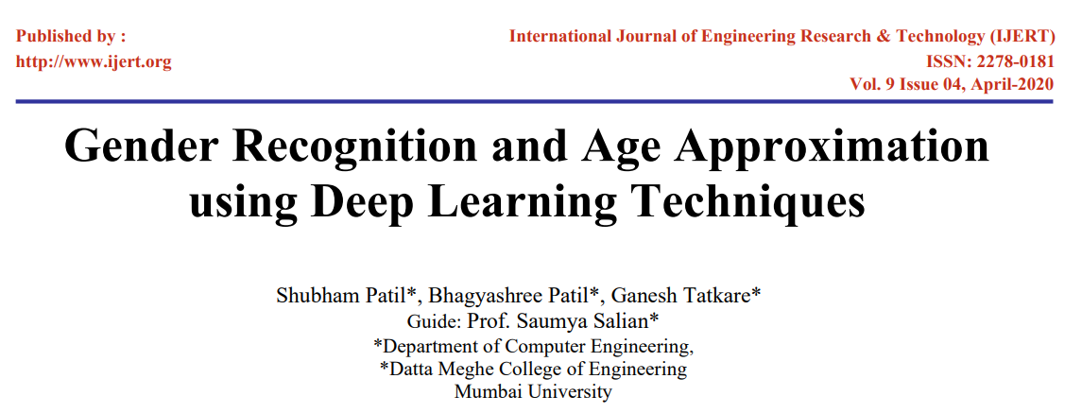
Research Gap of our Project
The paper that we have used as our reference in this project is :
Apart from the work done in the above paper, we implemented emotion and gender classification by using KNN, SVM, CNN and modified VGG16

Slide 8

ML Models

Slide 9

KNN
K-nearest neighbour is one of the Supervised learning algorithms mostly used for the classification of data on the basis of how its neighbours are classified.
It is also called a lazy learner algorithm because it does not learn from the training set immediately instead it stores the dataset and at the time of classification, it performs an action on the dataset.
Text mining
Agriculture
Finance
Medical
Facial recognition
Recommendation systems (Amazon, Hulu, Netflix, etc)

Slide 10
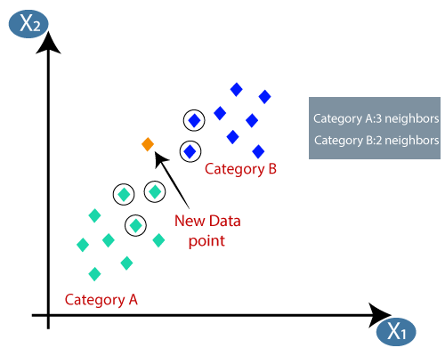

KNN

Slide 11
SVM
In machine learning, support vector machines, are supervised learning models with associated learning algorithms that analyze data for classification and regression analysis.
The objective of the support vector machine algorithm is to find a hyperplane in an N-dimensional space that distinctly classifies the data points
Texture Classification
Binary Image Classification
Speech Recognition

Slide 12
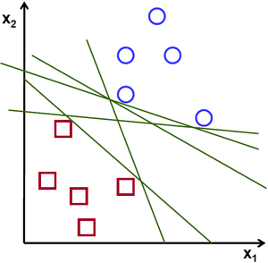
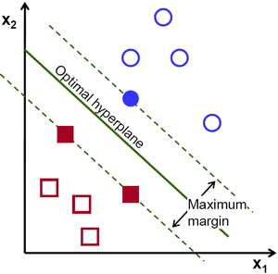

SVM

Slide 13

DL Models

Slide 14

CNN
A Convolutional Neural Network (ConvNet/CNN) is a Deep Learning algorithm which can take in an input image, assign importance (learnable weights and biases) to various aspects/objects in the image
A ConvNet is able to successfully capture the Spatial and Temporal dependencies
The architecture performs a better fitting to the image dataset due to the reduction in the number of parameters involved and reusability of weights.

Slide 15
CNN

Slide 16
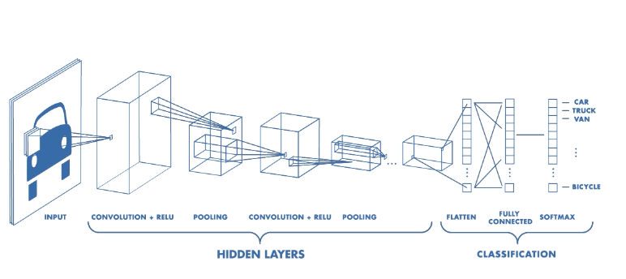
CNN

Slide 17
VGG – 16
The Visual Geometry Group from Oxford University is regarded as simple and powerful model than Alex Net
The implementation was done separately with 16 and 19 layers depth and hence the names VGG16, VGG19 were given
The 16 layers of VGG16 start with 64 filters initially and grow up to 512 filters till the last layer
Finally, in the classification layer, the architecture is defined by 4096 nodes

Slide 18
VGG – 16
Convolutional Networks are great for image problems however, they are computationally expensive if you use a big architecture and don’t have a GPU. For that, we have two solutions:
GPU’s
Transfer Learning
We use the patterns that the NN found to be useful to classify images of a given problem to classify a completely different problem without retraining that part of the network
By using the Transfer Learning technique you can remove the last classification layer and add our own extra dense layers for feature extraction to train the model on our dataset

Slide 19
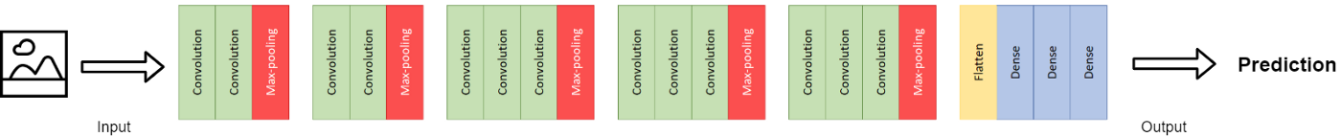
VGG16

Slide 20

Implementation

Slide 21






Implementation
DL Models (CNN, VGG - 16
Emotion and Gender Prediction
Data Pre Processing
$$1^{st}$$
$$2^{nd}$$
$$3^{rd}$$
$$4^{th}$$
$$5^{th}$$
ML Models (KNN, SVM)
Comparison between considered models

Slide 22

Results and Comparison

Slide 23

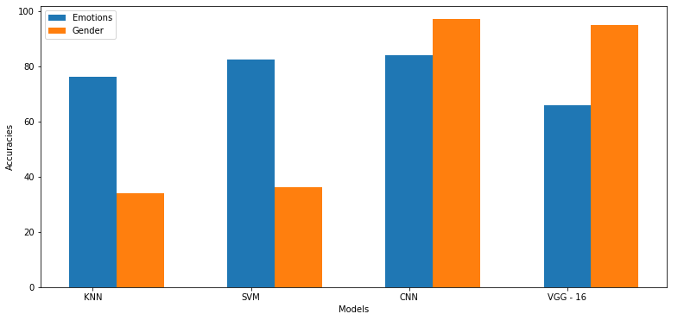
KNN - Model

Slide 24

Conclusion & Future Scope
Finally, we conclude by saying that we as a team have successfully implemented Emotion and Gender recognition, further improved it, and achieved excellent accuracy for VGG – 16 model. Also, we have visualized the model in a web application using Streamlit
As a part of future enhancement, we would like to extend this project by implementing much more robust models like AlexNet, and ResNet – 50 and develop an application of the above models in real life.

Slide 25
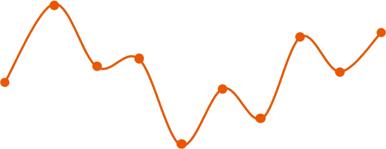
☺☺☺☺☺☺☺☺☺☺☺☺☺☺☺☺☺☺☺☺
Thank You
☺☺☺☺☺☺☺☺☺☺☺☺☺☺☺☺☺☺☺☺

