Slide 1

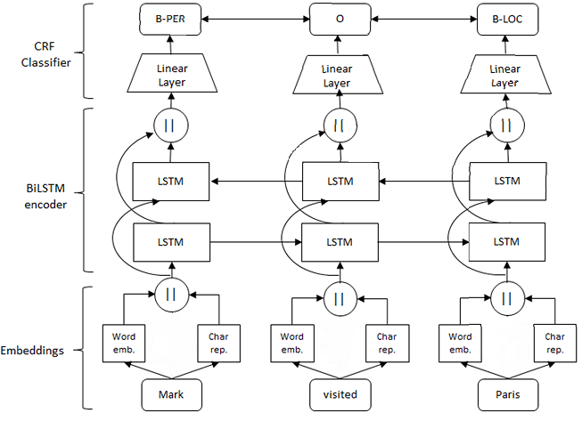
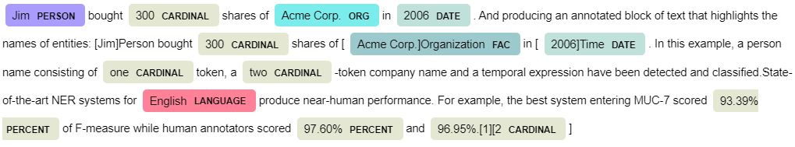
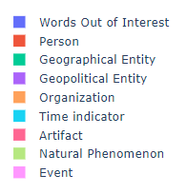
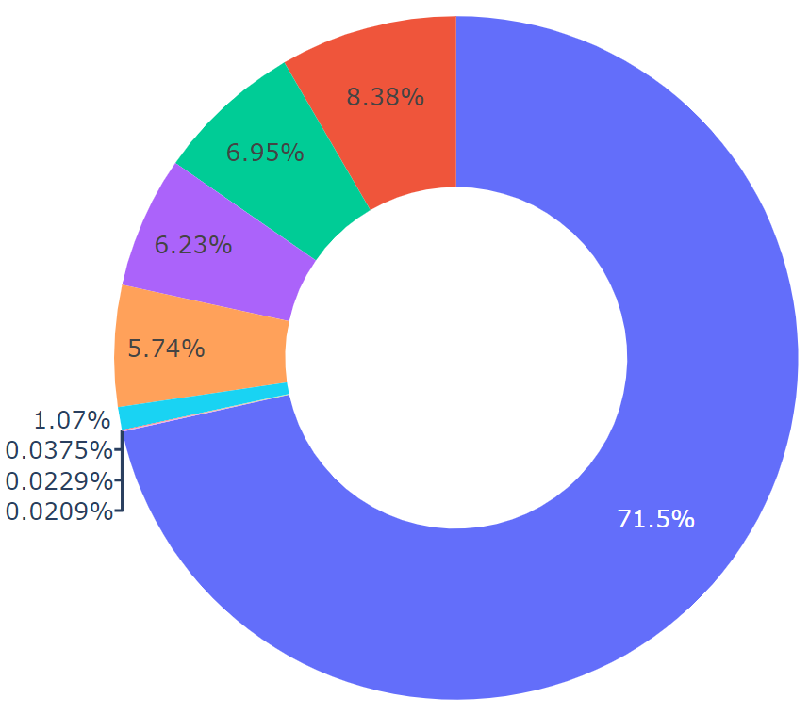
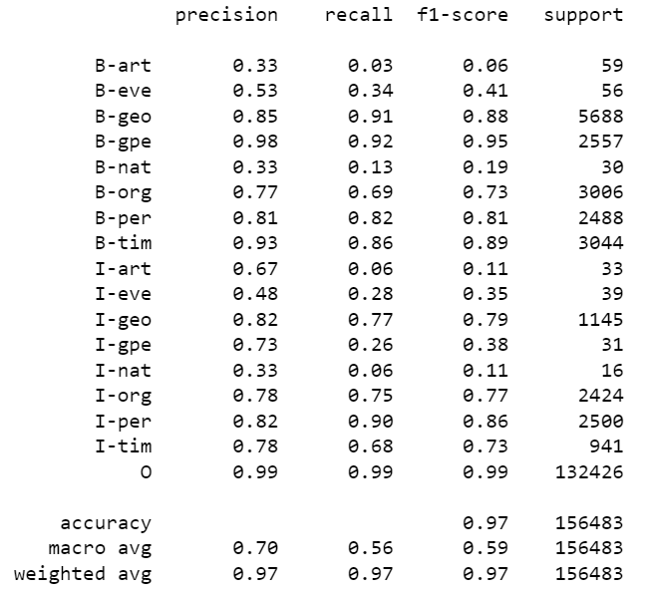
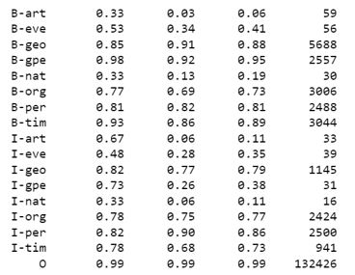

A Study on Named Entity Recognition with Different Word Embeddings on GMB Dataset using Deep Learning Pipelines
Charan Tej Kandavalli, Chavali Surya Teja , Sugash T M , Deepa Gupta
Department of Computer Science and Engineering, Amrita Vishwa Vidyapeetham, Bengaluru, India.
Archetypal emotions :
Materials & Methods
Key Results
Introduction
In natural language processing, named entity recognition (NER) is an integral part of the development information extraction job. NER tries to recognize words like person, organization, business, names of places, temporal phrases, and economies in a written text using pre-established or published information.
Model | A | P | R | F1
BiLSTM | 98.8 | 68 | 52 | 55
Character-BiLSTM-Attention | 99.25 | 62 | 57 | 58
BiLSTM-CRF | 99.53 | 63 | 49 | 50
BERT – BiLSTM – CRF | 99.71 | 66 | 51 | 56
GloVe – BiLSTM – CRF | 99.3 | 59 | 48 | 50
Word2Vec– BiLSTM-CRF | 98.86 | 41 | 38 | 38
fastText – BiLSTM – CRF | 96.99 | 23 | 21 | 20
Fig.1. Named Entity Recognition
Fig. 2. Model Architecture
Few Applications of Named Entity Recognition are:
Classifying content for news providers
Efficient Search Algorithms
Powering Content Recommendations
For example, “England (Organization) won the 2019 world cup vs The 2019 world cup happened in England (Location)” and “Washington (Location) is the capital of the US vs The first president of the US was Washington (Person)”.
Named Entity Recognition helps us to tag the entity correctly in situations like the one stated above
Fig. 3. NER Tag Distribution across the entire GMB Dataset
Panchendrarajan, Rrubaa & Amaresan, Aravindh. (2019). Bidirectional LSTM-CRF for Named Entity Recognition.Y. Zhang, Y. Liu, F. Weninger and B. Schuller(2017), "Multi-task deep neural network with shared hidden layers: Breaking down the wall between emotion representations," 2017 IEEE International Conference on Acoustics, Speech and Signal Processing (ICASSP), New
Yang, Gang & Xu, Hongzhe. (2020). A Residual BiLSTM Model for Named Entity Recognition. IEEE Access. PP. 1-1. 10.1109/ACCESS.2020.3046253
Fig. 4. Evaluation Metrics for the Character – Embedding – Attention model
Contact:
bl.en.u4aie19013@bl.students.amrita.edu, bl.en.u4aie19014@bl.students.amrita.edu, bl.en.u4aie19062@bl.students.amrita.edu, g_deepa@blr.amrita.edu

