Slide 1

Mountain Car with Q-Learning
Team - DYNAMIC DUDES
Team - DYNAMIC DUDES
AIE19013
AIE19014
AIE19062
Charan Tej. K
Ch. Surya Teja
Sugash T.M

Slide 2







STEP 02
STEP 04
STEP 06
RL Formulation
RL Model
Results and Discussion
STEP 01
STEP 03
STEP 05
STEP 07
Problem Statement
Literature Survey & Gaps and Challenges
Implementation
Conclusion

Slide 3


Problem Statement

Slide 4


Problem Statement
The Mountain Car Problem
The car starts in between two hills. The goal is for the car to reach the top of the hill on the right.
The car does not have enough engine power to reach the top of the hill by just accelerating forward.
To win, the car must build momentum by swinging itself backward and forwards until it has enough speed to reach the flag.

Slide 5

RL Formulation

Slide 6

RL Formulation
Agent - The car is our reinforcement learning agent. It interacts with the environment by taking actions; playing the game.
State - The states are the position of the car in the horizontal axis on the range [-1.2, 0.6] and its velocity on the range [-0.07, 0.07].
Action Space - The possible actions are left, neutral and right and these three actions are represented by the integers 0, 1 and 2
Environment – One of the OpenAI Gym environment is used. OpenAI Gym is a toolkit that provides a wide variety of simulated environments.
import gym
env = gym.make('MountainCar-v0')

Slide 7

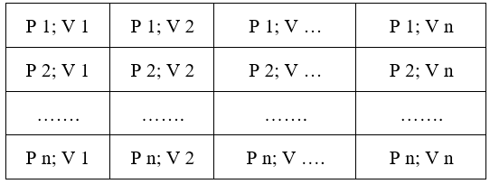
RL Formulation
Q(S,A)= Q(S,A) + $∝$[R(S,A) +$γ$ ( max ( Q’ (S’,A”) ) - Q(S,A) ]

Slide 8
RL Formulation
Reward - Rewarding the model at every state proportionally to the amount of energy it builds up. The car needs to build up enough kinetic energy (speed) to then transform it into potential energy (height).
Rewarding the amount of energy the car stores each time will help it learn to reach the flag.
Value - For our car to learn what actions to take at every step, it will try to determine “how good” each action is.
Policy – In order to balance between exploration and exploitation for a mountain car problem the logic has been built behind to choose the appropriate action.

Slide 9

Literature Survey, Gaps & Challenges

Slide 10

Literature Survey
Reference – 1
In this work, the authors have discussed a generative flow of the RPCL algorithm in the Open AI gym environment and tested that algorithm on three of the gym environments, namely – inverted pendulum with discrete control input, mountain car problem with discrete/continuous control inputs, a bipedal walker with a 4-dimensional continuous control input.
They were also able to successfully visualize the performance metrics of the demonstrator and their own agent and have estimated that the reward factor for major states is 0 in order to complete the task as quickly as possible. They have also proved that Continuous episodic tasks are better performing than the discrete ones, in behavior cloning.
https://arxiv.org/pdf/2009.09577.pdf

Slide 11
Literature Survey
Reference – 2
The authors have modelled a TAMER framework in [2], by replacing the MDP reward signal with a human reward signal, TAMER avoids the MDP reward signal's limited and delayed characteristics.
They have shown that SARSA (λ), along with linear model-based gradient descent is known to perform better in Mountain car RL agent formulation. The authors have mainly focused on integrating different RL-based approaches such as modelling Q – function and TAMER-based learning.
https://citeseerx.ist.psu.edu/viewdoc/download?doi=10.1.1.294.2360&rep=rep1&type=pdf

Slide 12
Gaps & Challenges
Mountain Car problem using DQN takes 1.75 hours for solving 1835 episodes but in order to decrease the solving time we have built a Q-Learning model which takes 22 min for 283600 episodes
Hyperparameter tuning has been performed in order to infer some useful results about Q-Learning model
The challenge we faced is the lack of high performance computer systems which in turn took a lot of time for training our model

Slide 13

RL Model
(Q-Learning)

Slide 14

RL Model
Q-Learning is a reinforcement learning policy that will find the next best action, given the current state. It chooses this action at random and aims to maximize the reward
Q-learning is called off-policy because the updated policy is different from the behavior policy. In other words, it estimates the reward for future actions and appends a value to the new state without actually following any greedy policy
The Q-function uses the Bellman equation and takes two inputs: state (s) and action
Q(S,A)= Q(S,A) + $∝$[R(S,A) +$γ$ ( max ( Q’ (S’,A”) ) - Q(S,A) ]

Slide 15
RL Model
Step 1 – Create an initial Q-table with all Q-values initialized to Zero.
Step 2 – Choose an action and perform it to update values in the table
Step 3 – Get the value of the reward and calculate the value, Q-value by using Bellman Equation
Step 4 – Then continue the same until the table is filled or an episode ends

Slide 16

Implementation

Slide 17






Implementation
Exploring the Environment
Bellman’s Equation
Hyperparameter Tuning
$$1^{st}$$
$$2^{nd}$$
$$3^{rd}$$
$$4^{th}$$
$$5^{th}$$
Defining the discretization method
Training and Exploring the Results
17

Slide 18

Results and Discussions

Slide 19
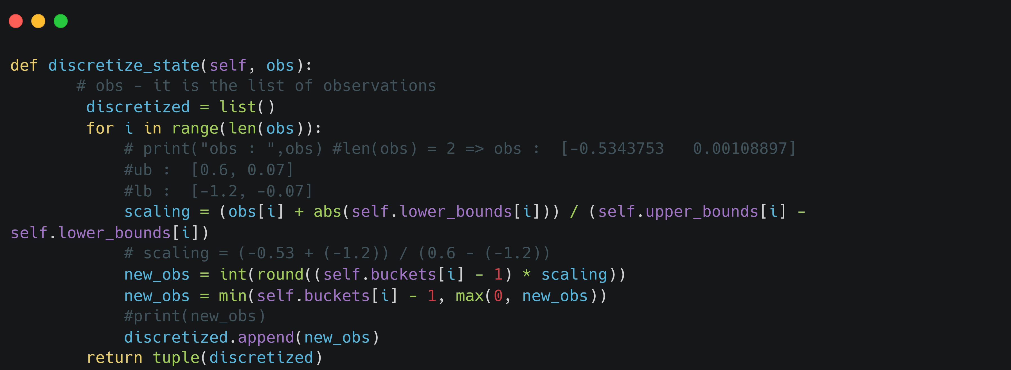
Demo Code
The goal of tabular discretization is to learn the value for all possible states in a table form. The table will contain all possible states
Our state space is continuous, meaning that there are infinitely many states and we cannot just make an infinitely large table to represent our state space, and therefore we split it up into chunks.

Slide 20
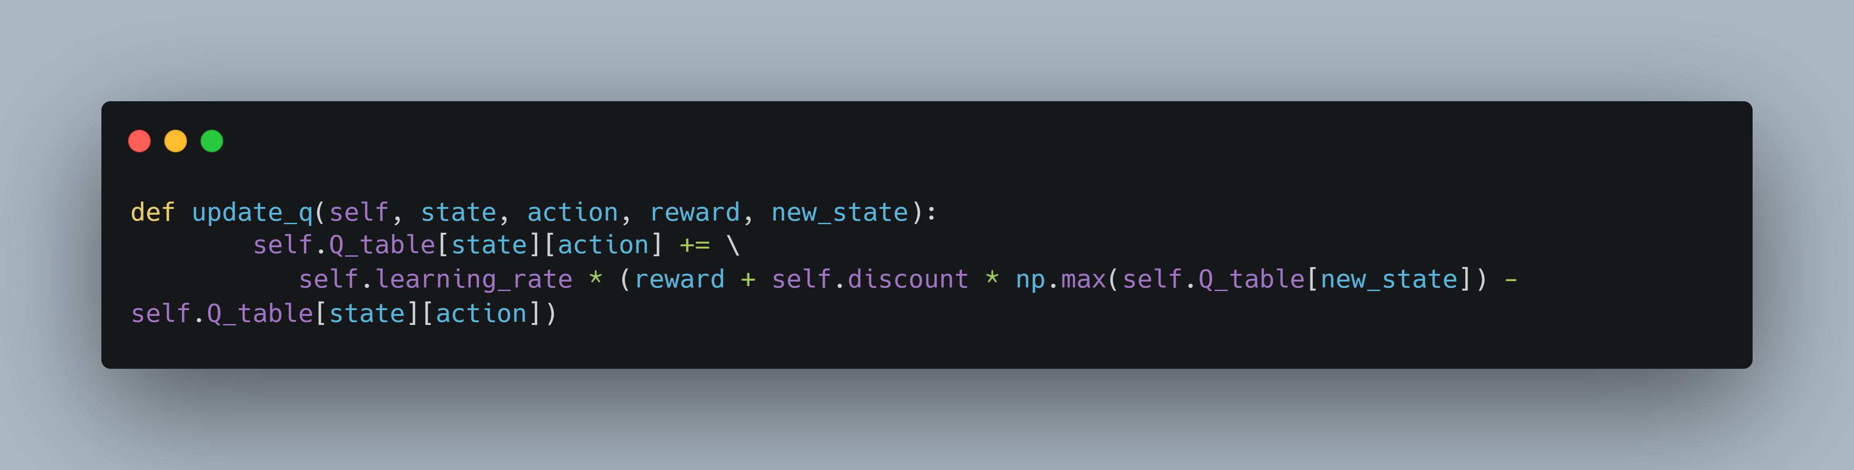
Demo Code
Q(S,A)= Q(S,A) + $∝$[R(S,A) +$γ$ ( max ( Q’ (S’,A’) ) - Q(S,A) ]

Slide 21
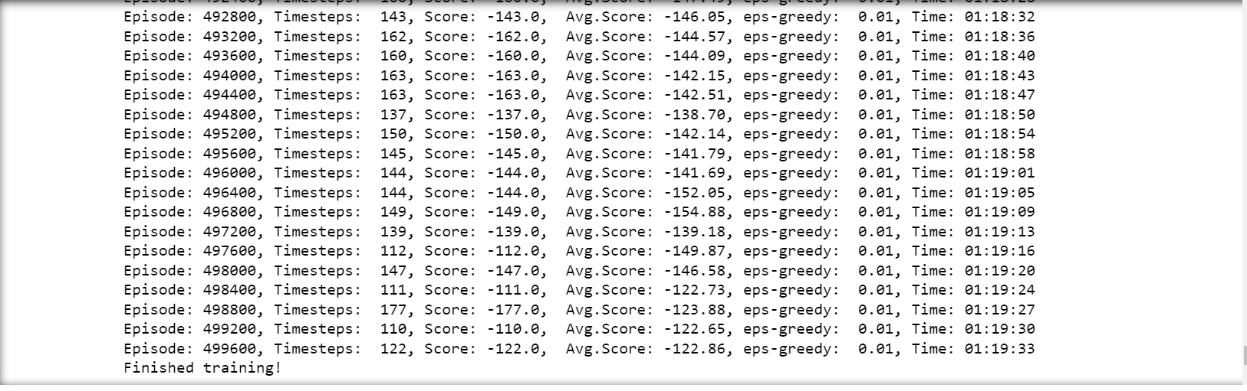
Training
It took 1 hr. 20 min for our model to train 5 lakh episodes for the considered environment
Our Environment threshold was -110, the training started with an average score of -200 and at the end, it was -122.86.

Slide 22
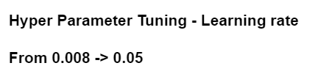
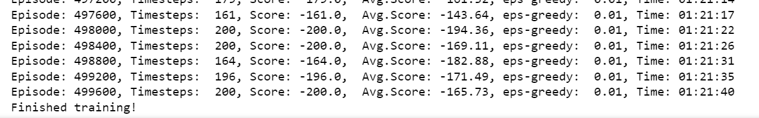
Hyperparameter Tuning
In our model the hyperparameters were learning rate, discount rate decay and epsilon

Slide 23
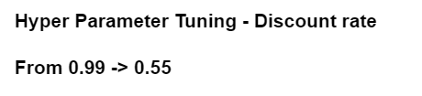
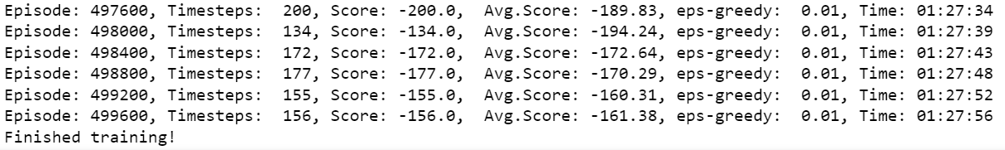
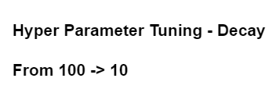
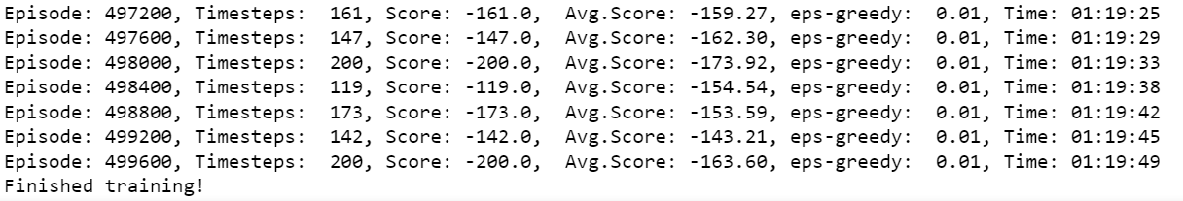
Hyperparameter Tuning

Slide 24
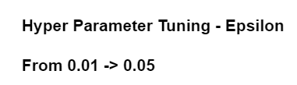
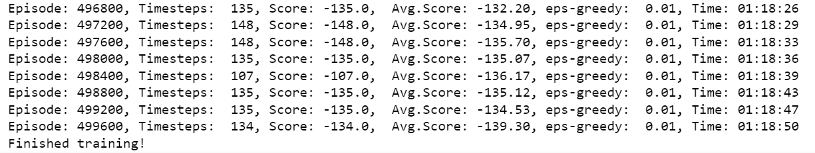
Hyperparameter Tuning

Slide 25

Conclusion
To the best of our knowledge, we have successfully implemented the mountain car problem using Q-learning algorithm and we have also explored the model by tuning the hyperparameters
In future, we would like to enhance this project by using much more robust methods like Twin Delayed Deep Deterministic Policy Gradients (TD3) and Proximal Policy Optimization methods and compare the results with our own model
&
Future Scope

Slide 26
References
https://arxiv.org/pdf/2009.09577.pdf
https://citeseerx.ist.psu.edu/viewdoc/download?doi=10.1.1.294.2360&rep=rep1&type=pdf
https://towardsdatascience.com/reinforcement-learning-applied-to-the-mountain-car-problem-1c4fb16729ba
https://www.gymlibrary.ml/environments/classic_control/mountain_car/?highlight=mountain

Slide 27

☺☺☺☺☺☺☺☺☺☺☺☺☺☺☺☺☺☺☺☺
Thank You
☺☺☺☺☺☺☺☺☺☺☺☺☺☺☺☺☺☺☺☺

