Slide 1

Implementation of different Modulations with layer mapping
FPGA Project
BY:
SANGANA SAI VENKATA SURYA TEJA(EE23MTECH11032)
GEDELA MADHU BABU(EE23MTECH11027)
VALLAMKONDA SAI KIRAN(EE23MTECH11038)

Slide 2
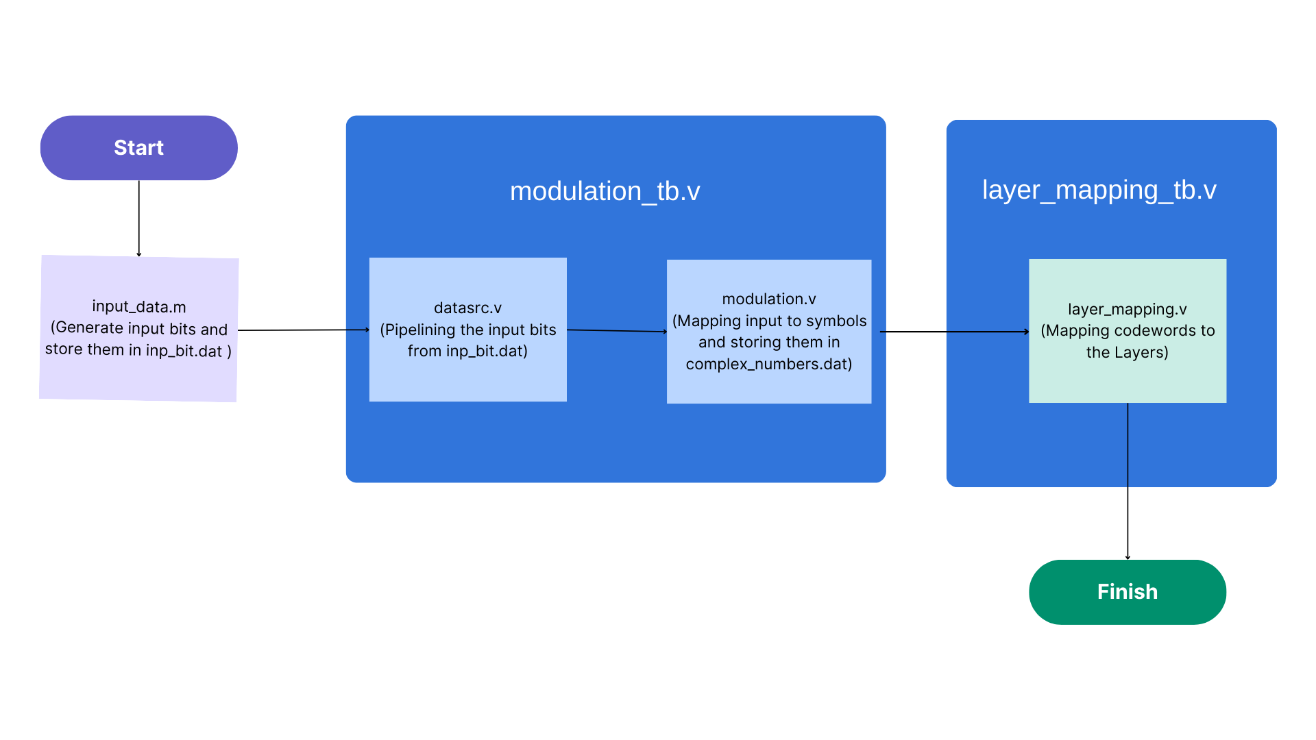
Block Diagram:

Slide 3
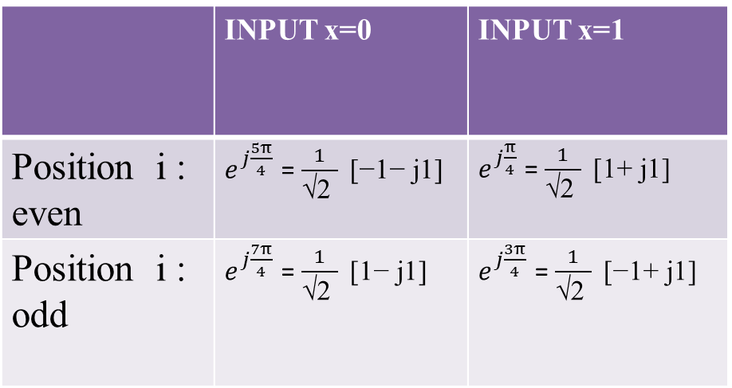

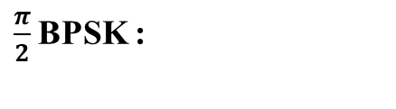
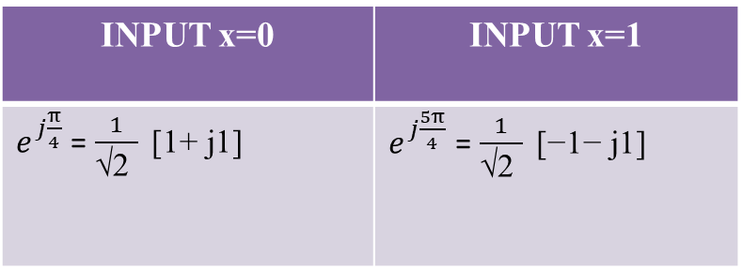
BPSK :
INPUT x=0 | INPUT x=1
$e^{j\frac{π}{4}}$ = $\frac{1}{\text{√2 }} \text{[}\text{1}\text{+ }\text{j}\text{1}\text{]}$ | $e^{j\frac{5π}{4}}$ = $\frac{1}{\text{√2 }} \text{[}\text{−1−} \text{j}\text{1}\text{]}$
Modulation Mapper :
The modulation mapper takes binary digits, 0 or 1, as input and produces complex-valued modulation symbols as output:
BPSK:
d(i) =$\frac{1}{\text{√2 }} \text{[(1 }\text{−} \text{2}\text{b}\text{(}\text{i}\text{)) + }\text{j}\text{(1 − 2}\text{b}\text{(}\text{i}\text{)]}$
$\frac{π}{2}$BPSK :
d(i) =$\frac{{\text{e}}^{\text{j}\frac{\text{π}}{2}\text{(}\text{i} \text{mod} \text{2)}}}{\text{√2 }}\text{[(1 }\text{−} \text{2}\text{b}\text{(}\text{i}\text{)) + }\text{j}\text{(1 − 2}\text{b}\text{(}\text{i}\text{)]}$
$\frac{π}{2}$BPSK :
 | INPUT x=0 | INPUT x=1
Position i : even | $e^{j\frac{5π}{4}}$ = $\frac{1}{\text{√2 }} \text{[}\text{−1−} \text{j}\text{1}\text{]}$ | $e^{j\frac{π}{4}}$ = $\frac{1}{\text{√2 }} \text{[}\text{1}\text{+ }\text{j}\text{1}\text{]}$
Position i : odd | $e^{j\frac{7π}{4}}$ = $\frac{1}{\text{√2 }} \text{[}\text{1−} \text{j}\text{1}\text{]}$ | $e^{j\frac{3π}{4}}$ = $\frac{1}{\text{√2 }} \text{[}\text{−1}\text{+ }\text{j}\text{1}\text{]}$

Slide 4
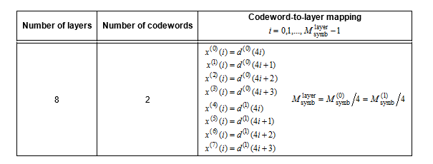
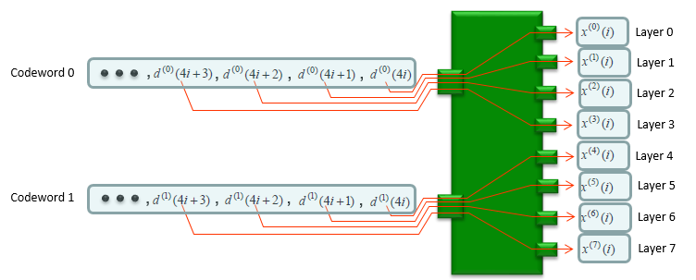
Layer Mapping:

Slide 5
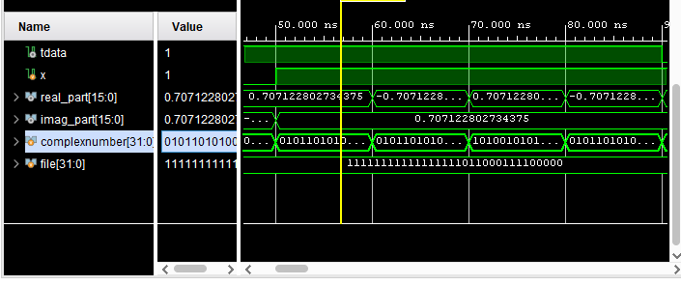
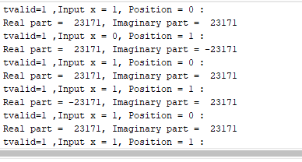
Simulation Result for $\frac{π}{2}$BPSK Modulation:

Slide 6
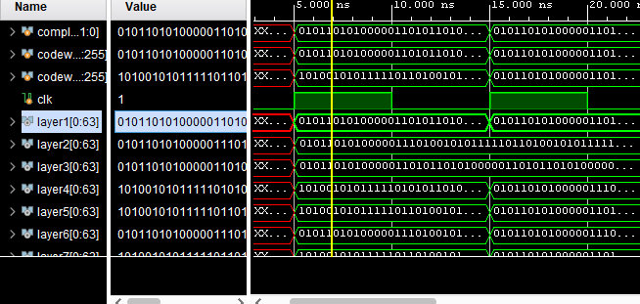
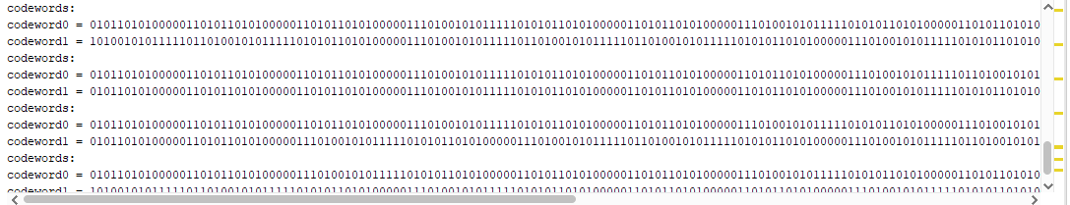
Simulation Result for Layer Mapping:

Slide 7
THANK YOU

