Slide 1
Youtube Pulse : Tracking Trends & Engagement
DATS 6401 – Surya vamsi Patiballa (G40559527)
[Section :- 10]

Slide 2
Abstract
The ’youtube.csv’ dataset is taken from Kaggle website in order to analyze the whole data and to visualize the relationships/dependencies of other features like tags,channel_title,publish_date etc on the target variable ‘views’.Here this dataset consists of almost 1,58,000 rows and 17 columns.In those columns,there are 4 Numerical and 13 categorical features.Here is a summary of these :-
views,likes,dislikes & comment_count → Numerical
Video_id,trending_date,title,channel_title,category_id,
publish_date,time_frame,tags,published_day_of_week,publish_country, --> Categorical
comments_disabled,ratings_disabled,video_error_or_removed

Slide 3
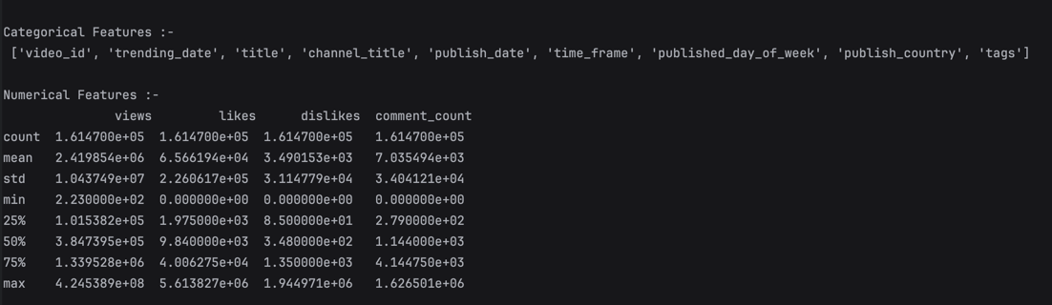
Dataset description
I observed the dataset and decided to change the ‘time_frame’ which is in time representation to weekday to categorize it for my visualization purpose.
I also decided to drop ‘index’,’video_id’,’comments_disabled’,’ratings_disabled’ & ‘video_error_or_removed’ columns as they are purely irrelevant to my analysis. They are Boolean features and didn’t contribute that much.

Slide 4
OUTLIER DETECTION (Using Box Plot)
Among all the features, views, likes, dislikes, and comment count—has a large number of outliers that are significantly higher than the majority of the data.These are found by plotting box plots individually.

Slide 5
Outlier Removal (by IQR method)
All outliers are removed using IQR method by taking upper and lower bounds.Hence,my dataset is OUTLIER FREE!!

Slide 6
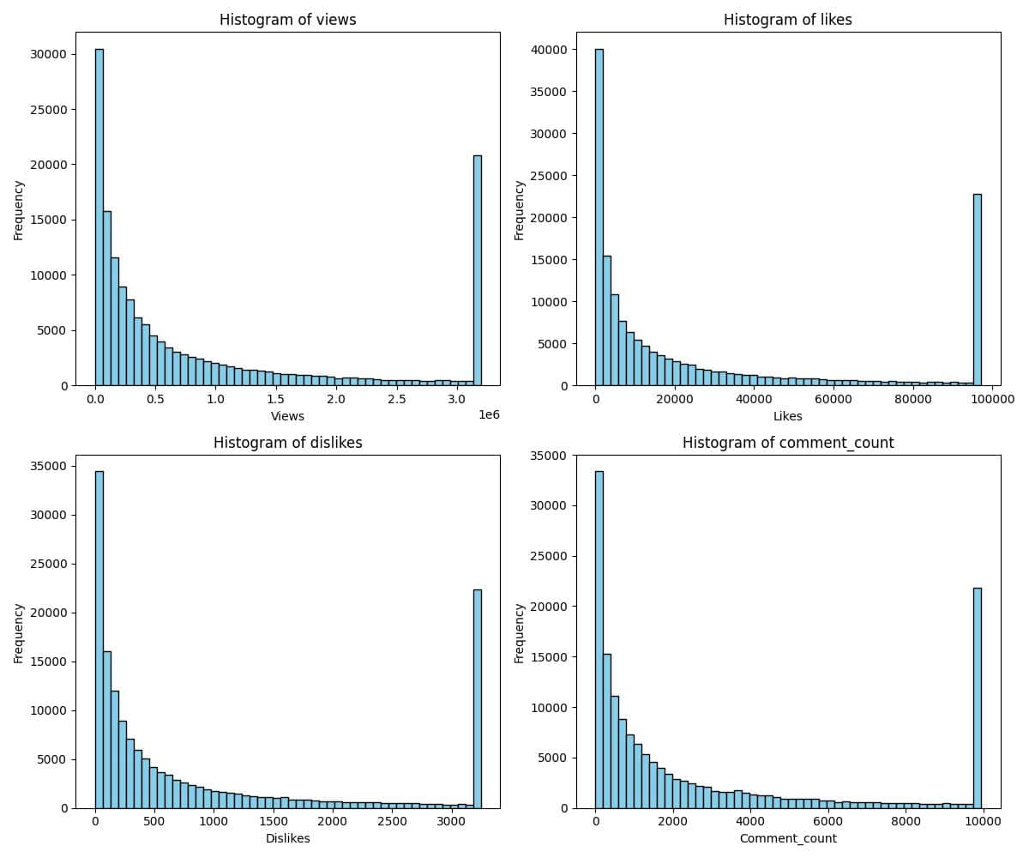
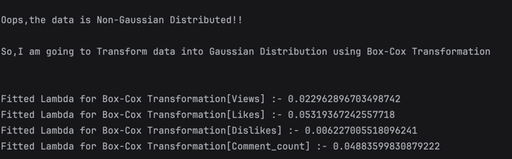
DATA TRANSFORMATION
This data is Not Normally distributed.I got to know this by plotting Histograms. The shape of curve is not Bell.
So,I did Box-Cox transformation and then transferred into Gaussian Distribution.

Slide 7
NORMALLY DISTRIBUTED DATA

Slide 9
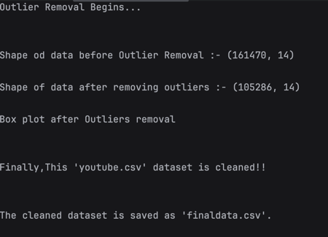
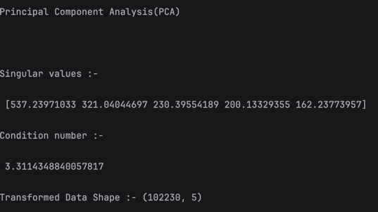
Shape of Data(Before and After Outlier Removal)
Principal Component Analysis (PCA)

Slide 10
LINE PLOTS
All four metrics—views, likes, dislikes, and comment count—show a significant increase in recent years, particularly around 2017 and 2018. This suggests that engagement with YouTube content has surged during this period, which could be attributed to a number of factors including increased internet accessibility, more content creators etc.
The spikes in the graphs for views, likes, and comments appear to be correlated, as they increase around the same time. The dislikes graph also shows a spike, but it's less aligned with the other metrics, which may indicate different viewer behavior with regard to content that is not well-received.
The sharp peaks, particularly visible in the views and likes graphs, suggest the presence of outlier events, likely viral videos that have captured the attention of a large audience in a short span of time.

Slide 11
BAR PLOT (for common no of tags used)
The tags 'funny' and 'comedy' are the most frequent, indicating that humorous content is highly popular on YouTube.
The variety of tags, including 'music', '2018', 'pop', 'news', 'trailer', 'video', 'interview', 'humor', 'live', 'entertainment', 'review', 'official', 'vlog', 'celebrity', 'television', and 'how-to' represent a broad range of interests among YouTube users.

Slide 12
BAR GRAPHS
The first graph shows that some categories (notably the one with category ID 24) are much more common than others.
The second graph indicates that video publishing is relatively consistent across weekdays, with a slight decrease on Saturday and a more notable drop on Sunday.
The third graph shows that certain countries (possibly 'RU' and 'FR' based on the visible labels) have higher counts of published videos than others.
The fourth graph displays the count of videos published during different parts of the day, with 'afternoon' having the highest count followed by 'evening'.

Slide 13
PIE CHARTS
The main inference from the pie chart, which illustrates the distribution of videos by part of the day, is that the afternoon is the most popular time for publishing videos, accounting for approximately 42.8% of the total. This is followed by the evening at 29.7%, suggesting that the latter half of the day is the preferred time for video uploads.
The main inference here is that Category 24 dominates the chart, constituting 29.5% of the videos, which suggests that it is the most popular or most frequently uploaded category on YouTube within this dataset. Other categories represent a smaller share of the total, with Categories 22 and 1 also having significant portions at 12.4% and 11.3%, respectively.

Slide 14
Kernel Density Estimation (KDE plot)
All four distributions are heavily right-skewed, indicating that a large number of videos have relatively low engagement metrics (views, likes, dislikes, comment counts) while a small number have very high engagement.
The long tails extending to the right in each of the plots suggest the presence of outliers. These outliers are videos with exceptionally high views, likes, dislikes, or comment counts compared to the rest.

Slide 15
HEAT MAP
There is a strong positive correlation between all the pairs of variables. Likes, dislikes, and comment counts are all positively correlated with views, suggesting that as the number of views increases, so does the number of likes, dislikes, and comments. This indicates that higher visibility leads to higher engagement.
Likes and comment counts have a relatively high correlation coefficient (0.68), suggesting that videos that receive a lot of likes also tend to receive a lot of comments. This could imply that users who engage with content by liking it are also likely to engage in the comments section.

Slide 16
Scatter Plot Matrix
For views, likes, dislikes, and comment counts, there is a heavy concentration of data points near the origin. This suggests that most videos have low engagement metrics, which is consistent with the presence of a long tail distribution in each individual histogram along the diagonal.
The scatter plots show that higher values in one metric correspond to higher values in another, but the concentration of points near the lower end of the axes indicates that this relationship is stronger among less popular videos.

Slide 17
MULTIVARIATE BOX / BOXEN PLOT
Each metric has numerous outliers, as indicated by the points beyond the "whiskers" of the box plots. These outliers suggest that while the majority of videos have a relatively lower range of engagement, there is a significant number of videos that far exceed the typical engagement metrics, potentially due to viral content.
The median (the line within the box) for each metric is closer to the bottom of the box, which indicates a skewed distribution with a tail on the higher end. This is particularly pronounced for views and likes. The presence of these long tails indicates that a small number of videos have exceptionally high views, likes, dislikes, or comments compared to the rest.

Slide 18
COUNT PLOTS
The count of videos published is fairly consistent across the weekdays, with a slight dip on Sunday. This suggests that content creators may prefer to post videos during the weekdays, possibly to capture a larger audience when people are more likely to be online during workdays.
One country, labeled 'FR', has a notably higher number of videos published compared to the other displayed countries. This suggests that 'FR' is either a larger market for video content on the platform, has more active content creators, or the dataset has a higher representation of videos from this country.

Slide 19
The END…

