Slide 1
Capstone Project
Zomoto Restaurant Clustering and Sentiment Analysis
Sundar K

Slide 2
CONTENT
❑ Introduction
❑ Problem statement
❑ Data Pipeline
❑ Data Description
❑ Exploratory Data Analysis
❑ Models performed
❑ Models Validation
❑ Clustering
❑ Conclusion

Slide 3
Introduction
Zomato is an Indian restaurant aggregator and food delivery start-up founded by Deepinder Goyal and Pankaj Chaddah in 2008. Zomato provides information, menus and user-reviews of restaurants, and also has food delivery options from partner restaurants in select cities.

Slide 4
Problem Statement
The Project focuses on Customers and Company, you have to analyze the sentiments of the reviews given by the customer in the data and made some useful conclusion in the form of Visualizations. Also, cluster the zomato restaurants into different segments. The data is vizualized as it becomes easy to analyse data at instant. The Analysis also solve some of the business cases that can directly help the customers finding the Best restaurant in their locality and for the company to grow up and work on the fields they are currently lagging in.
This could help in clustering the restaurants into segments. Also the data has valuable information around cuisine and costing which can be used in cost vs. benefit analysis

Slide 5
Data Pipeline
● Exploratory Data Analysis (EDA): In this part we have done some EDA on the features to see the trend.
● Data Processing: In this part we went through each attributes
● Model Creation: Finally in this part we created,XGB,SVM, Random Forest models. These model is being analyzed ,so as to get the best performing model for our project, and also we done k means clustering ,and PCA

Slide 6
Data Description
Zomoto Restaurant names and Metadata
1. Name : Name of Restaurants
2. Links : URL Links of Restaurants
3. Cost : Per person estimated Cost of dining
4. Collection : Tagging of Restaurants w.r.t. Zomato categories
5. Cuisines : Cuisines served by Restaurants
6. Timings : Restaurant Timings
Zomato Restaurant Reviews
1.Restaurant : Name of the Restaurant
2. Reviewer : Name of the Reviewer
3. Review : Review Text
4. Rating : Rating Provided by Reviewer
5. MetaData : Reviewer Metadata - No. of Reviews and followers
6. Time: Date and Time of Review
7. Pictures : No. of pictures posted with review

Slide 7
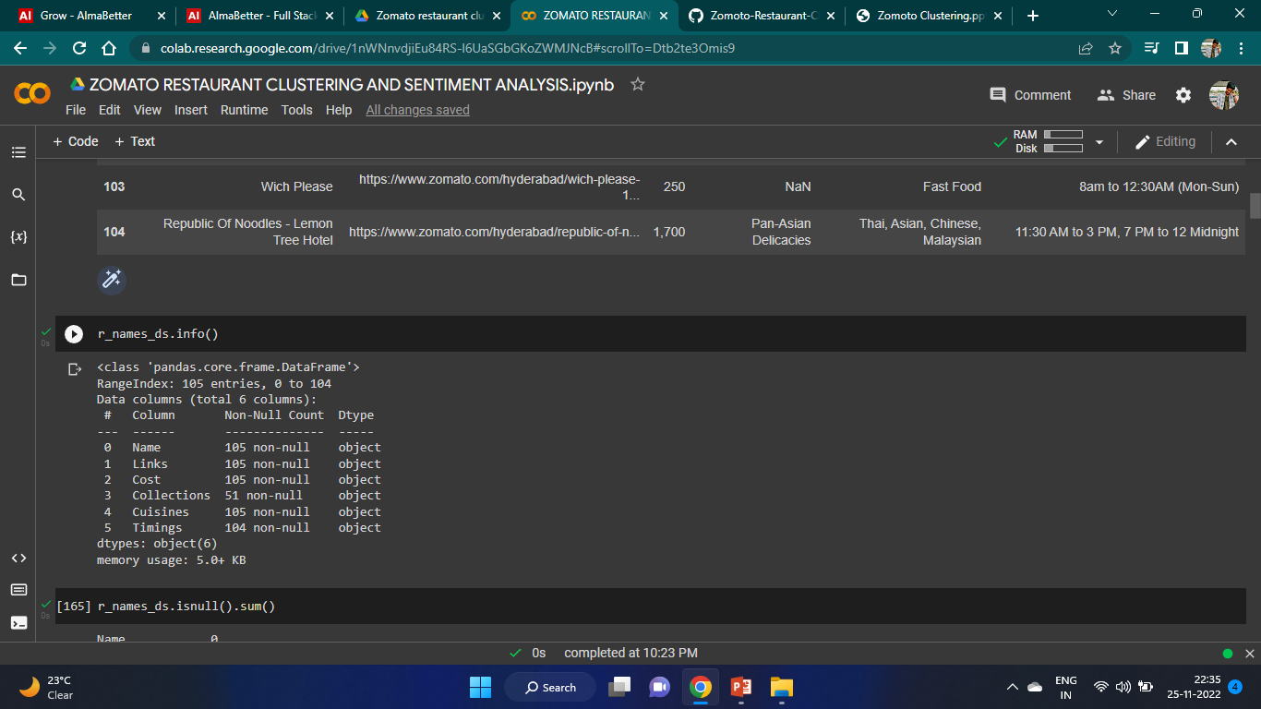
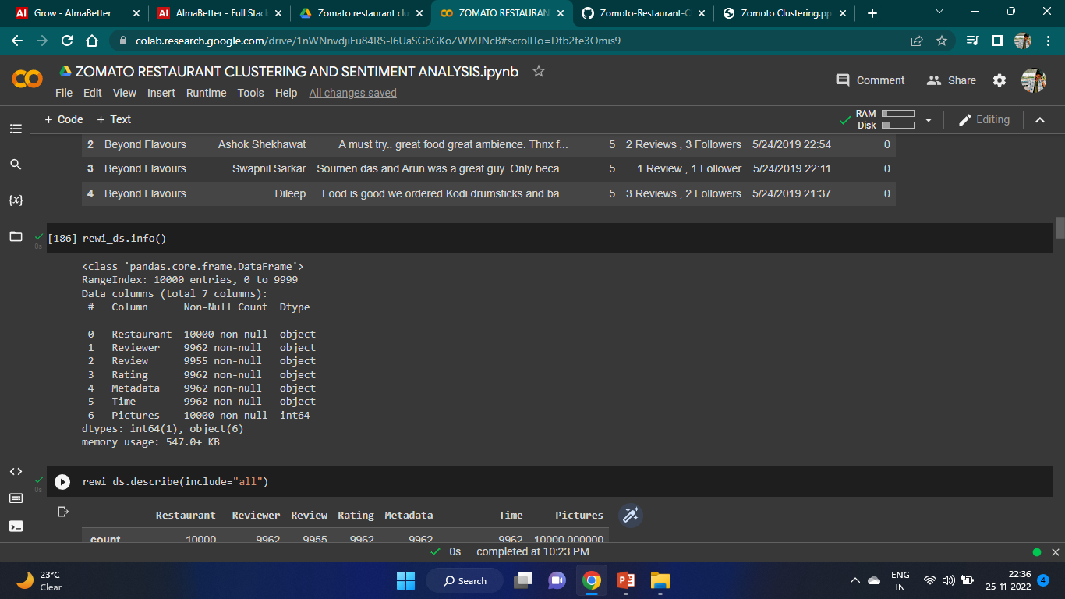
Data Features

Slide 8
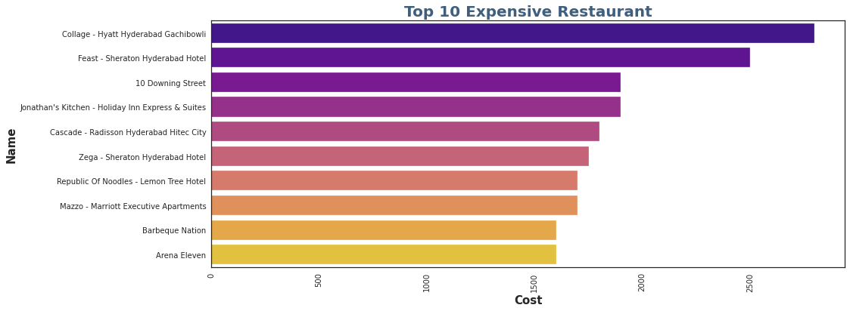
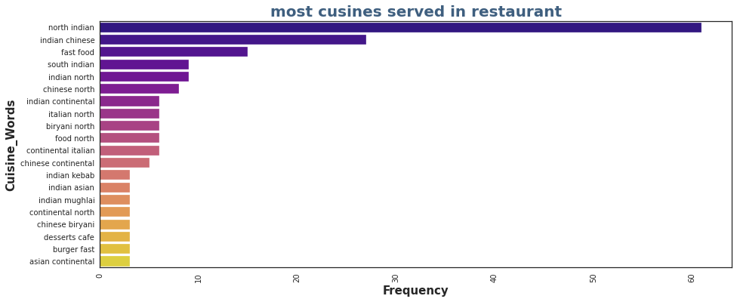
EDA

Slide 9
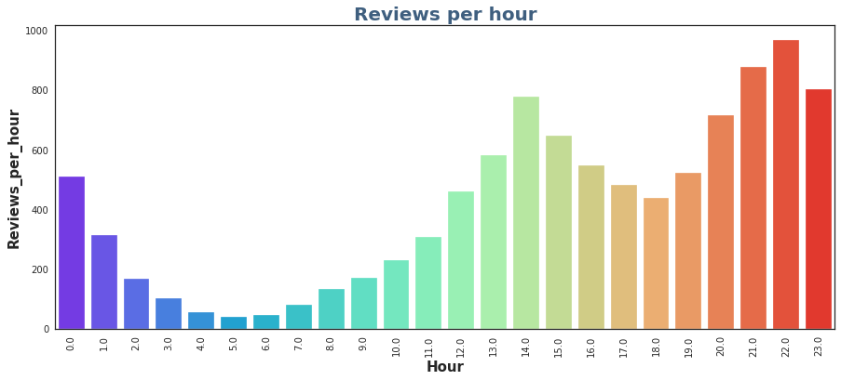
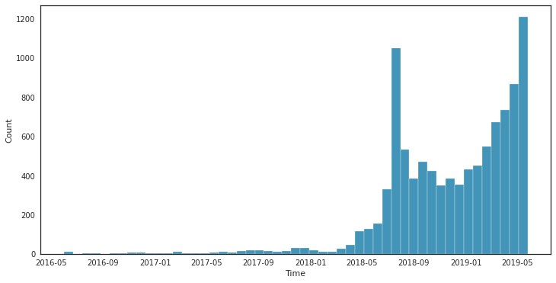
EDA

Slide 10
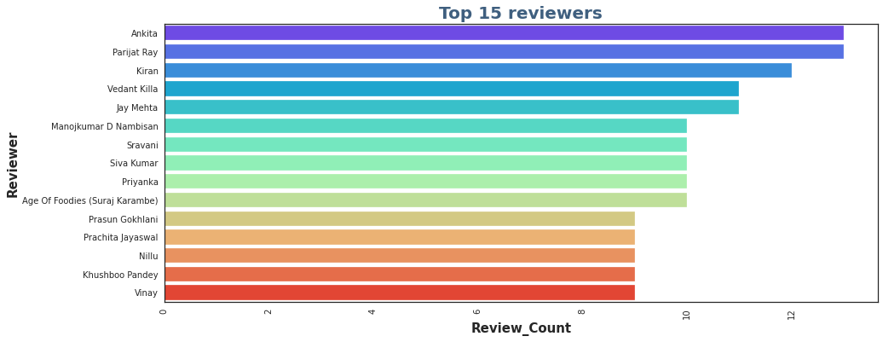
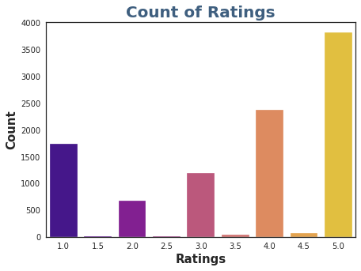
EDA

Slide 11
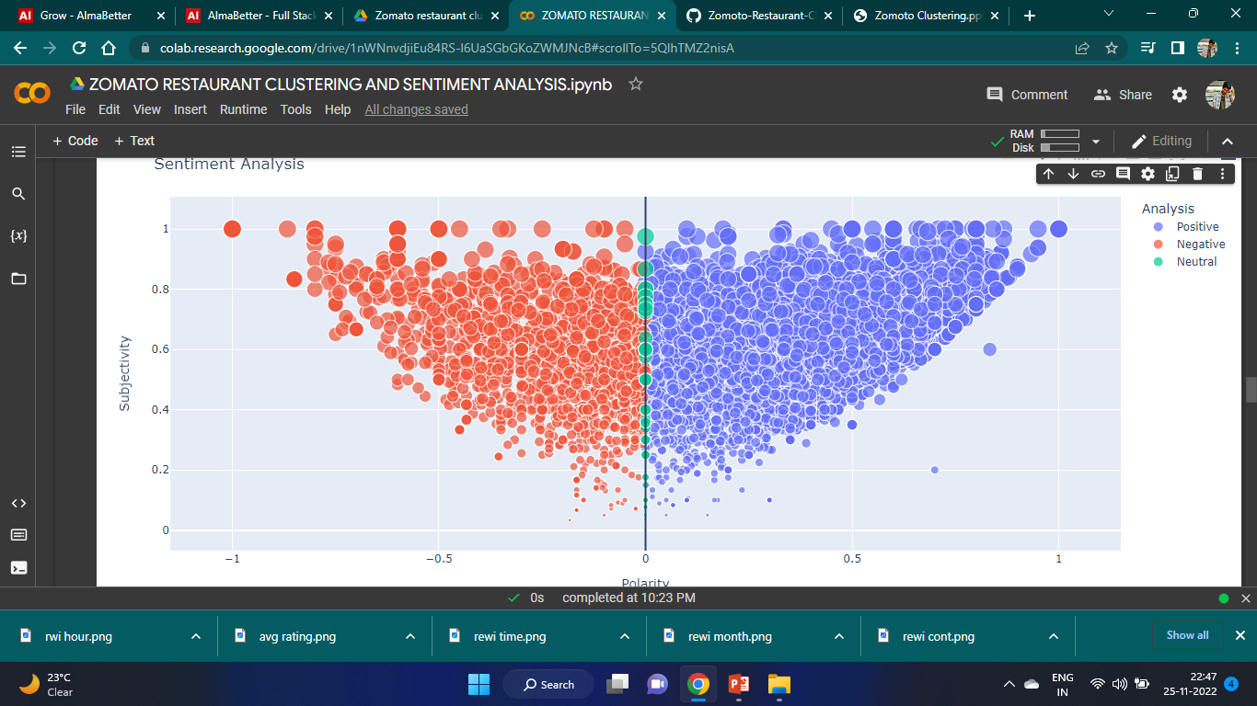
EDA

Slide 12
Model Performed
1.Random Forest 2.XGB 3.Support Vector Machine

Slide 13
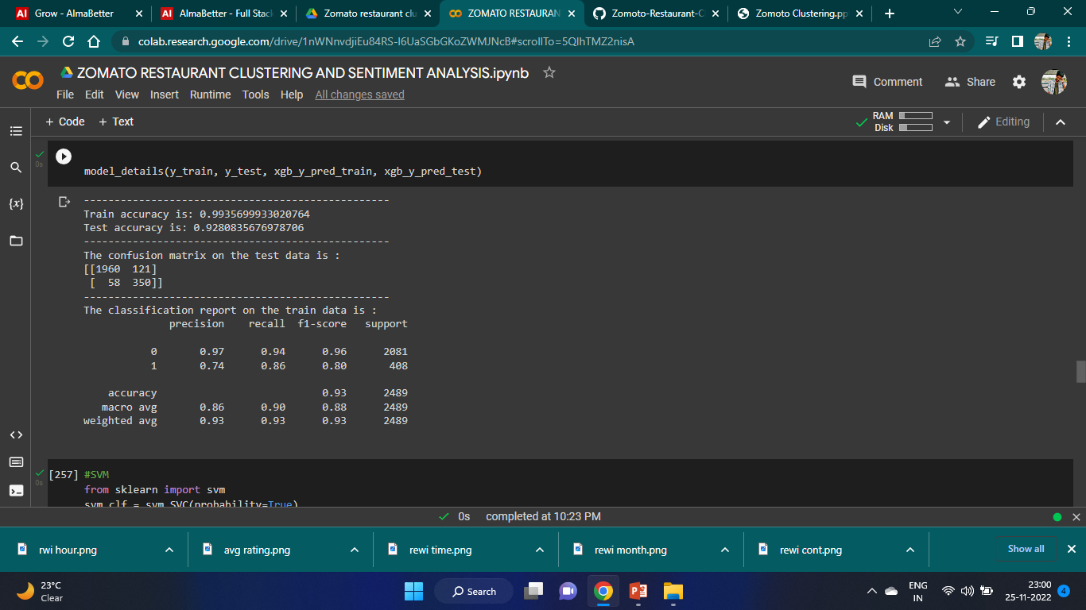
Model Validation Model : XGB

Slide 14
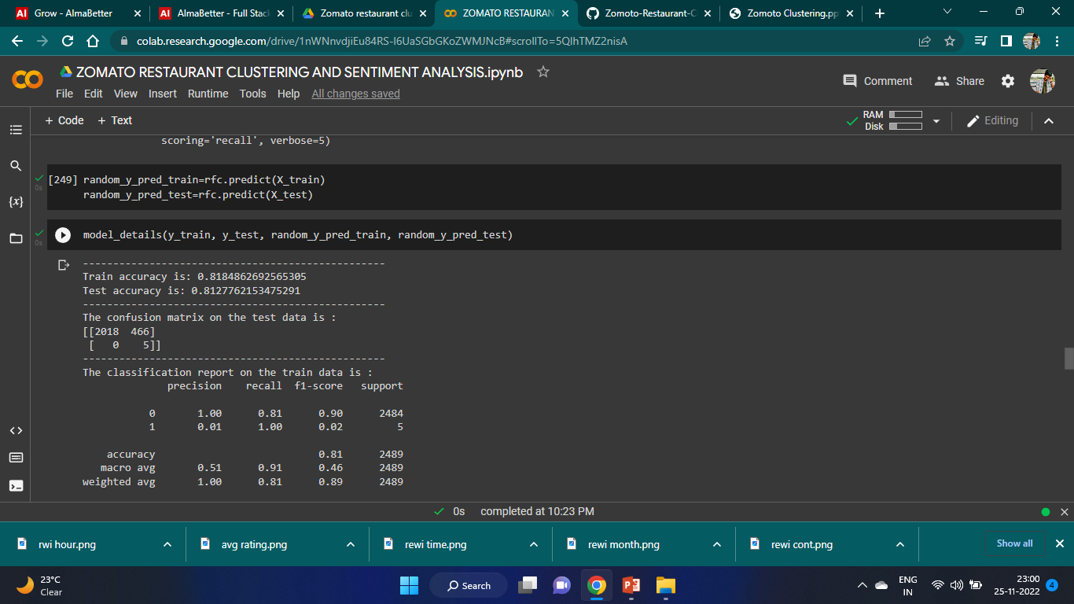
Model : Random Forest

Slide 15
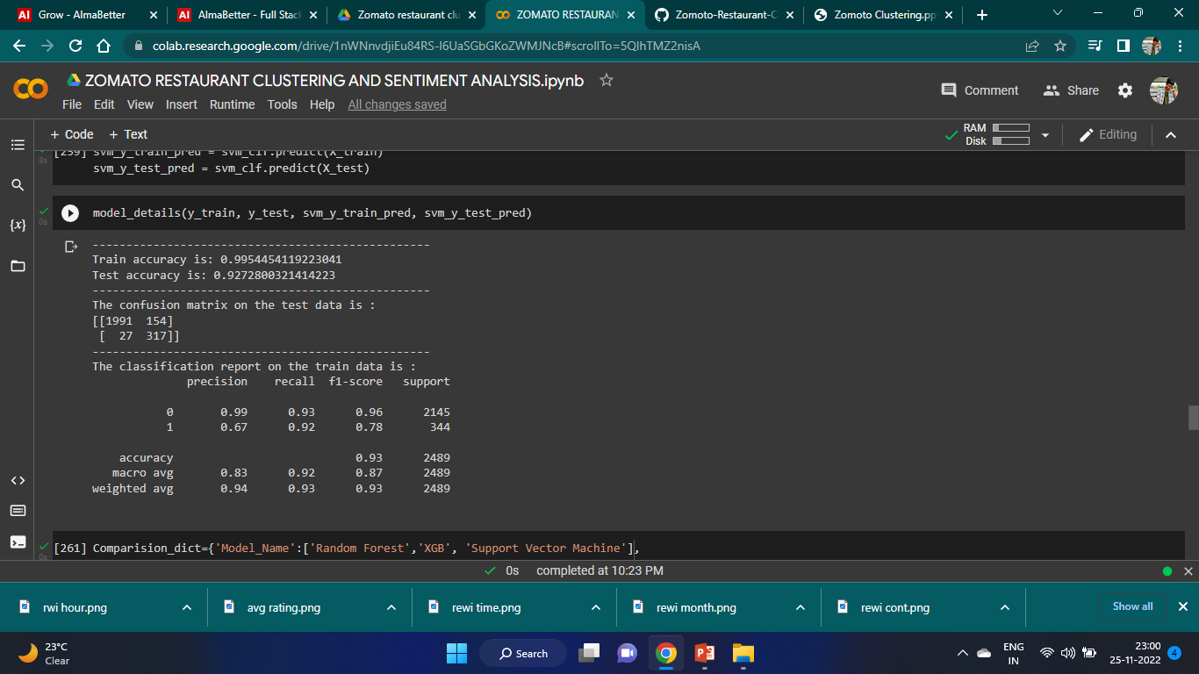
Model : SVM

Slide 16
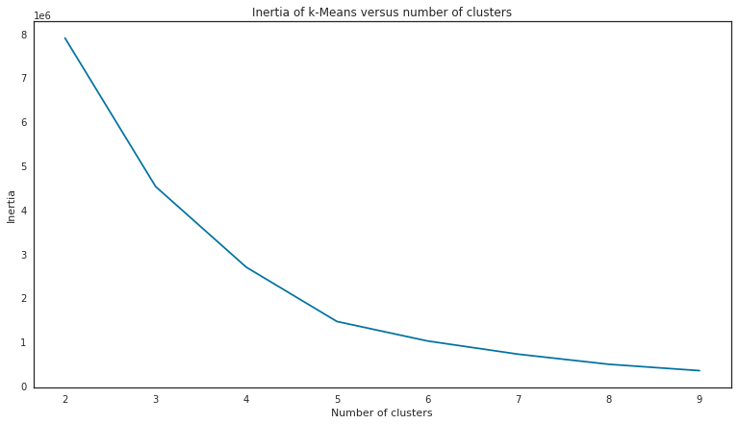
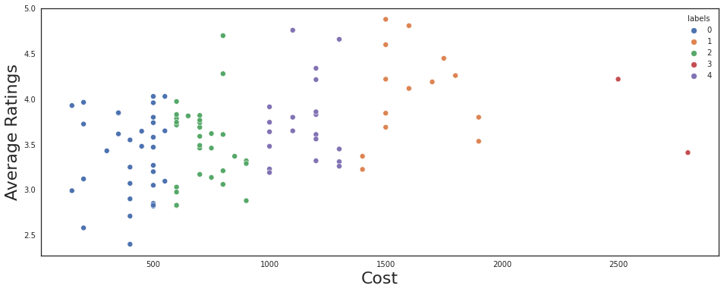
Clustering K-means clustering

Slide 17
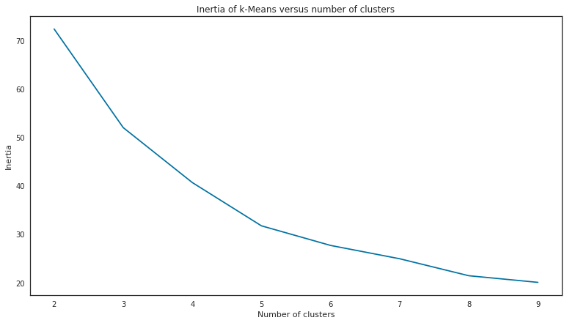
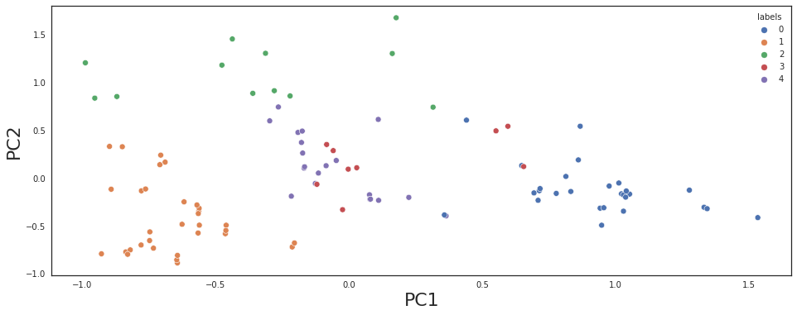
PCA - Principal Component Analysis

Slide 18
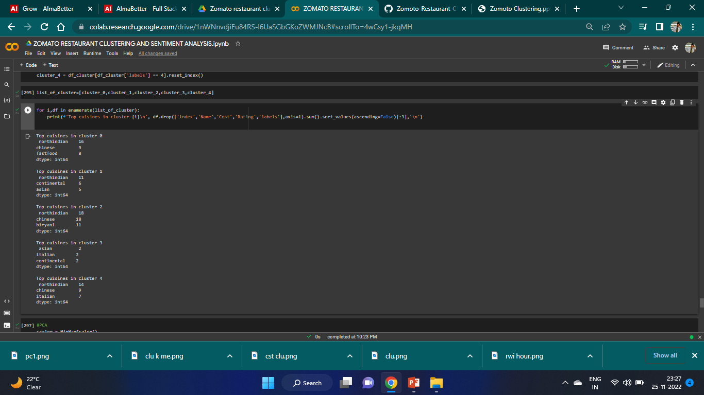
Top 3 cuisines in 5 clusters in K-means

Slide 19
Conclusion
The most popular cuisines are the cuisines which most of the restaurants are willing to provide. The most popular cuisines in Hyderabad are North Indian, Chinese, Continental, and Hyderabadi. Sentiment Analysis was done on the reviews and a model was trained in order to identify negative and positive sentiments. SVM and XGB both performed well and we can choose any one them,SVM and XGB are having 0.921 and 0.981 of testing accuracy respectively. We got best cluster as 5 in K-Means and Principal Component Analysis(PCA).

Slide 20
Thankyou

