Slide 1
Employee Task Management
Angular • Spring Boot • MySQL • Kubernetes (Minikube)

Slide 2
Project Overview
Goal: Manage employees and task status with a clear, responsive UI
Frontend: Angular (cards, search, sort, router View/Edit/Delete)
Backend: Spring Boot REST API on port 8083
Database: MySQL (employees table incl. designation & taskStatus)
Deployment: Local Kubernetes via Minikube

Slide 3
Key Features
Employee cards show Name, Email, Designation, Status
Status chips: Pending, In Progress, Completed (normalized in UI)
Search across name/email/designation/status
Sort by name, status, or id
Clean styling with hover effects & shadows

Slide 4
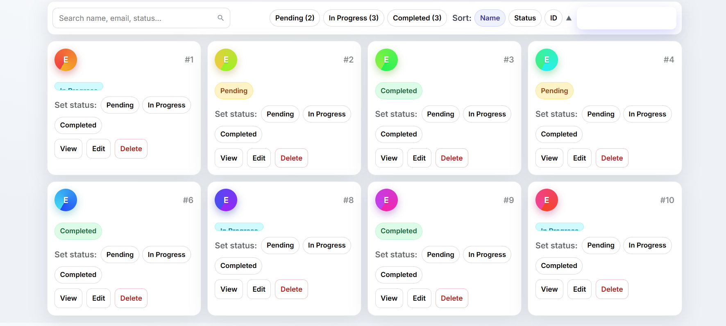
Frontend UI Snapshot
Compact inline row: Employee + Designation (single-line, ellipsis)
Robust status display for 'In Progress' variants
RouterLink for View/Edit; Delete calls API then refreshes list
Responsive grid with modern look
Employee List — sample view

Slide 5
API & Environment
Angular environments hold API base (environment.ts / prod.ts)
Base URL examples: http://localhost:8083 or Minikube service URL
All calls: ${environment.apiBase}/api/v1/employees
Add Employee form posts JSON to /api/v1/employees

Slide 6
Run Backend Locally (8083)
cd "C:\Users\surya\Downloads\backend emp" mvn -q -DskipTests package java -jar (Get-ChildItem .\target\*.jar | Sort-Object LastWriteTime -Desc | Select-Object -First 1).FullName Open: http://localhost:8083/api/v1/employees

Slide 7
Kubernetes (Minikube) — Deploy & Access
minikube start --driver=docker --cpus=2 --memory=4096 minikube image build -t emp-backend:latest . kubectl apply -f k8s/deployment.yaml -f k8s/service.yaml kubectl rollout status deploy/emp-backend kubectl port-forward svc/emp-backend 8083:8083

Slide 8
Testing & Validation
Use Angular form to add an employee → card appears in list
DevTools Network: POST/GET /api/v1/employees returns 2xx
Hit API directly in browser to confirm backend availability
Adjust environment.apiBase if using a different URL

Slide 9
Next Steps
Authentication & roles (Admin/User)
Task entity with due dates, reminders, analytics
CI/CD for image build & k8s deploy
Unit/E2E tests + logging/metrics

