Slide 1





Collect
DATA ANALYSIS ESSENTIALS · CORNERSTONE PROJECT
Smart Retail Sales Analysis
& Demand Forecasting
Clean
Analyze
DMart Sales Dataset (2011 – 2017)
PRESENTED BY
Predict
S. Leela Venkata Krishna Reddy
25B11CS861
P. Surya Akhil
25B11CS717
K. Surya Raja Mokshagna
25B11CS453
Department of Computer Science and Engineering

Slide 2







CONTENTS
Presentation Outline
01
02
03
Abstract
Introduction
System Analysis
04
05
06
Dataset
Requirements
Methodology
07
08
09
Implementation
Results
Conclusion
Smart Retail Sales Analysis & Demand Forecasting
1

Slide 3



01 · ABSTRACT
Abstract
We analyze seven years of DMart sales data (2011 – 2017) to understand what sells, where and when — and train machine learning models to predict future sales, helping stores plan stock and make smarter decisions.
Prepare
Analyze
Predict
Present
Clean the data and add useful columns
Find trends with charts
Train models to forecast sales
Share insights through a dashboard
Smart Retail Sales Analysis & Demand Forecasting
2

Slide 4




02 · INTRODUCTION
Why Retail Sales Data Matters
Retail businesses generate large volumes of sales data every day. Analyzing it helps understand:
THE CHALLENGE
Manual analysis of large datasets is time-consuming and error-prone.
Product performance
Regional sales
OUR APPROACH
Use data analytics and machine learning to analyze sales and forecast future demand.
Seasonal demand patterns
Customer purchasing behavior
Smart Retail Sales Analysis & Demand Forecasting
3

Slide 5



03 · SYSTEM ANALYSIS
Existing System
HOW IT WORKS TODAY
PROBLEMS
Data kept in Excel / CSV sheets
Slow and time-consuming
Hard to handle large data
Analysis done manually
Missing and messy values
Trends are hard to spot
Limited visualization
No demand forecasting
Poor inventory planning
Our dataset: 18,041 sales records from 2011 to 2017
Smart Retail Sales Analysis & Demand Forecasting
4

Slide 6






03 · SYSTEM ANALYSIS
Proposed System
Clean
Enrich
Analyze
Predict
Fix dates, fill gaps, check unusual values
Add useful columns like year, month and profit margin
Charts on sales, products, customers and regions
Train 3 models and keep the best one
BENEFITS
Faster analysis
Clear insights
Sales forecasts
Better stock planning
Smart Retail Sales Analysis & Demand Forecasting
5

Slide 7



04 · DATASET
Dataset Description
Column | What it means
Order Date / Ship Date | When the order was placed and shipped
Customer Name, Segment | Who bought (Consumer, Corporate, Home Office)
State, City, Region | Where the sale happened
Category, Sub-Category | Product group (3 categories, 17 sub-categories)
Product Name | Item purchased
Ship Mode | How it was shipped
Quantity, Discount | Units sold and discount given
Sales | Order value — what we predict
Profit | Money earned on the order
18,041
sales records
23
columns
2011–17
time period
Smart Retail Sales Analysis & Demand Forecasting
6

Slide 8









05 · REQUIREMENTS
What We Used
HARDWARE
SOFTWARE
Intel i3+
Processor
Windows
Operating system
Python
Language
Jupyter / Colab
Coding notebook
4 GB RAM
Minimum
Pandas & NumPy
Data handling
Matplotlib
Charts
Scikit-learn
Machine learning
20 GB
Storage
MS Excel
Dataset
Power BI
Dashboard
GitHub
Code storage
Smart Retail Sales Analysis & Demand Forecasting
8

Slide 9




06 · METHODOLOGY
Project Workflow
01
02
03
04
05
Collect Data
Load Data
Explore
Clean
Add Features
10
09
08
07
06
Evaluate & Save
Train Models
Split 80 / 20
Prepare for Model
Analyze & Visualize
Smart Retail Sales Analysis & Demand Forecasting
9

Slide 10
07 · IMPLEMENTATION
Loading & Exploring the Data
Python
EMPTY CELLS · DF.ISNULL().SUM()
import pandas as pd
df = pd.read_excel("DMart_All_Data_2011_2017.xlsx",
sheet_name="All Data")
df.shape # (18041, 23)
df.isnull().sum() # count empty cells
Order ID 0 Discount 0
Order Date 0 Sales 0
Customer Name 0 Profit 0
Country 0 Quantity 0
State 0 Feedback? 9994
City 0 Source 0
Region 0 Row ID 8047
Segment 0 Ship Date 8047
Ship Mode 0 Customer ID 8047
Category 0 Postal Code 8047
Sub-Category 0 Product ID 8047
Product Name 0
WHAT WE FOUND
18,041 rows and 23 columns
Sales, profit, quantity and discount are complete
Smart Retail Sales Analysis & Demand Forecasting
10

Slide 11
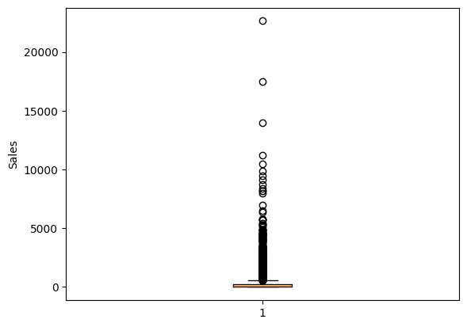

07 · IMPLEMENTATION
Cleaning the Data
Python
Box plot of Sales
df["Order Date"] = pd.to_datetime(df["Order Date"],
errors="coerce")
mode = df["Segment"].mode()
df["Segment"] = df["Segment"].fillna(mode[0])
median = df["Sales"].median()
df["Sales"] = df["Sales"].fillna(median)
plt.boxplot(df["Sales"].dropna())
Dates fixed
Text turned into dates
Gaps filled
No blanks in key columns
Maximum sales: 22,638.48
Smart Retail Sales Analysis & Demand Forecasting
11

Slide 12





07 · IMPLEMENTATION
Adding Useful Columns
New columns created from the existing data (Step 5 in the notebook)
Year · Month · Day · Quarter
Shipping Days
Has Discount
Taken from Order Date
Ship Date − Order Date
True if Discount > 0
Profit Margin
Discount Amount
Order Size
Profit ÷ Sales × 100
Sales × Discount
Low ≤ 100 · Medium ≤ 500 · High > 500
Smart Retail Sales Analysis & Demand Forecasting
12

Slide 13
07 · IMPLEMENTATION
Preparing Data for the Model
Text → Numbers
Remove extra columns
Scaling
Split the data
9 category columns converted to numbers (LabelEncoder)
Names, dates, source, feedback and profit columns dropped
Quantity, discount, date and shipping columns scaled (StandardScaler)
80% training, 20% testing (random_state = 42)
14,432
3,609
18
rows to train
rows to test
input columns
Smart Retail Sales Analysis & Demand Forecasting
13

Slide 14


07 · IMPLEMENTATION
Training & Saving the Model
Python
Linear Regression
LinearRegression()
from sklearn.linear_model import LinearRegression
model = LinearRegression()
model.fit(X_train, y_train)
from sklearn.tree import DecisionTreeRegressor
model_dt = DecisionTreeRegressor(random_state=42)
model_dt.fit(X_train, y_train)
from sklearn.ensemble import RandomForestRegressor
model_rf = RandomForestRegressor(n_estimators=100,
random_state=42)
model_rf.fit(X_train, y_train)
import pickle
with open("dmart_sales_model.pkl", "wb") as file:
pickle.dump(model_rf, file)
Decision Tree
random_state = 42
Random Forest
n_estimators = 100
Saved model
dmart_sales_model.pkl
Smart Retail Sales Analysis & Demand Forecasting
14

Slide 15




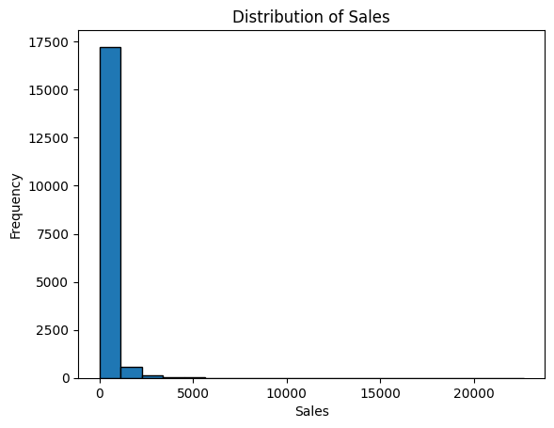
08 · RESULTS
Sales at a Glance
4,645,683
569,637
257.51
3
Total sales
Total profit
Average order
Most common quantity
TAKEAWAY
Most orders are small
A few big orders push totals up
Orders range from 0.44 to 22,638
Smart Retail Sales Analysis & Demand Forecasting
15

Slide 16
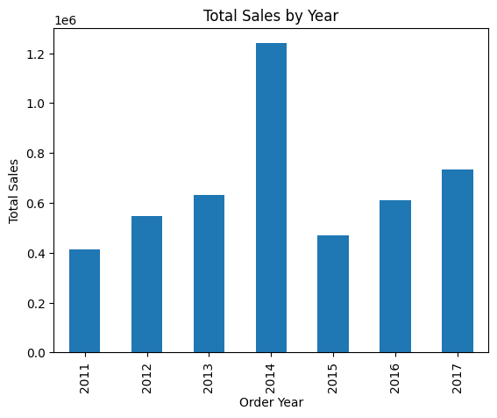
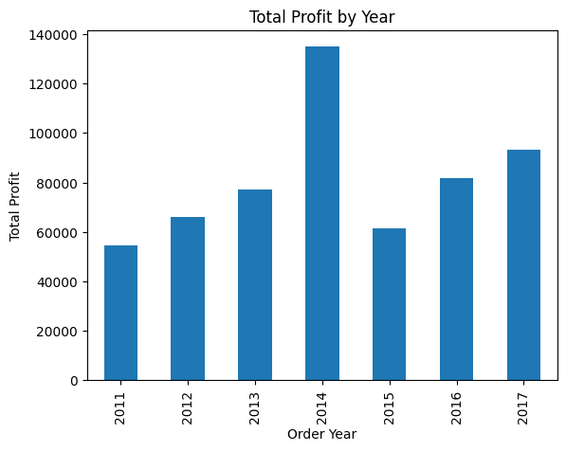
08 · RESULTS
Sales and Profit by Year
TAKEAWAY
2014 was the best year — sales 1,239,278 and profit 134,874. Sales dipped in 2015, then grew again.
Smart Retail Sales Analysis & Demand Forecasting
16

Slide 17
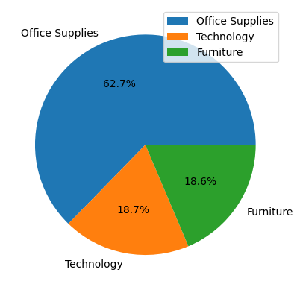
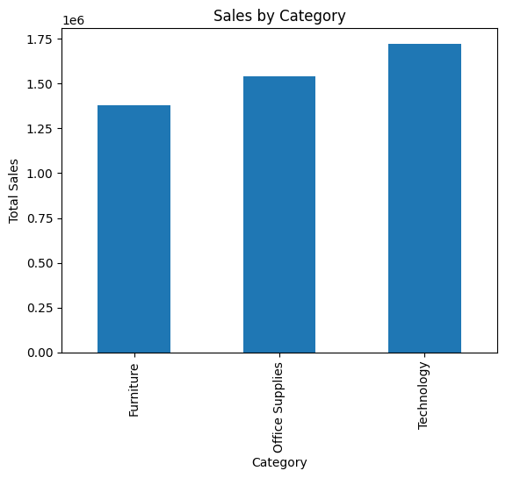
08 · RESULTS
Which Products Sell Best?
Category | Sales | Profit
Technology | 1,722,169 | 254,009
Office Supplies | 1,542,705 | 247,443
Furniture | 1,380,809 | 68,185
Most ordered: Binders (2,582), Art (1,948), Storage (1,897)
TAKEAWAY
Office Supplies are ordered most (62.7%), but Technology brings the most sales and profit.
Smart Retail Sales Analysis & Demand Forecasting
17

Slide 18
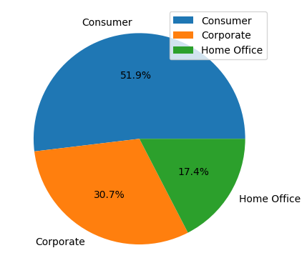
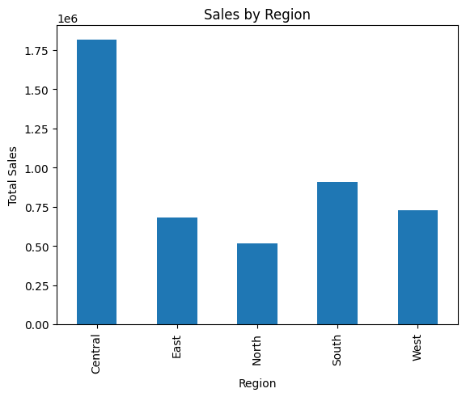
08 · RESULTS
Who Buys and Where?
Region | Profit
Central | 197,342
West | 108,418
South | 100,914
East | 91,523
North | 71,439
TAKEAWAY
Consumers place over half of all orders. The Central region brings in the most sales and profit.
Smart Retail Sales Analysis & Demand Forecasting
18

Slide 19
08 · RESULTS
Do Discounts Help?
Discount | Avg. profit
0% | 65.33
10% | 74.24
15% | 53.30
20% | 24.43
30% | −41.21
32% | −88.56
35% | −225.14
40% | −93.85
Discount | Avg. profit
45% | −276.70
50% | −102.07
60% | −89.29
65% | −375.71
70% | −107.48
80% | −102.19
85% | −1,925.00
≤ 20%
discount → still profitable
> 20%
discount → loss on average
Output of df.groupby("Discount")["Profit"].mean()
Smart Retail Sales Analysis & Demand Forecasting
19

Slide 20
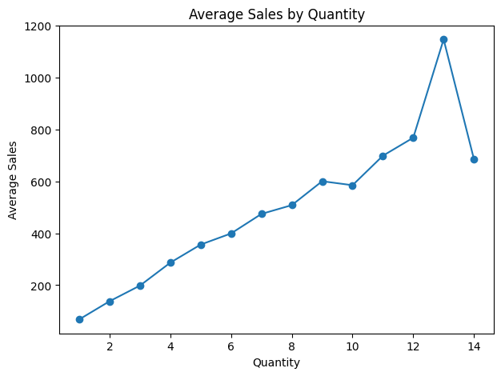
08 · RESULTS
Bigger Baskets, Bigger Sales
SALES BY REGION AND CATEGORY
Region | Furniture | Office | Tech
Central | 535,711 | 609,594 | 671,187
East | 208,291 | 205,516 | 264,974
North | 136,742 | 176,786 | 202,451
South | 247,452 | 329,955 | 331,565
West | 252,613 | 220,853 | 251,992
TAKEAWAY
More items per order = higher order value
Smart Retail Sales Analysis & Demand Forecasting
20

Slide 21
08 · RESULTS
Top 10 Products by Sales
# | Product | Sales
1 | Canon imageCLASS 2200 Advanced Copier | 61,599.82
2 | Nokia Smart Phone, Full Size | 30,645.00
3 | Fellowes PB500 Electric Punch Plastic Comb Binding Machine with Manual Bind | 27,453.38
4 | Cisco TelePresence System EX90 Videoconferencing Unit | 22,638.48
5 | HON 5400 Series Task Chairs for Big and Tall | 21,870.58
6 | GBC DocuBind TL300 Electric Binding System | 19,823.48
7 | GBC Ibimaster 500 Manual ProClick Binding System | 19,024.50
8 | Hewlett Packard LaserJet 3310 Copier | 18,839.69
9 | HP Designjet T520 Inkjet Large Format Printer - 24" Color | 18,374.90
10 | GBC DocuBind P400 Electric Binding System | 17,965.07
2×
The Canon copier sold double the next best product
Office machines and tech items fill the top 10
Smart Retail Sales Analysis & Demand Forecasting
21

Slide 22

08 · RESULTS
Which Model Predicts Best?
Linear Regression
Decision Tree
Random Forest
Average error
Accuracy (R²)
Average error
Accuracy (R²)
Average error
Accuracy (R²)
267.69
0.21
137.39
0.14
108.41
0.50
★ BEST MODEL
Random Forest wins — lowest error and highest score. Saved as dmart_sales_model.pkl for predictions.
Smart Retail Sales Analysis & Demand Forecasting
22

Slide 23



09 · CONCLUSION
Conclusion
DEPLOYMENT
2014
Technology
Power BI dashboard
was the best sales year
earns the most profit
Web app for predictions
Central
≤ 20%
is the top region
discount keeps orders profitable
Model saved (.pkl)
Best model: Random Forest, saved for sales prediction
Smart Retail Sales Analysis & Demand Forecasting
23

Slide 24
Thank You
Questions?
S. Leela Venkata Krishna Reddy · P. Surya Akhil · K. Surya Raja Mokshagna
Department of Computer Science and Engineering

