Slide 1
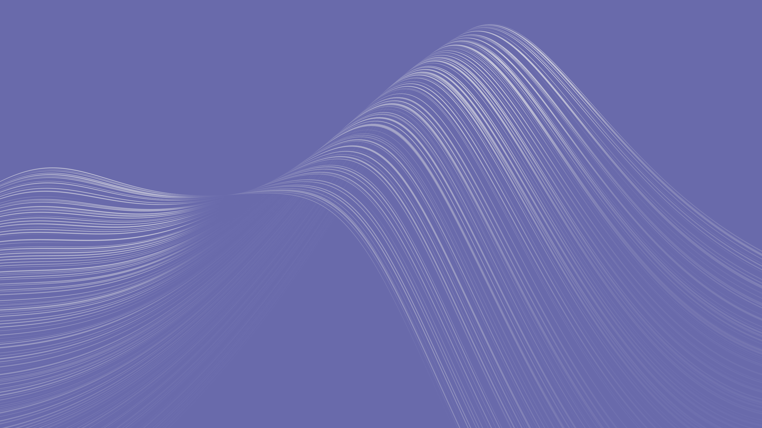
GRAPHQL

Slide 2

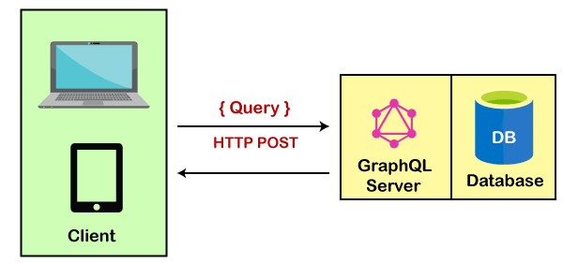
GRAPHQL
GraphQL is a new API standard invented and developed by Facebook. It is an open-source server-side technology, now maintained by a large community of companies and individuals of all over the world. It is also an execution engine that works as a data query language and used to fetch declarative data.
It was developed to optimize RESTful API calls and provides a flexible, robust, and more efficient alternative to REST.

Slide 3
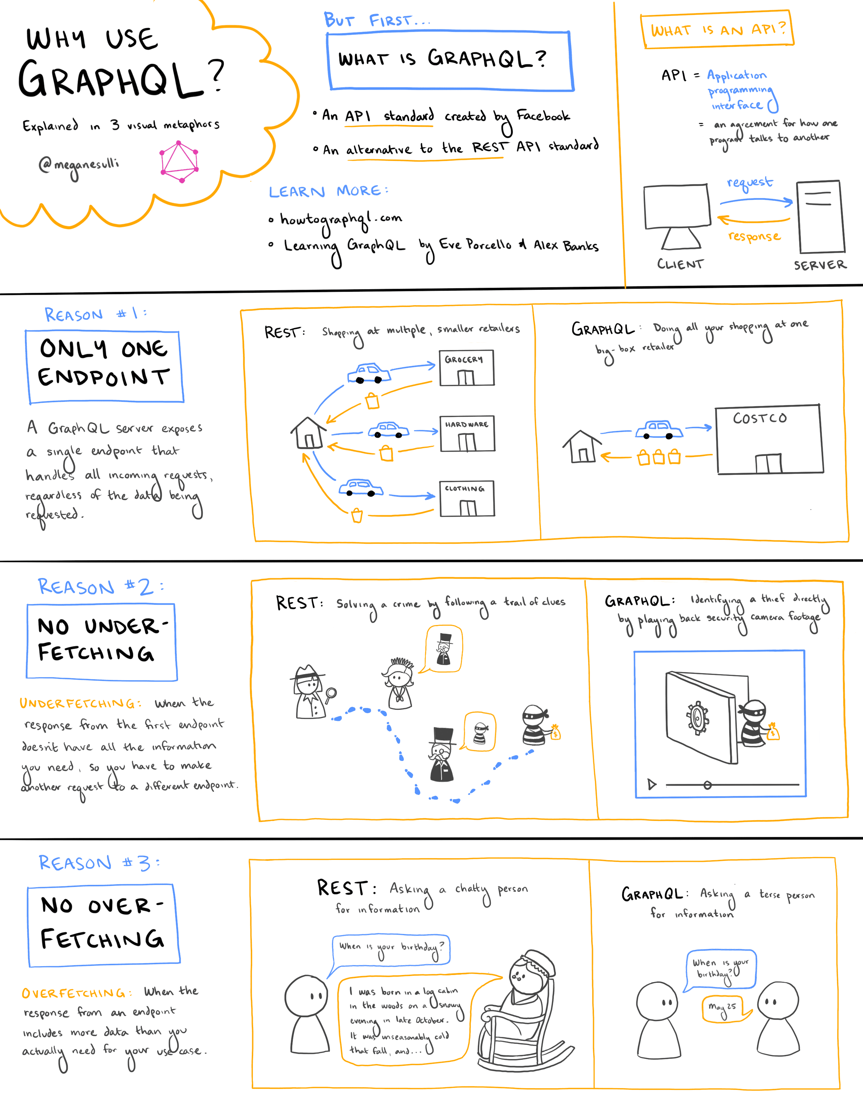

Slide 4
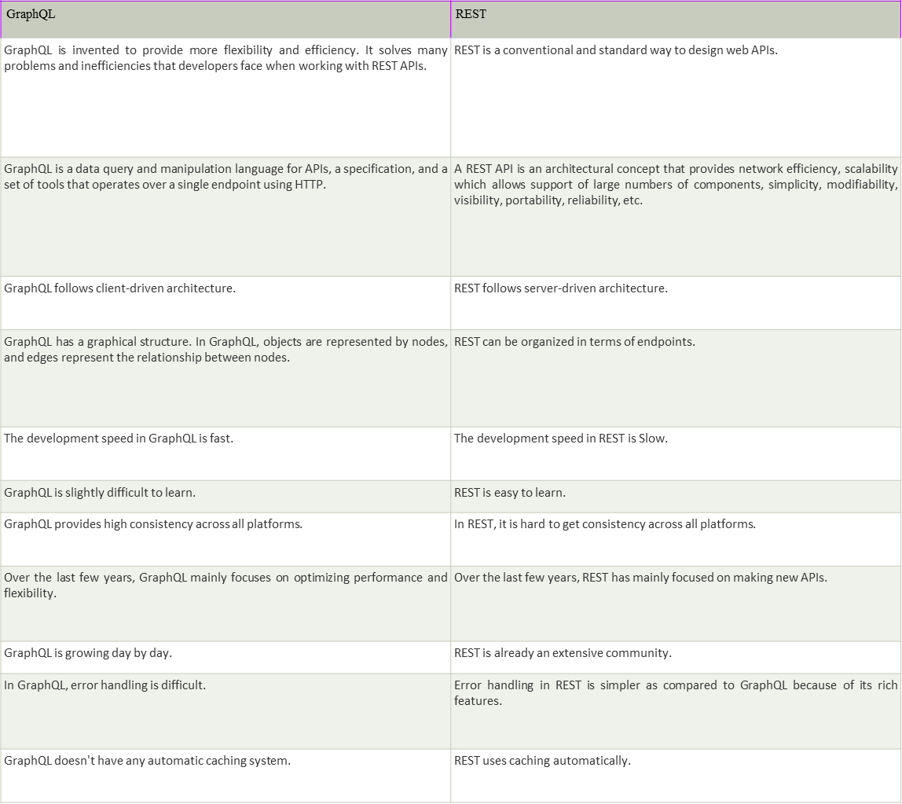
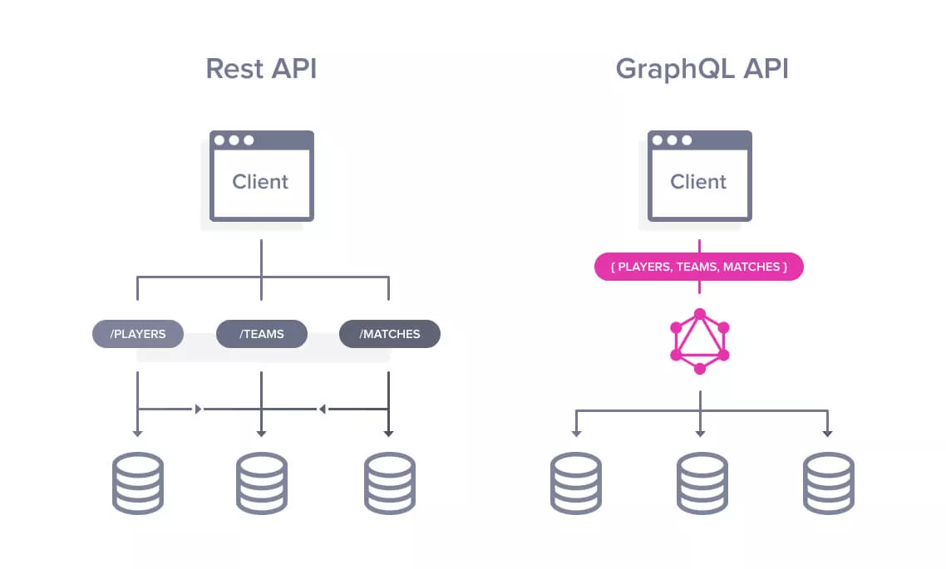

Slide 5
Advantages | Disadvantages
GraphQL is faster | GraphQL query complexity
Best for complex systems and microservices | GraphQL caching
No over-fetching and under-fetching problems | GraphQL rate limiting
Hierarchical structure
Defines a data shape
Code-sharing
Strongly typed

Slide 6
WHERE IS GRAPHQL IS BETTER THAN RESTAPI
When you use REST API to fetch information, it will always return a complete dataset. For example, if you want to request information from two objects, you have to perform two REST API requests. The biggest advantage of using the REST API is its simplicity. In REST APIs, you have one endpoint that does only one task, so it is easy to understand and manipulate.
In REST API, if you retrieve some information from a specific endpoint, you will always get a complete data set because, in REST APIs, you couldn't restrict the fields that the REST API returns. This is called over fetching. On the other hand, by using GraphQL, you can escape from over fetching. You can query your request to fetch exactly what you need from multiple objects. Once you get familiar with GraphQL, it is easy and powerful. It facilitates you to fetch only the required data, so; you limit the amount of processing required.

Slide 7
Where REST API is better than GraphQL
REST is already an industry standard for companies deploying APIs. It provides a lot of great features such as client-server architecture, stateless server, cachability, layered system, load balancer, uniform interface, etc.

Slide 8
Conclusion
So, by comparing both, we can see that GraphQL is an API of the future. A lot of companies such as Facebook, Github, Twitter, Coursera, yelp, Pinterest, Serverless, ProductHunt, Shopify, etc. are using it now. Both GraphQL and REST are used to send data over HTTP, but GraphQL certainly has many advantages over REST.

