Slide 1
Capstone Project I
Topic: Rubberband: Efficient Cost-Aware Hyperparameter Tuning on GPU Clusters
Guided By: Dr. Abhinandan S. Prasad & Dr. Sudeepta Mishra
Group 41
Team Members:
Suryadeep Mallick(2022CSB1132)
Ashutosh Singh(2022SCB1071

Slide 2
MOTIVATION
Skyrocketing hyperparameter-tuning costs
Large search spaces → dozens to hundreds of trials
GPUs billed by the hour, idle time wastes budget
Rigid static allocations
Fixed number of GPUs per trial can under- or over-provision
No adaptivity to changing workload or cloud latency
Sublinear scaling
Beyond a certain GPU count, adding more devices yields diminishing JCT improvements
Causes (from RubberBand):Communication overhead, Straggler imbalance, Cloud latencies

Slide 3
PROBLEM STATEMENT
Respect a global time budget (e.g. complete all trials within 2 hours)
Minimize monetary cost under cloud billing models
Maintain model-accuracy guarantees
How can we automatically resize compute allocation over time to:

Slide 4
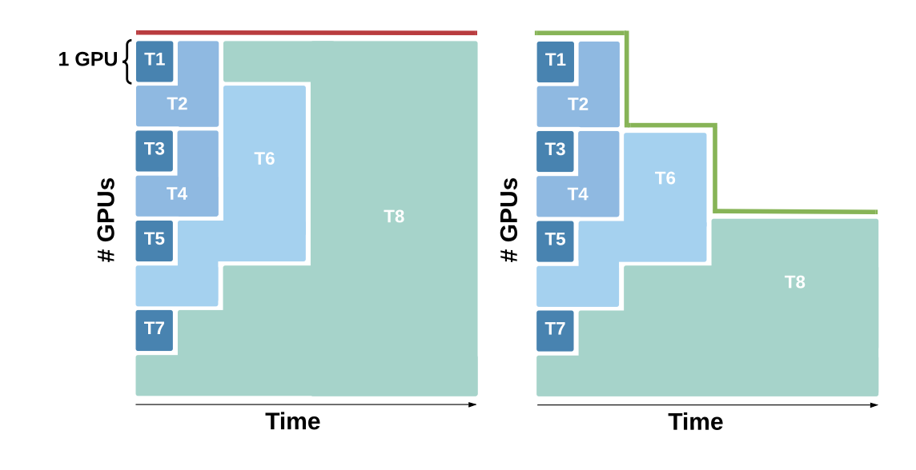
STATIC ALLOCATION
ELASTIC ALLOCATION

Slide 5
WHAT IS RUBBERBAND
Profile
Run small “probe” jobs at different GPU counts
Measure mean/std training times for each configuration
Plan
Build a DAG-based simulator of scale, init, train, sync steps
Greedy search over stage-wise allocations to meet time & cost caps
Execute
Kick off Ray actors for each trial
Dynamically scale in/out GPUs mid-job
Employ placement logic to co-locate workers and reduce comms
RubberBand is an elastic hyperparameter‐search framework (EuroSys ’21) that automatically scales your compute cluster up and down over the course of a tuning job to meet a global deadline at minimal cost.

Slide 6
Key Benefits
Up to 2× cost reduction vs. best static allocation (EuroSys ’21)
Guaranteed deadline adherence through time-budget constraint
Minimal accuracy loss, since each trial still finishes its full iterations

Slide 7
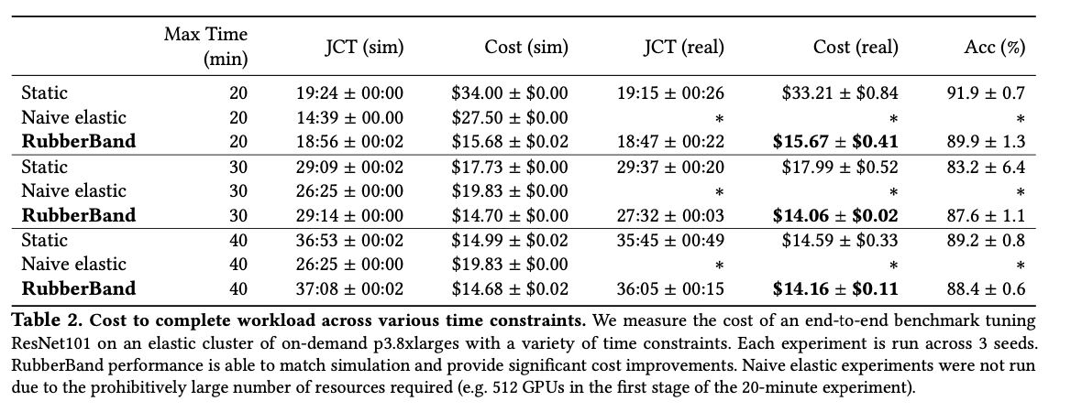
“END-TO-END COST & COMPLETION TIME COMPARISON (RESNET101 ON P3.8XLARGE)”

Slide 8
“RUBBERBAND” IN A NUTSHELL
Core idea: profile, plan, simulate, and execute an elastic schedule
2× cost savings vs. static baselines (EuroSys ’21)
Declarative experiment spec → offline planning & profiling → online scaling

Slide 9
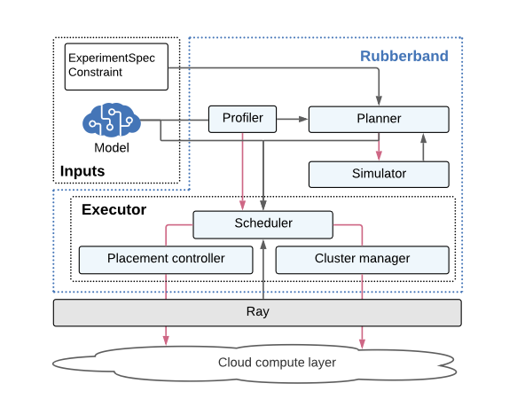
SYSTEM ARCHITECTURE (HIGH-LEVEL)

Slide 10
LETS MOVE TO IMPLEMENTATION

Slide 11
LIBRARIES USED
1. Ray
Used to launch remote training workers (Ray actors)
Enables parallel execution of multiple trials
Supports dynamic scaling (scale-in/out) during the job
Powers distributed orchestration for profiling and execution
2. PyTorch
Core deep learning framework
Defines model architecture (BaseModel, SimpleCNNModel)
Provides training loop, loss functions, and optimizers
Enables multi-GPU training via DistributedDataParallel (DDP)
3. Torchvision
Supplies the CIFAR-10 dataset
used in experiments
Applies standard image transforms (normalization, tensor conversion)
Seamlessly integrates with PyTorch DataLoader
4. NumPy
Performs statistical analysis (mean/std of epoch times)
Used in the profiler to summarize GPU scaling behavior
Supports simulation logic for modeling execution time and cost

Slide 12
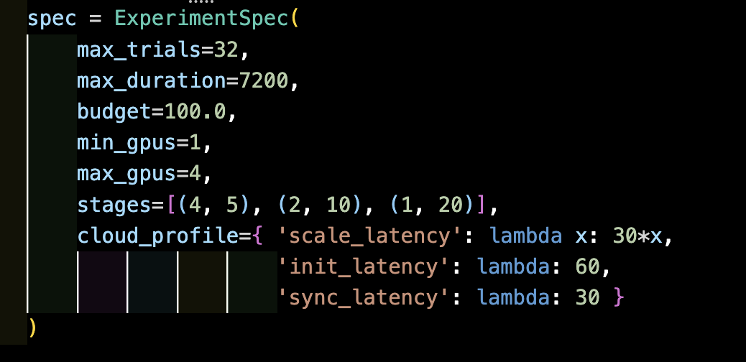
ExperimentSpec: Declarative Job Configuration
Code Snippet:
Field | Description
max_trials | Total number of hyperparameter trials (e.g. 32)
max_duration | Wall-clock deadline in seconds (e.g. 3600 s = 1 hr)
budget | Dollar budget cap (e.g. 100.0)
min_gpus | Minimum GPUs per stage
max_gpus | Maximum GPUs per stage
stages | List of (num_trials, iterations) tuples defining search phases
cloud_profile | Latency functions for scale, init, and sync steps

Slide 13
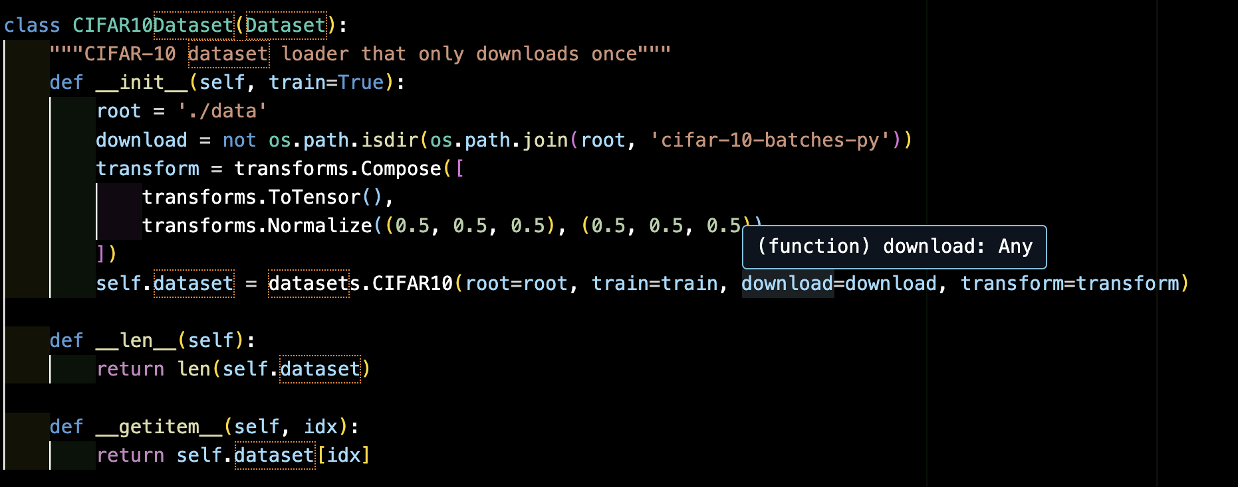
Dataset Interface (CIFAR-10 Example)

Slide 14
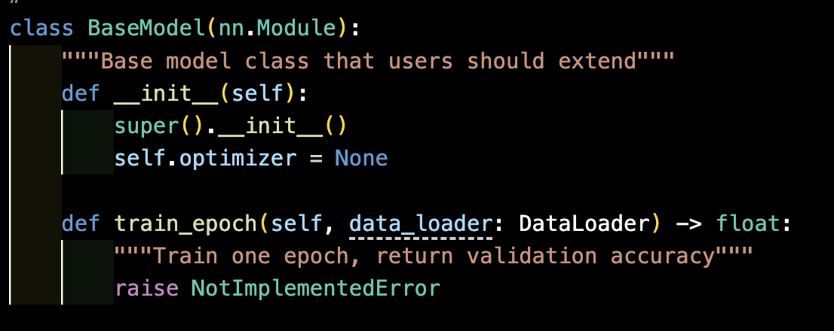
BaseModel Interface
Users extend this for their own neural network models
Must implement one training epoch

Slide 15
RayWorker – Profiling Actor for Elastic Hyperparameter Tuning
Purpose
RayWorker is a distributed Ray actor that profiles training latency of deep learning models using PyTorch DDP to inform cost-aware planning, as inspired by the RubberBand framework.
Key Features Distributed Setup: Initializes PyTorch DDP using rank and world_size per worker. Model Profiling: Runs limited batches (max_batches) to quickly estimate training speed. Resource-Aware: Uses DataLoader with DistributedSampler to simulate realistic parallel training.
Connection to RubberBand
Supports the scaling profile generation phase by profiling how training latency changes with GPU count—critical for generating elastic, low-cost resource plans under time constraints.

Slide 16
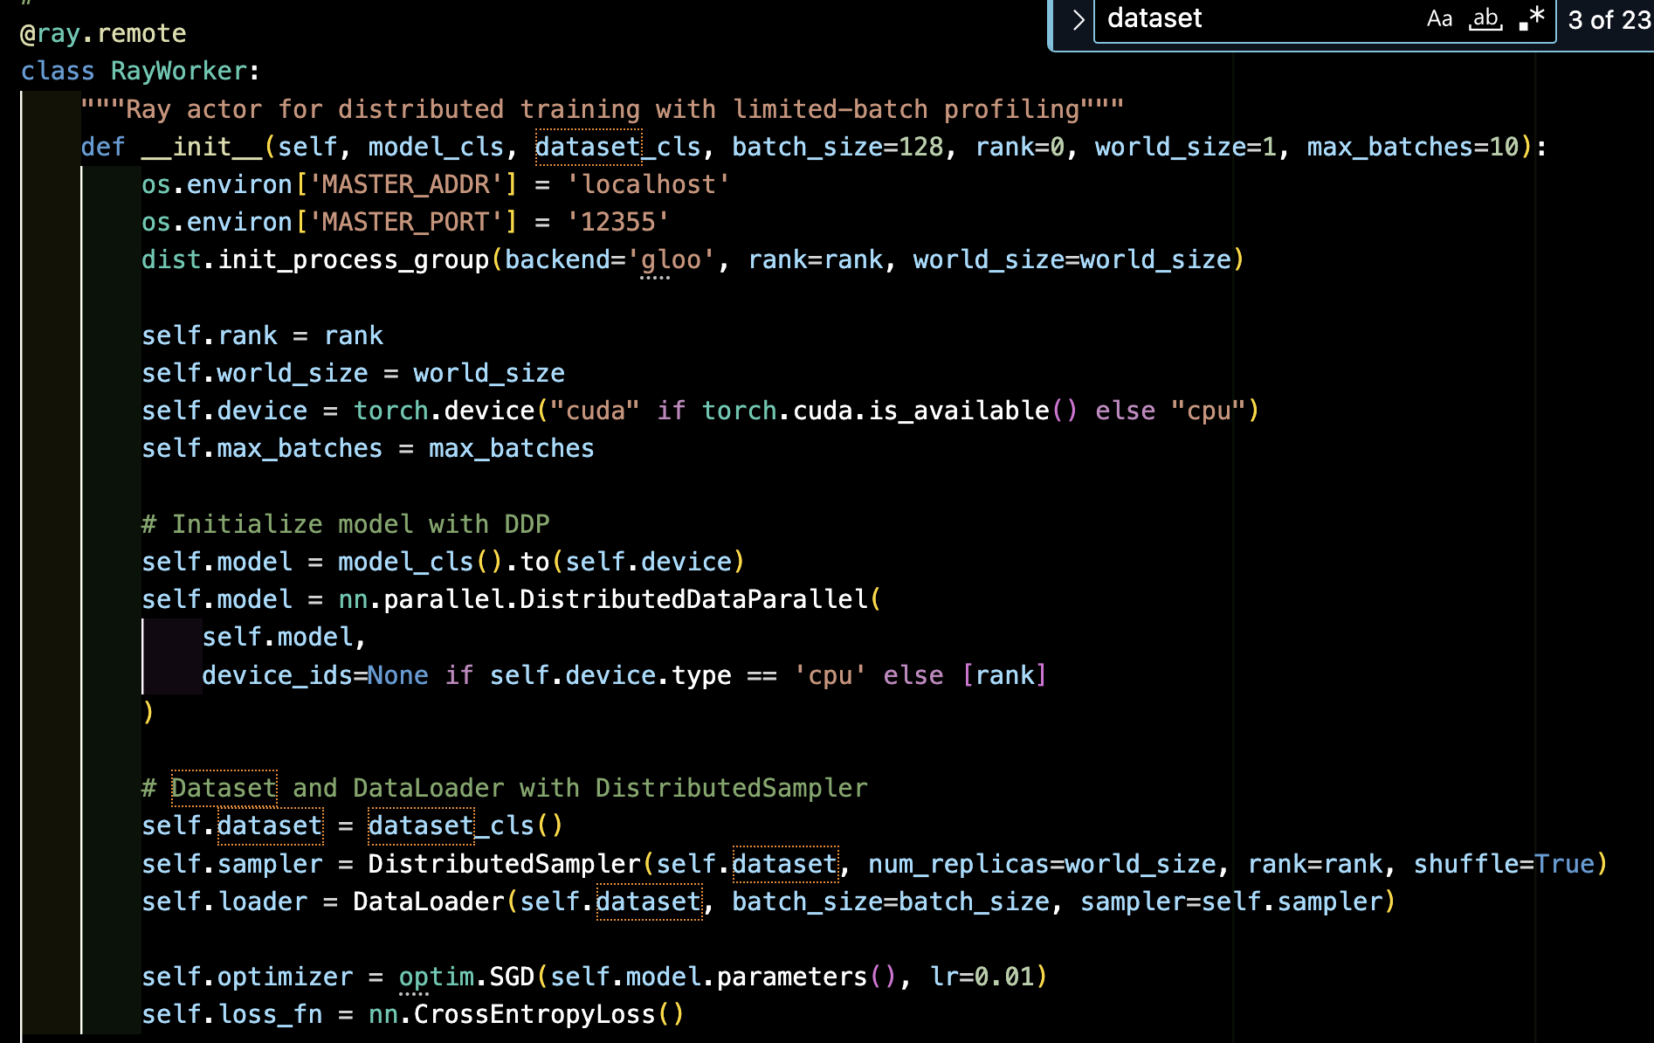
Code Snippet

Slide 17
PROFILER
How It Works
Profiler takes a model class (SimpleCNNModel) and a dataset class (CIFAR10Dataset)
For GPU counts [1, 2, 4, ..., max_gpus]:
Launches that many RayWorker actors
Each worker runs profile_step() to train a few batches
Collects per-epoch times: uses np.mean(...) and np.std(...)
Stores results in self.scaling_profile[gpus]
Purpose
To measure how training speed improves with more GPUs
Builds a scaling profile for use by the simulator and planner
What It Produces
{
'mean_time': <avg epoch time>,
'std_time': <std deviation>,
'efficiency': <speedup-per-GPU>
}
Why It’s Important
Helps decide if adding GPUs is worth the cost
Reveals sublinear scaling due to sync/comm overheads
Input to TimeSimulator and ResourcePlanner

Slide 18
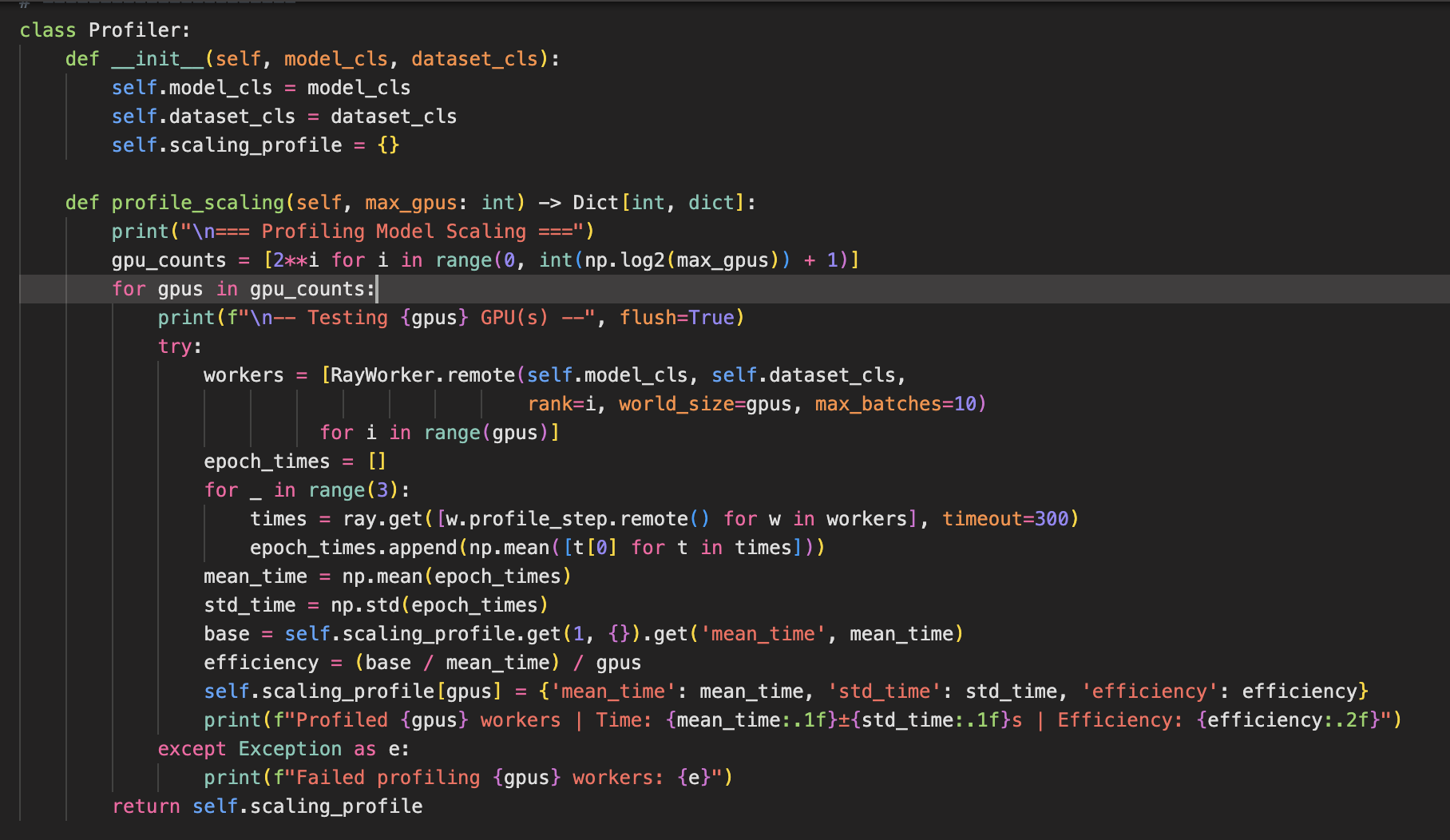
PROFILER CODE

Slide 19
How It Works
Constructs DAG nodes:
scale_{stage_idx}: scaling GPUs at each stage
init_{stage_idx}_{gpu_idx}: initializing GPUs
train_{stage_idx}_{trial_idx}: training trials with given GPUs and iterations
sync_{stage_idx}: synchronization points between stages
DAG edges represent dependencies, e.g.:
scale → init → train → sync
Latencies sampled from profiles (cloud_profile and scaling_profile):
scale_latency(delta GPUs)
init_latency()
train_latency(mean, std, iterations) sync_latency()
Simulator
Purpose
Simulate distributed training workflows described by an ExperimentSpec and GPU plan (list of GPU counts per stage).
Model execution as a Directed Acyclic Graph (DAG) capturing task dependencies and resource allocation.
Estimate Job Completion Time (JCT) and resource cost under
realistic latency variability.
What It Produces
Distribution of possible job completion times (JCT) for the given experiment and plan.
Expected cost based on total GPU usage and latency samples.
Insights into bottlenecks and resource efficiency.
Why It’s Important
Provides realistic performance estimates incorporating latency variability.
Helps select GPU allocations (plan) that optimize training time and cost.
Captures complex stage dependencies via DAG, reflecting actual system constraints.
Enables informed decision-making for resource scheduling and scaling in distributed ML.

Slide 20
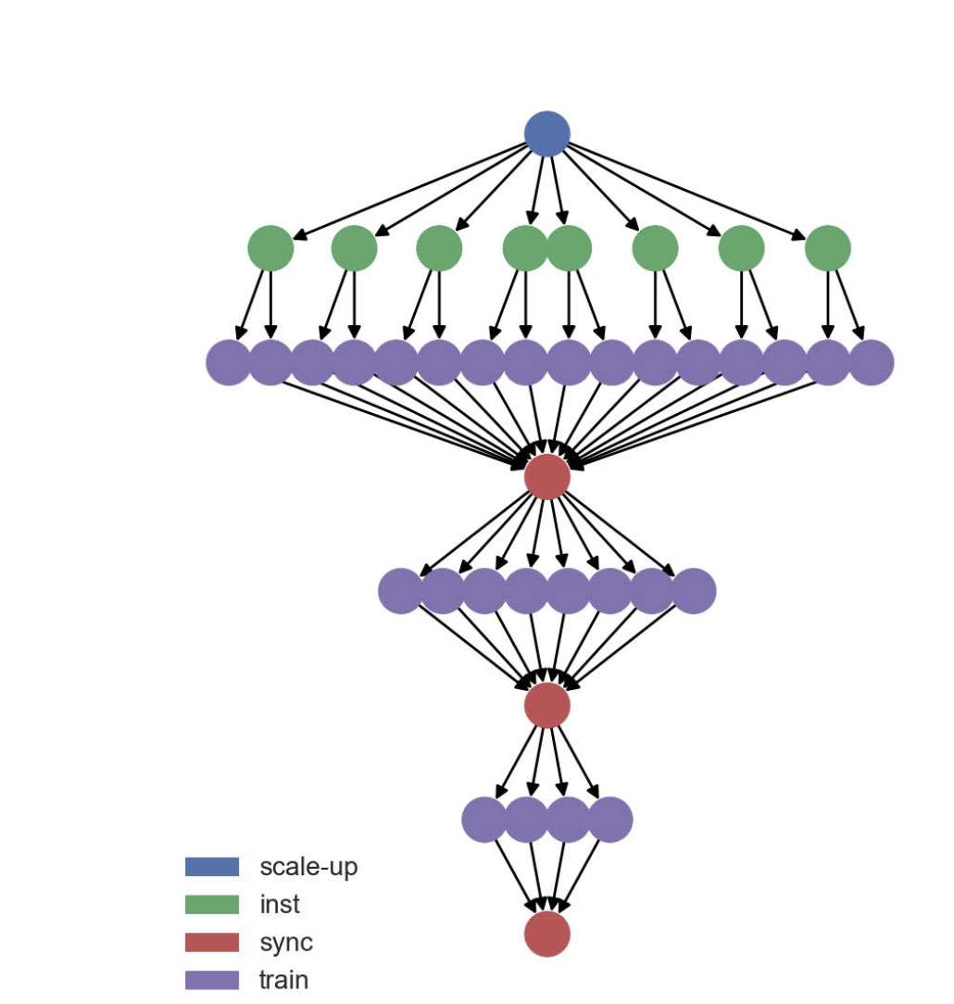
DAG FOR ANY GIVEN EXPERIMENT

Slide 21
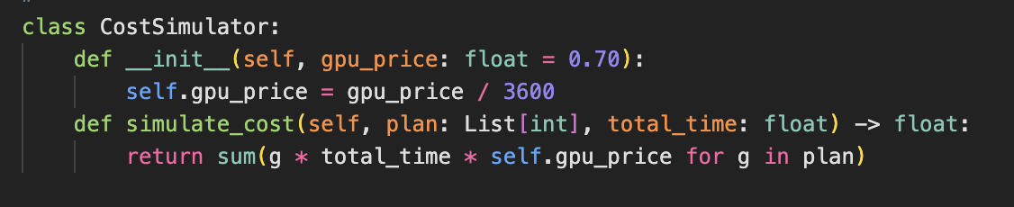
COST SIMULATOR

Slide 22
PseudoCode(Visualisation)
for i in range(len(plan)):
for f in [2, 3]:
new_plan = plan.copy()
new_plan[i] = max(1, plan[i] // f)
if meets_constraints(new_plan):
if delta_cost / delta_time is best:
plan = new_plan
Purpose
To optimize GPU allocation across training stages, balancing job completion time (JCT) and cost.
Finds a cost-efficient plan under user-defined constraints (max cost, max time, etc.).
Resource Planner
What It Produces
A resource plan (list of GPU counts per stage) that offers efficient trade-offs between cost and time.
Why It’s Important
Avoids brute-force search; uses intelligent heuristics.
Generates non-uniform GPU allocations that better fit cloud pricing models.
Adapts to different user constraints (max_cost, max_time, etc.)
Improves over static planning, saving real dollars and hours.

Slide 23
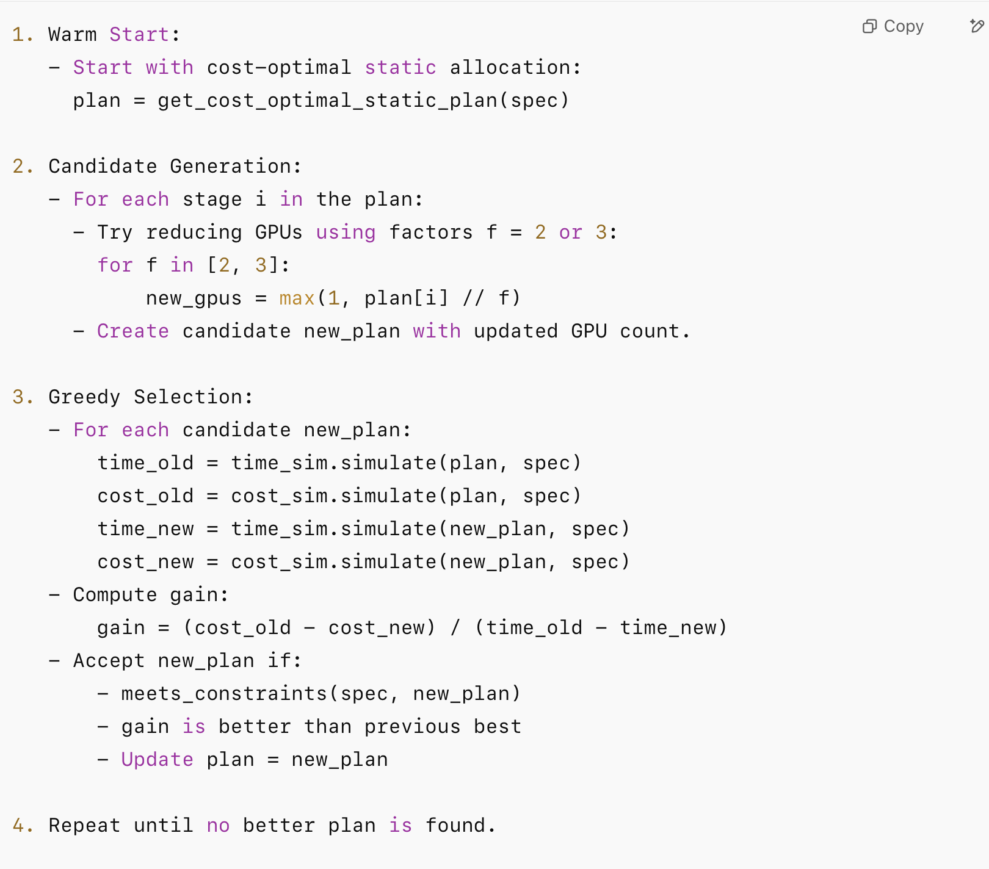
Working

Slide 24
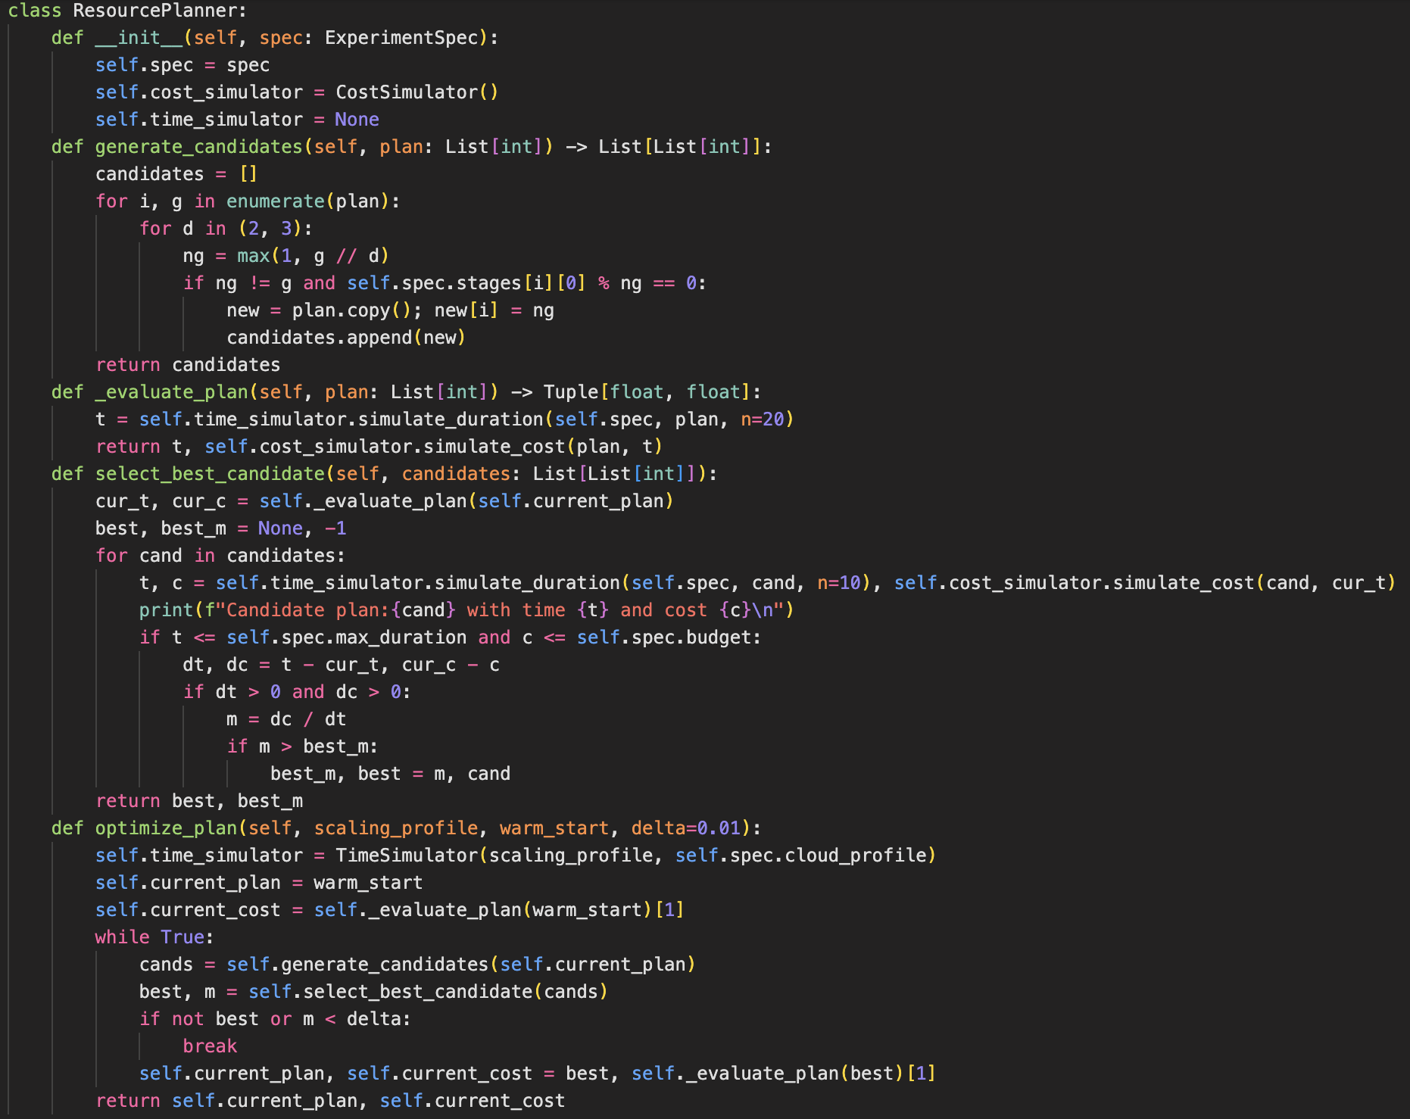
RESOURCE PLANNER

Slide 25
Implement the Executor Module
Integrate Execution with Planner Output
Reproduce and Evaluate Against Baselines
Build the full executor responsible for running the planned resource schedule.
This includes:
A Cluster Manager to scale GPU resources during job execution.
A Placement Controller to optimize GPU assignment and co-location.
Connect the executor to follow the schedule generated by the planner.
Ensure that trial execution aligns with GPU allocations across stages.
Conduct a comparative evaluation using the setup in the RubberBand paper.
Compare with static and naive elastic baselines on metrics like:
Job Completion Time (JCT)
Total GPU cost
FUTURE WORK

Slide 26
Lessons Learned
Elasticity yields biggest gains under tight time constraints and compute-dominated costs
Naive elasticity (fixed per-trial allocation) can backfire
Accurate profiling & placement are crucial

Slide 27
References Key citations: RubberBand EuroSys ’21, Successive Halving, Hyperband Acknowledgements: We would like to thank the following individuals and organizations for their support during this project: Dr. Abhinandan S. Prasad For providing technical insights and feedback that helped refine our approach. Ashu Kaushik For assisting with the deployment environment and container setup.

Slide 28
T
H
A
N
K
Y
O
U

