Slide 1

Product Sales Analysis Using Machine Learning
Sit Dolor Amet

Slide 2

Product Sales Analysis
Introduction:
Product sales analysis is a critical aspect of business operations, as it helps organizations understand their product performance, customer preferences, and market trends.
Analyzing product sales data provides valuable insights for decision-making and can lead to improved sales strategies, inventory management, and profitability.

Slide 3
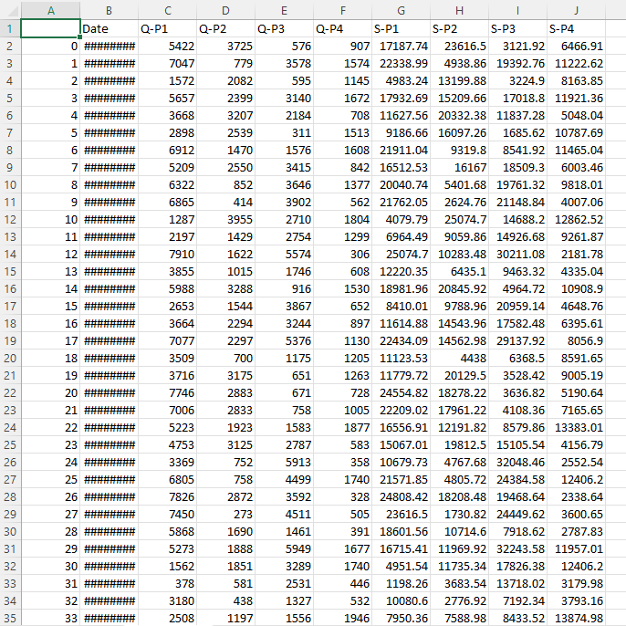
Given Dataset:

Slide 4
Necessary Steps to Follow:
1.Import the Necessary Libraries:
Start by importing the required libraries.
Program:
import pandas as pd
import numpy as np
2. Load the Dataset:
Read the dataset from a file, such as a CSV file, into a Pandas Dataframe. Replace ‘statsfinal.csv' with the actual filename of your dataset.
Program:
data = pd.read_csv(‘'C:/Users/asus/Downloads/statsfinal.csv’)

Slide 5
3.Explore the Data:
Before preprocessing, it's essential to get an overview of the dataset.
Program:
# Display the first few rows of the dataset
print(data.head())
# Get basic information about the dataset
print(data.info())
# Check for missing values
print(data.isnull().sum())
# Summary statistics
print(data.describe())

Slide 6
4.Feature Engineering:
Create new features or modify existing ones if needed for your analysis. This step depends on the specifics of your analysis.
Program:
data['year'] = pd.to_datetime(data['date']).dt.year
data['month'] = pd.to_datetime(data['date']).dt.month
5.Data Transformation:
Transform data to make it suitable for analysis. You might need to encode categorical variables, normalize or scale numerical features, and perform other transformations.

Slide 7
Importance of loading and processing dataset:
Loading and preprocessing the dataset is an important first step in
building any machine learning model. However, it is especially
important for product sales analysis models, as product price datasets are
often complex and noisy.
By loading and preprocessing the dataset, we can ensure that the
machine learning algorithm is able to learn from the data effectively and
accurately.
Challenges involved in loading and preprocessing a product sales dataset
Data Volume:
Large datasets can be challenging to load and process efficiently, as they may not fit into memory. You may need to implement data loading strategies like data streaming or batch processing.

Slide 8
Missing Data:
Sales datasets often contain missing values, which must be dealt with appropriately. Imputing missing values or deciding how to handle records with missing data is an important preprocessing step.
Data Integration:
your sales data comes from multiple sources or systems, integrating the data into a single coherent dataset can be challenging. You'll need to establish data mappings and standardize the data formats.
Data Validation:
Ensuring data accuracy and consistency is crucial. You may need to implement data validation checks to identify and handle data that doesn't meet predefined criteria.

Slide 9
How to overcome the challenges of loading and preprocessing a product sales analysis dataset
There are a number of things that can be done to overcome the
challenges of loading and preprocessing a product sales dataset, including:
Use a data preprocessing library:
There are a number of libraries available that can help with data
preprocessing tasks, such as handling missing values, encoding
categorical variables, and scaling the features.
Carefully consider the specific needs of your model:
The best way to preprocess the data will depend on the specific
machine learning algorithm that you are using. It is important to
carefully consider the requirements of the algorithm and to preprocess
the data in a way that is compatible with the algorithm.

Slide 10
1.Loading the dataset:
Loading the dataset using machine learning is the process of bringing
the data into the machine learning environment so that it can be used
to train and evaluate a model.
The specific steps involved in loading the dataset will vary depending
on the machine learning library or framework that is being used.
However, there are some general steps that are common to most
machine learning frameworks:
a.Identify the dataset:
The first step is to identify the dataset that you want to load. This
dataset may be stored in a local file, in a database, or in a cloud storage
service.

Slide 11
b.Load the dataset:
Once you have identified the dataset, you need to load it into the
machine learning environment. This may involve using a built-in
function in the machine learning library, or it may involve writing your
own code.
c.Preprocess the dataset:
Once the dataset is loaded into the machine learning environment,
you may need to preprocess it before you can start training and
evaluating your model. This may involve cleaning the data, transformingthe data into a suitable format, and splitting the data into training and
test sets.

Slide 12
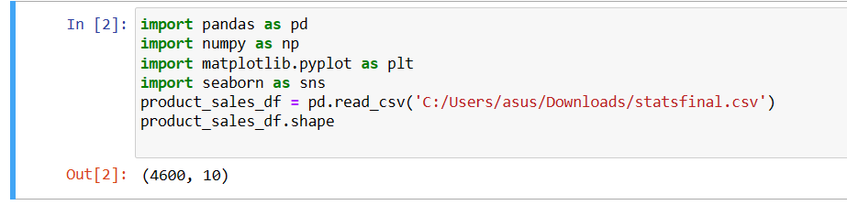
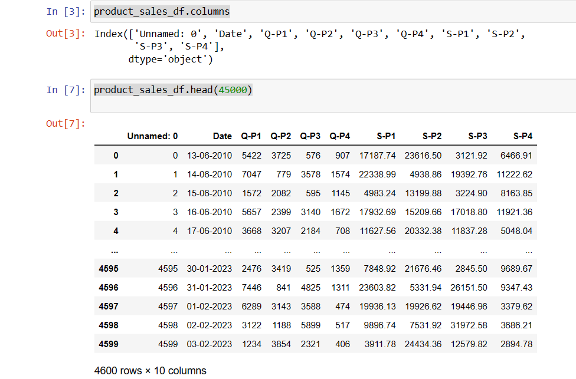
Program:

Slide 13
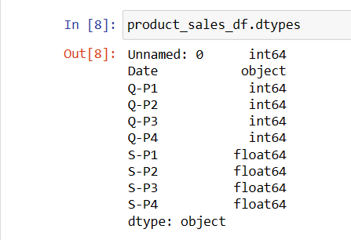
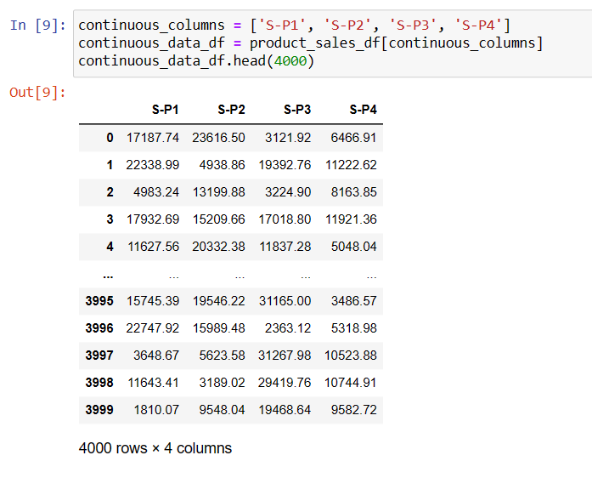

Slide 14
2.Preprocessing the dataset:
Data preprocessing is the process of cleaning, transforming, and
integrating data in order to make it ready for analysis.
This may involve removing errors and inconsistencies, handling
missing values, transforming the data into a consistent format, and
scaling the data to a suitable range.
Visualisation and Pre-Processing of Data:
Visualizing and preprocessing data are crucial steps in product sales analysis. Let's start with data visualization using Python and the Matplotlib and Seaborn libraries, and then we'll discuss data preprocessing

Slide 15
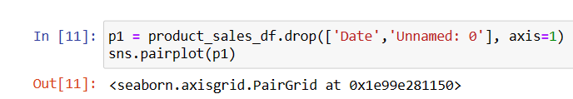
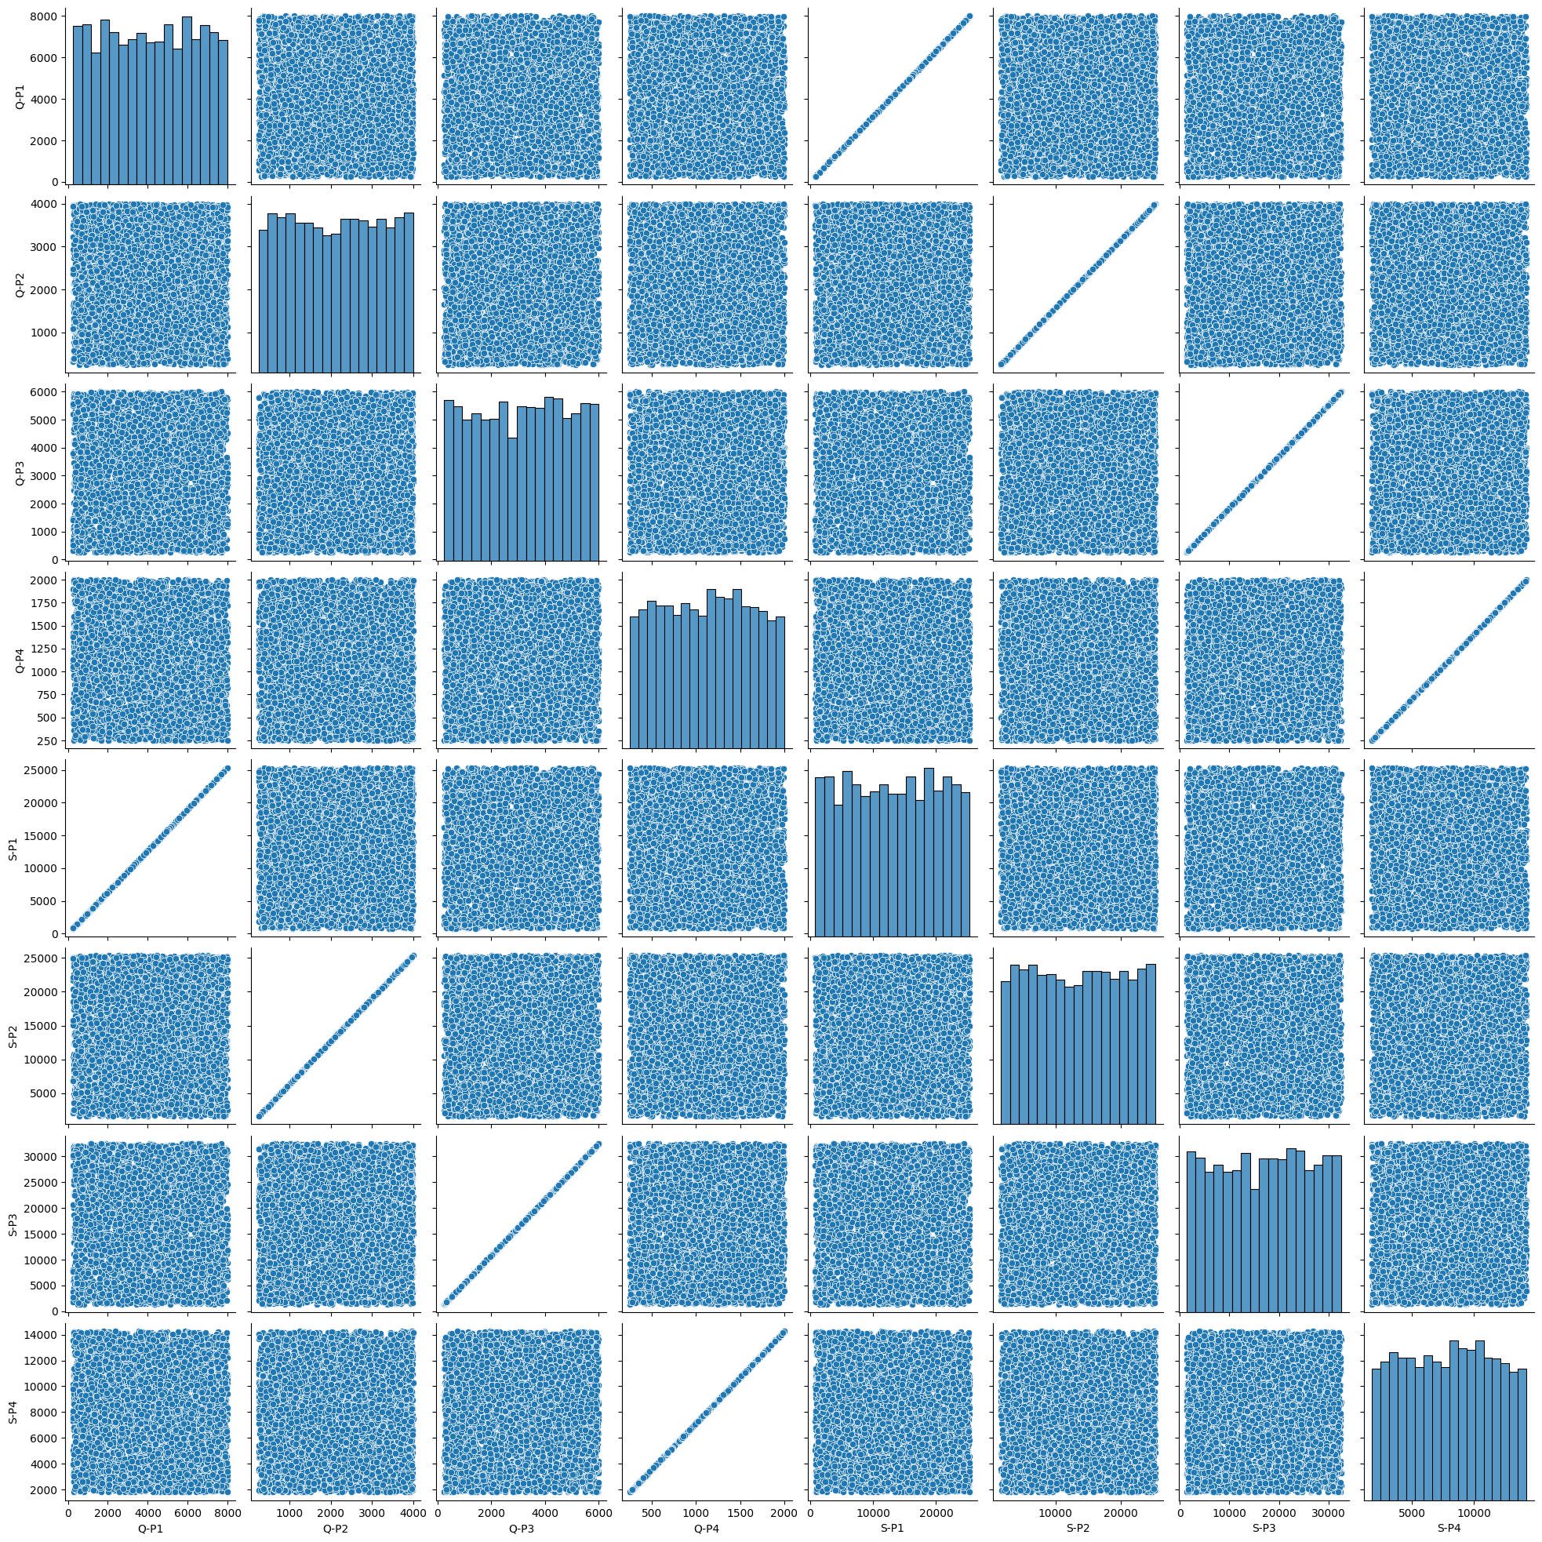
Visualize continuous numeric variables

Slide 16
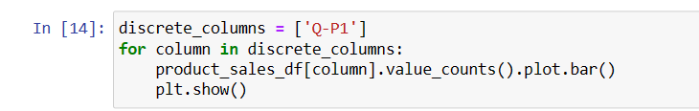
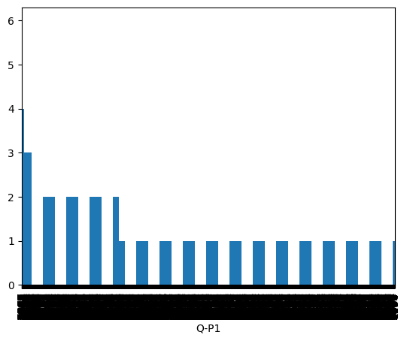
Visualize discrete numeric variables

Slide 17
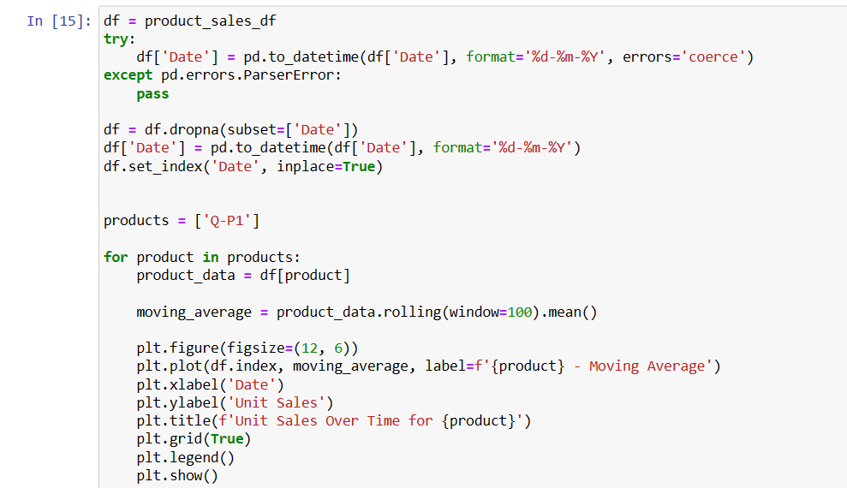

Slide 18
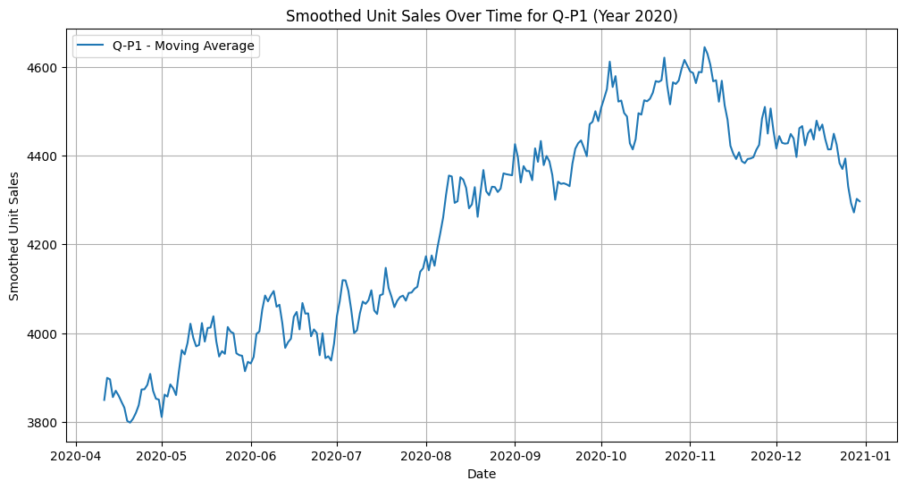

Slide 19
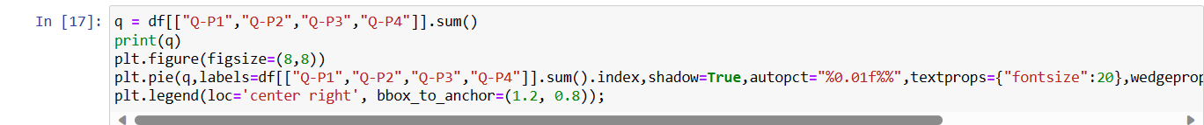
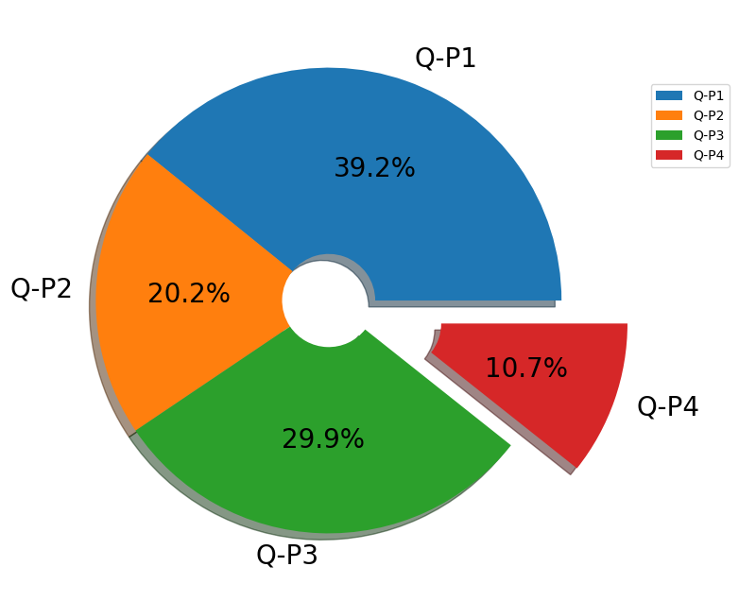

Slide 20
Some common data preprocessing tasks include:
Data cleaning: This involves identifying and correcting errors and
inconsistencies in the data. For example, this may involve
removing duplicate records, correcting typos, and filling in missing
values.
Data transformation: This involves converting the data into a
format that is suitable for the analysis task. For example, this may
involve converting categorical data to numerical data, or scaling
the data to a suitable range.
Feature engineering: This involves creating new features from
the existing data. For example, this may involve creating features
that represent interactions between variables, or features that
represent summary statistics of the data.

Slide 21
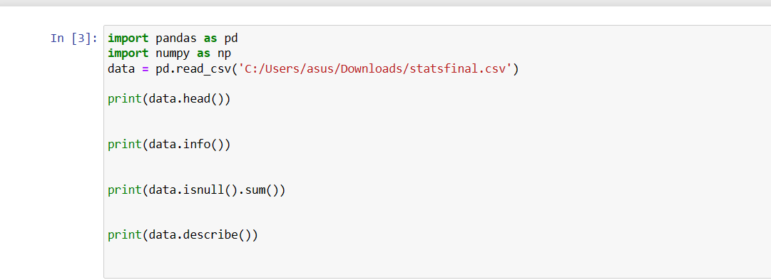
Program:

Slide 22
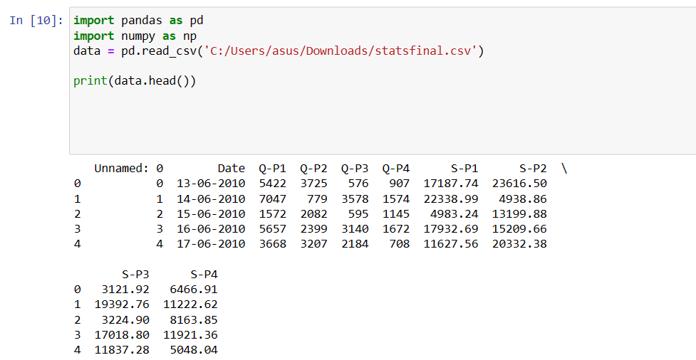

Slide 23
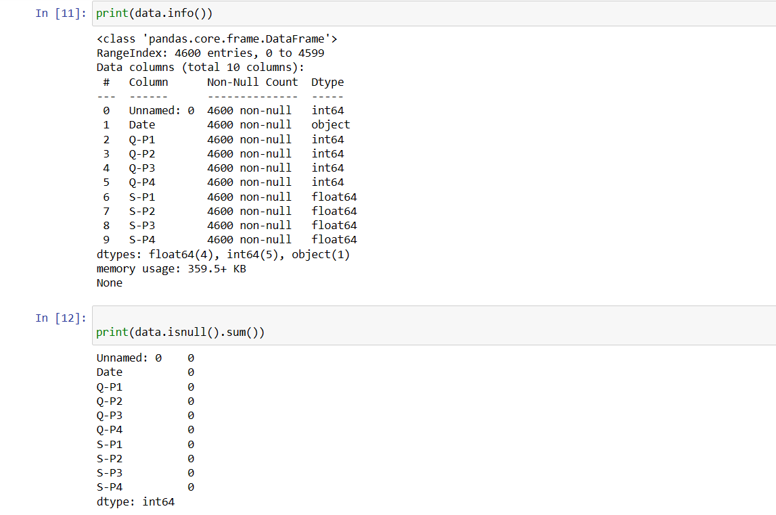

Slide 24
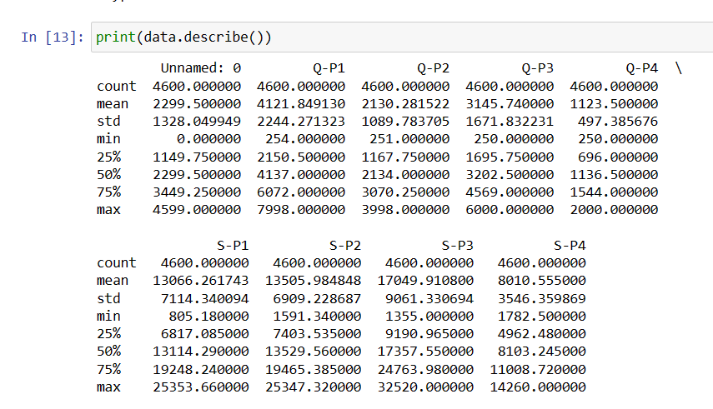

Slide 25
Conclusion:
Conducting a product sales analysis is a critical component of any business strategy. It provides valuable insights into the performance of products, customer behavior, and market trends.
Successful product sales analysis often requires cross-functional collaboration among data analysts, domain experts, and decision-makers. Continuous skill development is essential to stay updated with the latest tools and techniques in the field.
product sales analysis is a multifaceted process that empowers businesses to make informed decisions, optimize their operations, and achieve greater profitability. By leveraging data, visualizations, and insights, companies can adapt to market dynamics and stay competitive in a constantly evolving business environment.

