Slide 1
PRODUCT SALES ANALYSIS
PHASE 4

Slide 2
INTRODUCTION:
Product sales analysis is a critical aspect of business operations, as it helps organizations
understand their product performance, customer preferences, and market trends.
Analyzing product sales data provides valuable insights for decision-making.
It can lead to improved sales strategies, inventory management, and profitability.

Slide 3
Data Source:
The dataset for the above mentioned project was obtained from kaggle website.
Kaggle is an popular dataset providing source where obtained datasets are with high quality and less errors.

Slide 4
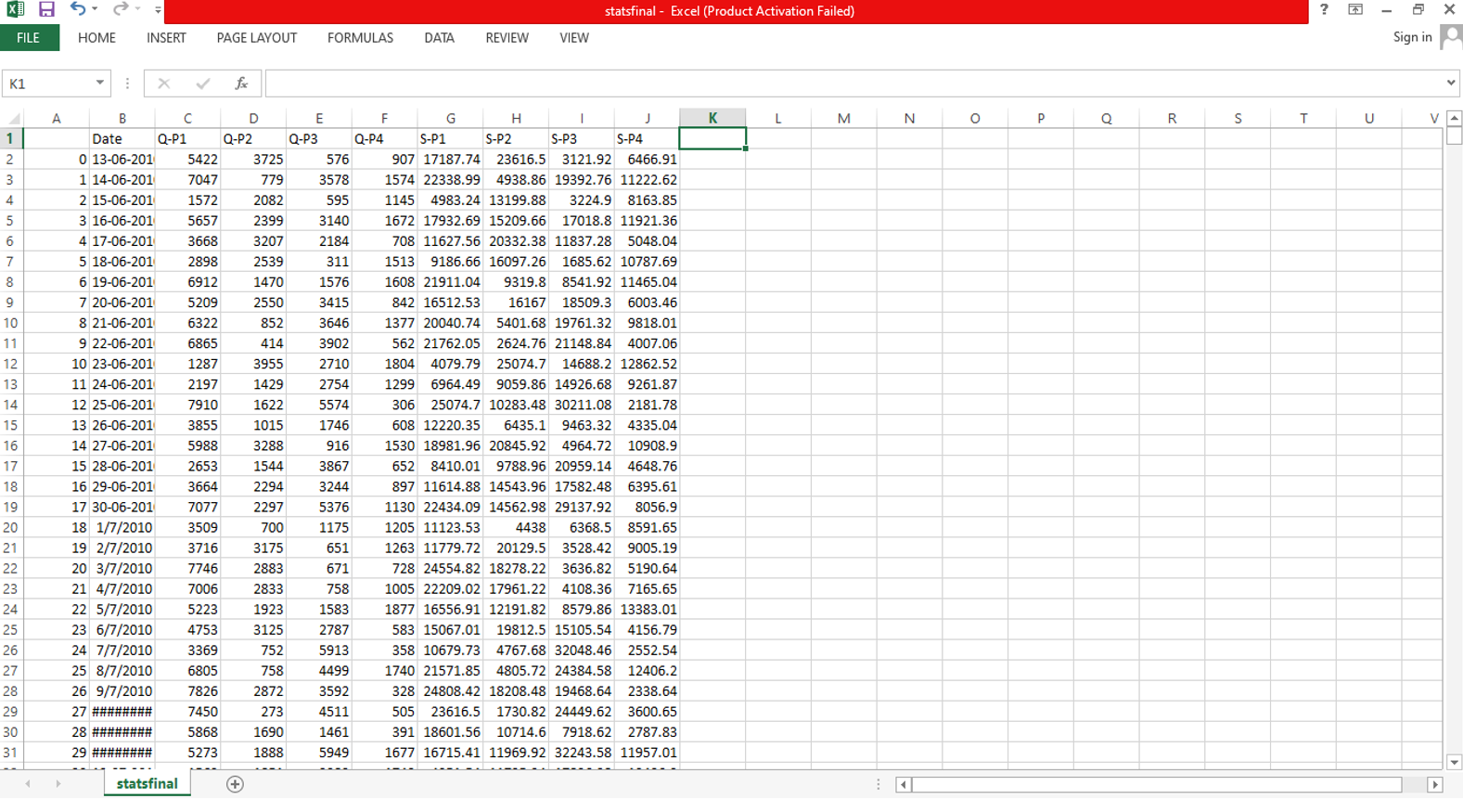
Imported Dataset:

Slide 5
IBM COGNOS:
Cognos is a business intelligence performance management tools for IBM.
It allows technical and non-technical employees in any company to analyse, extract and create interactive dashboards that enable the company to take relevant decisions.
The Cognos tool combines a multitude of products which enables communication with different third parties.
In this Phase, to visualization and reporting the Dataset, We use IBM Cognos.

Slide 6
We have dataset to analysis but the contains errors and outliers so, we using some techniques to clean the dataset
The techniques are:
1.Data cleaning
Filling missing value
Removing Duplicate Records
Handling Outliers
2.Data Transformation and Feature Engineering
3.Predictive Modeling
4.Visualization and Reporting

Slide 7
To perform the three analyze and report
1. top-selling products
2. customer preferences
3. sales trends
And we design interactive dashboards
Dashboards are a type of data visualization, and often use common visualization tools such as graphs, charts, and tables.

Slide 8
DASHBOARD:
Top Selling Product
Sales Trend
Customer Preference

Slide 9
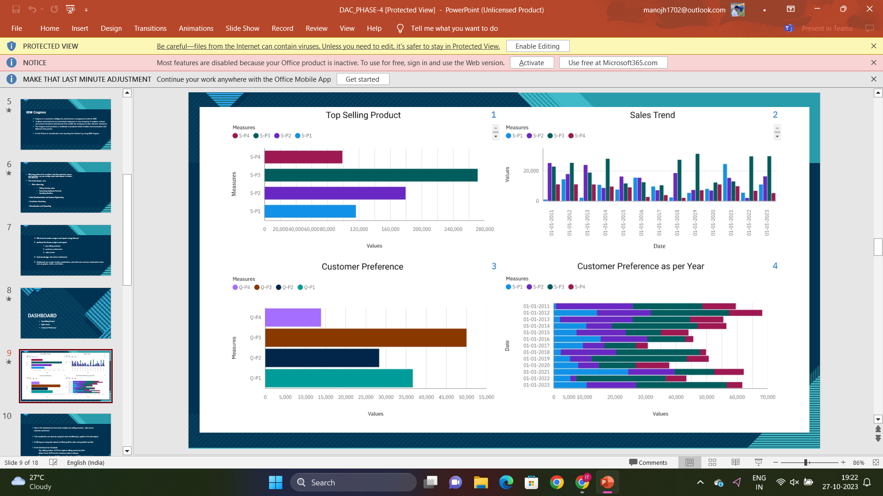

Slide 10
Now in the dashboard we have three analysis top selling products , sales trend, customer preferences
This visualization are done by using bar chart and filtering is applied in the all analysis.
In filtering we using date column for filtering all the sales and quantities by Date.
In the Dashboard we Conclude,
Top selling product : S-P3 has highest selling product by Date
Sales Trend- S-P3 has the maximum sales in all year
Customer preference:Q-P3 has high Quantity and S-P3 has highest sales

Slide 11
IDENTIFYING PRODUCTS WITH THE HIGHEST SALES:
The top-selling product can vary significantly depending on various factors such as time, location, and industry.
It's important to note that the top-selling product in one category or market may not be the same in another.
In this dataset has 4 products S-P1, S-P2, S-P3, S-P4 then we find the highest sales through the 4 products.

Slide 12
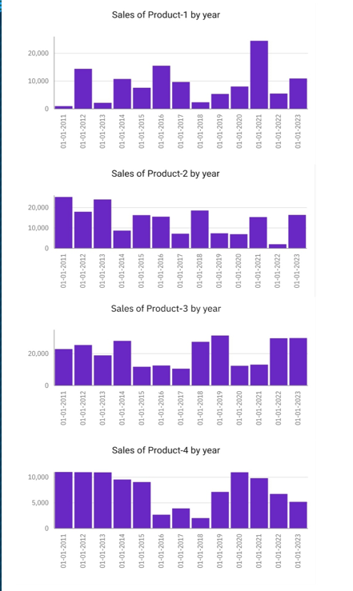
In this graphical represent the year wise sales
we have a 4 column charts (Product 1,product 2,product 3, product 4)
In this case we apply the date on x-axis
Products are apply in y-axis
Dates are filtered as 2011 - 2023

Slide 13
PEAK SALES PERIODS:
In the context of business and data analysis, refers to the long-term movement or direction in which a company's sales figures are changing.
It involves analyzing historical sales data to identify patterns or tendencies in sales performance over a specific period of time.
Understanding sales trends is crucial for businesses because it can help them make informed decisions

Slide 14
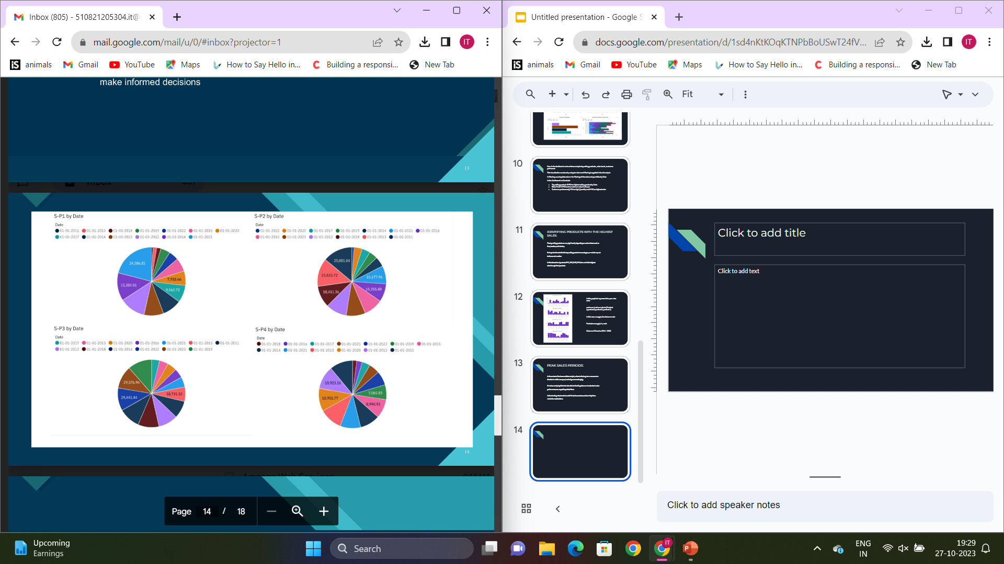

Slide 15
CUSTOMER PREFERENCES:
Customer preferences refer to the specific choices, tastes, and desires of individual customers or groups of customers when it comes to products, services, or experiences offered by a business.
Understanding customer preferences is crucial for businesses because it enables them to tailor their offerings and marketing strategies to better meet customer needs and increase customer satisfaction.

Slide 16
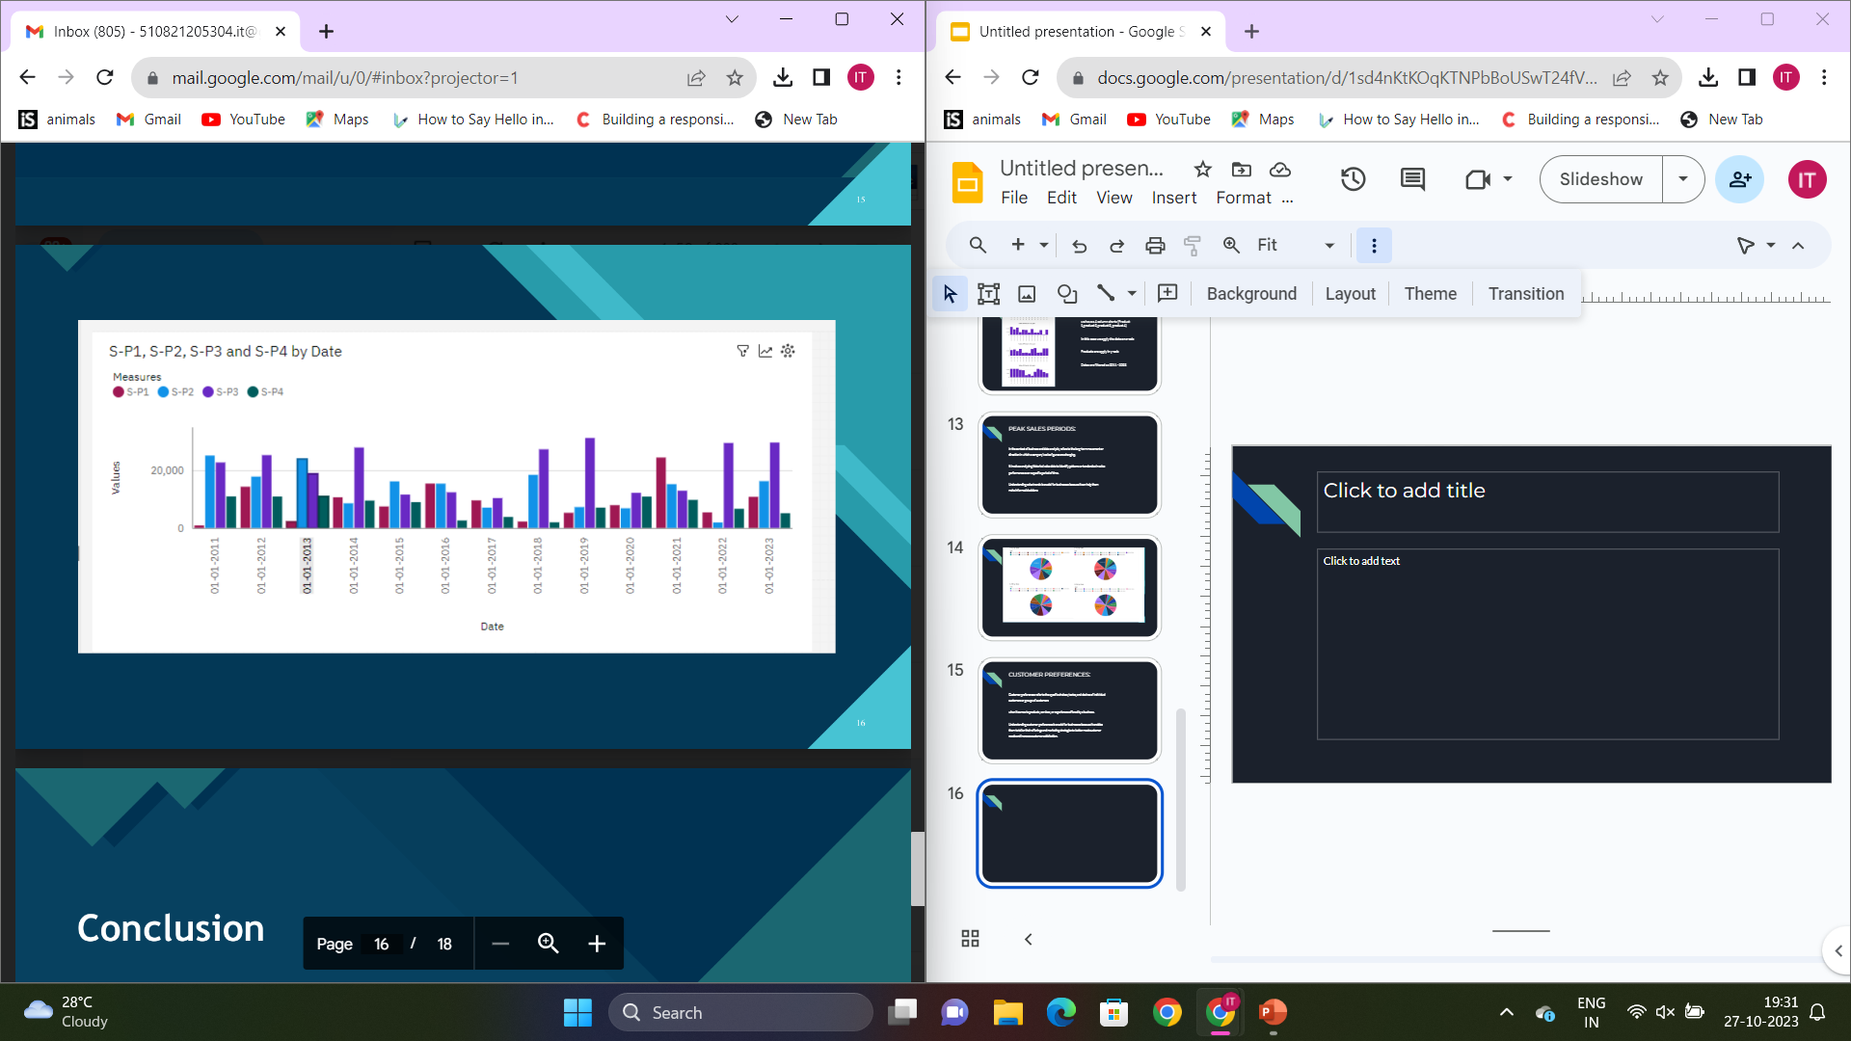

Slide 17
CONCLUSION:
product sales analysis empowers businesses to make informed decisions, optimize their operations, and achieve greater profitability.
By leveraging data, visualizations, and insights, companies can adapt to market dynamics and stay competitive in a constantly evolving business environment.

Slide 18
THANK YOU..

