Slide 1


Name
Department
Semester
KINJOL DAS
ECE
5th
Name
Department
Semester
BYTE
FORCE
ECE
5th
MAHARSHI ROY
Name
Department
Semester
SWASTIKA GHOSH
ECE
5th
Name
Department
Semester
SURYAGNIK ROY
ECE
5th
Ev ision – Smarter Diagnostics for Smarter Mobility
RED HOUSE | 10

Slide 2

PROBLEM STATEMENT & OBJECTIVE
What's the Problem?
Electric Vehicle Diagnostic Tool(House: RED; Problem Statement No.:10)
The aim of this project is to design a real-time, low-cost EV diagnostic system that monitors voltage, current, temperature, and driving behavior, and then alerts about faults, unsafe driving, or battery health issues. This ensures driver safety, longer battery life, and reliable EV performance.
01

Slide 3
WHY THIS PROBLEM MATTERS?
EVs are growing fast, but users face battery failures, charging issues without warning which leads to accidents.
Driving style impacts battery and motor health, yet drivers get no real-time feedback.
Mechanics depend on costly diagnostic tools, making quick, affordable service difficult.
Fleet owners and drivers want simple, low-cost, real-time monitoring to prevent breakdowns and extend battery life.
A portable EV diagnostic tool bridges this gap, improving safety, reliability, and trust in EVs.
Why it Matters?
A low-cost diagnostic tool bridges the gap between complex EV systems and everyday users.
It helps in preventive maintenance, avoids sudden breakdowns, and builds trust in EV technology.
Why It Matters
02

Slide 4
THE IDEA!
Battery Health Monitoring by Cycle: Tracks battery condition based on charge–discharge cycles
for accurate diagnostics.
Humidity Sensor Integration: Monitors environmental humidity to prevent moisture-related
battery issues.
No Miniature Circuits Used: Avoids delicate circuits that cannot easily get damaged,
increasing system reliability.
Smart Alerts & Predictions: Reduces false alarms and predicts maintenance needs
using real-time and historical data.
User-Friendly Interface: Provides clear, actionable insights via a display.
Unique Advantage: Combines cycle-based battery monitoring
and environmental sensing safely, unlike conventional EV diagnostic tools.
Due to this Battery Health Monitoring, there is lot more of reduction in E-waste.
Our Big Idea
03

Slide 5
WHAT MAKES OUR SYSTEM USEFUL OR UNIQUE
Why It’s Cool
Accurate Battery Health: Cycle-based monitoring gives precise insights, not just random readings.
Prevents Damage: Humidity sensing reduces risk of moisture-related failures.
Higher Reliability: No miniature circuits → more durable and less prone to failure.
User Convenience: Easy-to-read interface saves time and improves decision-making.
Cost Saving
04

Slide 6
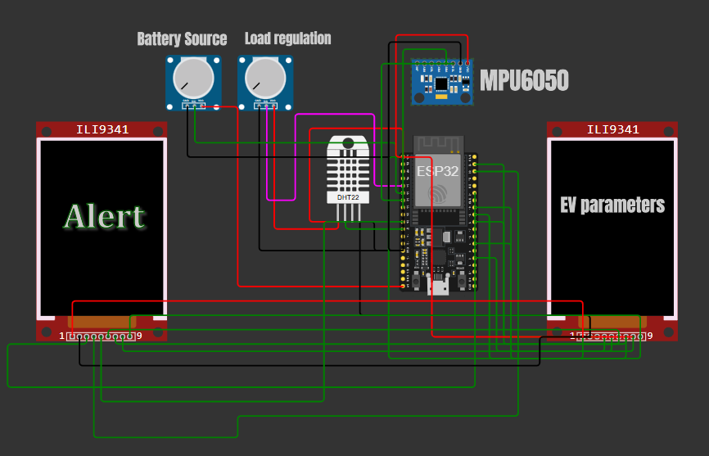
THE CIRCUIT DIAGRAM
Wiring Up
05

Slide 7
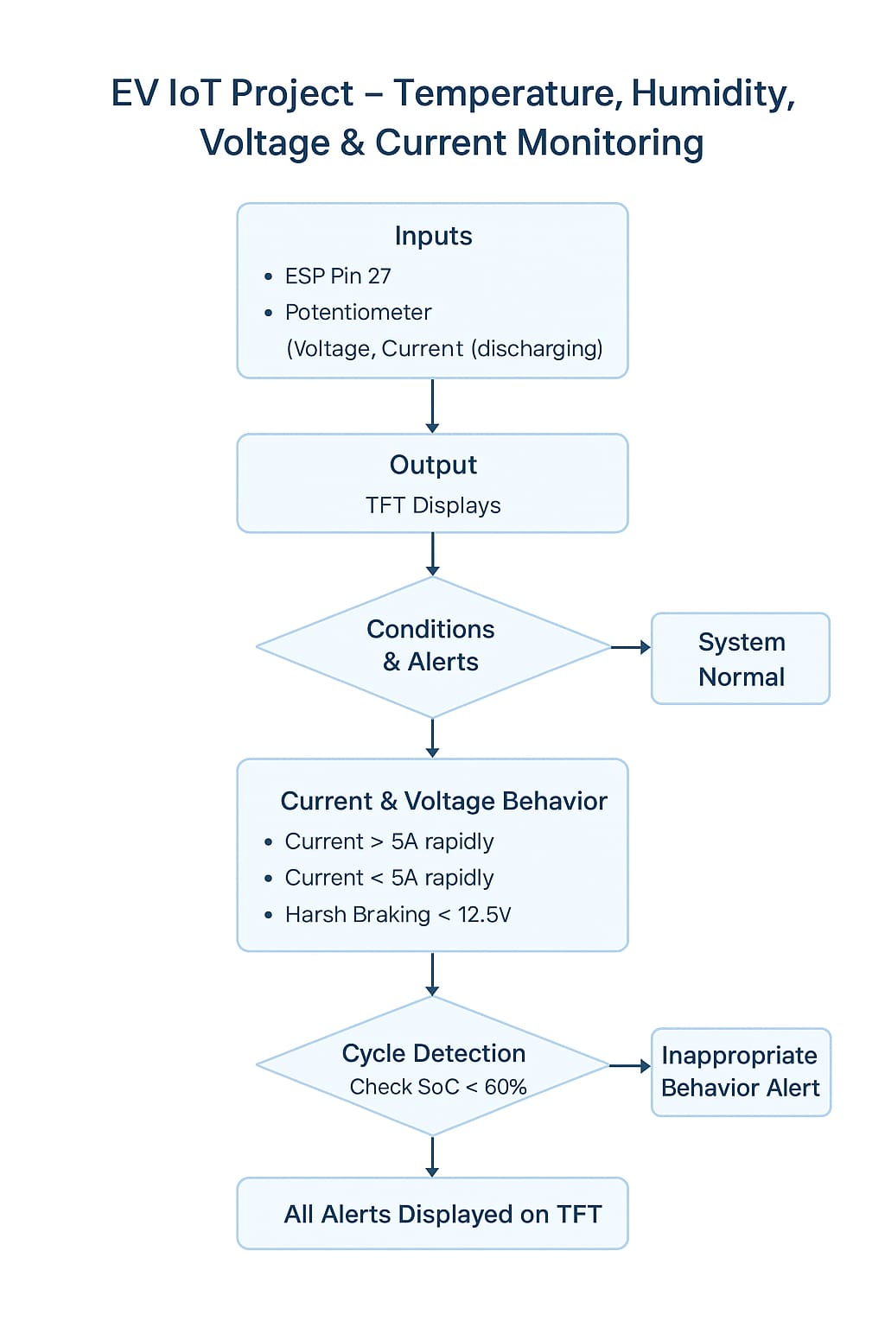
FLOWCHART
How It Works
06

Slide 8
TECHNOLOGY STACK
Hardware:
ESP32
DHT22
2 ILI9341(TFT DISPLAY):
TFT1 → shows real-time parameters (V, A, SOC, Temp, Humidity,
Battery Cycles, Health).
TFT2 → shows alerts only (low voltage, overheating, high humidity).
4.POTENTIOMETER(2):ONE USED FOR VOLTAGE SOURCE AND OTHER FOR DEMONSTRATION PURPOSE.
Software:
WOKWI SIMULATOR
ARDUINO IDE
Tech Stuff
07

Slide 9
CHALLENGES & SOLUTIONS
CHALLENGES
SOLUTIONS
1.Basic sensors (potentiometers, DHT22, ESP32 ADC):Limited accuracy, cannot capture real EV battery behavior. Low cost , need for calibration for modern EV system
2.No remote monitoring:Data only on TFT, no cloud or app. Increases cost due to modules & connectivity.
3.EEPROM logging:Limited write cycles, small memory. SD card module adds slight extra cost.
4.Voltage-based SOC estimation:Simple linear mapping is inaccurate in real EVs. Requires additional circuitry → medium cost.
5.Scalability to real EV battery packs: Prototype monitors single source → not suitable for multi-cell packs. Higher cost (BMS chips).
Use dedicated current/voltage sensors (INA219, ACS712) and better temp sensors (thermistor/DS18B20).
Add WiFi (MQTT) / GSM for alerts.
Use FRAM / SD card for data history for battery usage pattern monitoring to improvements.
Add Coulomb counting / BMS algorithms.
Add multi-cell monitor ICs / CAN bus.
Hurdles & Fixes
08

Slide 10
REFERENCES & PROJECT LINKS
References:
Roy, P. K., Shahjalal, M., Shams, T., Fly, A., & Stoyanov, S. (2023).
Huhman, B. M. (2017).
Pech, M., Vrchota, J., & Bednář, J. (2021).
Bourechak, A., Zedadra, O., Kouahla, M. N., & Guerrieri, A. (2023).
Duan, Z., Zhang, L., Feng, L., Yu, S., Jiang, Z., Xu, X., & Hong, J. (2021).
Project Links:
GitHub repo : https://github.com/Suryagnik414/evision-ev-diagnostic-tool
Prototype : https://wokwi.com/projects/440894629608796161
Demo video on prototype : https://youtu.be/JreFqKJ2MZE?si=ttxcJ0dFnNfuFVFQ
Demo video on ppt : shared on github
Where We Got Help
09

