Slide 1

Śhārāb – A Beverage Company Delhi

Slide 2
Problem Formulation slide
Decision Problems | Research Objectives
Do the people enjoy their leisure time drinking in bars, casino or open areas of stores? If yes, what kind of people? | Check by city specific areas where there are bars or liquor stores.
 | Check the standard of the people by the counting ATM near the Bar or liquor store. Assumptions upper & middle class would go for e-cash or on-spot cash via ATM were as mostly the lower class will go with cash payment only.
Can we target sales to rise, if we start with only liquor and later onwards with bars? | Yes. According to government estimates, Delhi needs to have at least 70 to 80 more liquor shops. (Reference : TOI 2012) <<This data is old but still not yet achieved its mark>>

Slide 3
Description slide
We picked Delhi as focal city because:
It’s one of the most diversified area in India where servicemen and businessmen from across sectors come. (Reference: Wiki)
Being the India’s capital city, liquor has less import duty from surrounding states. Therefore majority living people of upper, middle and lower class prefer to purchase it from here. Thus making higher probability of sale not only in Delhi but also in NCR.
We picked beverages client because:
Delhi being is grown at fast pace but lacking in the beverages business i.e. by an average Delhi has three shops for every one lakh population (Reference : TOI 2012).
Over the years Gov has taken several measures to uplift this business in NCR and exercise the rules for the ease of business. (Reference: Gov. Excise Department)
Back-up Plan:
Uttar Pradesh, Haryana, Rajasthan are the three main states in Delhi NCR.(Reference: Current & Future Of NCR) If any hit by the Gov. rule and regulations or pubic we can target the other states where a small market would have been already made.
Haryana being the most ease to beverages business has higher probability of success and it has less TAX. (Reference: TOI 2015)

Slide 4
Proxy List & their justifications
Liquor Store
More the number of liquor store in an area, higher will be probability of selling.
Bar
It will help us decide the group of people upper, middle and lower class.
ATM & Banks
It will help us know if people are willing to spend by cash or e-cash.
Every Bank has ATM 24*7, therefore they are clubbed together. If we take only ATM it will show very less areas for financials.
All the three proxies will collectively help us decide which kind of liquor to sell in which area i.e. areas with more stores and less ATM, will be willing to pay for cheaper liquor brand, or areas with more bars will be willing to pay for expensive liquor brand, etc.

Slide 5
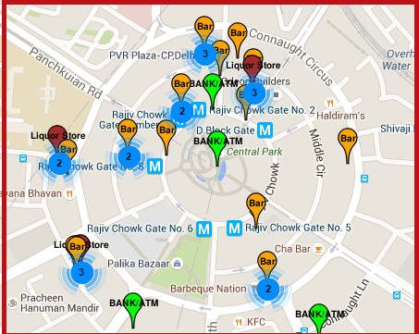
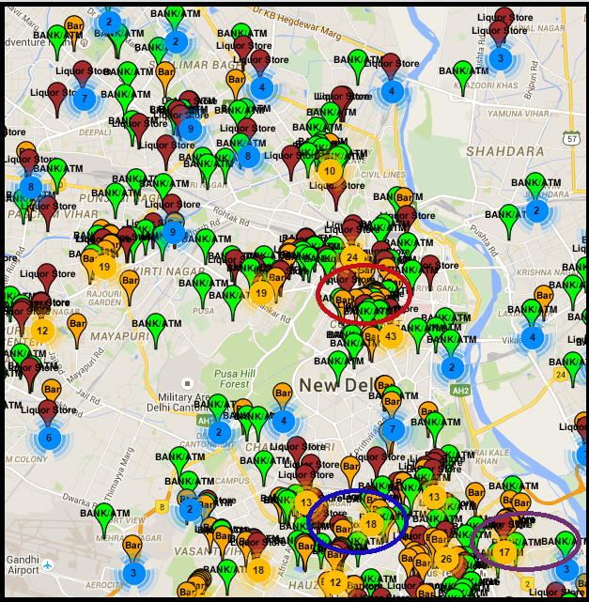
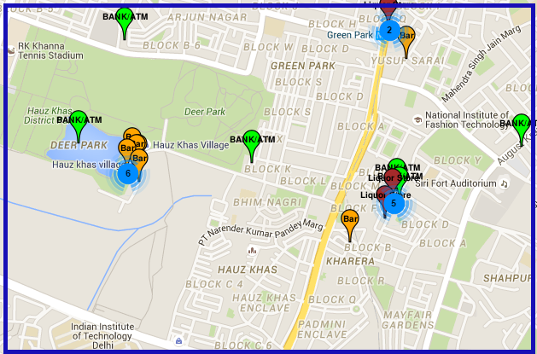
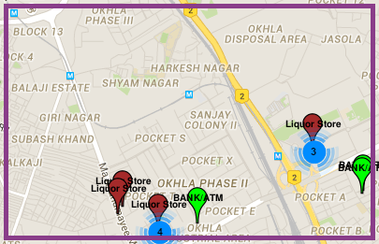
Result Slides
Connaught Place
Hauz Khas
Okhla

Slide 6
Interpretation slide
Connaught Place
In this Central Business District of Delhi, there are 18 bars , 4 ATM/Bank and 3 liquor stores. This means bars owners either buy stock from stores or directly from the beverages owners to meet the demand. Therefore we have greater chance of experimenting and winning the huge crowd which can be easily predicted by 18 successful bars among all three proxies.
We can target the market by selling more expensive products and less cheaper products because mostly upper and middle income class will be here for fun.
Hauz Khas
Blossomed into a popular eating and shopping precinct, it has 7 Bars, 6 ATM/Bank and 3 Liquor stores targeting the youth largely because of it’s location surrounding.
Since this place comprises of youth of all the income classes, we can setup bar along with all kind of our products.
Okhla
Being the busiest industrial suburb in South Delhi, there are 5 liquor store, 1 bar and 4 ATM/Bank which mainly consist of middle and lower income class who are fond of drinking with less expense. Thus making a key area for making and gaining popularity among the market.
We can target the market by selling more cheaper products and less expensive products.
NOTE: The Interpretations Slide derived from Result Slides is also made by keeping facts mentioned by wiki links, highlighted separately, and Gov. Of Delhi: ECONOMIC SURVEY OF DELHI.

Slide 7
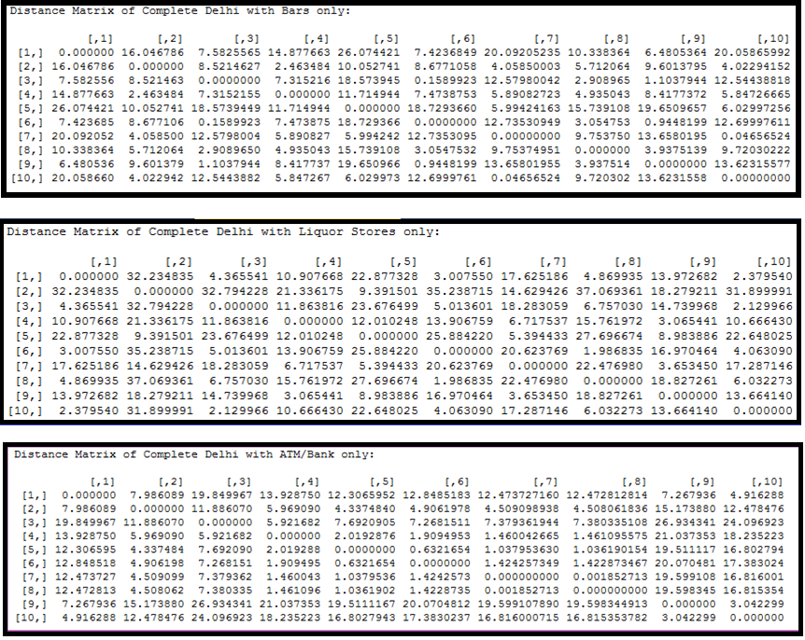
Distance Matrix

Slide 8
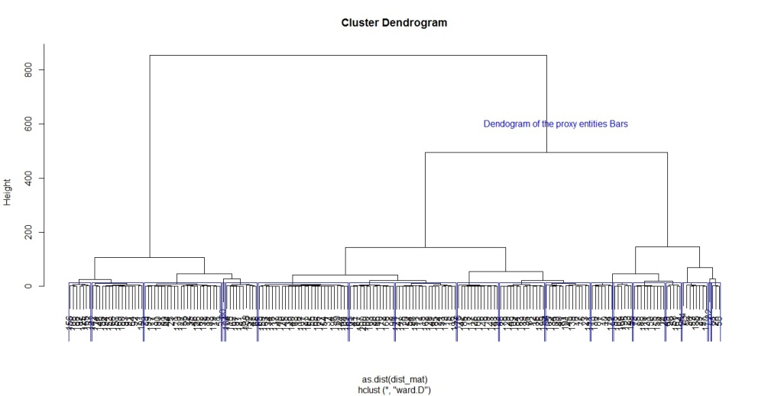
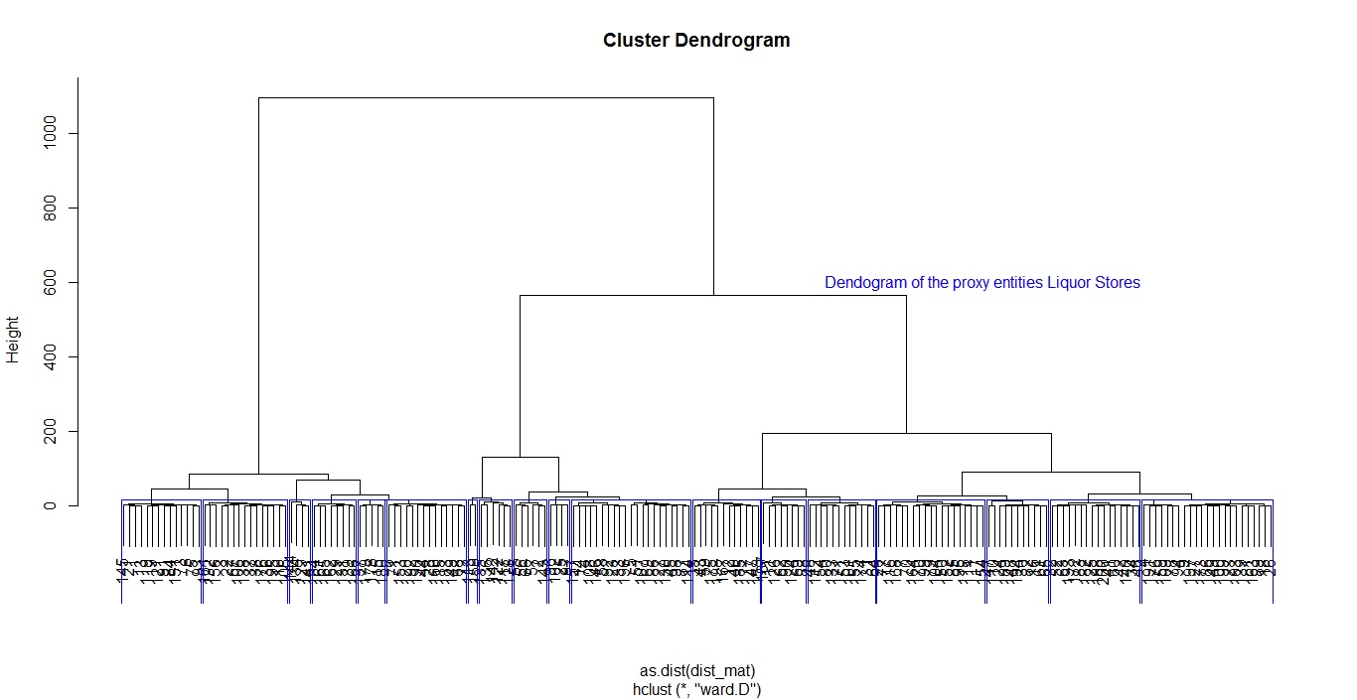
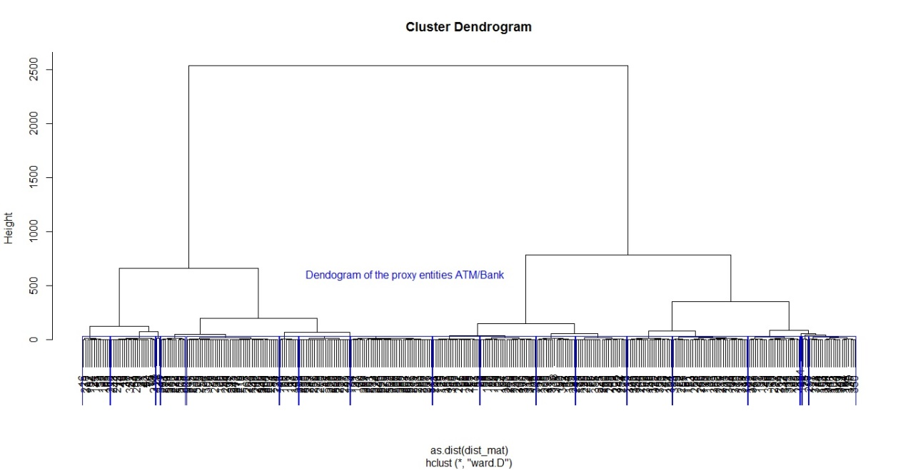
Dendogram with Clustered Entities.
Bars
Liquor Store
Bank & ATM

Slide 9
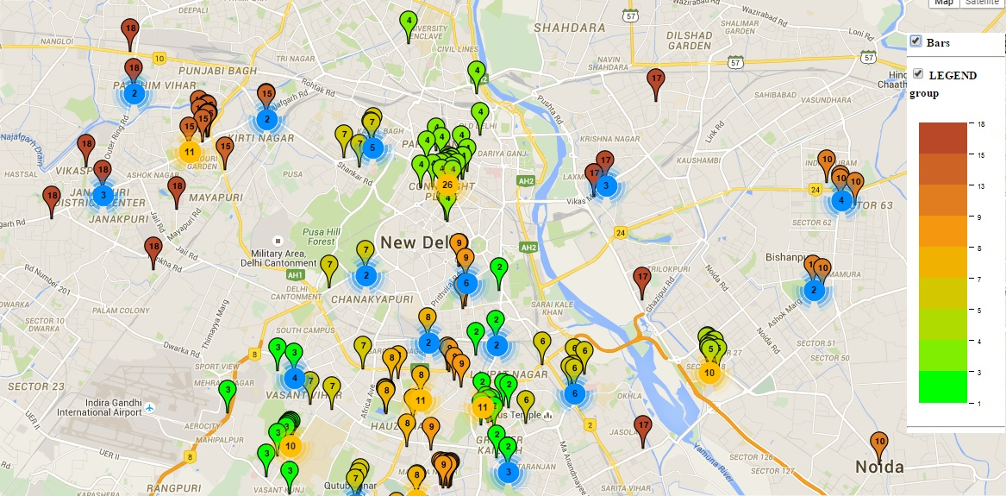
Plots with Clustered Entity - Bars

Slide 10
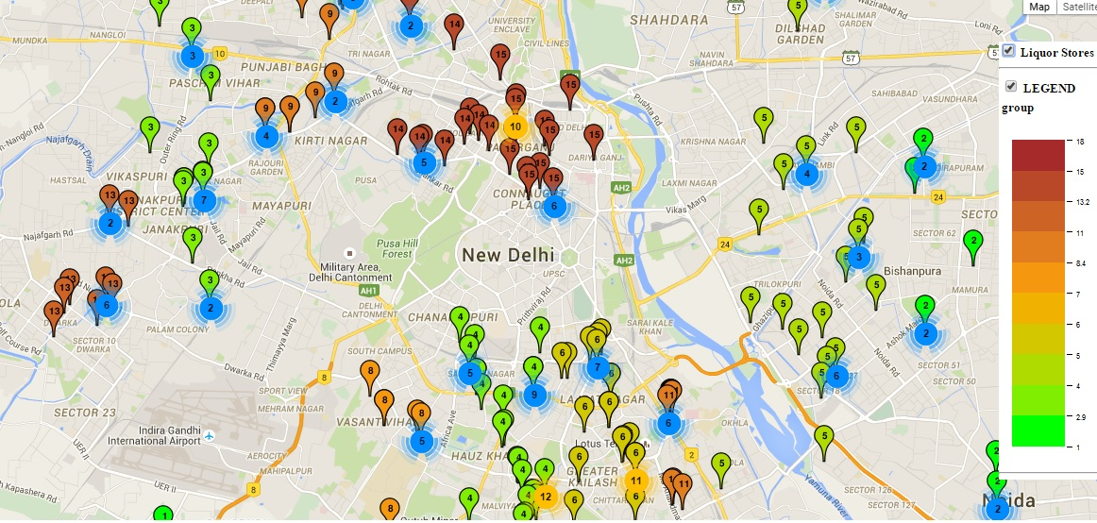
Plots with Clustered Entity – Liquor Stores

Slide 11
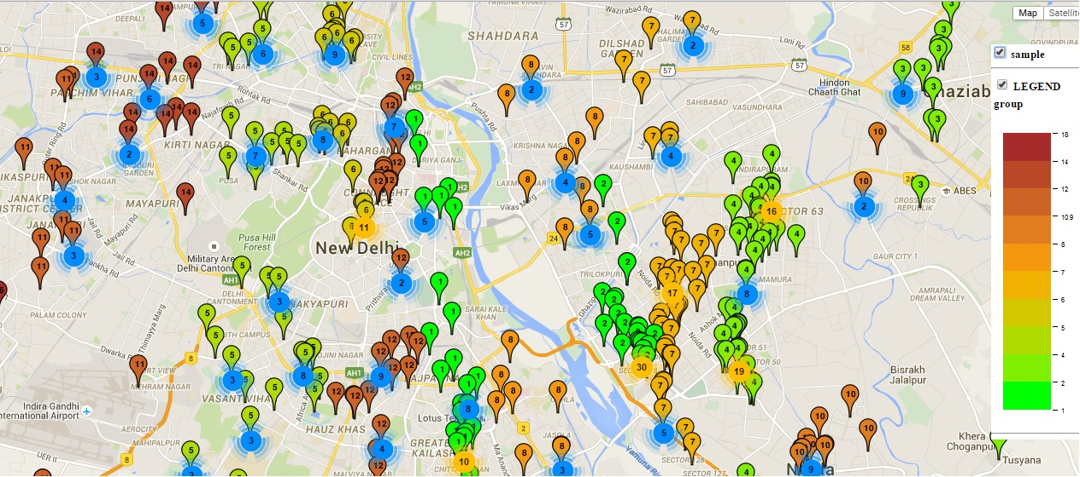
Plots with Clustered Entity – ATM & Bank

Slide 12
Code along with other attachments files used in this PPT

Slide 13
Conclusions/assumptions by observation from graph for complete Delhi
Liquor Store ∝ 1/ATM
If more liquor store and less ATM, chances are higher that people will spend more in cash.
Bar ∝ 1/ Liquor Store
Bar is more and less liquor store, chances are higher that people with heavy pocket size(i.e. upper or middle income group) will go. Though there is no restriction for lower income class, but it is assumed that they would rather save money have drink not in bar.
Bar ∝ 1/ATM
If more Bars and less ATM, chances are higher that people spend more in e-cash.
*Liquor Stores: Normally don’t trade with debit/credit card machines.

