Slide 1

Efficient use of machine learning models to evaluate the parametric performance of the ML models for language translation from Telugu to Hindi.
​
Team details:
BL.EN.U4CSE22254
BL.EN.U4CSE22267
BL.EN.U4CSE22287

Slide 2
Agenda
Introduction and motivation
Problem Statement
Solution Design and Architecture
Implementation
Conclusion

Slide 3
Introduction and Motivation
Language translation is a vital component of Natural Language Processing (NLP), enabling meaningful communication across culturally and linguistically diverse communities. Translating between Telugu, a Dravidian language spoken widely in southern India, and Hindi, an Indo-Aryan language predominant in northern and central India, is particularly challenging due to significant differences in grammar, syntax, word order, and semantic structures. These challenges are compounded by the fact that Telugu is a low-resource language, with limited availability of parallel corpora and other linguistic resources needed for computational tasks. To address these complexities, this study leverages advanced deep learning models such as Long Short-Term Memory Networks (LSTM) and Fairseq, each offering unique advantages for handling low-resource languages and complex translation tasks. By fine-tuning these models under varying hyperparameter settings, such as learning rate, dropout, and embedding dimensions, this research aims to optimize translation quality while addressing the linguistic and resource-related challenges. The study not only seeks to enhance Telugu-to-Hindi translation but also provides valuable insights into bridging linguistic divides for other low-resource language pairs, thereby promoting inclusivity and accessibility in India's multilingual digital ecosystem.

Slide 4
Problem statement and Data Description
Problem Statement
This research addresses the challenges of translating between Telugu and Hindi, two linguistically distinct languages, with Telugu being a low-resource language. The limited availability of parallel corpora and the complexities of grammar and syntax hinder accurate machine translation. This study leverages deep learning models like LSTM and Fairseq, focusing on fine-tuning parameters such as dataset size and epochs to improve translation accuracy and develop an effective framework for low-resource language translation.
Data Description
The dataset used in this study consists of 21,404 bilingual sentence pairs in Hindi and Telugu. These pairs are sourced from structured resources, such as language-learning books, providing contextually aligned translations. Each entry comprises a Hindi sentence or phrase and its corresponding Telugu translation. To ensure consistency and accuracy, the dataset was preprocessed to remove punctuation, digits, and unnecessary spaces. Start (START_) and end (_END) tokens were added to the Telugu sentences to define sequence boundaries, aiding in training the translation model. The dataset reflects diverse linguistic patterns and vocabulary, making it a valuable resource for evaluating and fine-tuning machine translation models for low-resource language pairs.

Slide 5
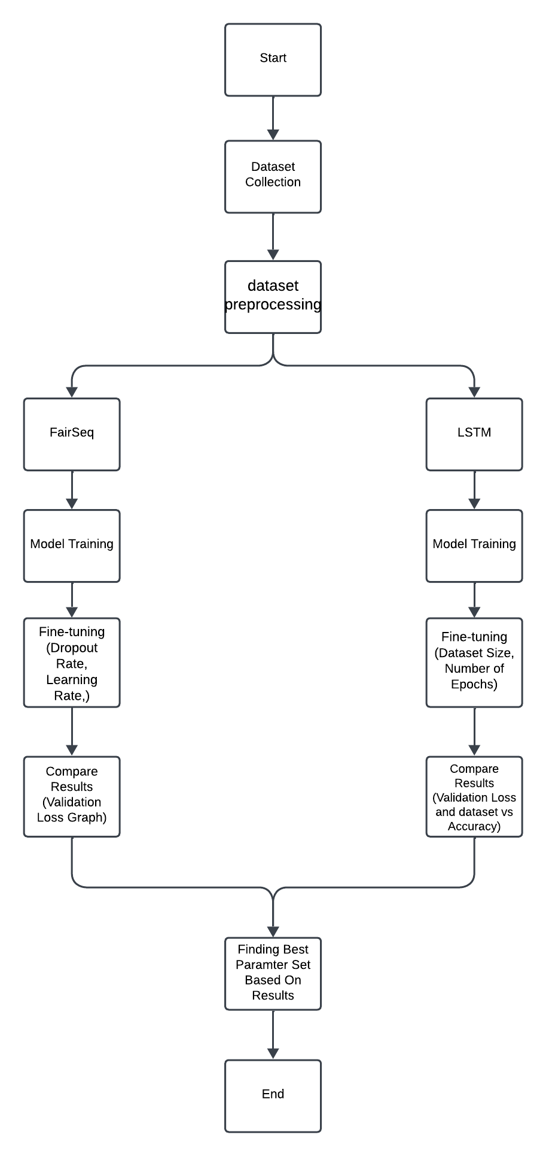
Solution design and Architecture

Slide 6
Implementation Details for LSTM
Architecture:
An encoder-decoder architecture was employed to model the sequential nature of translation tasks.
Encoder: The Telugu sentence was tokenized, padded, and fed into an embedding layer followed by an LSTM layer. The encoder transformed the input sequence into a fixed-length context vector capturing the semantic meaning of the sentence.
Decoder: The context vector from the encoder was passed to the decoder, which consisted of another embedding layer and an LSTM layer. The decoder generated the Hindi sentence word by word, using the context vector and the previously generated word as inputs.
Hyperparameters:
Embedding Dimension: 256
LSTM Units: 512
Optimizer: RMSprop
Loss Function: Categorical Crossentropy
Batch Size: 64
Training:
The LSTM model was trained on subsets of the dataset (10%, 20%, 40%, 60%, 80%, and 100%) to evaluate the impact of dataset size on accuracy.
The number of epochs was varied (e.g., 5, 10, 20) to analyze the effect of training duration on the model’s performance.

Slide 7
Implementation Details for Fairseq
Architecture:
A transformer-based sequence-to-sequence model was implemented using the Fairseq framework, which is optimized for machine translation tasks.
Encoder: The Telugu input was tokenized and passed through multiple transformer layers to encode the input sequence into a high-dimensional representation.
Decoder: The encoded representation was passed to a transformer-based decoder to generate the Hindi sentence. The attention mechanism in the decoder facilitated the alignment between input and output sequences.
Hyperparameters:
Embedding Dimension: 512
Number of Transformer Layers: 6
Optimizer: Adam
Learning Rate: 0.001 with a learning rate scheduler
Batch Size: 128
Training:
Fine-tuning was conducted by adjusting the dropout rate (0.1, 0.3) and embedding dimensions and learning rates.

Slide 8
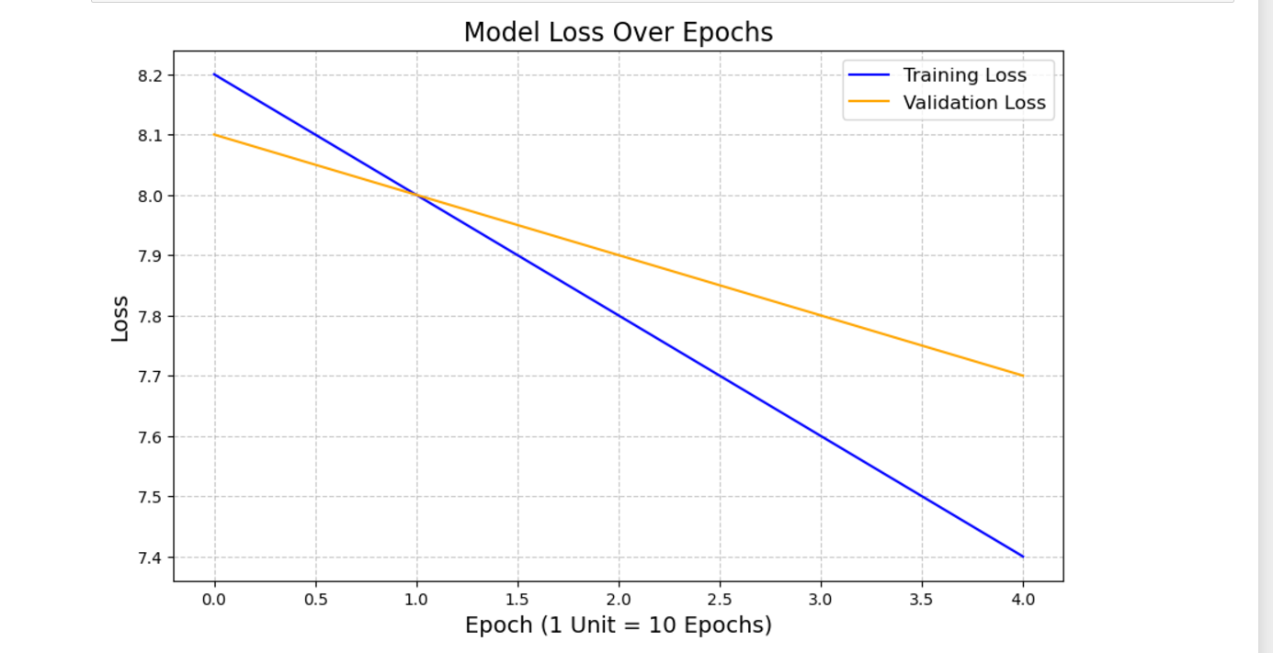
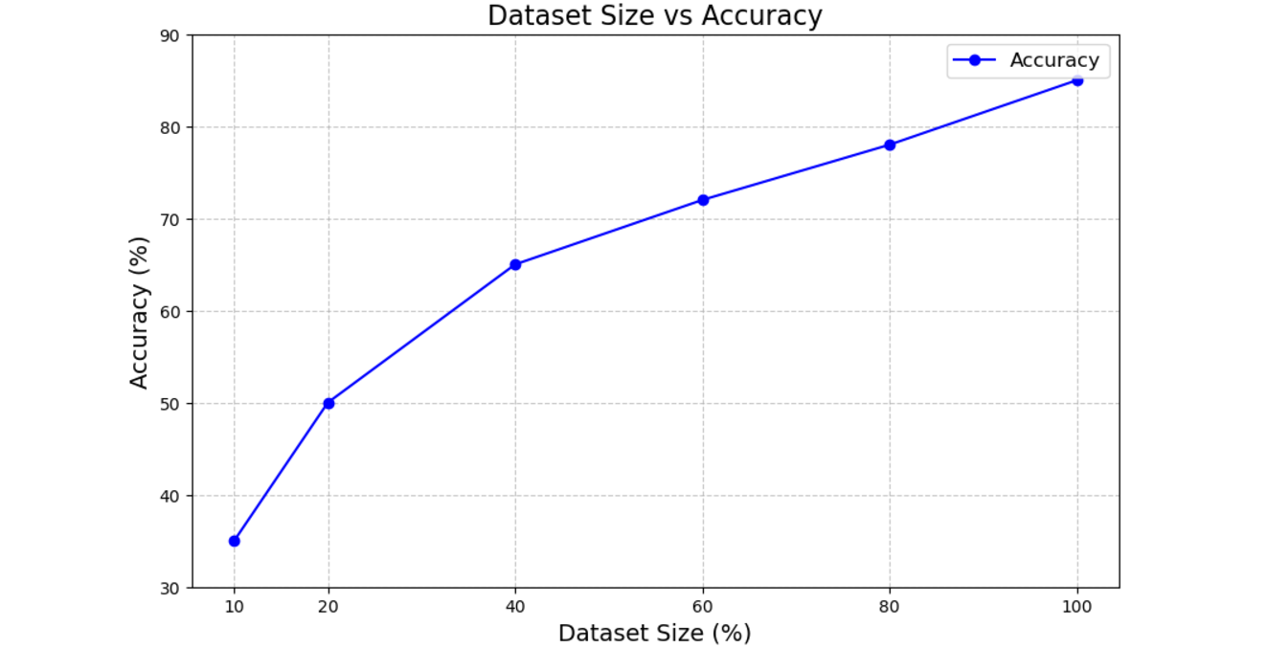
Result and analysis for LSTM

Slide 9
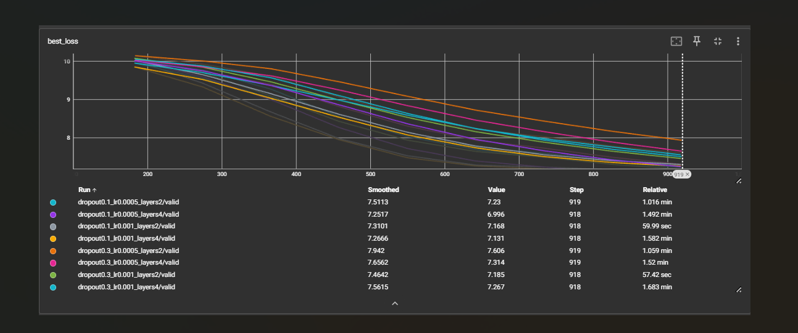
Results for Fairseq

Slide 10
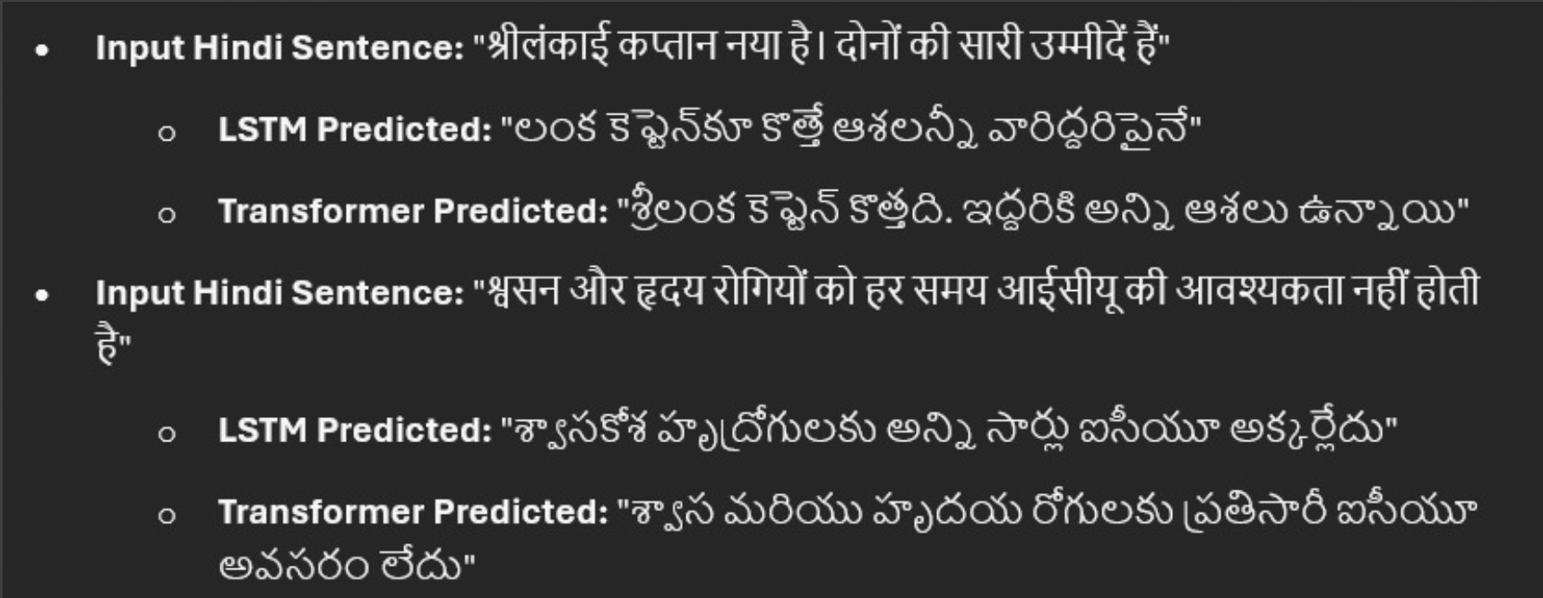
Comparitive Study

Slide 11
Conclusion
The comparative analysis establishes the Fairseq Transformer model as the superior choice for Hindi-to-Telugu translation tasks, showcasing its ability to achieve significantly lower training and validation losses, faster convergence, and semantically richer translations. The Transformer's advanced architecture, leveraging multi-head attention mechanisms and positional encoding, enables it to handle complex linguistic patterns more effectively than the Encoder-Decoder LSTM. However, this study highlights that fine-tuning plays a crucial role in enhancing model accuracy for both approaches. For the LSTM, fine-tuning the dataset size and the number of epochs significantly improved its performance, ensuring better generalization over varying training sizes. In contrast, for the Fairseq Transformer, fine-tuning hyperparameters such as dropout rates, embedding sizes, and learning rates led to better optimization and higher translation quality. These findings underscore the importance of hyperparameter optimization in achieving the full potential of machine translation models and pave the way for more robust and effective systems tailored for low-resource language pairs.

Slide 12

Thank you !!!!!

