Slide 1
Register Runtime Fabric in Anypoint Platform
Login into Anypoint Platform and Choose the business group where we want to install RTF.
Go to Runtime Manager option
Click Runtime Fabrics from left side navigation
Create Runtime Fabric

Slide 2
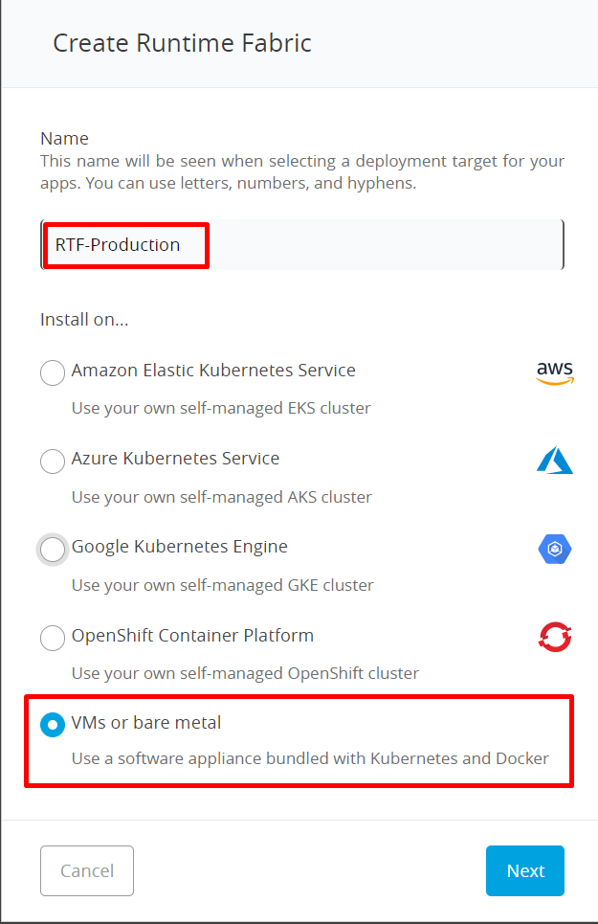
Provide name for your RTF cluster.
Select VM or bare metal options
Click Next

Slide 3
Click Download files to download RTF installer configuration files
Copy the activation data (we will use this data as part of installation from VM)
Go back to previous page

Slide 4
Once you come to the main page, we will see Runtime Fabric which we registered and it will show ready for activation.
Now, we have successfully registered Runtime Fabric environment from Anypoint platform

Slide 5
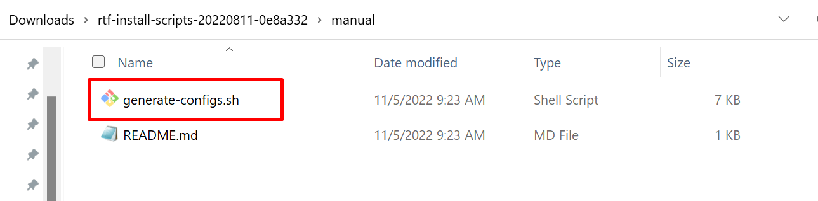
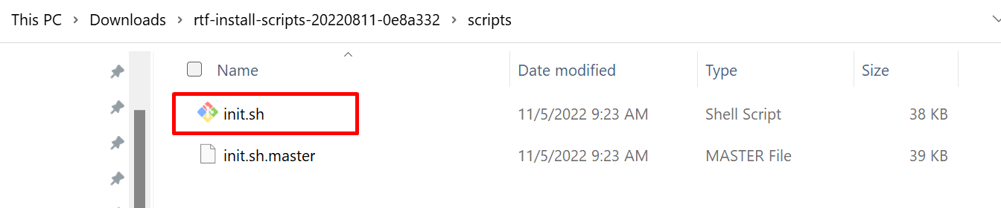
Explore the file which downloaded
generate-config.sh – will help to generate the required configuration for installation
Init.sh – Execute this file to install RTF workers/controllers

Slide 6
Installation steps:
Pre-Requestives:
3 – VM for controller node, 3 – VM for worker node.
In controller nodes, allocate file system vdc with 150 GB and vdb with 100 GB
In worker nodes, allocate file system vdc with 150 GB
SELinux - keep disabled on all VMs
Verify the file system
[muleusr@hostname01 :~]$ lsblk -a
NAME MAJ:MIN RM SIZE RO TYPE MOUNTPOINT
vdb 252:16 0 100G 0 disk /var/lib/gravity/planet/etcd
vdc 252:32 0 250G 0 disk /var/lib/gravity
Create the directory /opt/anypoint/runtimefabric
Identify the number of controllers and workers which are required. Create a required VM and get the IP address.
Login into VM where we want to install the controller nodes using your user.
Create the folder “setup” in /home/muleusr where we need to copy the files which are required for installation.
Copy the init.sh and generate-configs.sh to /home/muleusr/setup

Slide 7
generate config.sh
  Modify the generate-config.sh to generate the config.
    In the below config (RTF_CONTROLLER_IPS), we are using 3 controller nodes (CIP1, CIP2, CIP3). Replace this with actual IP address
    RTF_WORKER_IPS , We are using 3 worker nodes. Give actual the IP address with space instead of WIP1 WIP2 WIP3.
    RTF_ACTIVATION_DATA, fill the activation data copied while registering runtime fabric from Anypoint platform
    RTF_HTTP_PROXY – fill your organization proxy server details
    Fill the docker device and etcd device location
    Fill the license details
    Fill network CIDR and service CIDR range details.
    RTF_CONTROLLER_IPS=‘CIP1 CIP2 CIP3'
    RTF_WORKER_IPS=‘WIP1 WIP2 WIP3'
    RTF_ACTIVATION_DATA=‘ABCdddddddddddddhhhhhhhhhhhttttttWWWsssssddddddddggggggeeeeBc=='
    RTF_HTTP_PROXY='http://proxyhostname:9480'
    RTF_DOCKER_DEVICE=‘/prod/vdc'
    RTF_ETCD_DEVICE=‘/prod/vdb'
    RTF_MULE_LICENSE=‘fill the mule license data here'
    POD_NETWORK_CIDR=‘192.151.0.0/18'
    SERVICE_CIDR=‘192.152.0.0/18'
Once the file is modified with the required details, change the permission to execute permission by running following command
[muleusr@hostname01:~/setup]$ sudo chmod +x ./generate-configs.sh
2. Execute the following command to generate the required configs.
[muleusr@hostname01:~/setup]$ sudo ./generate-configs.sh
Note: In the above <muleusr> login user.

Slide 8
  Copy the config generated config and execute the cat command in individual controller nodes and worker nodes. Based on IP details which generated, executed that specific entry in appropriate servers. The below is sample is for leader node of controller. As we gave this IP in the first position of controller nodes, it is considered as leader in controller nodes.
    cat > /opt/anypoint/runtimefabric/env <<EOF
    RTF_PRIVATE_IP=CIP1
    RTF_NODE_ROLE=controller_node
    RTF_INSTALL_ROLE=leader
    RTF_INSTALL_PACKAGE_URL='https://runtime-fabric.s3.amazonaws.com/installer/runtime-fabric-2.0.1661808686-2ff0e92.tar.gz'
    RTF_ETCD_DEVICE=/prod/vdb
    RTF_DOCKER_DEVICE=/prod/vdc
    RTF_TOKEN='my-cluster-token'
    RTF_NAME='runtime-fabric'
    RTF_ACTIVATION_DATA='ABCdddddddddddddhhhhhhhhhhhttttttWWWsssssddddddddggggggeeeeBc=='
    RTF_MULE_LICENSE= ‘fill the mule license data here'
    RTF_HTTP_PROXY='http://proxy:9480'
    RTF_NO_PROXY=''
    RTF_MONITORING_PROXY=''
    RTF_SERVICE_UID=''
    RTF_SERVICE_GID=''
    POD_NETWORK_CIDR=‘192.151.0.0/18'
    SERVICE_CIDR=‘192.152.0.0/18'
    EOF
  2. Once the above command executed, file with “env” is created in that folder.
  3. Once leader node is successful, proceed to execute the cat command for that server in appropriate controller nodes.
  4. Once controller nodes are complete, execute the same thing in worker node.

Slide 9
  Installation using init.sh
  For each nodes, copy the init.sh inside /opt/anypoint/runtimefabric
  In list of controller nodes, Start running init.sh from controller leader node and then next to other controller nodes.
  Before running change the permission of file by running following command
  [muleusr@hostname01:~/runtimefabric]$ sudo chmod +x ./init.sh
  [muleusr@hostname01:~/runtimefabric]$ sudo ./init.sh
  3. Once installation is complete in controller each nodes, then install it in worker each node.
  4. During the installation, installation logs will get displayed in console and also it get stored in /var/log/rtf-init.log, which we can watch it from tail -f /var/log/rtf-init.log

Slide 10
Installation – logs - Controller node:
435s: Waiting for Runtime Fabric to become ready: [agent]
440s: Waiting for Runtime Fabric to become ready: [agent]
445s: Waiting for Runtime Fabric to become ready: [agent]
450s: Waiting for Runtime Fabric to become ready: [agent]
455s: Waiting for Runtime Fabric to become ready: [agent]
460s: Waiting for Runtime Fabric to become ready: [agent]
466s: Waiting for Runtime Fabric to become ready: [agent]
Runtime Fabric is ready.
Done.
17 / 18: Install Mule license
================================================
Configuring Mule license...
Update rtf
Mule license updated.
Done.
18 / 18: Wait for connectivity
================================================
Waiting up to 10m0s for readiness
Runtime Fabric is ready.
Done.
Runtime Fabric installation complete.

Slide 11
Installation – logs - Worker node:
11 / 12: Add cgroup cleanup job
================================================
Skipped. Detected OS version: 8.4, not compatible.
Done.
12 / 12: Configure dockerd proxy
================================================
Done.
Runtime Fabric installation complete.

Slide 12
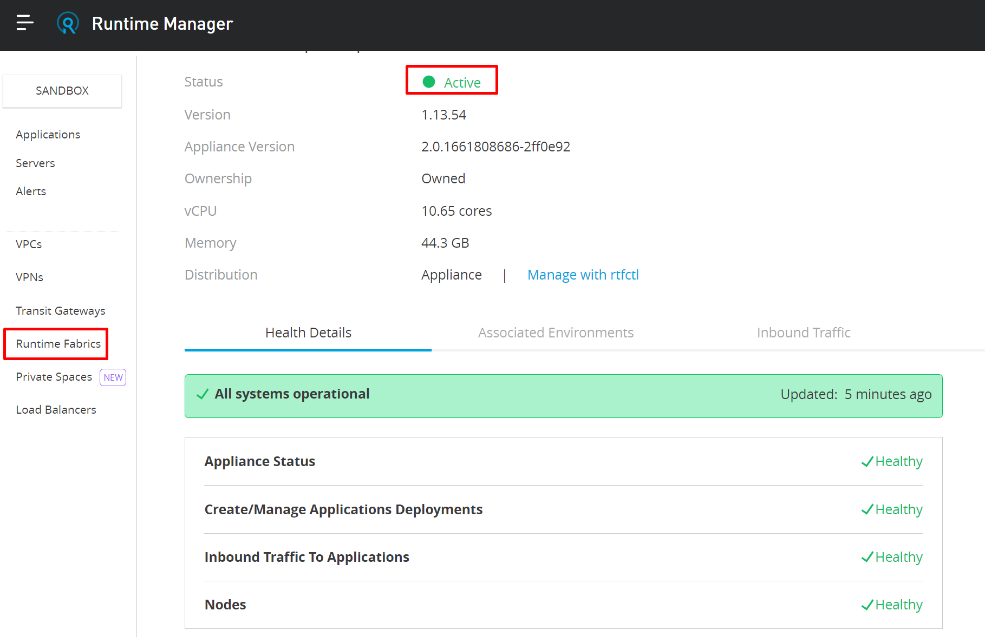
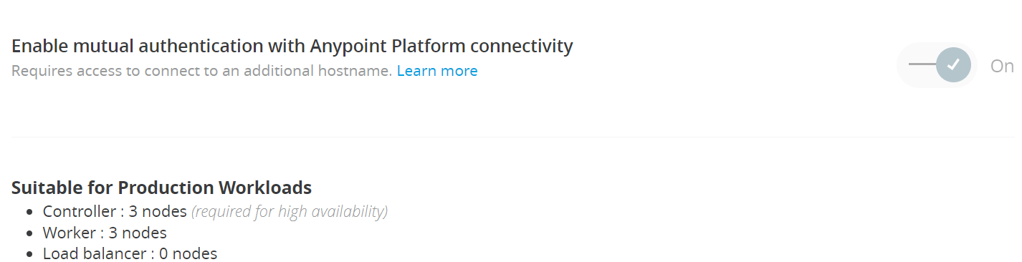
Anypoint platform – Runtime Fabric

Slide 13
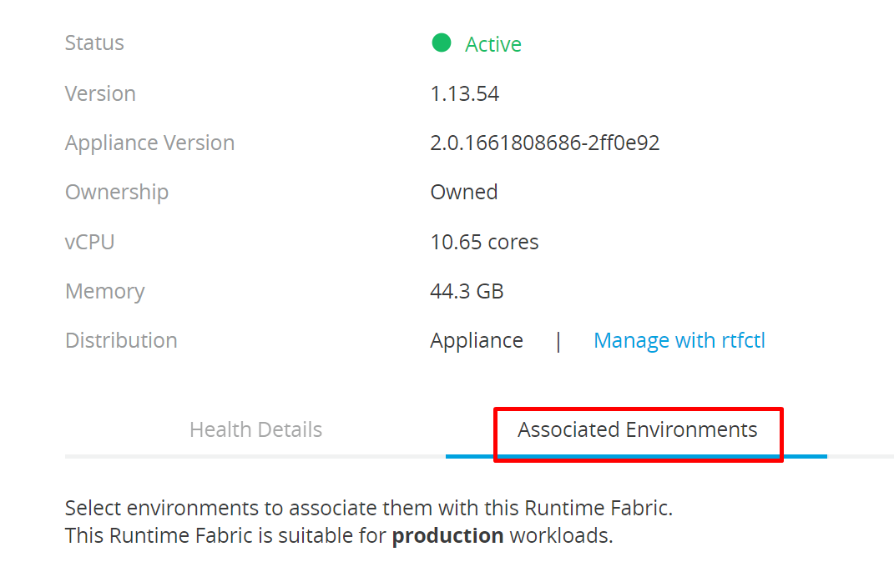
Anypoint platform – Associated Environment
Check the checkbox for required environment

Slide 14
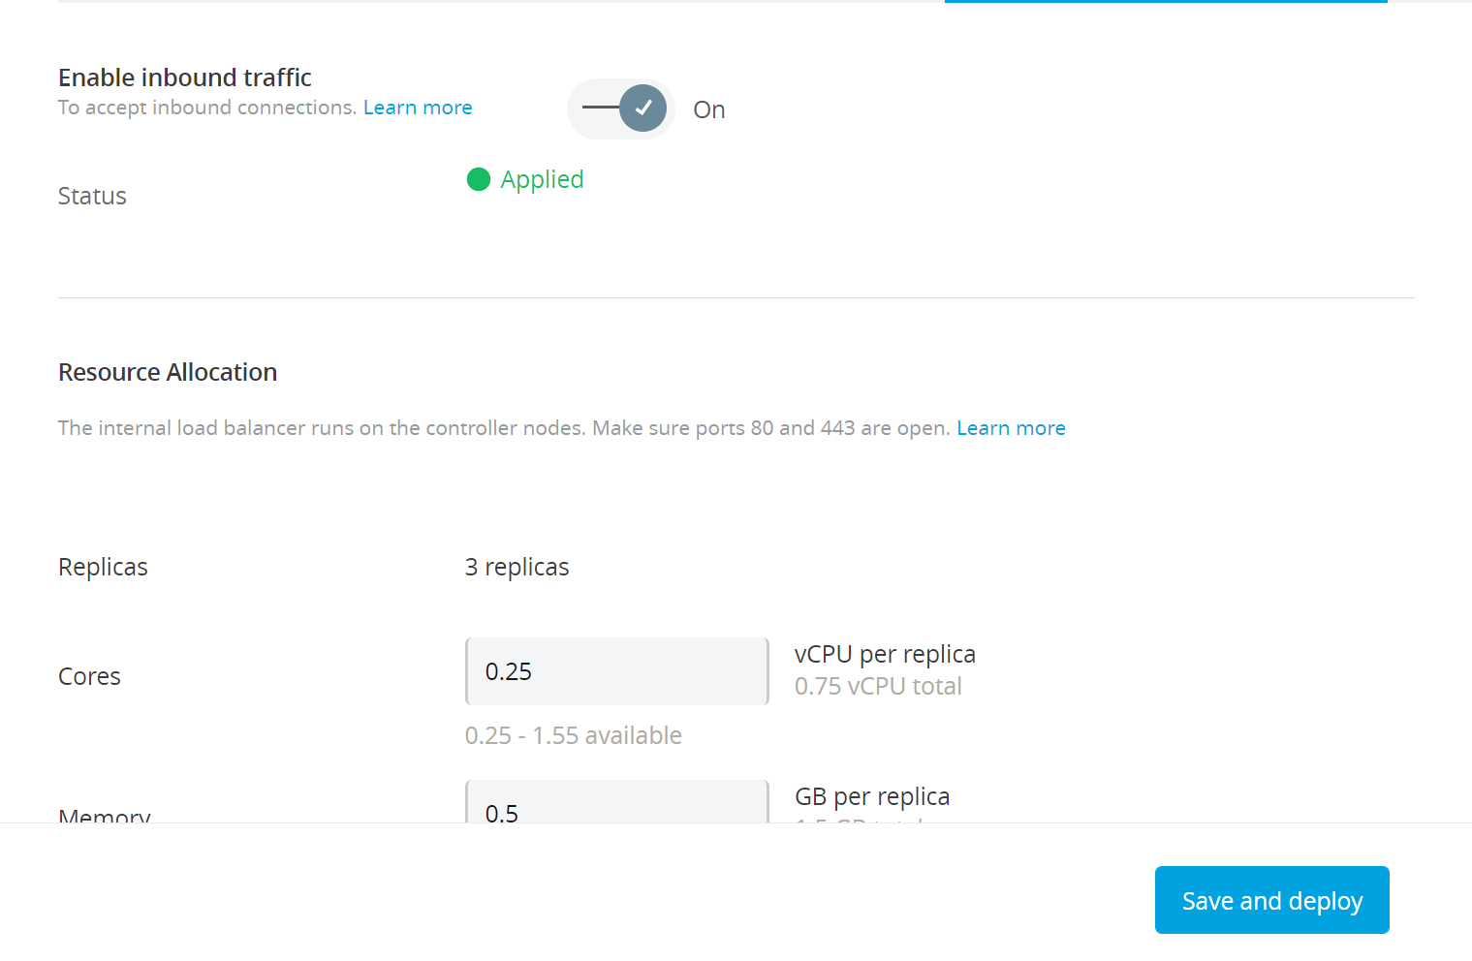
Verification from Anypoint platform – Inbound Traffic

Slide 15
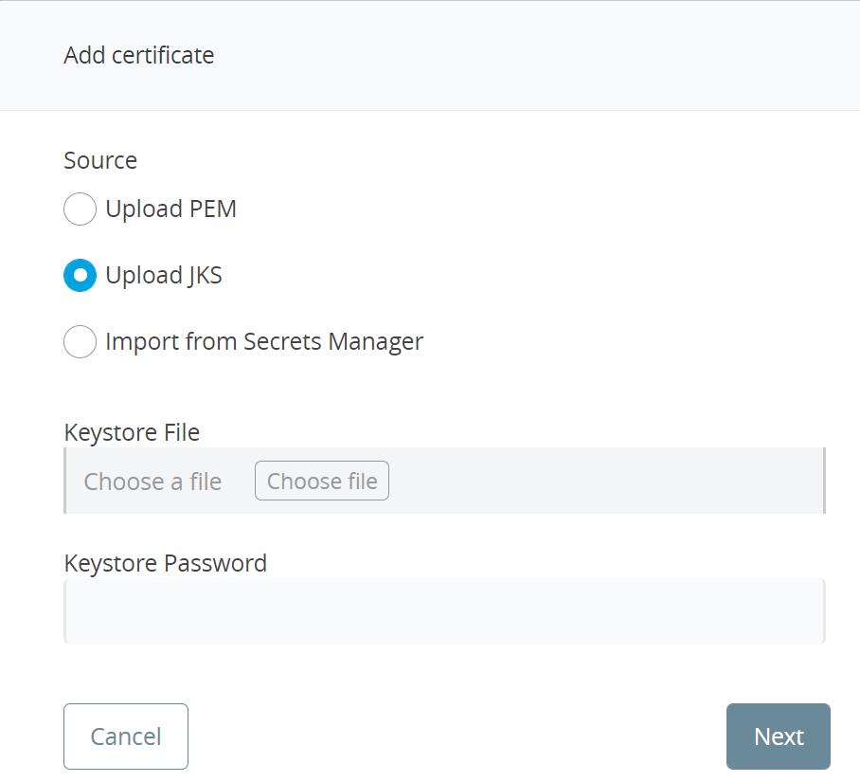
Anypoint platform – Add Certificate

Slide 16
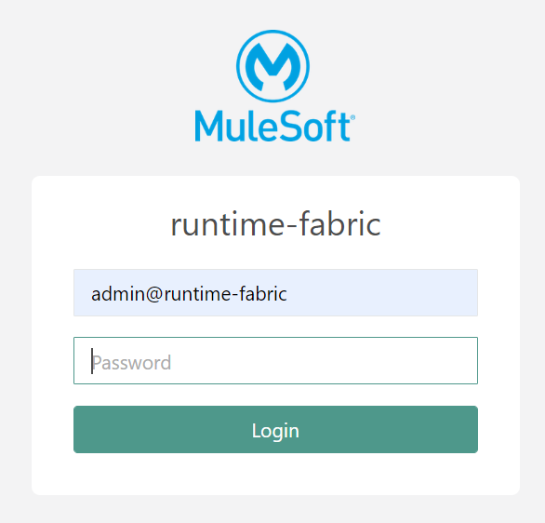
Ops Center
Extract Ops Center Credentials from main/leader controller node
cat /var/log/rtf-init.log | grep -B 1 -A 3 "Ops Center“
https://<leadercontrolernode>:32009/web/login

Slide 17
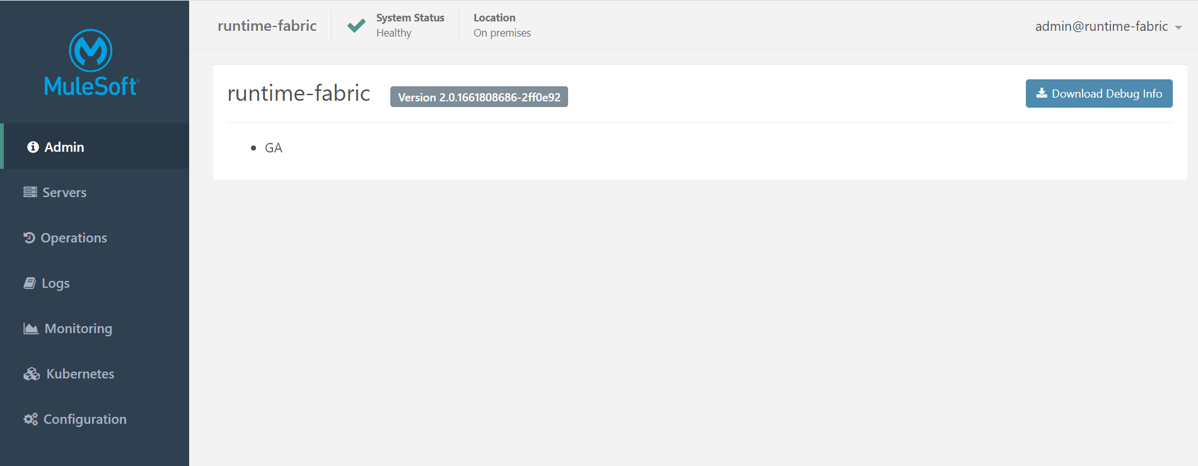
Ops Center - Admin

Slide 18
Ops Center - Servers

Slide 19
Ops Center - Monitoring

Slide 20
Ops Center - Kubernetes
Pods tab will show list of applications installed in that environment with worker hostname and Pods IP address

Slide 21
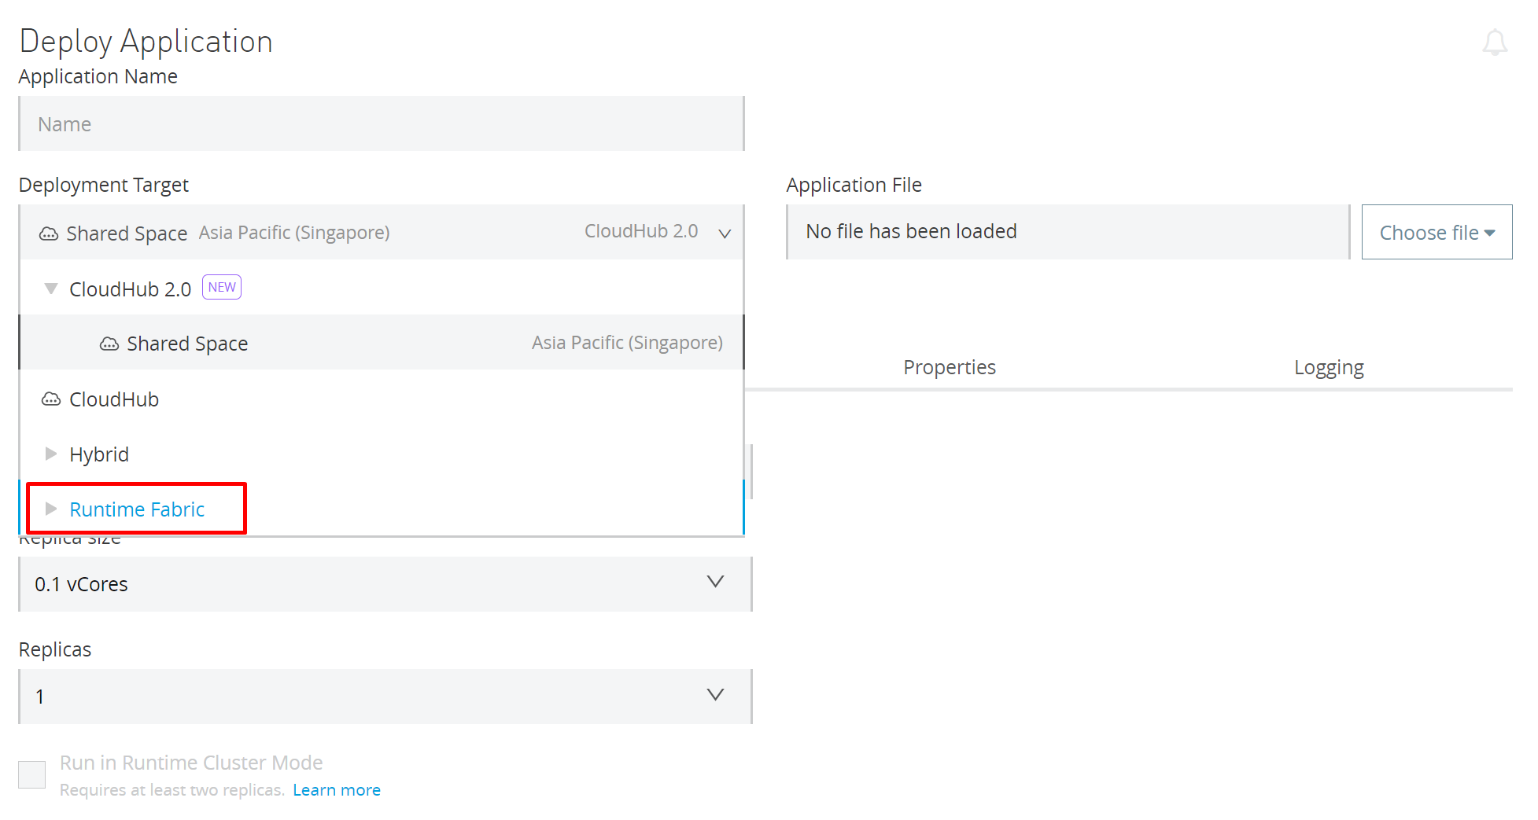
Deploy application into Runtime fabric
Deploy application into Runtime fabric

Slide 22
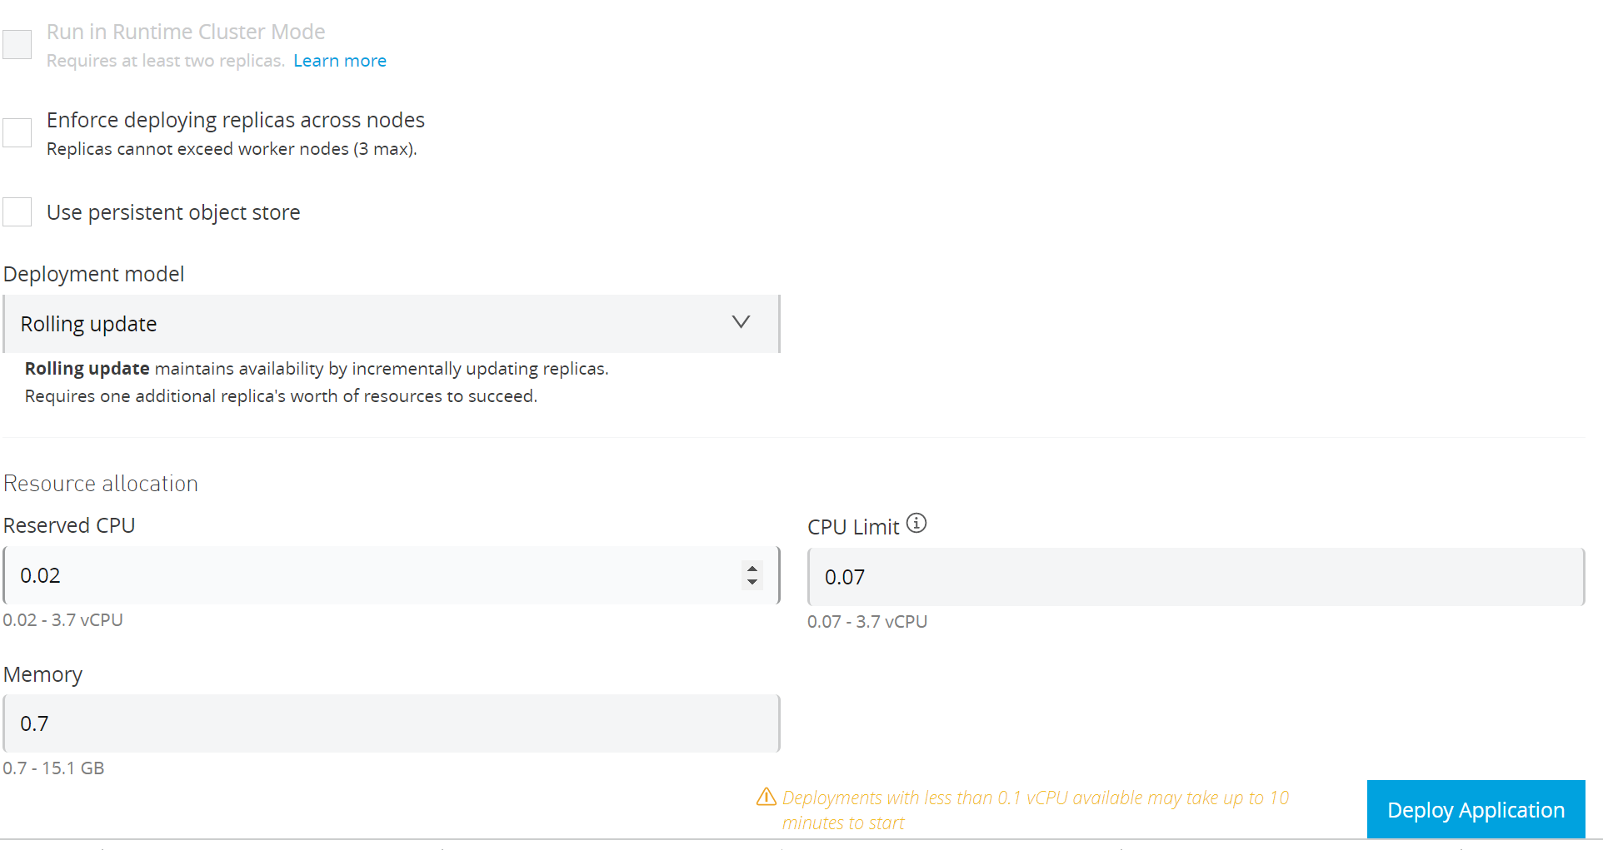
Deploy application into Runtime fabric

