Slide 1
Object Oriented Programming CS F213
Dr Pranav M. Pawar

Slide 2
Contents
Command Line Argument
Examples
this keyword
Examples
static keyword
Examples
final keyword
Examples
Sources:
Chapter 1, Cay Horstmann, Object Oriented Design & Patterns, John Wiley & Sons, 2006, 2nd Edition
Chapter 6, 7, Herbert Schildt, The complete Reference Java 2, 5th Edition, Tata McGraw Hill.
https://www.tutorialspoint.com/Java-command-line-arguments
http://www.w3professors.com/java-programs/add-two-numbers-by-using-command-line-argument/
https://beginnersbook.com/2013/04/java-static-class-block-methods-variables/
https://www.javatpoint.com/static-keyword-in-java
https://www.edureka.co/blog/static-keyword-in-java/
https://www.javatpoint.com/final-keyword
https://www.geeksforgeeks.org/final-keyword-java/

Slide 3
Command Line Argument
An information that directly follows the program's name on the command line when it is executed.
Arguments are stored as strings in the String array passed to main( ).
Example 1: CommandLine.java
Example 2: sum.java

Slide 4
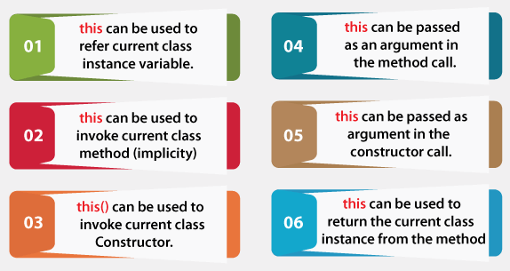
this keyword
Source: https://www.javatpoint.com/this-keyword

Slide 5
this keyword
this: To refer current class instance variable
Example 1: TestThis1.java
Parameters (formal arguments) and instance variables are same.
Example 2: TestThis2.java
Solution to problem observed in Example 1
Example 3: TestThis3.java (with this)
Local variables(formal arguments) and instance variables are different, no need of this.

Slide 6
this keyword
this: To invoke current class method
If you don't use the this keyword, compiler automatically adds this keyword while invoking the method.
Example 4: TestThis4.java
this(): To invoke current class constructor
Can be used to invoke the current class constructor.
It is used to reuse the constructor or for constructor chaining.
Example 5: TestThis5.java
Calling default constructor from parameterized constructor.
Example 6: TestThis6.java
Calling parameterized constructor from default constructor.
Example 5: TestThis7.java
Reuse the constructor or constructor chaining.

Slide 7
this keyword
this: To pass as an argument in the method.
Example 8: S2.java
this: To pass as argument in the constructor call
It is useful if we have to use one object in multiple classes.
Example 9: A4.java
this: Can be used to return current class instance.
Can return this keyword as an statement from the method. In such case, return type of the method must be the class type (non-primitive).
Example 10: Test1.java

Slide 8
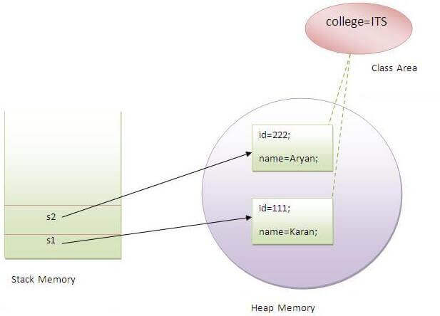
static keyword
Static variable
The static variable can be used to refer to the common property of all objects (which is not unique for each object), for example, the company name of employees, college name of students, etc.
The static variable gets memory only once in the class area at the time of class loading.
Example 11: TestStaticVariable1.java

Slide 9
static keyword
Static method
A static method belongs to the class rather than the object of a class.
A static method can be invoked without the need for creating an instance of a class.
A static method can access static data member and can change the value of it.
Example 12: TestStaticMethod.java

Slide 10
static keyword
Static Block
Is used to initialize the static data member.
It is executed before the main method at the time of class loading.
Example 13: StaticBlockExample.java
Static class
A class can be made static only if it is a nested class.
Example 14: StaticClassExample.java

Slide 11
final keyword
Used to restrict the user.
Final variable
If you make any variable as final, you cannot change the value of final variable.
Example 15: Bike9.java
Final method
If you make any method as final, you cannot override it.
Example 16: Bike.java
Final class
If you make any class as final, you cannot extend it or inherit it.
Example 17: Honda.java

Slide 12
Thank You!

