Slide 1
Object Oriented Programming CS F213
Dr Pranav M. Pawar

Slide 2
Contents
Packages
Types of packages
Examples
Access Modifiers
Examples
Sources:
Chapter 1, Cay Horstmann, Object Oriented Design & Patterns, John Wiley & Sons, 2006, 2nd Edition
Chapter 9, Herbert Schildt, The complete Reference Java 2, 5th Edition, Tata McGraw Hill.
https://www.geeksforgeeks.org/packages-in-java/
https://www.w3schools.com/java/java_packages.asp

Slide 3
Packages
Package in Java is a mechanism to encapsulate a group of classes, sub packages and interfaces.
Packages are used for,
Preventing naming conflicts. For example there can be two classes with name Employee in two packages.
Making searching/locating and usage of classes, interfaces easier.
Providing controlled access: using access specifiers.
Packages can be considered as data encapsulation (or data-hiding).
Types of Packages
Built in packages
User defined packages

Slide 4
Built in Packages
Common built in packages
java.lang: Contains language support classes(e.g classed which defines primitive data types, math operations). This package is automatically imported.
java.io: Contains classed for supporting input / output operations.
java.util: Contains utility classes which implement data structures like Linked List, Dictionary and support ; for Date / Time operations.
java.applet: Contains classes for creating Applets.
java.awt: Contain classes for implementing the components for graphical user interfaces (like button , ;menus etc).
java.net: Contain classes for supporting networking operations.
How to add any packages in program?
=> import

Slide 5
User defined packages
These are the packages that are defined by the user.
For creating packages
First we create a directory with name of packages.
Then create the class inside the directory with the first statement being the package names.
Example 1: myPackage
Executing created myPackage
javac MyClass.java //Compile the class
javac -d . MyClass.java //Compile class and package together
javac PrintName.java //Then compile a class where package is used
java PrintName

Slide 6
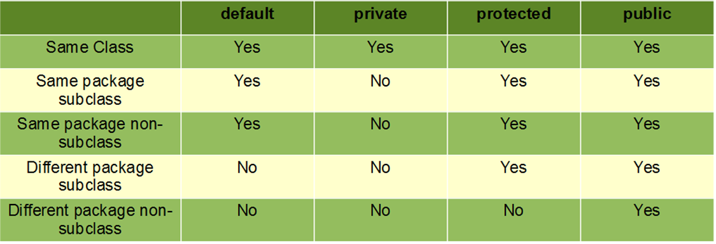
Access Modifier
Access modifiers in Java helps to restrict the scope of a class, constructor, variable, method or data member.
Four types of access modifiers available in java:
Default – No keyword required
Private
Protected
Public

Slide 7
Access Modifier
Default
When no access modifier is specified for a class, method, or data member – It is said to be having the default access modifier by default.
The data members, class or methods which are not declared using any access modifiers i.e. having default access modifier are accessible only within the same package.
Example 2:
Here, we will create two packages (p1 and p2) and the classes (class Try1 in p1 and class Try2 in p2) in the packages will be having the default access modifiers and we will try to access a class from one package from a class of the second package.
Note: Refer to Folder p1 for p1-package and folder p2 for p2-package in course notes of Lecture 7.

Slide 8
Access Modifier
Java program to illustrate error while using class from different package with default modifier
package p1;
class Try1
{
void display()
{
System.out.println("Hello World!");
}
}
package p2;
import p1.*;
class Try2
{
public static void main(String args[])
{
Try1 obj = new Try1();
obj.display();
}
}
Output:
error: package p1 does not exist import p1.*;
error: cannot find symbol
Try2 obj = new Try2();

Slide 9
Access Modifier
Private
The private access modifier is specified using the keyword private.
The methods or data members declared as private are accessible only within the class in which they are declared.
Any other class of same package will not be able to access these members.
Classes or interface cannot be declared as private.
Eg. Create two classes A and B within same package p1. We will declare a method in class A as private and try to access this method from class B and see the result.
Example 3: Next slide

Slide 10
Access Modifier
Java program to illustrate error while using class from different package with private modifier
package p1;
class A
{
private void display()
{
System.out.println(“HelloWorld!");
}
}
class B
{
public static void main(String args[])
{
A obj = new A();
//trying to access private method of //another class
obj.display();
}
}
Output:
error: display() has private access in A

Slide 11
Access Modifier
Protected
The protected access modifier is specified using the keyword protected.
The methods or data members declared as protected are accessible within same package or sub classes in different package.
Ex. Create two packages p1 and p2. Class A in p1 is made public, to access it in p2. The method display in class A is protected and class B is inherited from class A and this protected method is then accessed by creating an object of class B.
Example 4: Next slides

Slide 12
Access Modifier
Java program to illustrate protected modifier
package p2;
import p1.*;
// importing all files from package p1
//Class B is subclass of A
class B extends A
{
public static void main(String args[])
{
B obj = new B();
obj.display();
}
}
Output:
In class A
package p1;
public class A
{
protected void display()
{
System.out.println("In class A");
}
}

Slide 13
Access Modifier
Public
The public access modifier is specified using the keyword public.
The public access modifier has the widest scope among all other access modifiers.
Classes, methods or data members which are declared as public are accessible from every where in the program. There is no restriction on the scope of a public data members.
Example 5: Next slides

Slide 14
Access Modifier
Java program to illustrate public modifier
package p2;
import p1.*;
// importing all files from package p1
//Class B is subclass of A
class B
{
public static void main(String args[])
{
A obj = new A;
obj.display();
}
}
Output:
In class A
package p1;
public class A
{
public void display()
{
System.out.println("In class A");
}
}

Slide 15
Thank You!

