Slide 1
Object Oriented Programming CS F213

Slide 2
Contents
Layout Manager
BorderLayout
Example
FlowLayout
Example
GridLayout
Example
BoxLayout
Example
Sources (Slide 3 to 16):
https://www.javatpoint.com/java-swing
https://cse.iitkgp.ac.in/~dsamanta/java/ch10.htm
https://www.studytonight.com/java/java-swing.php

Slide 3
Layout Manager
The LayoutManagers are used to arrange components in a particular manner.
LayoutManager is an interface that is implemented by all the classes of layout managers.
Following are the important layout and layout manger classes:
BorderLayout
FlowLayout
GridLayout
BoxLayout

Slide 4
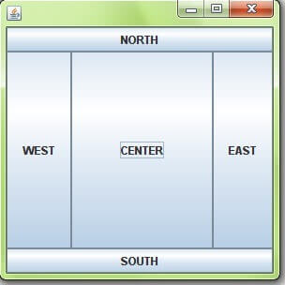
BorderLayout
The BorderLayout is used to arrange the components in five regions: north, south, east, west and center.
Each region (area) may contain one component only.
It is the default layout of frame or window.
Example 1 (Border Layout)

Slide 5
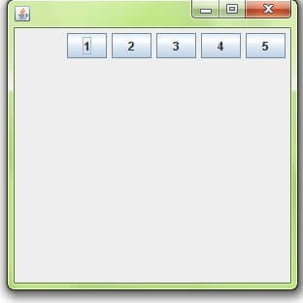
FlowLayout
The FlowLayout is used to arrange the components in a line, one after another (in a flow).
It is the default layout of panel.
Different flows: LEFT, RIGHT, CENTER
Example 2 (FlowLayout)

Slide 6
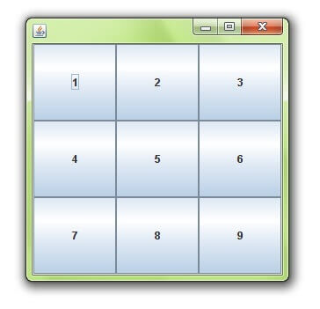
GridLayout
The GridLayout is used to arrange the components in rectangular grid.
Example 3 (GridLayout)

Slide 7
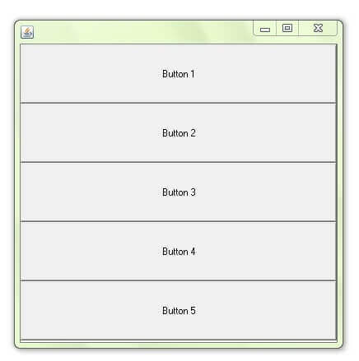
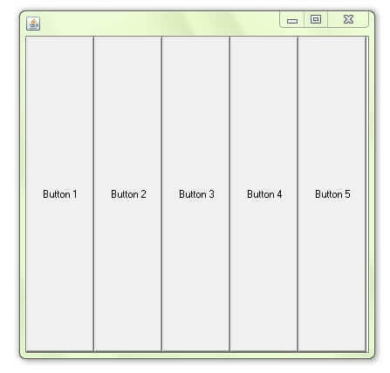
BoxLayout
The BoxLayout is used to arrange the components either vertically or horizontally.
Example 4 (BoxLayout)

Slide 8
Thank you.

