Slide 1
Object Oriented Programming CS F213

Slide 2
Contents
Introduction
Life cycle of thread
Thread priorities and scheduling
Creating a thread in Java
Implementing Runnable Interface
Extending Thread class
Thread methods
Sources (Slides 3 to 19):
Cay Horstmann, Object Oriented Design & Patterns, John Wiley & Sons, 2006, 2nd Edition
https://www.tutorialspoint.com/java/java_multithreading.htm
https://www.w3schools.com/java/java_threads.asp
https://www.geeksforgeeks.org/multithreading-in-java/
http://pages.cs.wisc.edu/~mattmcc/cs537/notes
https://www.hubberspot.com/2012/08/how-life-cycle-of-thread-in-works-in.html
http://www.cse.lehigh.edu/~glennb/oose

Slide 3
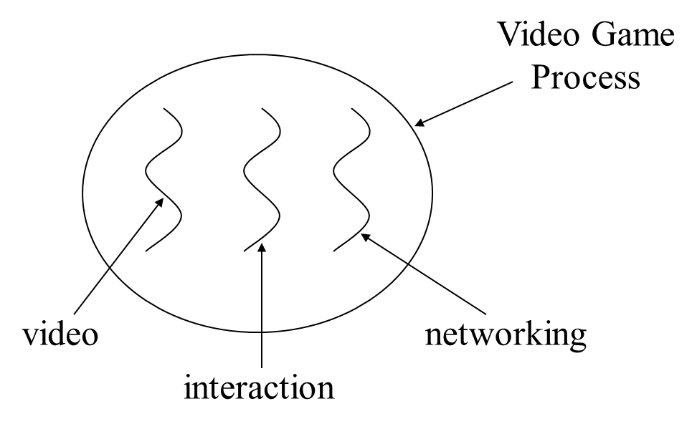
Introduction
What is thread ?
Individual and separate unit of execution that is part of a process
Multiple threads (multi-threading) can work together to accomplish a common goal
Example:
Video Game example: one thread for graphics, one thread for user interaction, one thread for networking.
In a Web browser we may do the following tasks at the same time: scroll a page, download an image, play sound, print a page.

Slide 4
Introduction
A multi-threaded program
Contains two or more parts that can run concurrently
Each part can handle a different task at the same time making optimal use of the available resources specially when your computer has multiple CPUs.
Multi-threading enables you to write in a way where multiple activities can proceed concurrently in the same program.

Slide 5
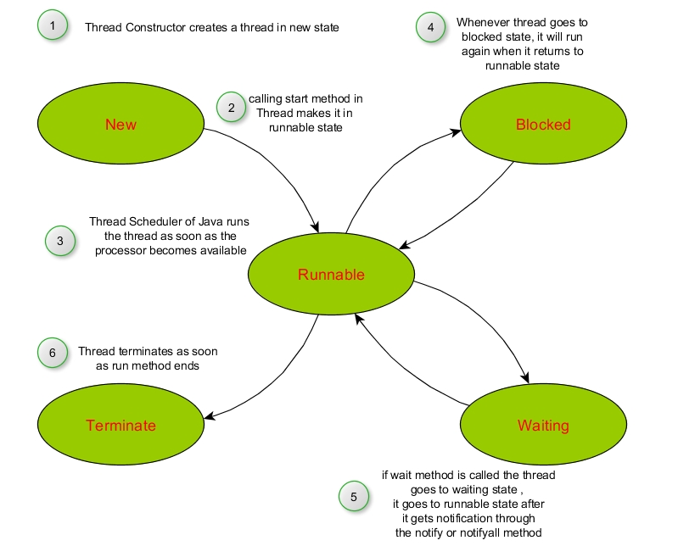
Life cycle of thread (1)

Slide 6
Life cycle of thread (2)
New (Born) state
Thread just created
When start called, enters ready state
Runnable state (Running state)
Highest-priority ready thread enters running state
System assigns processor to thread (thread begins executing)
When run completes or terminates, enters dead state
Terminate (Dead) state
Thread marked to be removed by system
Entered when run terminates or throws uncaught exception

Slide 7
Life cycle of thread (3)
Blocked state
Entered from running state
Blocked thread cannot use processor, even if available
Common reason for blocked state - waiting on I/O request
Waiting state
Entered when wait called in an object thread is accessing
One waiting thread becomes ready when object calls notify
notifyAll - all waiting threads become ready
Other state
Sleeping state
Entered when sleep method called
Cannot use processor
Enters ready state after sleep time expires

Slide 8
Thread Priorities and Scheduling
All Java applications are multithreaded
Threads have priority from 1 to 10
Thread.MIN_PRIORITY - 1
Thread.NORM_PRIORITY - 5 (default)
Thread.MAX_PRIORITY - 10
New threads inherit priority of thread that created it
Timeslicing
Each thread gets a quantum of processor time to execute
After time is up, processor given to next thread of equal priority (if available)
Without timeslicing, each thread of equal priority runs to completion.
Java scheduler
Keeps highest-priority thread running at all times
If timeslicing available, ensure equal priority threads execute in round-robin fashion
New high priority threads could postpone execution of lower priority threads

Slide 9
Creating thread in Java
Implementing Runnable interface
Step 1: Implement a run() method provided by a Runnable interface.
run() is an entry point for the thread and put required logic inside it.
Step 2 : Instantiate a Thread object using the below constructor,
Thread(Runnable threadObj, String threadName);
where, threadObj is an instance of a class that implements the Runnable interface and threadName is the name given to the new thread.
Step 3: Start thread object by calling start() method, which executes a call to run( ) method.

Slide 10
Example 1
//Example 1: Using Runnable interface
class RunnableDemo implements Runnable {
private Thread t;
private String threadName;
RunnableDemo( String name)
{
threadName = name;
System.out.println("Creating " + threadName );
}

Slide 11
Example 1
public void run(){
System.out.println("Running " + threadName );
try { for(int i = 4; i > 0; i--)
{
System.out.println("Thread: " + threadName + ", " + i);
// Let the thread sleep for a while.
Thread.sleep(50);
}
}
catch (InterruptedException e)
{
System.out.println("Thread " + threadName + " interrupted.");
}
System.out.println("Thread " + threadName + " exiting.");
}

Slide 12
Example 1
public void start ()
{
System.out.println("Starting " + threadName );
if (t == null)
{
t = new Thread (this, threadName);
t.start ();
}
}
}

Slide 13
Example 1
public class TestThread
{
public static void main(String args[])
{
RunnableDemo R1 = new RunnableDemo( "Thread- 1");
R1.start();
RunnableDemo R2 = new RunnableDemo( "Thread- 2");
R2.start();
}
}
Output:
Creating Thread-1
Starting Thread-1
Creating Thread-2
Starting Thread-2
Running Thread-1
Thread: Thread-1, 4
Running Thread-2
Thread: Thread-2, 4
Thread: Thread-1, 3
Thread: Thread-2, 3
Thread: Thread-1, 2
Thread: Thread-2, 2
Thread: Thread-1, 1
Thread: Thread-2, 1
Thread Thread-1 exiting.
Thread Thread-2 exiting.

Slide 14
Creating thread in Java
Extending a Thread Class
Step 1: Override run( ) method available in Thread class
run() is an entry point for the thread and put required logic inside it.
Step 2 : Start thread object by calling start() method, which executes a call to run( ) method.

Slide 15
Example 2
class ThreadDemo extends Thread
{
private Thread t;
private String threadName;
ThreadDemo( String name)
{
threadName = name;
System.out.println("Creating " + threadName );
}

Slide 16
Example 2
public void run(){
System.out.println("Running " + threadName );
try { for(int i = 4; i > 0; i--)
{
System.out.println("Thread: " + threadName + ", " + i);
// Let the thread sleep for a while.
Thread.sleep(50);
}
}
catch (InterruptedException e)
{
System.out.println("Thread " + threadName + " interrupted.");
}
System.out.println("Thread " + threadName + " exiting.");
}

Slide 17
Example 2
public void start ()
{
System.out.println("Starting " + threadName );
if (t == null)
{
t = new Thread (this, threadName);
t.start ();
}
}
}

Slide 18
Example 2
public class TestThread
{
public static void main(String args[])
{
ThreadDemo T1 = new ThreadDemo( "Thread- 1");
T1.start();
ThreadDemo T2 = new ThreadDemo( "Thread- 2");
T2.start();
}
}
Output:
Creating Thread-1
Starting Thread-1
Creating Thread-2
Starting Thread-2
Running Thread-1
Thread: Thread-1, 4
Running Thread-2
Thread: Thread-2, 4
Thread: Thread-1, 3
Thread: Thread-2, 3
Thread: Thread-1, 2
Thread: Thread-2, 2
Thread: Thread-1, 1
Thread: Thread-2, 1
Thread Thread-1 exiting.
Thread Thread-2 exiting.

Slide 19
Thread methods (important)
public void start()
Starts the thread in a separate path of execution, then invokes the run() method on this Thread object.
public void run()
If this Thread object was instantiated using a separate Runnable target, the run() method is invoked on that Runnable object.
public final void setName(String name)
Changes the name of the Thread object. There is also a getName() method for retrieving the name
public final void setPriority(int priority)
Sets the priority of this Thread object. The possible values are between 1 and 10.

Slide 20
Thread methods (important)
public final boolean isAlive()
Returns true if the thread is alive, which is any time after the thread has been started but before it runs to completion.
public static void sleep(long millisec)
Causes the currently running thread to block for at least the specified number of milliseconds.
public final void setDaemon(boolean on)
A parameter of true denotes this Thread as a daemon thread.
Daemon thread is a low priority thread that runs in background to perform tasks such as garbage collection.
public void interrupt()
Interrupts this thread, causing it to continue execution if it was blocked for any reason.
public static void yield()
Causes the currently running thread to yield to any other threads of the same priority that are waiting to be scheduled.

Slide 21
Thank you.

