Slide 1



SMART INDIA HACKATHON 2025
FENCE MONITOR
Problem Statement ID: SIH25077
Problem Statement Title: “A hardware that can detect and prevent unauthorized use of electric fences”
Theme: Smart Automation
PS Category: Hardware
Team ID:
Team Name (Registered on portal): Quantum Leap

Slide 2

Quantum Leap
Smart Electric Fence Monitoring & Safety System
IDEA/SOLUTION
PROBLEM RESOLUTION
IDEA/SOLUTION
Fast Detection – Identifies unauthorized access, power theft, leakage, or tampering within 0.5–2 seconds for reliable fence security
Tamper & Weather Resistant – Prevents interference, avoids fence-related faults, and ensures outdoor performance
LoRa Connectivity – Enables data transfer up to 50 km with <1% packet loss and ultra-low power usage
The system safeguards electric fences by detecting misuse early and preventing power theft or security breaches.
The system safeguards electric fences by detecting misuse and monitoring power theft or security breaches.
Microcontroller-driven system for complete fence monitoring
Two “eyes”:
Sub-meter tracks power.
Fence sensor ensures electricity flow.
Real-time alerts and logging to notify issues immediately
Robust, scalable, and cost-effective solution for farms, industrial sites, and large perimeters
Affordable and easy to install, ensuring accessibility for all users
“The system safeguards electric fences by detecting misuse early and preventing power theft or security breaches.
Microcontroller-driven system for complete fence monitoring
Two “eyes”:
Sub-meter tracks power.
Fence sensor ensures electricity flow.
Real-time alerts and logging to notify issues immediately
Robust, scalable, and cost-effective solution for farms, industrial sites, and large perimeters
Affordable and easy to install, ensuring accessibility for all users
DIFFERENTIATING FACTOR
Our device is built to work reliably in any environment, even challenging hilly regions.
It detects and prevents illegal electric fencing, encourages fair electricity use, and ensures data transparency.
With offline logging and buzzer alerts for added safety, our device is a valuable tool not only for farmers and industries, but also for helping the government reduce revenue loss.
@SIH Idea submission- Quantum Leap
2
Notes:
2

Slide 3
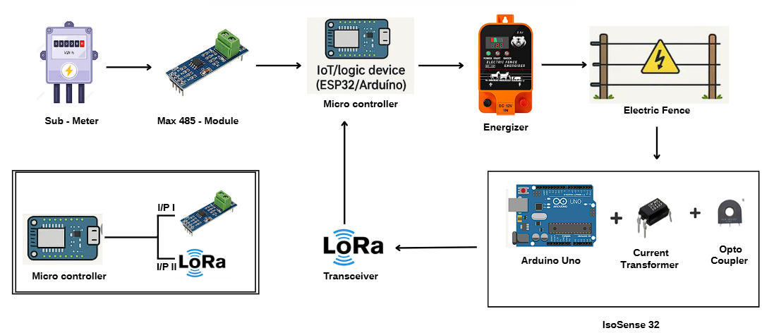
TECHNICAL APPROACH
Quantum Leap
Hardware Development:
ESP32 microcontroller, CT & voltage sensors, Pulsedetector, RS485 & LoRa modules, SD card.
Algorithms / Logic Development:
ESP32 analyzes sub-meter power and current via ADC, reads fence sensor data, checks multiple cases, and confirms anomalies multiple times using C code on the microcontroller.
Communication:
RS485 (sub-meter) and LoRa (fence sensors) for reliable wired and wireless data transfer.
PRODUCT STATUS: Simulation tests successful. Hardware prototype in progress; testing and validation nextPRODUCT STATUS: Simulation tests successful. Hardware prototype in progress; testing and validation next
PRODUCT STATUS:
Simulation tests successful. Hardware prototype in progress; testing and validation next.
Storage & Output:
Logs stored on SD card; barcode generated
for inspection.
PRODUCT STATUS: Simulation tests successful. Hardware prototype in progress; testing and validation nextPRODUCT STATUS: Simulation tests successful. Hardware prototype in progress; testing and validation next
Simulation Link: Simulation 1 & Simulation 2
Future AI Integration Plan Link: AI Integration Plan
@SIH Idea submission- Quantum Leap
3
Notes:
3

Slide 4
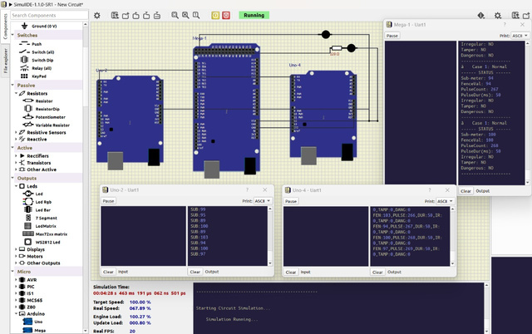
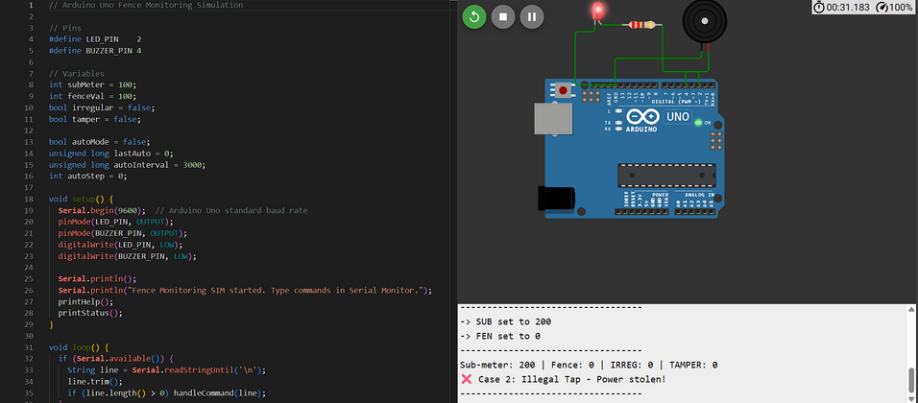

FEASIBILITY AND VIABILITY
Quantum Leap
ANALYSIS OF THE FEASIBILITY OF THE IDEA
Low-cost & offline:
Works without internet
Uses affordable, readily available hardware
Easy access & monitoring:
Logs stored on SD card
Enables farmers, industries, and KSEB to track usage
Reliable & scalable:
Detects illegal taps and faults in real-time
Suitable for all terrains
Low power consumption
SERIAL COMMUNICATION
TEST SUCCESSFULL
BRAIN COMPARATOR
TEST SUCCESSFULL
STRATEGIES FOR OVERCOMING THESE CHALLENGES
Safety & Reliability – Isolation, surge protection, and weatherproof enclosures ensure accuracy and durability.
Smart Alerts & Logging – Multi-mode alerts with LEDs,
buzzers, SMS, and SD card logging for easy use.
FENCE LINE CURRENT VOLTAGE
TEST SUCCESSFULL
Energy Efficiency – Low-power MCU and sensors
optimized for solar/battery usage.
@SIH Idea submission- Quantum Leap
4
Notes:
4

Slide 5
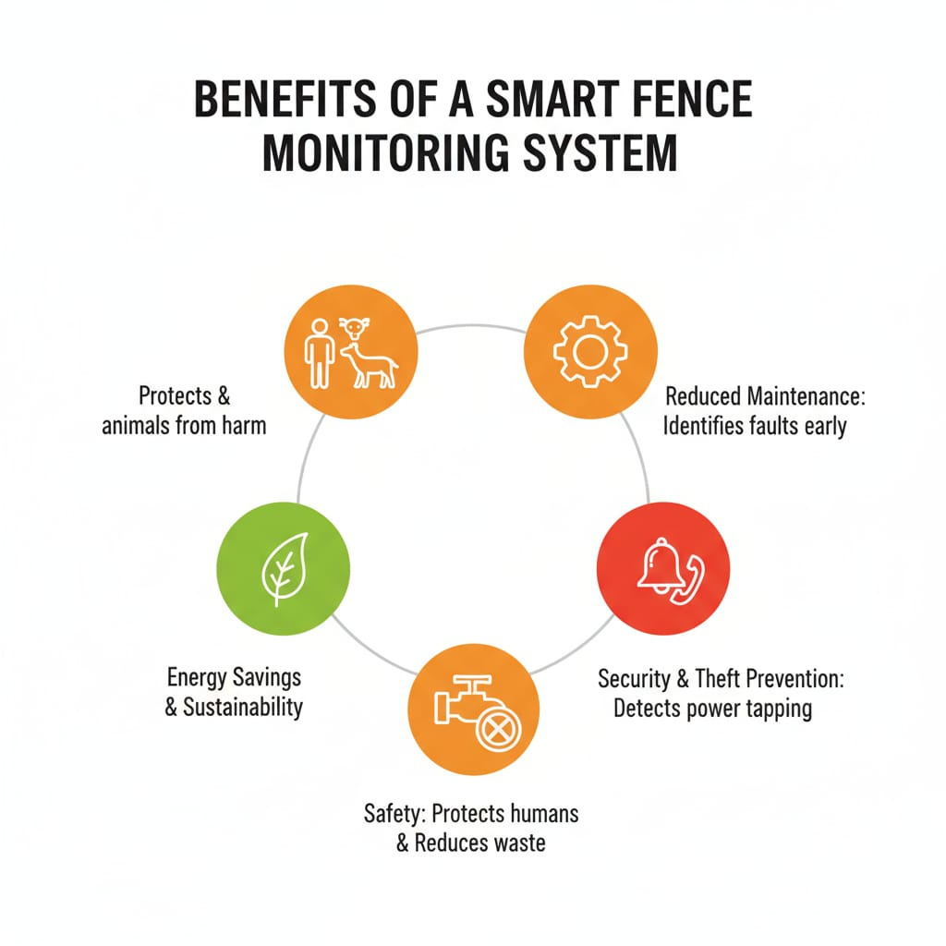
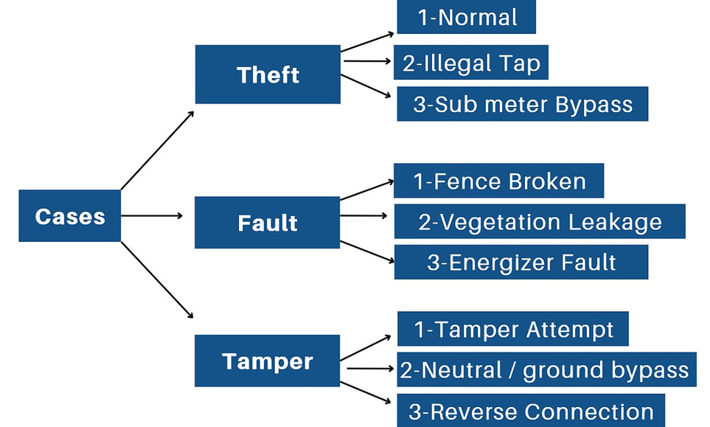
IMPACT AND BENEFITS
Quantum Leap
Protects both humans and animals from potential harm.
Identifies faults early, reducing maintenance needs.
Detects power tapping to enhance security and prevent theft.
Improves safety by reducing risks and minimizing waste.
Promotes energy savings and supports long-term sustainability.
@SIH Idea submission- Quantum Leap
5
Notes:
5

Slide 6

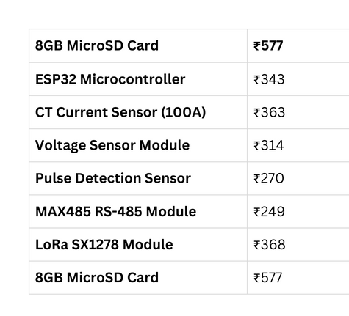
RESEARCH AND REFERENCES
Quantum Leap
Muthu P | ECE
Anushalakshmi S | AI & DS
Jaisurya R | ECE
Lavanya N | AI & DS
Nithish kumar M | ECE
Naga Adithyaa G R | ECE
MENTORS:
NAME
DEPT
Cost Estimation
Faculty mentor:
Dr.N.Manikanda Prabhu
Assistant Professor ECE
Industrial mentor:
Dr. Nagarajan Subramaniyam -
CEO, Xfold imaging Oy Vasaramaki 4D 22
Espoo 02750 Finland
~₹3000
References:
Design of Modular Smart Electric Fence System with Fall-back Communication Interface https://ieeexplore.ieee.org/document/10080302
IS 302-2-76 (1999): Safety of Household and Similar Electrical Appliances,
https://law.resource.org/pub/in/bis/S05/is.302.2.76.1999.pdf
https://www.researchgate.net/publication/375016423_Development_of_agriculture_electric_fence_monitoring_and_notification_system_using_Blynk_application
@SIH Idea submission- Quantum Leap
6
Notes:
6

