Slide 1


SKILL FORGE
AI DRIVEN ADAPTIVE LEARNING AND EXAM GENERATOR
PRESENTED BY :- SURYANSH DHAMA

Slide 2

INTRODUCTION
SkillForge is an AI-powered learning platform designed to personalize education.
It provides adaptive exams, automated assessments, dashboards for students, teachers, and admins, and certificate generation for high performers.

Slide 3
PROBLEM STATEMENT
1.
TRADITIONAL LEARNING IS NOT PERSONALIZED.
2.
MANUAL QUESTION PAPER CREATION IS TIME-CONSUMING.
NO CENTRALIZED SYSTEM FOR ASSESSMENTS, NOTES, AND PERFORMANCE.
3.
LACK OF AUTOMATED CERTIFICATION AND LEADERBOARDS.
4

Slide 4

Build a smart adaptive exam generator. Create dashboards for Admin, Teacher, Student.
PROJECT OBJECTIVES
Auto-generate certificates for >90% score. Add weekly s monthly leaderboards.
Provide notes, courses, and progress-tracking features.

Slide 5
SYSTEM USERS
Admin: Manages teachers, students, courses, notes, and analytics.
Teacher: Creates questions, reviews AI-generated exams,
tracks student performance.
Student: Takes exams, views notes, sees leaderboard, receives certificates.

Slide 6
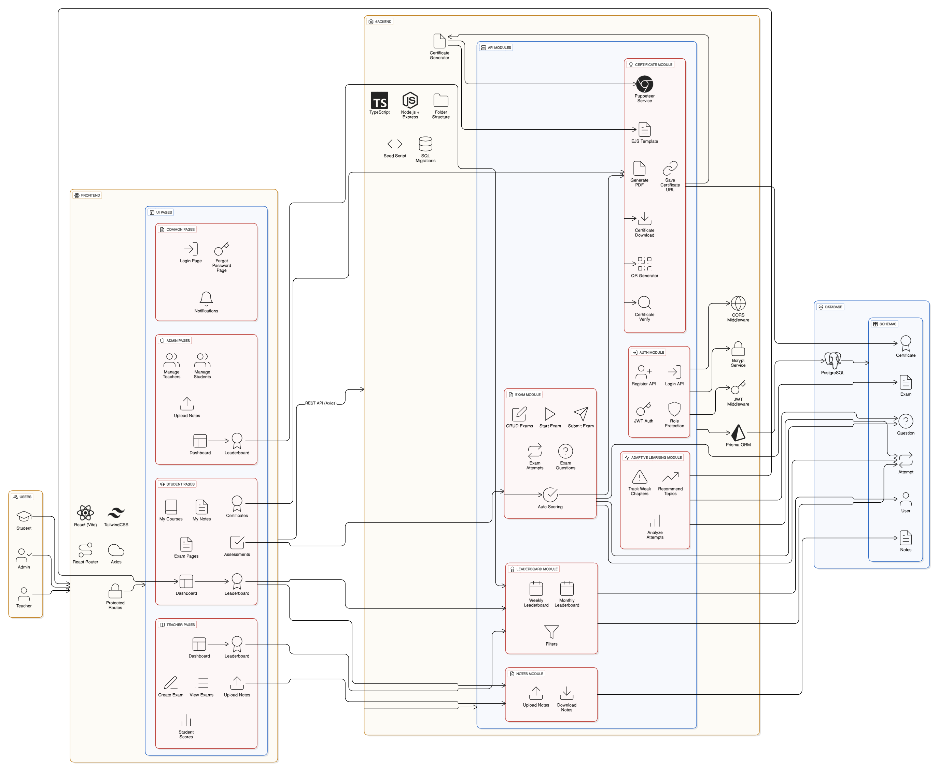
SYSTEM ARCHITECTURE

Slide 7




KEY FEATURES
MULTI-ROLE LOGIN (ADMIN/TEACHER/STUDENT) PERSONALIZED DASHBOARDS
AI-DRIVEN QUESTION GENERATION ADAPTIVE EXAM SYSTEM
NOTES + MY COURSES SECTION AUTOMATED SCORING CERTIFICATE AUTO-GENERATION
WEEKLY & MONTHLY LEADERBOARDS

Slide 8
ADAPTIVE EXAM WORKFLOW
STUDENT STARTS TEST
AI SELECTS QUESTIONS BASED ON PERFORMANCE
DIFFICULTY ADJUSTS DYNAMICALLY
TIMER-BASED TEST
AUTO EVALUATION
STUDENT RECEIVES SCORE + FEEDBACK
CERTIFICATE GENERATED IF SCORE ≥ 90%

Slide 9

AUTO-CREATED PDF CERTIFICATE STUDENT NAME + COURSE + SCORE
CERTIFICATE GENERATION
UNIQUE CERTIFICATE ID
QR CODE FOR VERIFICATION DOWNLOADABLE IN DASHBOARD

Slide 10
LEADERBOARD SYSTEM
WEEKLY TOP PERFORMERS: BASED ON WEEKLY AVERAGE SCORE
MONTHLY TOP PERFORMERS: HIGHEST SCORERS OF
THE MONTH
HELPS BUILD MOTIVATION, COMPETITIVENESS, AND CONSISTENT LEARNING.

Slide 11
TECHNOLOGIES USED
Frontend: React, TailwindCSS Backend: Node.js, Express Database: PostgreSQL
AI Services: OpenAI/Local LLM
PDF s QR: Puppeteer / HTML-to-PDF Auth: JWT + Role-based Access

Slide 12
CONCLUSION
SkillForge provides: Personalized learning paths Automated exam creation Smart analytics
Certificate generation Motivation through leaderboards
It reduces teacher workload and improves student learning outcomes.

Slide 13
THANK
YOU!

