Slide 1
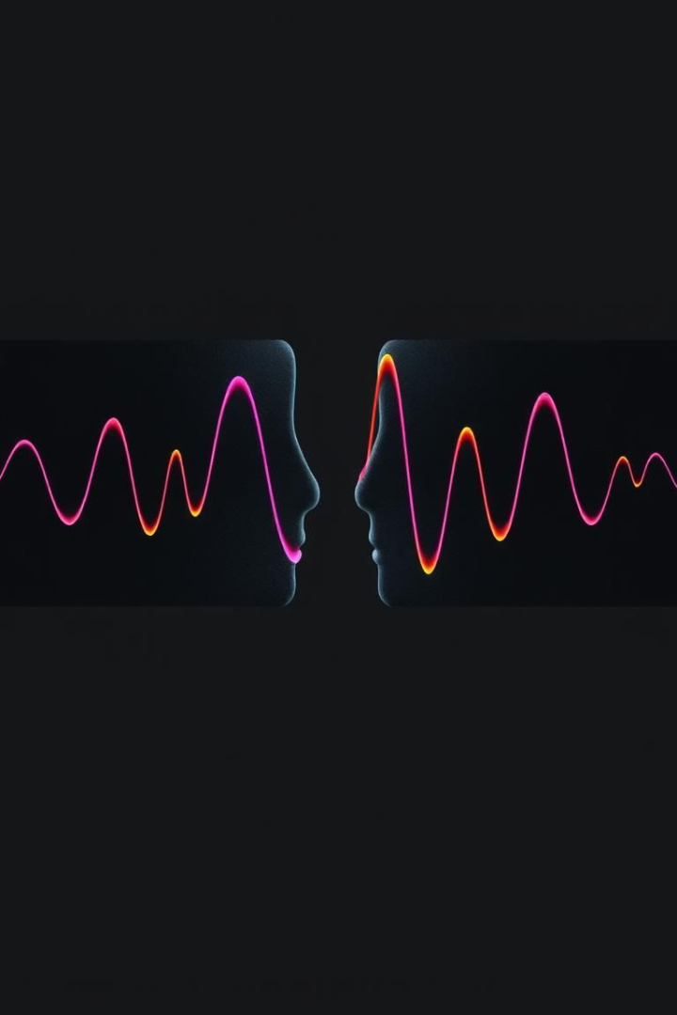
A Textless approach for Speech-to-Speech Comparison
We aim to match content from two speech samples. This determines their similarity, with applications like speech alignment and transcription validation. Speech varies, making this a challenge. We evaluate using Dynamic Time Warping (DTW) on raw model outputs for optimal comparison.

Slide 2
Hindi and Kannada Speech Dataset from AI4Bharat
Dataset Source
Why Hindi & Kannada?
AI4Bharat provides our dataset. It features high-quality, annotated speech recordings in Hindi and Kannada. These languages offer phonetic diversity. Transcriptions are available for supervised learning. This is ideal for training speech alignment models and future multilingual studies.
Enhances model generalizability
Diversity in phonetics
Cross-language applications

Slide 3




Leveraging Pre-Trained Speech Models
Nvidia's NEMO
Voice Activity Detection (VAD)
We use this model, to extract logits and embeddings for effective speech alignment.
This model helps to filter out non-speech segments from audio. It focuses on speech components. And we are using snakers4/silero-vad
NeMo Toolkit
NVIDIA's NeMo Toolkit is used for speech model inference and DTW implementation.

Slide 4





A New Approach to Speech Matching
Extract Logits
Preprocess Speech
Apply DTW
Compute Similarity Score
Use NEMO\_Prakrit for generating logits.
Use Dynamic Time Warping to align speech.
Apply VAD to remove silence and background noise.
Use DTW distance to measure similarity.
How is our approach novel?
Instead of comparing ASR-generated transcriptions, we compare speech embeddings directly.
This method improves accuracy in low-resource languages where ASR is unreliable.
Notes:
How is our approach novel?
Instead of comparing ASR-generated transcriptions, we compare speech embeddings directly.
This method improves accuracy in low-resource languages where ASR is unreliable.

Slide 5
Project Timeline & Task Breakdown
1
Data Preparation (1 week)
2
Method 1: Baseline DTW (1 - 2 weeks)
3
Method 2: Optimized DTW (1 - 2 weeks)
4
Testing & Final Evaluation (1 - 2 week)

Slide 6

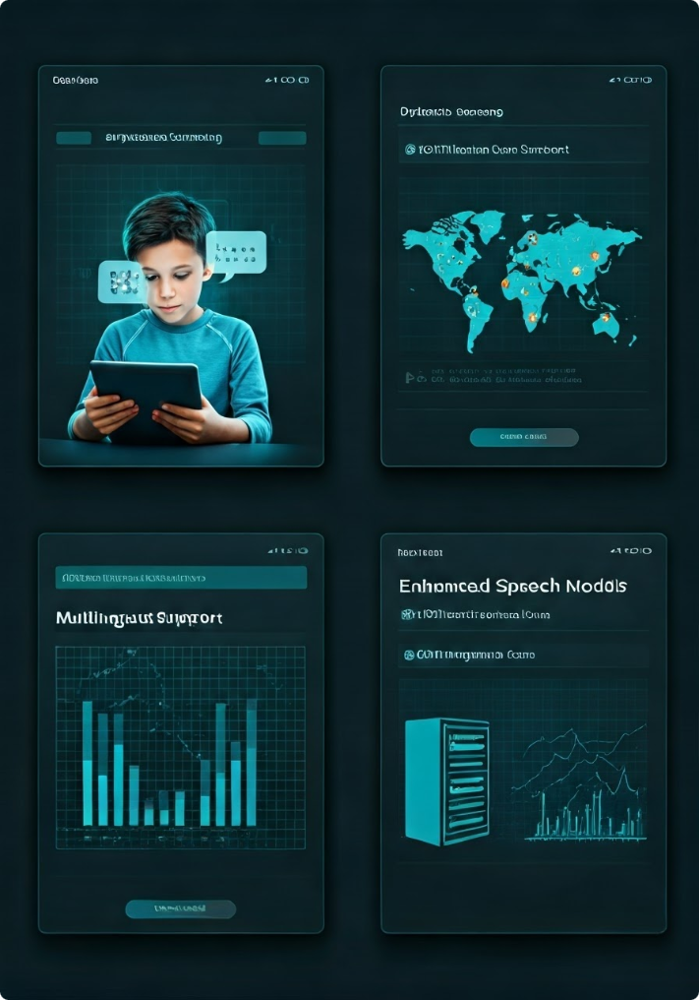
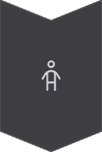



Beyond Speech Matching – Real-World Applications
Automated Speech Screening for Dyslexia
Help screen and rehabilitate children with pronunciation and speech disorders. Identify speech deviations with our method.
Multilingual Speech Alignment
Expand beyond Hindi & Kannada for better multilingual support. Improved support for various languages and dialects.
Improved Speech Scoring Models
Enhance models for education and accessibility. Improve access to resources and learning.
Integration with ASR systems
Enhance ASR accuracy. Support for transcription and validation.

Slide 7
Group 15 Members
1
Aditya Raj (241040002)
2
Suryansh Singh (241040087)
3
Shivansh Maheshwari (210987)

