Slide 1
Case Study Blackbuck
-- By Suryansh Prakhar

Slide 2
Task 1: 1.
There are regions and agents with high TRT (Total Resolution Time). A study was needed to get the details about the probable reasons using the variables from the data.
Probable recommendations and suggestions to the problems/opportunities identified are added as well.

Slide 3
Primary Focus
The primary focus is Total Resolution Time (TRT), which is in hours. This can be found in columns such as: Total Resolution Time x Blocked By Total Resolution Time Incl Weekends Hours Total Resolution Time WITHOUT WEEKENDS
The data also has various other related columns, including: Blocked By: This shows if there were delays due to blockages, which may impact resolution time. Agent Time Hours: The amount of time the agent spends resolving the case, which is likely to directly affect the resolution time. Cust Time Hours: Time spent by the customer. Consult Total Resolution Time: This shows the resolution time when consulting with other teams or departments. Time for First Response in Hours: The time taken to respond to the case initially, which can be an early indicator of potential delays.

Slide 4
EDA: Exploratory Data Analysis
To gain insights into the distribution and patterns of the data:
Descriptive Statistics: We compute the mean, median, and standard deviation of Total Resolution Time and agent time.
Correlation Analysis: We need to investigate the relationship between Total Resolution Time and other variables (e.g., complexity, agent time, customer time, blocked cases).
Time-Series Analysis: We’d analyze if there's a pattern over weeks or months (e.g., certain periods consistently show higher resolution times).
Outliers Detection: We’d identify if there are any significant outliers where resolution time is much higher than usual.

Slide 5
Internal Factors :
Investigate Blocked Cases:
We’d look specifically at cases that are blocked. It will help us to identify the reason. We’d then analyze if cases that are blocked have significantly higher resolution times.
Agent Performance Analysis:
We’d identify agents with consistently high resolution times and analyze potential reasons Agent Workload: Agents may have been assigned with too many cases. Manual Followups: We’d analyze if it has been done properly.

Slide 6
External Factors :
Product/Service: Are certain products or services causing longer resolution times?
If Yes then we’d investigate if the complexity of the product contributes to delays.
Vendor Team: If delays are related to vendor involvement and if certain vendor teams are contributing to longer resolution times.
Consultation Time: If agents are consulting with others, the time taken for consultations can significantly impact TRT.

Slide 7
Recommendations :
Optimize agent’s workload : Work should be divided uniformly, performance-based incentives can be added.
Optimal resource allocation : Proper resource should be allocation for each category.
Analyze and Reduce blockages : Identify causes and better communication between all the parties.
Training for agents : Pre-work training, mid-work training specially for red marked agents, frequent 1-on-1
Channel Optimization: Ensure closing and opening channel are being used effectively.
Automation : Automating routine tasks, scripts for known issues.
Data driven prioritization : Prioritize huge-impact issues for faster resolution.
Addressing Vendor delays : Implementation of corrective measures as tight SLAs, better communication, etc.
Proper and quick consultations : Consults should be clearer and quicker.

Slide 8
Task 1. 2.
Required Data Pointers :
Please ctrl + click the link below to open Google sheet
https://docs.google.com/spreadsheets/d/1M3zmlpS5CYTbWh62szfBQvdTFEo2UEU0jtriNbkHMsk/edit?usp=sharing

Slide 9
Task 2.
BACKGROUND
US based client requires efficient sales and revenue optimization service provider.
A team to make outbound calls to explain the product features, convince clients to adopt those features (come at a cost).
Requires the agents to be technically qualified and have excellent communication skills.

Slide 10
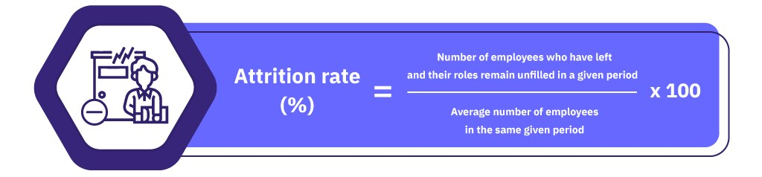
1.
We need well trained and tenured people to manage the operations, but the attrition is trending high @40%/ quarter
High attrition is very crucial to deal with as it can imply the following :
Decreased operational efficiency.
Negative impact on the team.
Negative brand perception.
Loss of clients/customers.
Increased pressure

Slide 11
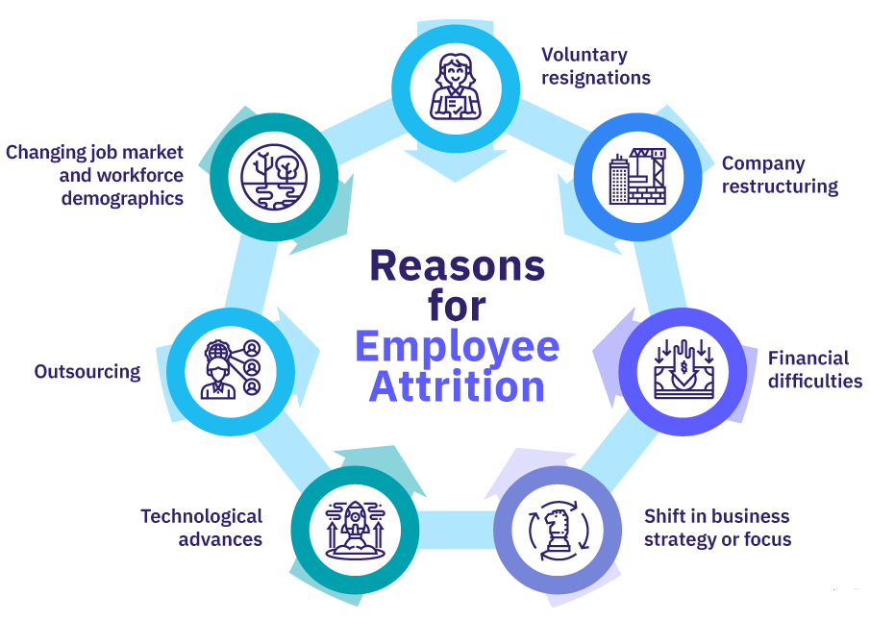
Reasons for Attrition :
Understanding the reason is very important to come up with solutions/strategies. One can never find the real reason but in general it can be as :
Lack of career growth opportunities
Inadequate benefits
Poor work-life balance
Lack of job satisfaction
Stressful work environment
Racism based on skin-color, gender, language, etc.

Slide 12
Solutions / Strategies :
Enhanced Onboarding and training : Structured program including product KT, business & sales of the company, buddy support initially
Competitive compensation and benefits : Both monetary and non-monetary benefits to be added.
Growth & development opportunities : Internal Promotions, Skill Development Programs, etc.
Employee engagement and recognition : Regular updates/feedbacks, team building, etc.
Improvement in work culture and environment : Stress management, listen to the employee’s issues.
Focus on leadership development : Empower managers, Supportive team leads and leadership too.
Upskill and reskill to fill open positions : Time-to-time skilling to avoid unforeseen situations.
Ensure transparent communication.
Exit Interview analysis and actions including retention plans.

Slide 13
2.
Client has increased the sales revenue target by 20% from the previous quarter. What are the steps one should take to meet the numbers?
Analyze current standing and set a benchmark : Need to assess past revenue and how we achieved it. Also, clear communication on what 20% mean.
Alignment and effective collaboration of all involved internal teams.
Setting up new KPIs which directly/indirectly align with the new target.
Review pricing and product offering : Mixing multiple products , selling bundles with some indirect offers, campaigns & ads about limited time offers, communicating about what we are offering and what extra can the customers get with it.
Strengthen lead generation and conversions, strengthen retention as well.
Cross-sell & upsell to existing customers / clients but not to overdo to avoid attrition.
Impactful training programs ,specially for cross functional team members.
Positive environment is a must.

Slide 14
3.
Client asked to ramp up the team by 50% with a live date in 60 days whereas our training time itself is 45 days. What's the best way to handle it? What are the challenges, risks and opportunities expected in this situation and risk mitigation strategies? What will be the communication strategy?
Ramping up the team by 50% with a live date in 60 days when the training time itself is 45 days is a very complex situation.
It’d require careful planning, efficient resource management & allocation
We’d be required to efficiently tackle the challenges & mitigate risks associated.

Slide 15
Handling Strategies:
Analysing situation and planning approach:
We need to consider Training time vs Deadline , which leaves 15 days to be fully productive.
Planned accelerated recruitment, onboarding and training (including buddy support program) would be needed.
Prioritise candidates with prior experience / pre trained / Internships.
Speed up training with parallel KTs, Outsourcing or hiring temporary qualified experienced trainers.
Implementing e-learning modules, videos and case-study documents.
Launch batch should be made out of the pool within 15-20 days of training.
Gradual ramp up should be started with the launch batch itself.
Gradual deployment of other candidates with buddy / Launch batch candidates support.

Slide 16
Challenges & Risks :
Training Delays and quality of training
Knowledge gaps can reduce productivity.
The deployed candidates might feel exhausted due to fast paced rigorous training.
Clients or customers dissatisfaction over the new candidates.
Even after ramping up, candidates can go on leave, say be it emergencies.

Slide 17
Opportunities :
Might come across various talents such as multilinguals, multitaskers, multi tools expertise, etc.
May attract talents with fresh perspective, brighter ideas, more potentials.
Process optimization would be a bi-product.
If done properly, client satisfaction would be a new normal.
Improved sales and outbound.

Slide 18
Risk Mitigation Strategies :
Maintaining training integrity
Clear communication establishment within the team and with the clients/customers.
Use multiple channels for training.
Priority to experienced candidates.
QA checks and mentoring to the pre and post production candidates.

Slide 19
Communication Strategies :
Clear communication with stake holders
Set clear expectations with the candidates as well as the clients.
Regular updates and feedbacks.
Transparent leadership and business needs.
Conclusion:
50% team ramp-up with a 60-day live date and 45-day training time is a challenging yet manageable task. By focusing on accelerated recruitment, streamlined training processes, and leveraging technology, we can successfully meet the target.

Slide 20
Thank you
SURYANSH PRAKHAR
Ph: 7979984267
prakharsuryansh535@gmail.com

