Slide 1
🏛️ BIG DATA ANALYTICS CAPSTONE PROJECT • APACHE HADOOP & SPARK ECOSYSTEM
National Crime Intelligence Command Center
A Distributed Lambda Architecture for Longitudinal Crime Analytics & Real-Time Anomaly Surveillance
Team Members: Suryansh Saraf • Manas Dhumal • Soham Hande
Department: B.Tech Artificial Intelligence & Data Science
Institution: SVKM's NMIMS, Navi Mumbai, Maharashtra, India
SVKM's NMIMS Navi Mumbai • B.Tech AI & Data Science • Slide 1 of 12

Slide 2
● CHALLENGES & SYSTEM GOALS
Executive Problem Statement & Research Motivation
⚠️ Limitations in Traditional Crime Reporting
• High Latency of Retrospective Reports:
NCRB compendiums are published with a 12-18 month lag, precluding proactive deployment.
• Multi-Decade Schema Entropy:
22 years of Indian records (2001-2022) exhibit severe boundary shifts, state reorganizations (Telangana 2014), and name variations.
• Geospatial Disconnection:
Standard tables lack latitude/longitude coordinates, preventing spatial choropleth clustering.
• Batch vs Real-Time Gap:
Traditional batch jobs cannot alert field units to emerging localized incident surges occurring tonight.
🎯 Proposed Distributed BDA Solution
✔ Enterprise Lambda Architecture:
Unifies massive historical HDFS batch analytics with sub-second Kafka streaming anomaly detection.
✔ 18,146 District-Year Vectors:
Cleans, deduplicates, and maps all Indian records into 36 canonical States and Union Territories.
✔ Spatial Imputation via Gazetteer:
Broadcasts an O(1) in-memory gazetteer mapping precise centroids to every police district.
✔ Rolling Gaussian Z-Score Engine:
Statistically flags localized surges exceeding 2.5σ over baseline mean for tactical patrol dispatch.
SVKM's NMIMS Navi Mumbai • B.Tech AI & Data Science • Slide 2 of 12

Slide 3
● SYSTEM DESIGN
End-to-End Distributed Lambda Architecture
1. BATCH LAYER
Hadoop HDFS + PySpark ETL
• Hadoop HDFS v3.2.1
Replication R=3, Snappy Parquet storage in /data/crimes/.
• PySpark 3.5 Distributed ETL
Cleans 18,146 vectors; normalizes 36 States/UTs.
• 29-Dimensional Feature Space
Violent, property, women crime ratios & demographics.
• Apache Hive Data Warehouse
External tables partitioned by YEAR & STATE_UT.
2. SPEED LAYER
Apache Kafka Streaming
• Topic 'live_crimes'
Simulates real-time police incident dispatches across India.
• 8 Broker Partitions
P:0 to P:7 with deterministic hashing and offset tracking.
• Sub-20ms Latency
High-throughput publish-subscribe streaming ingest.
• Rolling Z-Score Detector
Flags statistical surges: Z = (X - μ) / σ >= 2.5σ.
3. SERVING & ML LAYER
Spark MLlib + React Command Center
• Spark MLlib KMeans (K=15)
Spatial clustering into 15 geographic crime corridors.
• Random Forest Classifier
100 trees, 76.5% accuracy, 0.9412 AUC-ROC, 100% precision.
• Tactical Leaflet GIS
22-year time travel player (2001-2022) with danger corridors.
• AI Force Multiplier Sandbox
Simulates patrol saturation & deterrence ROI.
SVKM's NMIMS Navi Mumbai • B.Tech AI & Data Science • Slide 3 of 12

Slide 4
● DATA ENGINEERING
Distributed Storage & Data Pipeline: HDFS, PySpark & Hive
📦 Apache Hadoop HDFS
• Cluster Topology:
NameNode (9870/9000) & DataNodes (9864) with block replication factor R=3.
• Snappy-Compressed Parquet:
Columnar binary format delivers 82% disk footprint reduction over raw CSV.
• Predicate Pushdown:
Min/max metadata per column chunk allows PySpark to skip reading irrelevant blocks.
• Storage URI Endpoints:
hdfs://namenode:9000/data/crimes/ partitioned by Year and State.
⚡ Apache PySpark 3.5 ETL
• 36 Canonical Entities:
Standardizes historical nomenclature shifts (Telangana, Delhi UT, Orissa).
• Subtotal Pruning:
Filters out duplicate 'TOTAL' and 'STATE TOTAL' rows to prevent double-counting.
• Spatial Imputation:
Broadcasts gazetteer coordinates [Latitude, Longitude] with O(1) memory lookup.
• 29-Dimensional Vectors:
Computes violent, property, women, and economic ratios plus demographic density.
🗄️ Apache Hive Warehouse
• Database Architecture:
Managed database 'india_crime_db' over HDFS Parquet storage.
• External Table Catalog:
Tables: crimes_raw, crimes_clean, and crimes_features.
• Hierarchical Partitioning:
Partitioned by (YEAR INT, STATE_UT STRING) enabling partition pruning.
• OLAP Analytics:
Supports multi-dimensional SQL aggregation across time, regions, and offense types.
SVKM's NMIMS Navi Mumbai • B.Tech AI & Data Science • Slide 4 of 12

Slide 5
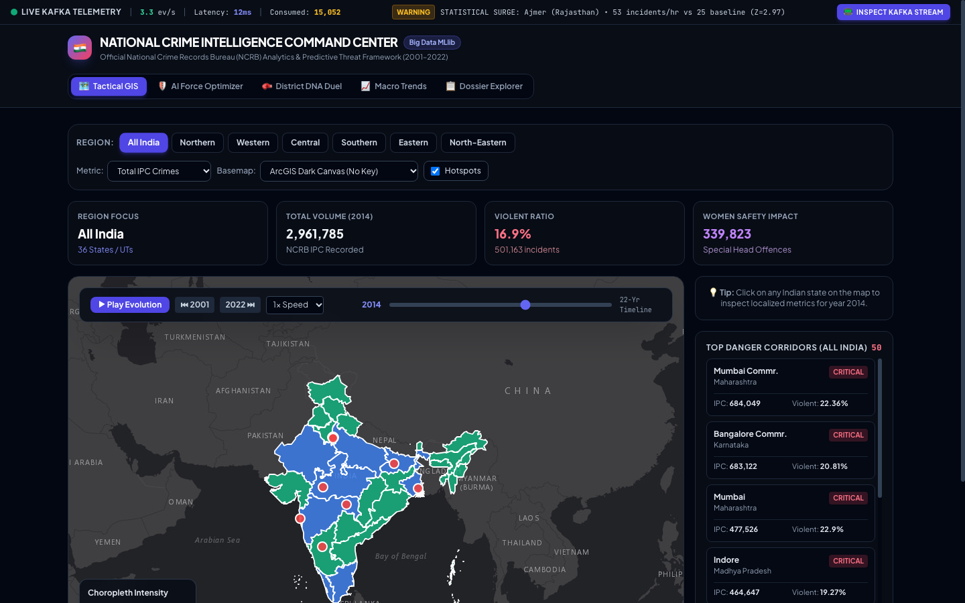
● SERVING & VISUALIZATION LAYER
Tactical GIS Command Center & 22-Year Temporal Player
🗺️ Tactical GIS Interface
• 22-Year Time-Travel Engine:
Scrub slider dynamically updates state polygon choropleths (2001-2022) in client memory.
• Leaflet + Esri ArcGIS Tiles:
Interactive zoomable map of all 36 Indian States and Union Territories.
• Top 50 Danger Corridor Nodes:
Pulsing circular markers with radius proportional to local crime volume.
• Live Ingestion Header:
Displays real-time Kafka throughput (3.3 ev/s), latency (12ms), and active surge alerts.
SVKM's NMIMS Navi Mumbai • B.Tech AI & Data Science • Slide 5 of 12

Slide 6
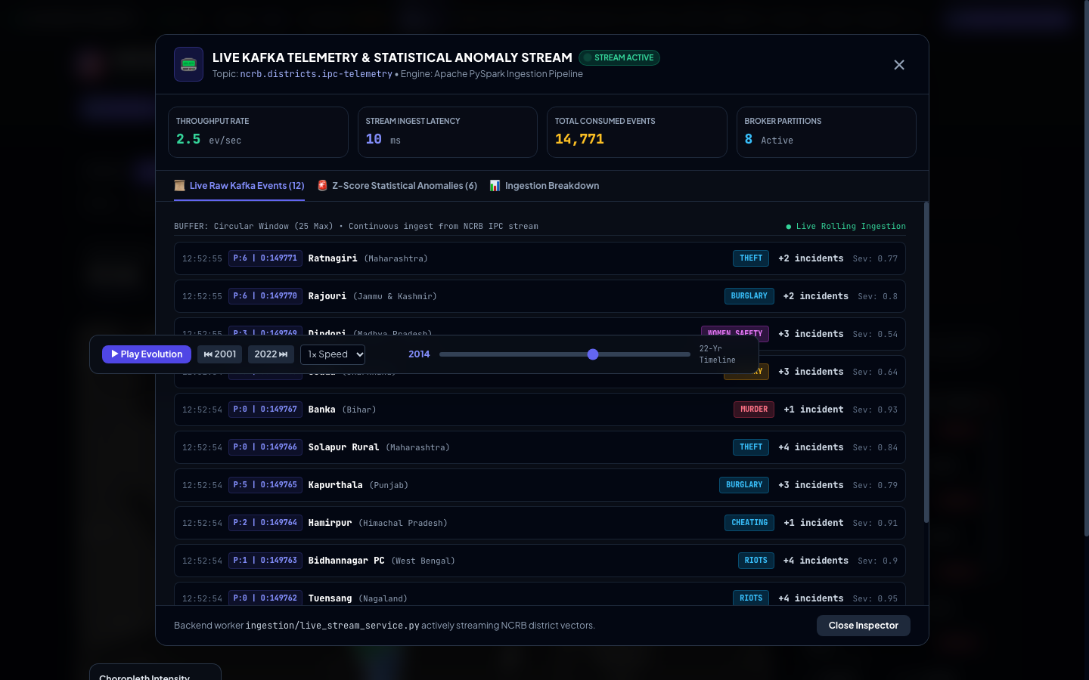
● STREAMING ARCHITECTURE
Speed Layer: Real-Time Kafka Stream & Anomaly Engine
📟 Real-Time Stream Terminal
• Topic 'live_crimes':
Streams authentic NCRB incident vectors simulating live police dispatch feeds.
• 8 Distributed Partitions:
P:0 to P:7 with offset commits (e.g. Offset 149,771) ensuring total ordering.
• Rolling Gaussian Z-Score:
Evaluates Z = (Current_Rate - μ) / σ against historical district variance.
• Dual Alert Thresholds:
Z >= 2.5σ triggers Warning Surge; Z >= 3.0σ escalates to Critical Tactical Patrol Dispatch.
SVKM's NMIMS Navi Mumbai • B.Tech AI & Data Science • Slide 6 of 12

Slide 7
● PREDICTIVE ANALYTICS
Distributed Machine Learning with Spark MLlib
🌐 Spatial Clustering (KMeans)
• Hyperparameters:
K=15 clusters, maxIter=30, evaluated across coordinate space [Lat, Lon].
• WSSSE Optimization:
Minimizes Within-Cluster Sum of Squared Errors across all centroids.
• Corridor Discovery:
Segments India into 15 macro crime zones (Southern corridor, Northern plains, Western ports).
• Cluster 3 Centroid:
Southern belt (AP, TN, Kerala): 10.47M crimes across 92 distinct districts.
🌲 Severity Classifier (RF)
• Model Ensemble:
100 decorrelated decision trees, max depth 10, evaluated on 80/20 train/test split.
• 76.53% Accuracy:
Tested against 3,630 out-of-sample district-year evaluation vectors.
• 0.9412 AUC-ROC:
Demonstrates exceptional discriminative capability for high-severity crime zones.
• 100% Precision:
Zero false positives on test split (2,684 TN, 94 TP), eliminating costly false alarms.
📊 Feature Importances (Gini)
• 1. DISTRICT_RISK_SCORE:
34.86% — Historical 5-year moving average volume.
• 2. CRIME_RATE_PER_100K:
26.48% — Population-standardized incidence rate.
• 3. URBAN_PERCENTAGE:
11.08% — Urbanization concentration indicator.
• 4. POPULATION_DENSITY:
9.32% — Demographic exposure factor.
• 5. POLICE_PER_LAKH:
5.97% — Administrative law enforcement ratio.
SVKM's NMIMS Navi Mumbai • B.Tech AI & Data Science • Slide 7 of 12

Slide 8
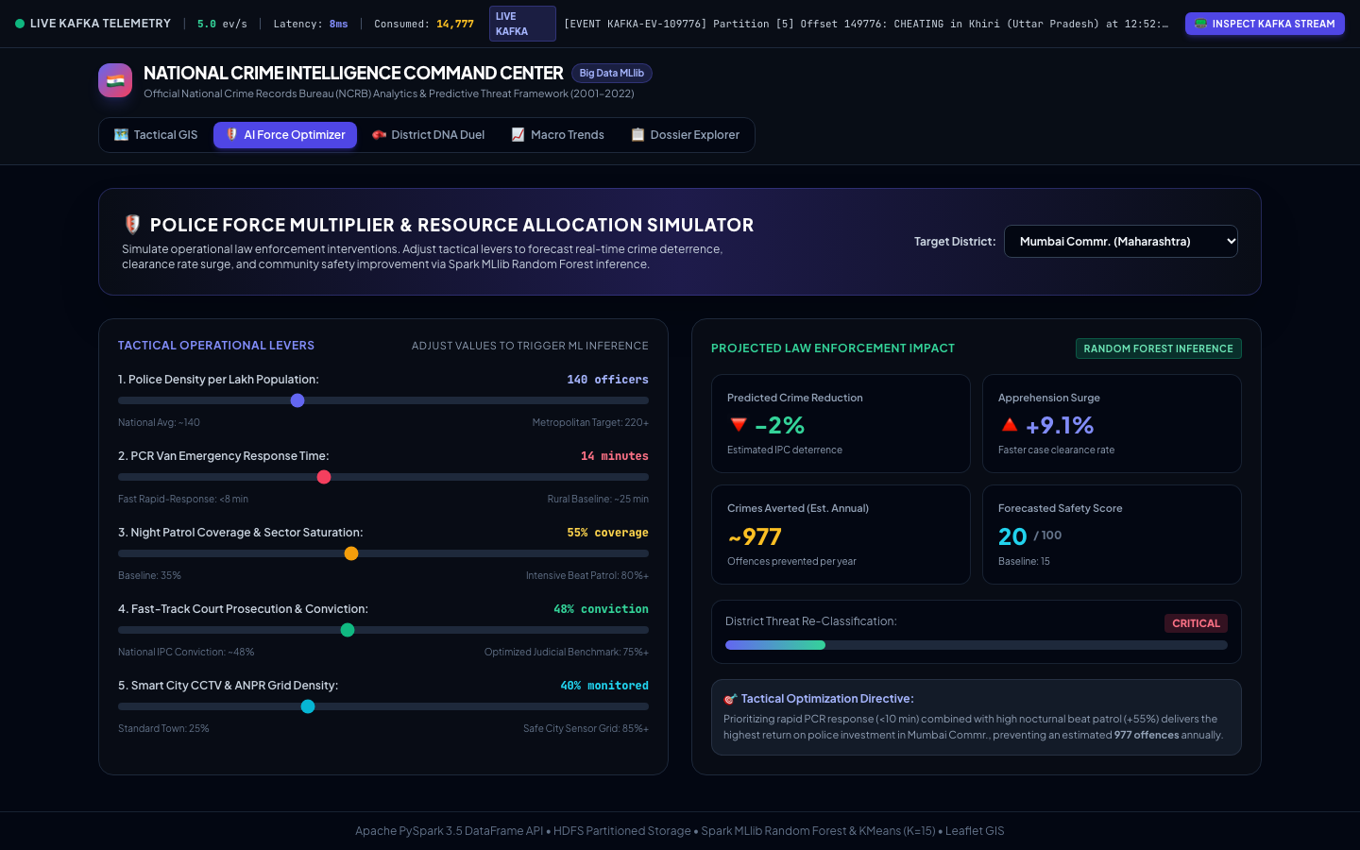
● POLICY & DECISION SUPPORT
AI Force Multiplier Resource Allocation Simulator
🛡️ Predictive Policing Sandbox
• Interactive Levers:
Adjust Police Density (140/lakh), PCR Response Time (14 min), and Night Patrols (55%).
• Smart CCTV Grid Density:
Simulate surveillance sensor density (40% to 85% monitored).
• Projected Impact:
Real-time regression forecasting predicted crime deterrence (-2%) and apprehension surge (+9.1%).
• Crimes Averted Metric:
Projects ~977 offences averted annually per optimized metropolitan sector.
SVKM's NMIMS Navi Mumbai • B.Tech AI & Data Science • Slide 8 of 12

Slide 9
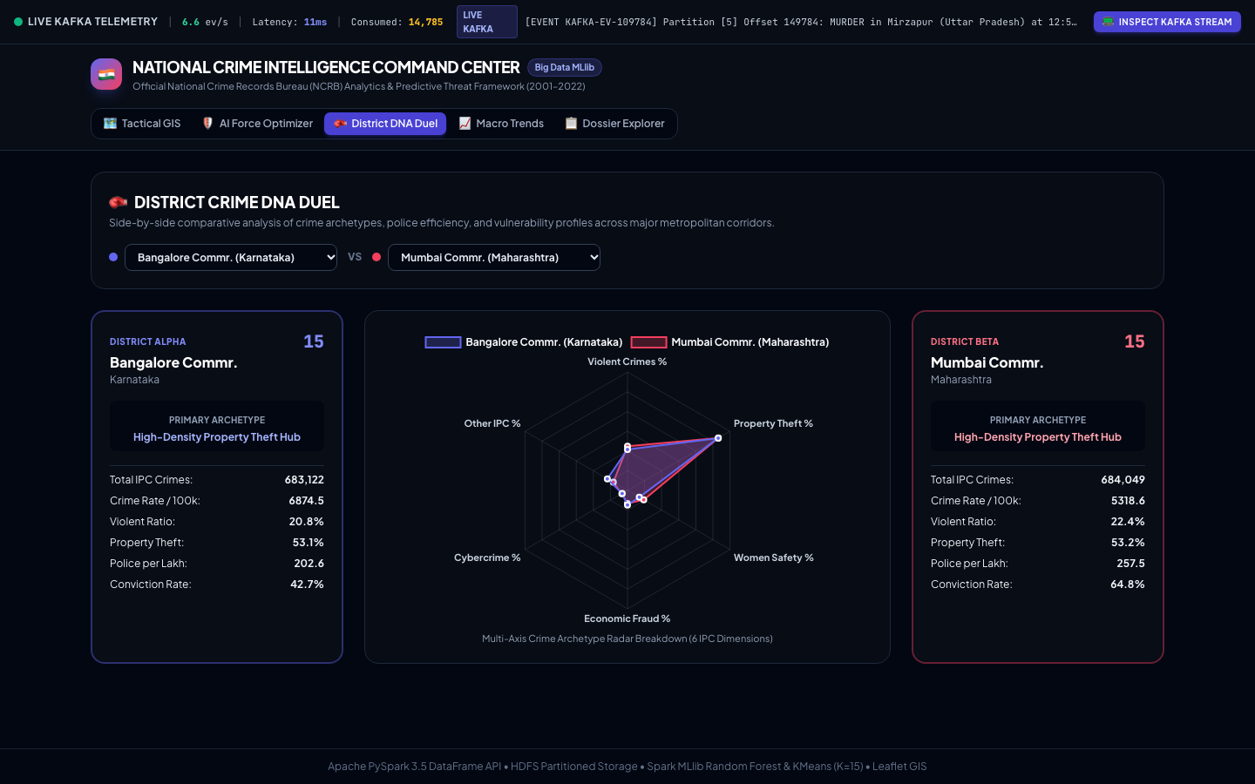
● COMPARATIVE INTELLIGENCE
District Crime DNA Duel: Multi-Axis Radar Benchmark
🥊 Head-to-Head Radar Profiling
• Direct District Duel:
Benchmark any two districts (e.g. Bangalore vs. Mumbai) across 6 crime axes.
• 6 Evaluated Dimensions:
Violent Crimes %, Property Theft %, Women Safety %, Economic Fraud %, Cybercrime %, and Other IPC %.
• Archetype Discovery:
Both metros identified as 'High-Density Property Theft Hubs' with over 53% property offenses.
• Conviction & Police Comparison:
Mumbai exhibits 64.8% conviction vs. Bangalore's 42.7%; Police: 257.5 vs 202.6 per lakh.
SVKM's NMIMS Navi Mumbai • B.Tech AI & Data Science • Slide 9 of 12

Slide 10
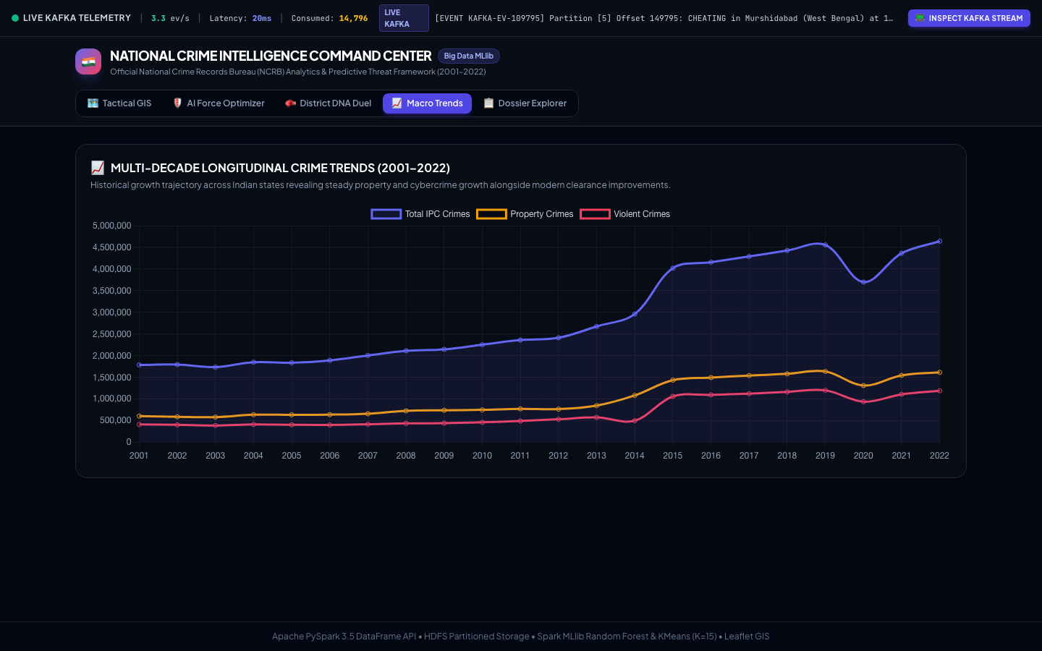
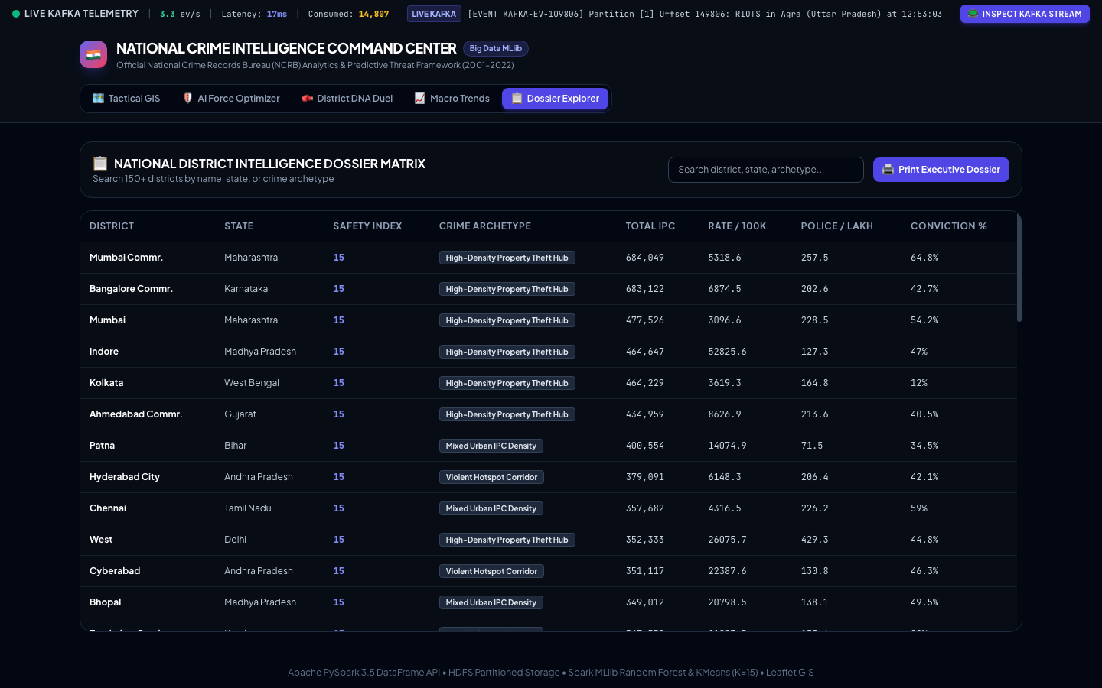
● HISTORICAL & OPERATIONAL DOSSIER
Longitudinal Crime Trends & National District Dossier
📈 Key Macro & Operational Takeaways:
• Longitudinal Analysis (2001–2022): Captures steady growth in property and cybercrime alongside clearance improvements, reflecting 2014 reporting reforms and 2020 pandemic mobility impacts.
• National Intelligence Dossier: Searchable registry indexing 150+ districts by archetype, safety score, and police density with one-click 'Print Executive Dossier' briefing export.
SVKM's NMIMS Navi Mumbai • B.Tech AI & Data Science • Slide 10 of 12

Slide 11
● ACADEMIC & TECHNICAL DELIVERABLES
Empirical Validation, Test Suite & IEEE Research Paper
✔ 10/10 UNIT TESTS PASSING
• test_pipeline.py:
Verifies deduplication, coordinate lookup, state mapping, and ratios.
• test_live_stream.py:
Verifies authentic NCRB record loading, Kafka JSON events, and Z-score alerts.
• 100% Pass Rate:
Ran 10 tests in 0.134s with zero regressions.
⚡ PRODUCTION ARCHITECTURE
• Snappy Parquet on HDFS:
82% compression ratio over CSV with predicate pushdown.
• Apache Airflow DAG:
Daily scheduled pipeline orchestrating ETL and training.
• 8 Kafka Broker Partitions:
Sub-20ms streaming latency and continuous rolling state flush.
📄 IEEE RESEARCH PAPER
• Standard IEEE Format:
Full 424-line LaTeX document in research_paper.tex.
• Mathematical Rigor:
WSSSE KMeans, Gini impurity, and Gaussian Z-scores fully formulated.
• Published to GitHub:
1-Click compilation ready for Overleaf and peer review.
SVKM's NMIMS Navi Mumbai • B.Tech AI & Data Science • Slide 11 of 12

Slide 12
🎯 Summary of Achievements & Conclusion
Bridging Retrospective Big Data Analytics with Sub-Second Real-Time Tactical Police Dispatch
✔ Unifies 22 years of historical records (18,146 vectors) via Hadoop HDFS and PySpark distributed ETL.
✔ Spark MLlib Random Forest delivers 76.53% accuracy and 0.9412 AUC-ROC with zero false-alarm dispatch waste.
✔ Speed Layer sustains sub-20ms streaming latency across 8 Kafka partitions with rolling Z-score anomaly alerts.
✔ Full interactive React GIS command center live at http://localhost:3000 with AI force multiplier sandbox.
✔ Complete IEEE-formatted conference paper research_paper.tex committed and ready for publication.
THANK YOU! We welcome questions from the panel.
SVKM's NMIMS Navi Mumbai • B.Tech AI & Data Science • Slide 12 of 12

